Slide 1
Note to teachers
Thank you for downloading this presentation from Better Planet Education. You are welcome to modify it by adding your own slides or deleting ones you don’t need.
Please do not remove the photo credits from any of the photos you use and we would be very grateful if you could leave Better Planet Education’s logo and web address on the relevant pages. We want to encourage more and more young people to learn more about taking care of our world for the future, and the website is a great starting point for this.
You can find lots more supporting information on Antarctica by visiting
https://www.betterplaneteducation.org.uk.

Slide 2
COLD AREAS:
THE ANTARCTIC
Registered charity number 1153740

Slide 3
1. WHERE ARE THE HOT AND COLD AREAS?
Image: NASA’s Earth Observatory

Slide 4
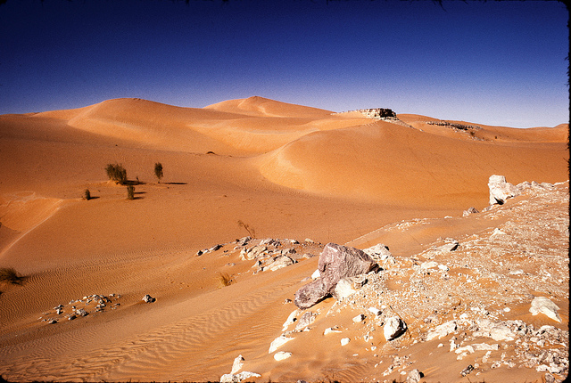
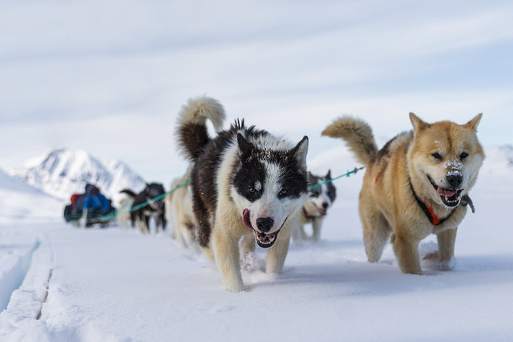
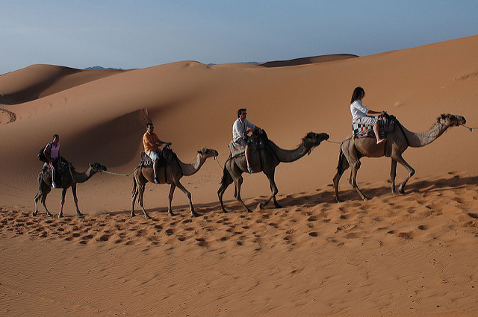
Comparing Hot and Cold Areas
Photo: Victor
Photo: Dave Price
Photo: Markus Trienke
Photo: Robbie

Slide 5
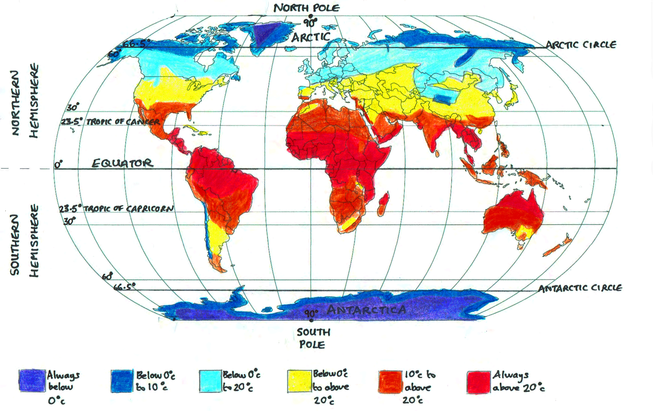
MAP SHOWING TYPICAL GLOBAL TEMPERATURES
Note: shading and lines are approximate

Slide 6
The Equator is an imaginary line around the Earth. Everywhere on the Equator is equally distant from the North Pole and the South Pole
Photo: Henri Bergius

Slide 7
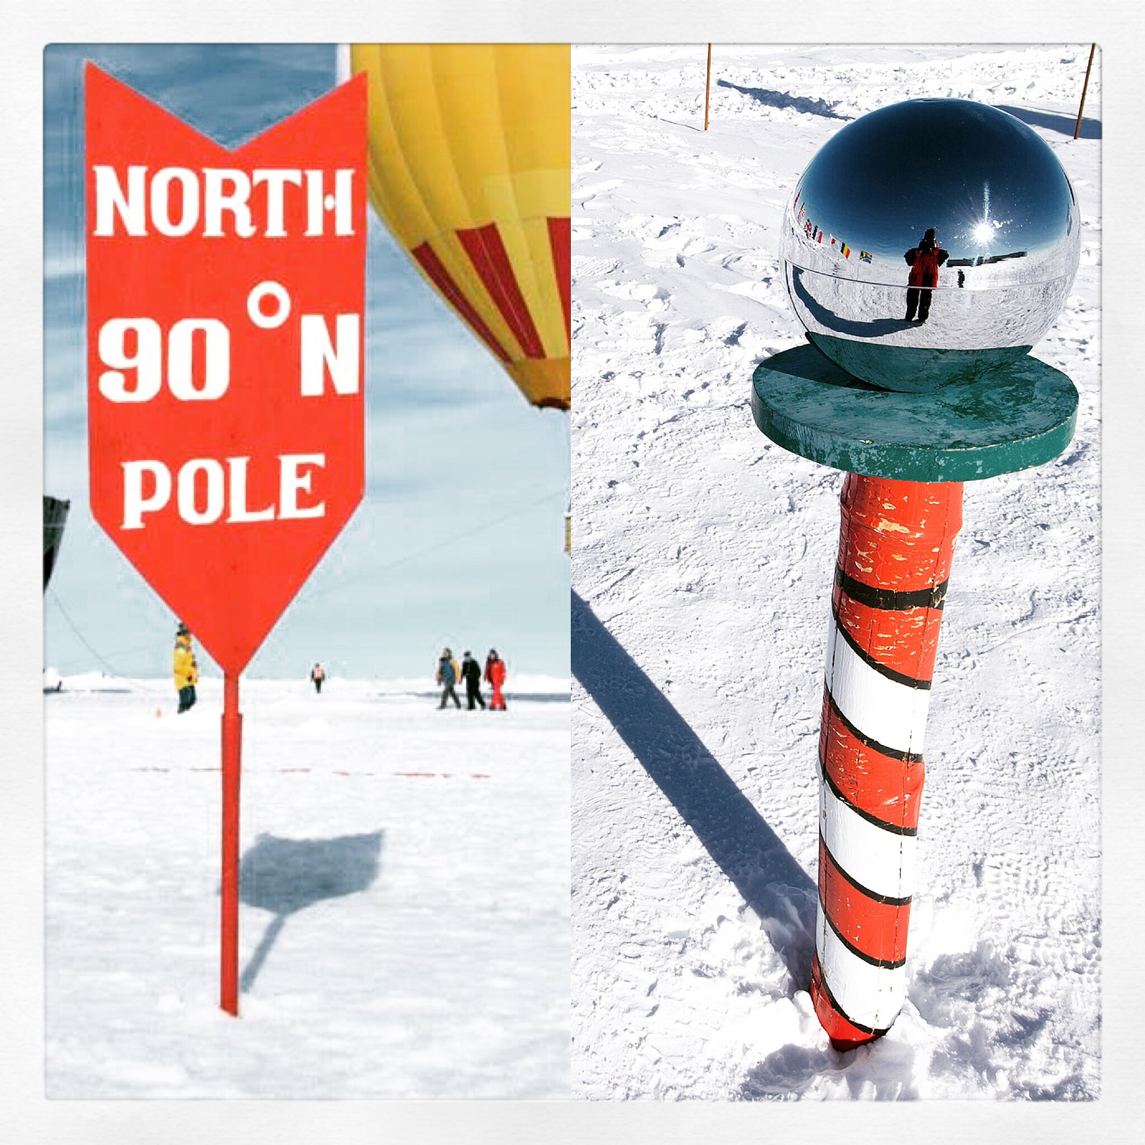
Both poles are very cold
But the South Pole is a lot colder than the North Pole
Photo: Christopher Michel

Slide 8
At the Poles, the sun’s rays strike the Earth at a very low angle so they are spread out over a greater area and temperatures are very low

Slide 9
2. WHAT IS IT LIKE IN ANTARCTICA?
Photo: Tak

Slide 10
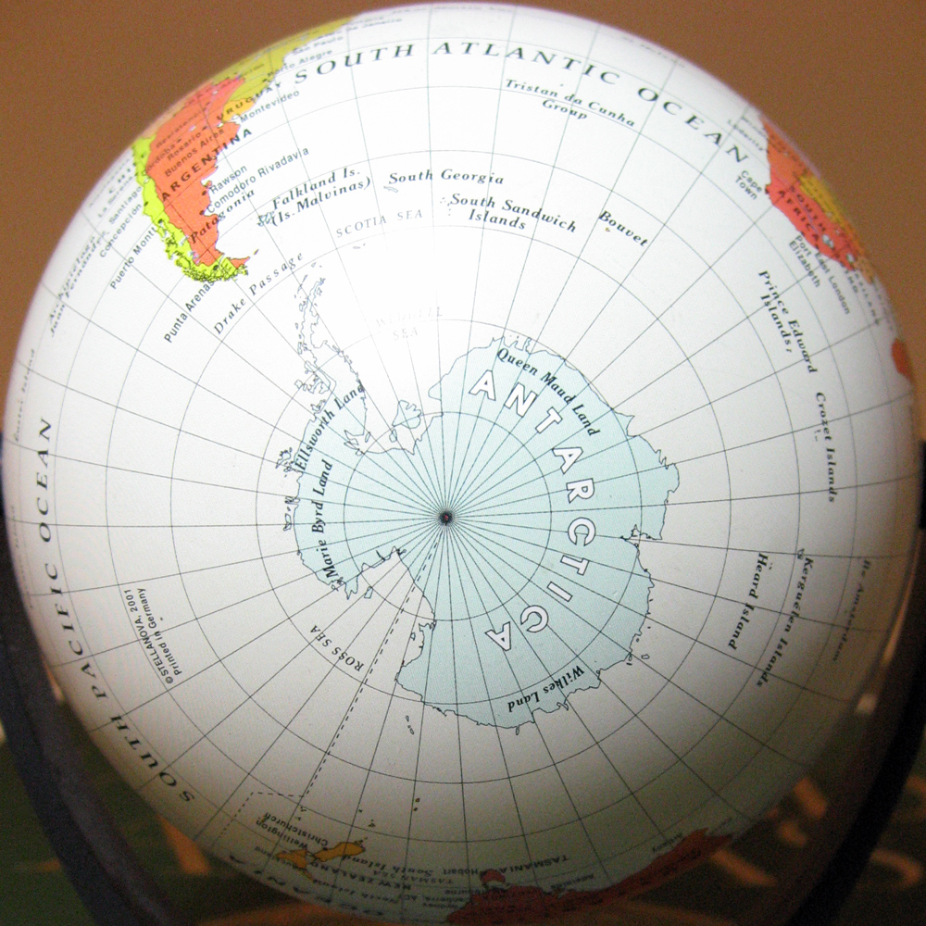
Antarctica is a huge frozen continent at the bottom of our planet
Photo: duncan c

Slide 11
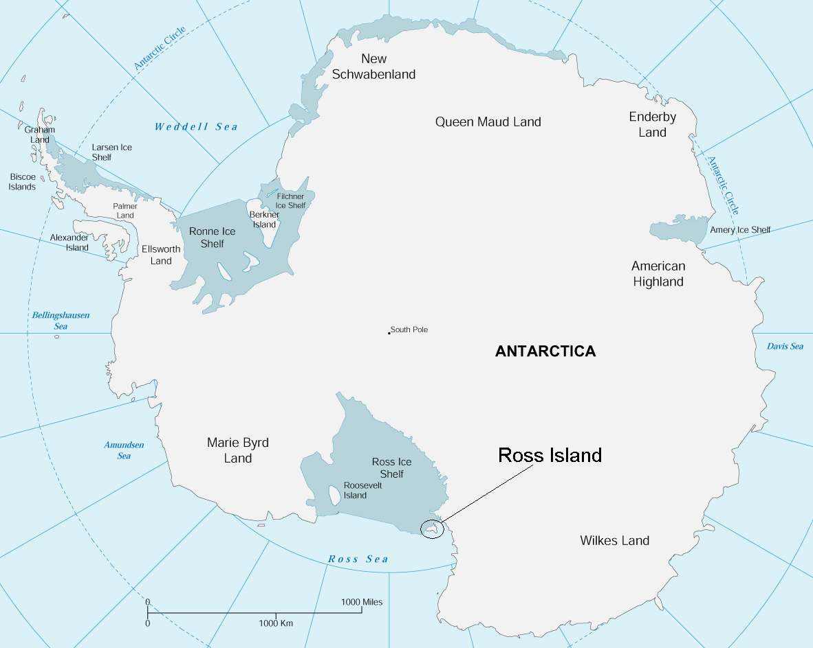
Antarctic Peninsula

Slide 12
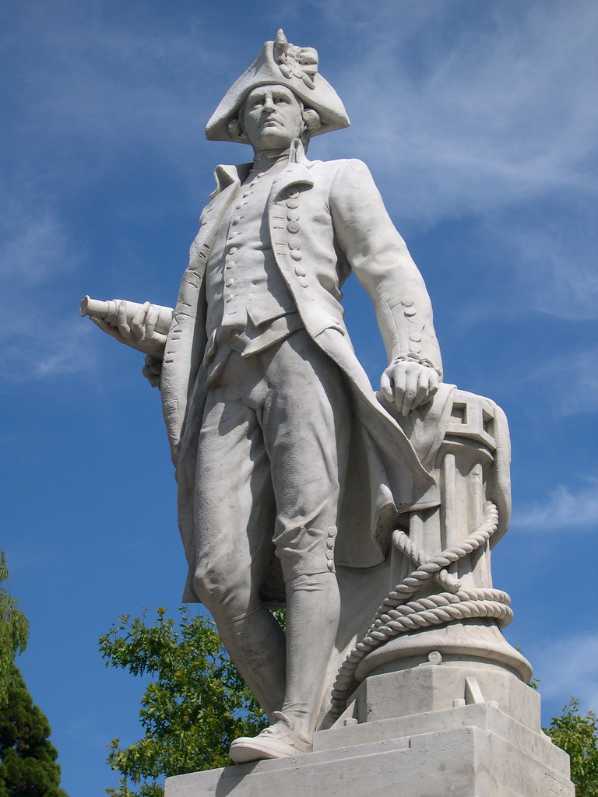
Captain James Cook’s Resolution was the first ship recorded to have crossed the Antarctic Circle in 1773, but they couldn’t see land
Photo: John Steedman

Slide 13
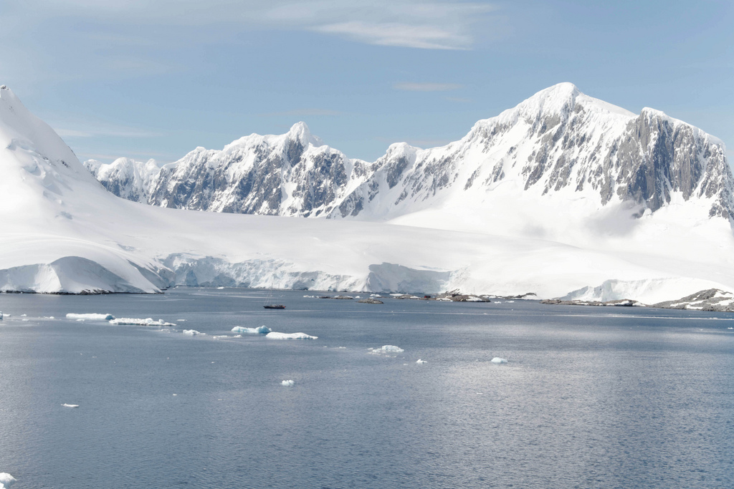
Captain Thaddeus Bellingshausen made the first recorded sighting of the continent of Antarctica in 1820
Photo: Ronald Woan

Slide 14
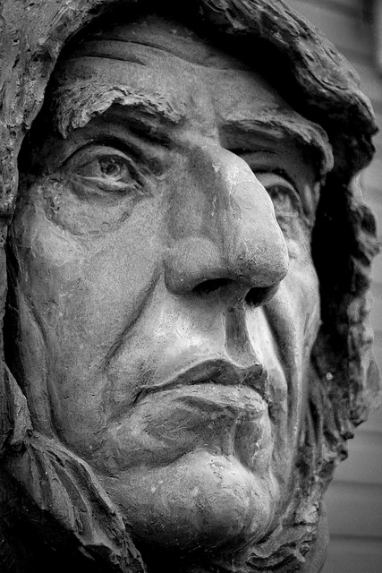
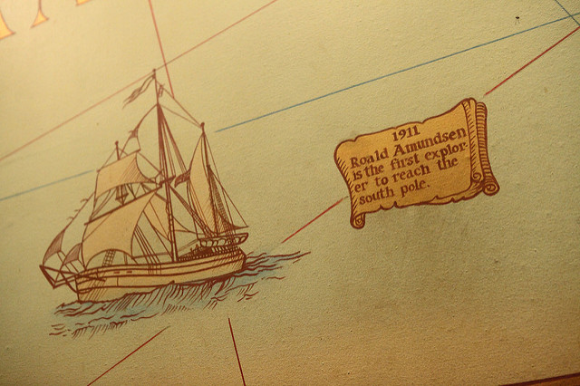
Roald Amundsen led the Antarctic expedition of 1910-12. They were the first to reach the South Pole on 14 December 1911.
Photo: Oyvind Lind
Photo: Sam Howzit

Slide 15
53 countries have signed a treaty that Antarctica is a place to be used only for peace and science
Photo: Brian Stetson

Slide 16
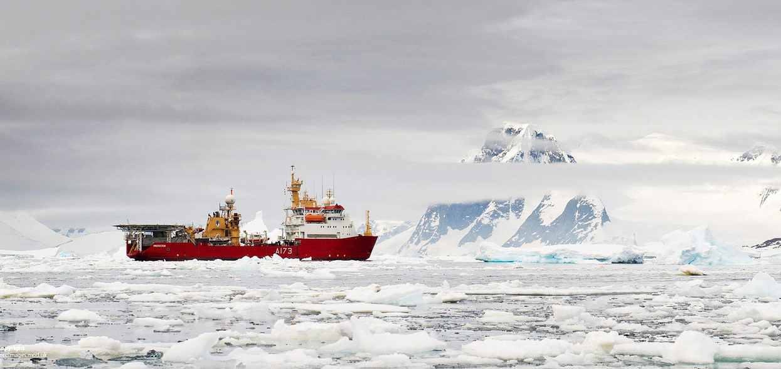
This Royal Navy Ice Patrol Vessel HMS Protector is carrying out inspections in accordance with the Antarctic Treaty
Photo: Defence Images

Slide 17
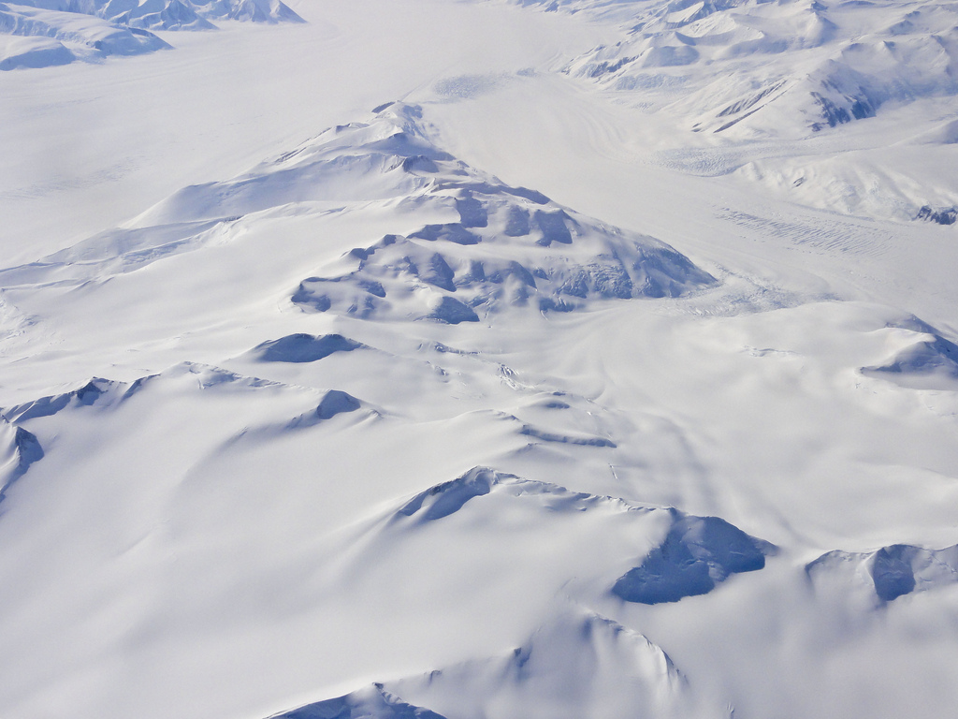
Photo: US Embassy
Antarctica is known as a polar desert as it receives very little rain or snowfall

Slide 18
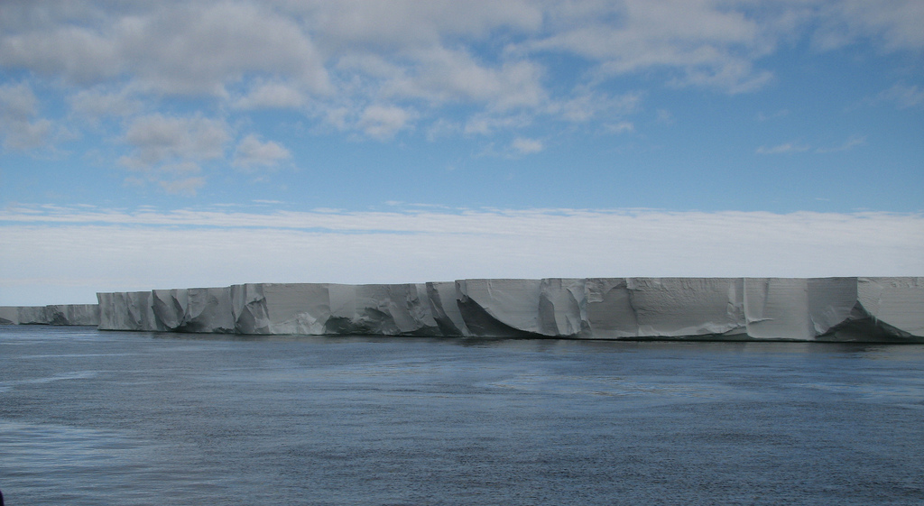
Much of the coastline of Antarctica is fringed by ice shelves. The Ross Ice Shelf covers an area greater than the British Isles
Photo: lin padgham

Slide 19
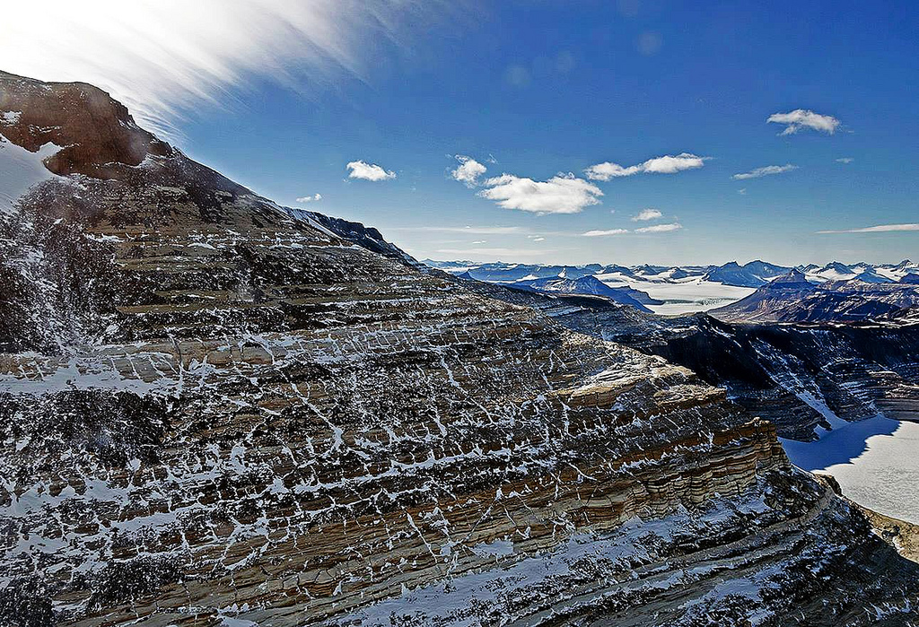
The Transantarctic mountain range has several peaks above 4000 metres
Photo~: Stuart Rankin

Slide 20
Photo: Eli Duke
Mount Erebus in Antarctica is the most southerly active volcano in the world

Slide 21
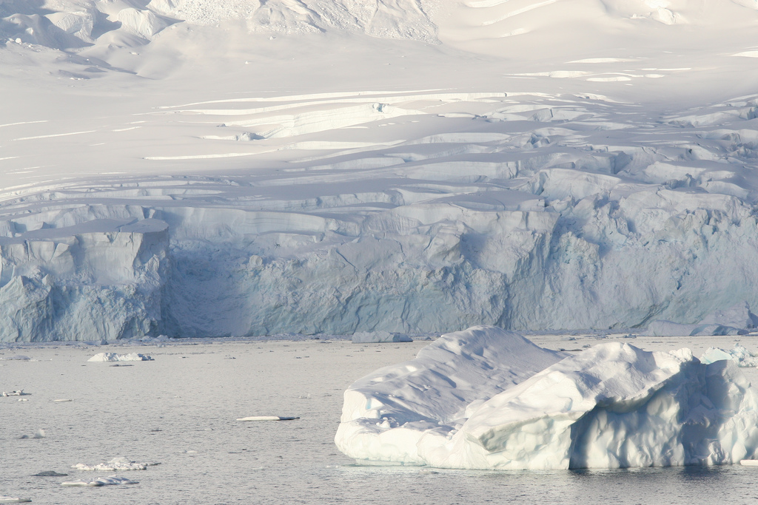
There is no colder, drier or windier place on Earth
Photo: Gilad Rom

Slide 22
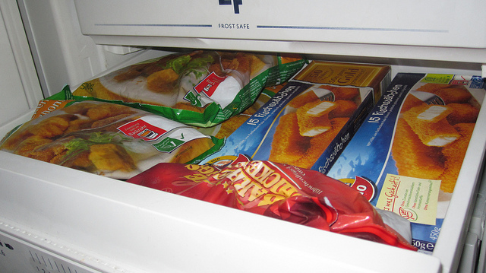
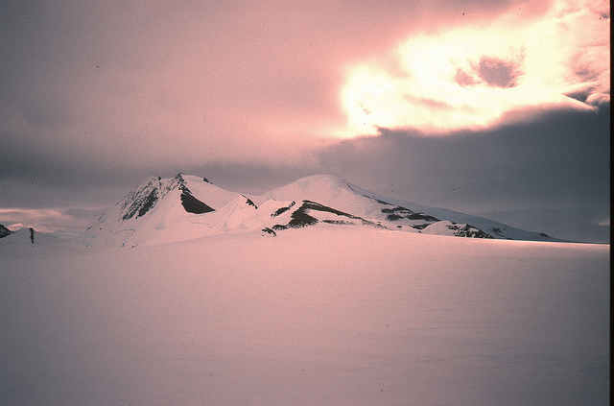
Your freezer at home runs at about -20ºc
Photo: Coffee Danube Still Life Photo
On the East Antarctic Ice Sheet temperatures as low as -85ºc have been recorded
Photo: euphro

Slide 23
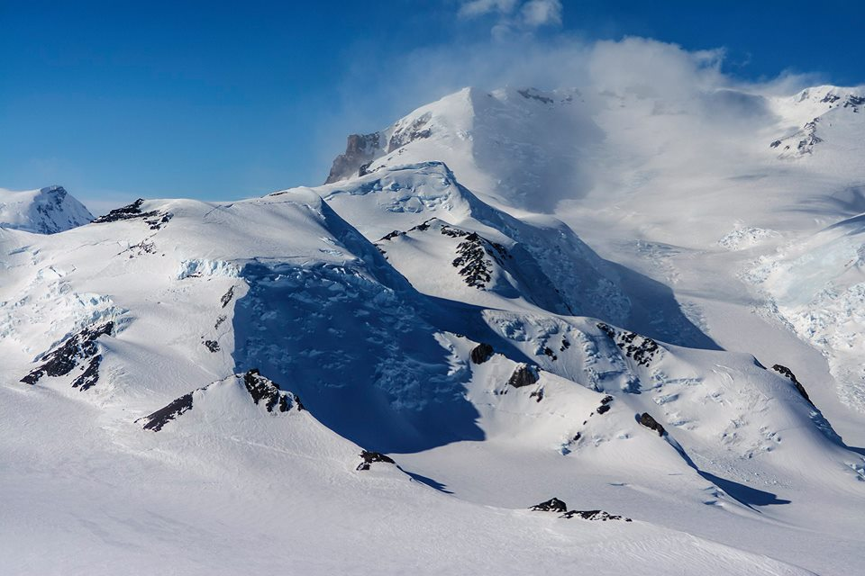
The coldest temperature ever recorded on Earth was in Antarctica - minus 89.2ºc
Photo: Stuart Rankin

Slide 24
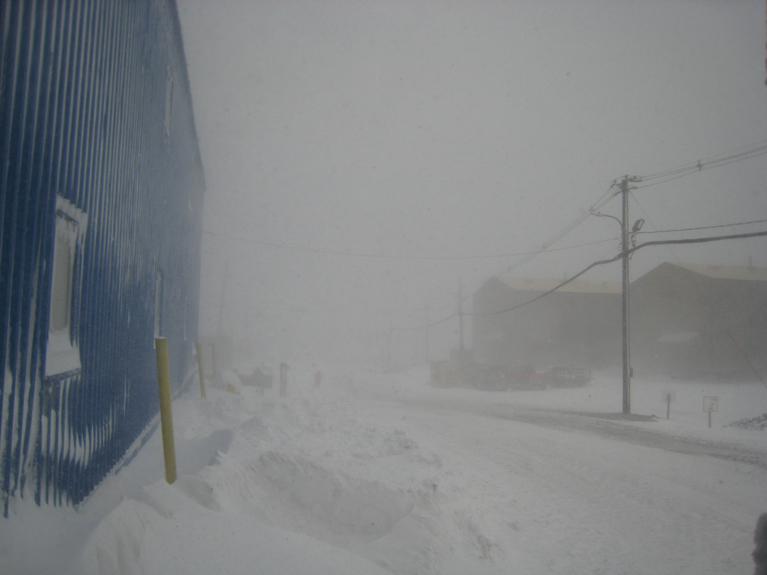
Winds in some parts of Antarctica can reach 200 mph
Photo: Bryan Kiechle

Slide 25
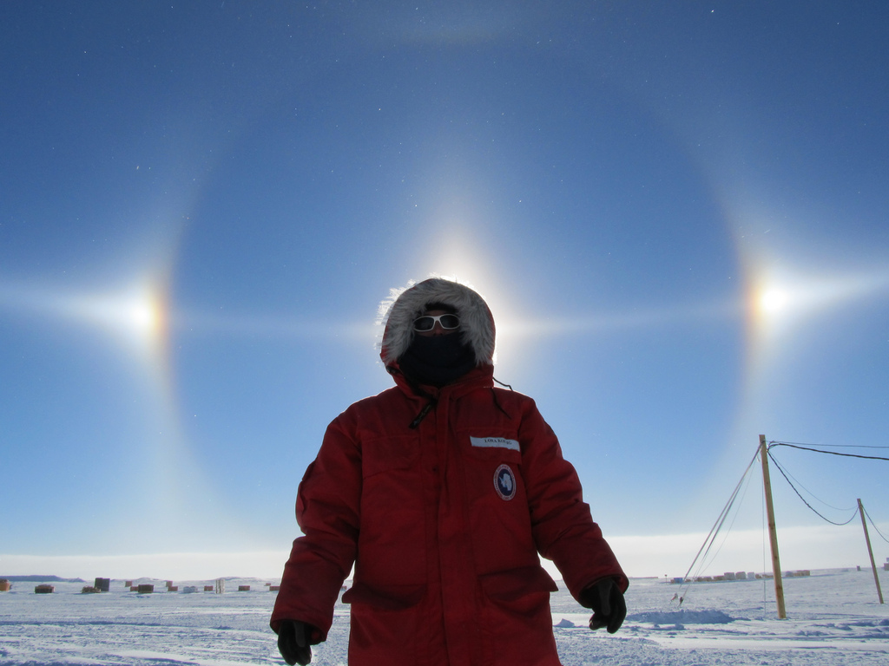
In September, the sun rises at the South Pole and then doesn’t set again until March! It becomes the Land of the Midnight Sun
Photo: NASA ICE

Slide 26
At the South Pole there are several months of complete darkness in the winter
Photo: Margo Nordquist

Slide 27
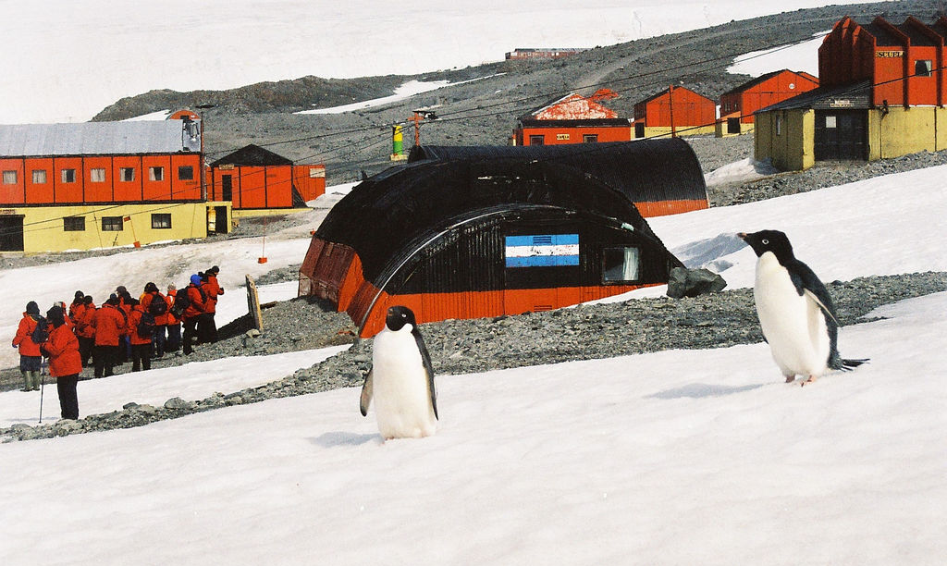
Many scientists and support staff come to Antarctica and stay at one of the research stations
Photo: Tim Ellis

Slide 28
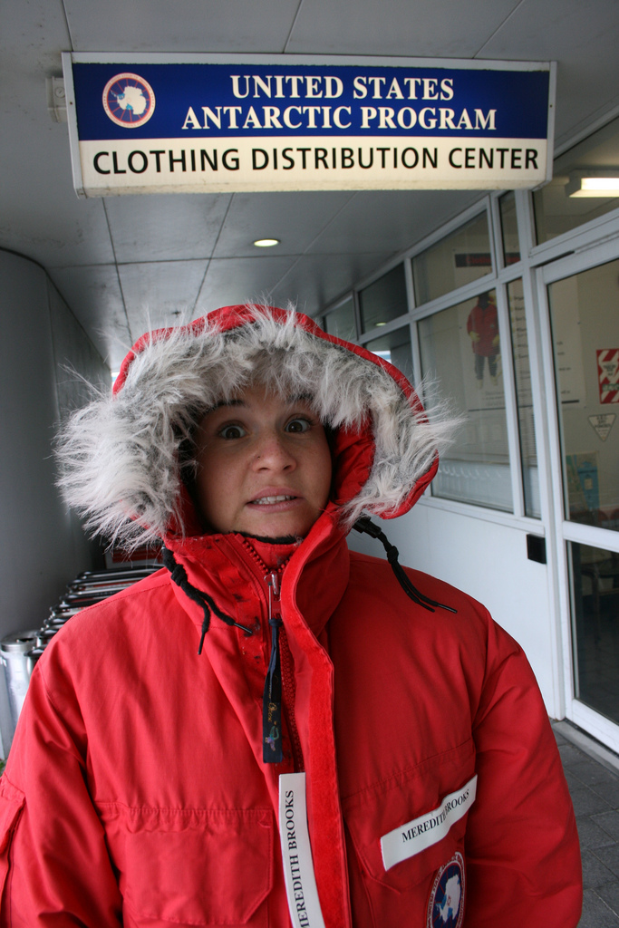
People working in Antarctica wear protective clothing to help them cope with the bitter cold and biting wind.
Photo: Eli Duke

Slide 29
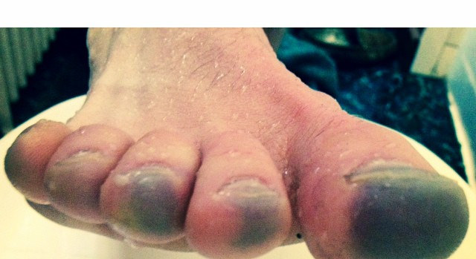
Antarctica can be a very dangerous place. There are many risks such as frost bite (below), dehydration, hypothermia, snow blindness and sunburn
Photo: Ben Murphy Online

Slide 30
Around 40,000 tourists visit Antarctica each year. Most come on cruise ships
Photo: Gilad Rom

Slide 31
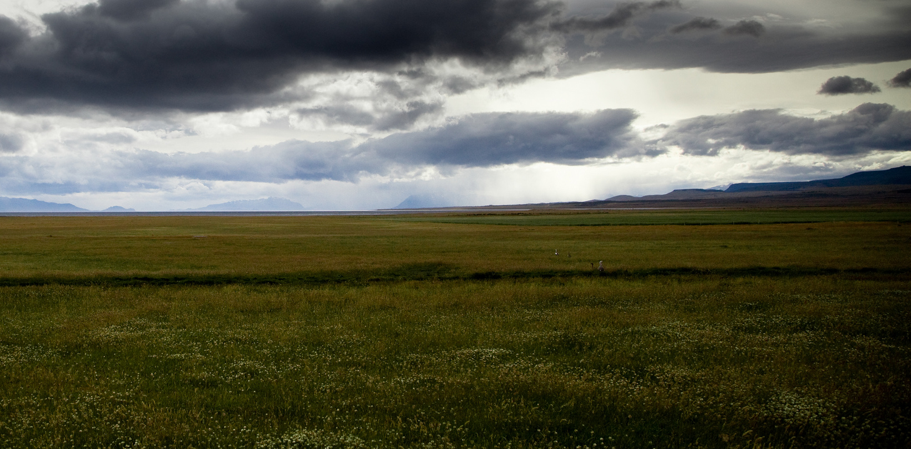
No trees or shrubs grow on Antarctica. But there are about 350 species of lichens, mosses and algae that are specially adapted to the low temperatures
Photo: Johann Perry

Slide 32
On the Antarctic Peninsula, summer brings just enough warmth and water to enable a few plants, mainly mosses, to grow on ice free surfaces.
Photo: University of Exeter

Slide 33
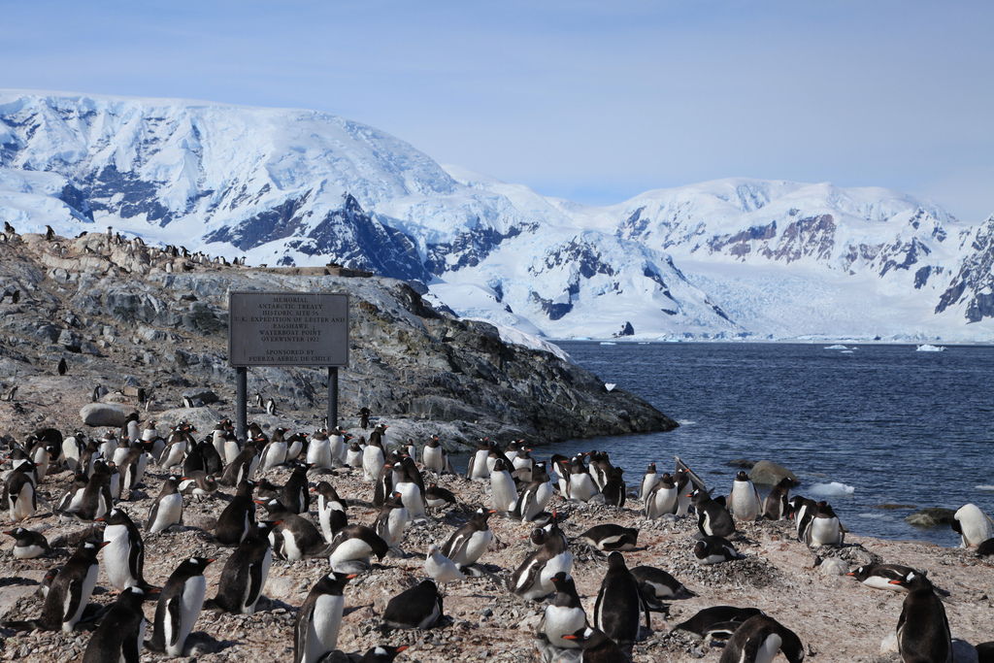
The oceans surrounding Antarctica support masses of the world’s sea life.
Photo: Liam Quinn

Slide 34
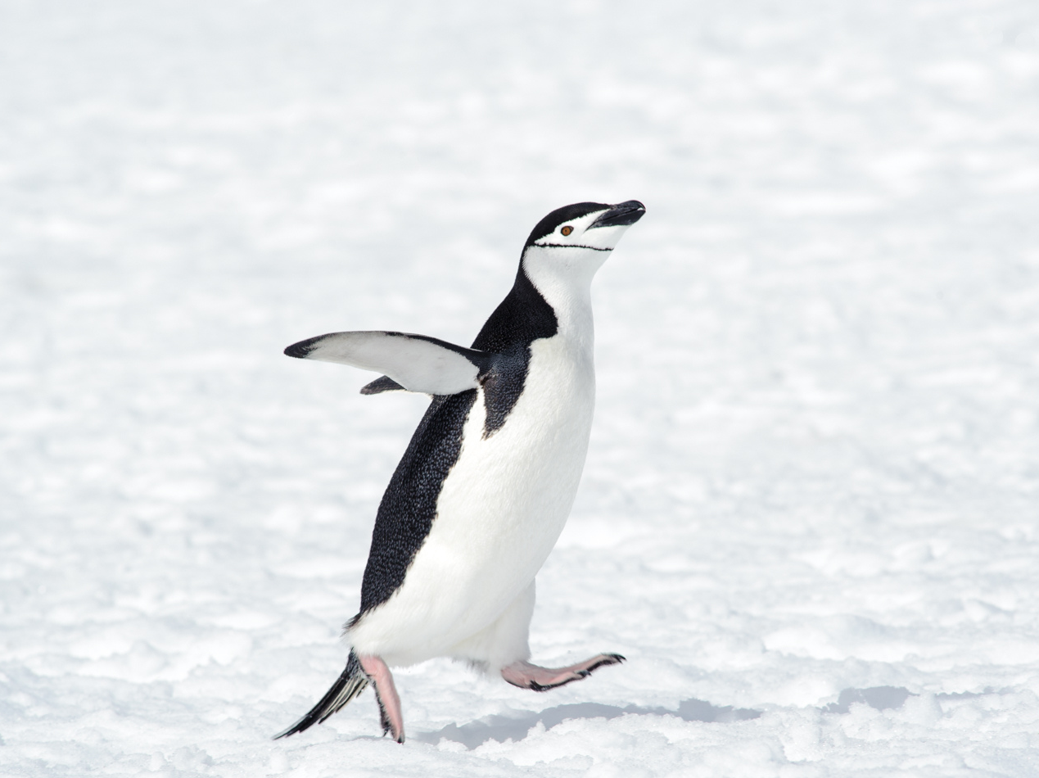
3. HOW ARE ANIMALS ADAPTED TO THE ANTARCTIC ENVIRONMENT?
Photo: Reeve Jolliffe

Slide 35
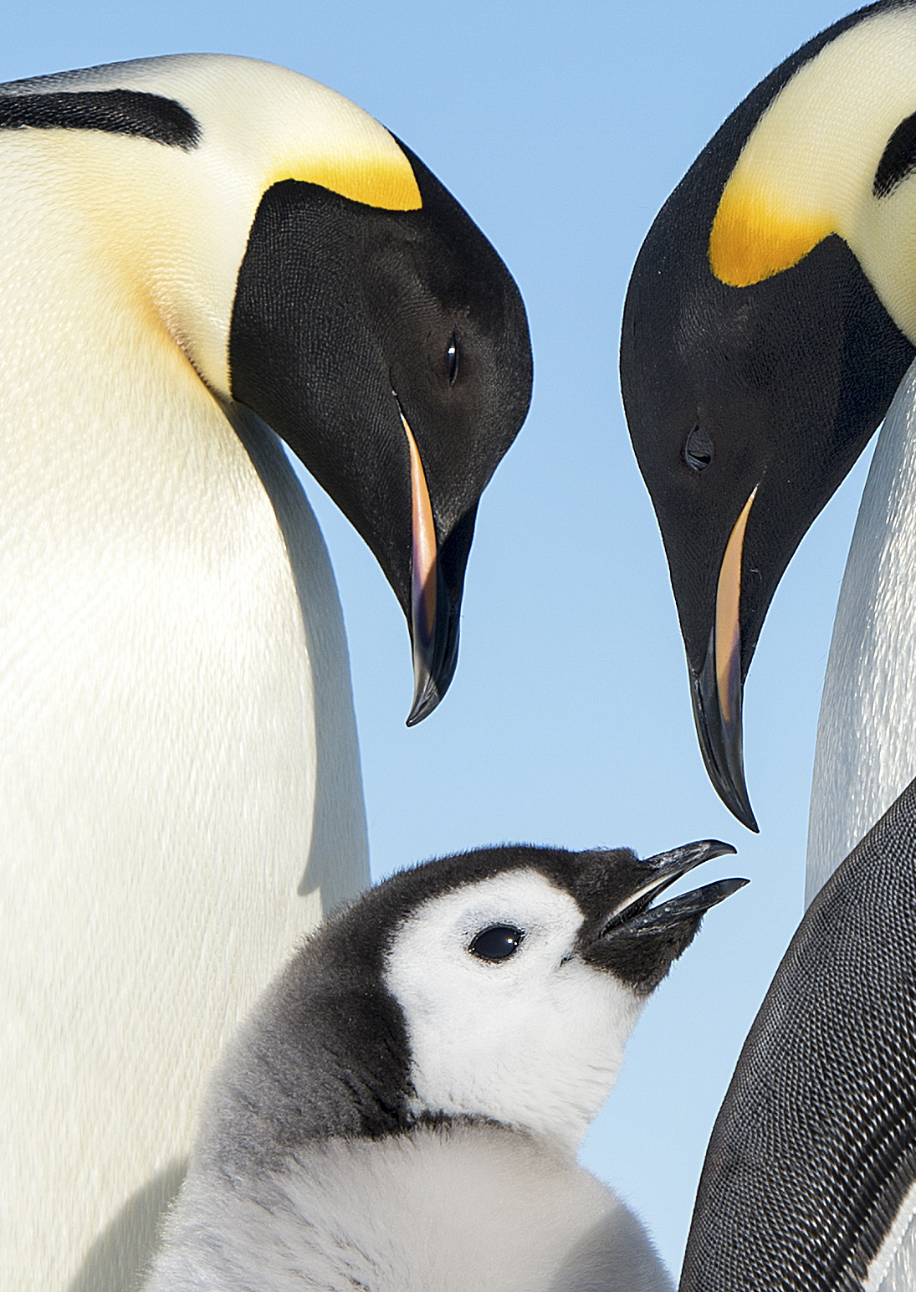
Although penguins have wings and feathers, they cannot fly.
Instead they have evolved into the most efficient swimmers and divers of all birds.
Photo: Christopher Michel

Slide 36
Penguins waddle! This is a very efficient way of walking as the swaying motion results in an 80% energy saving compared to a more static walk.
Photo: Tak

Slide 37
Penguins move quickly and efficiently by ‘tobogganing’ on slippery ice or snowy surfaces to save energy on long journeys - they lie on their fronts and push themselves with their feet!
Photo: Ian Duffy

Slide 38
Penguins have strong claws for gripping onto slippery ice when they come out of the sea
Photo: Tak

Slide 39
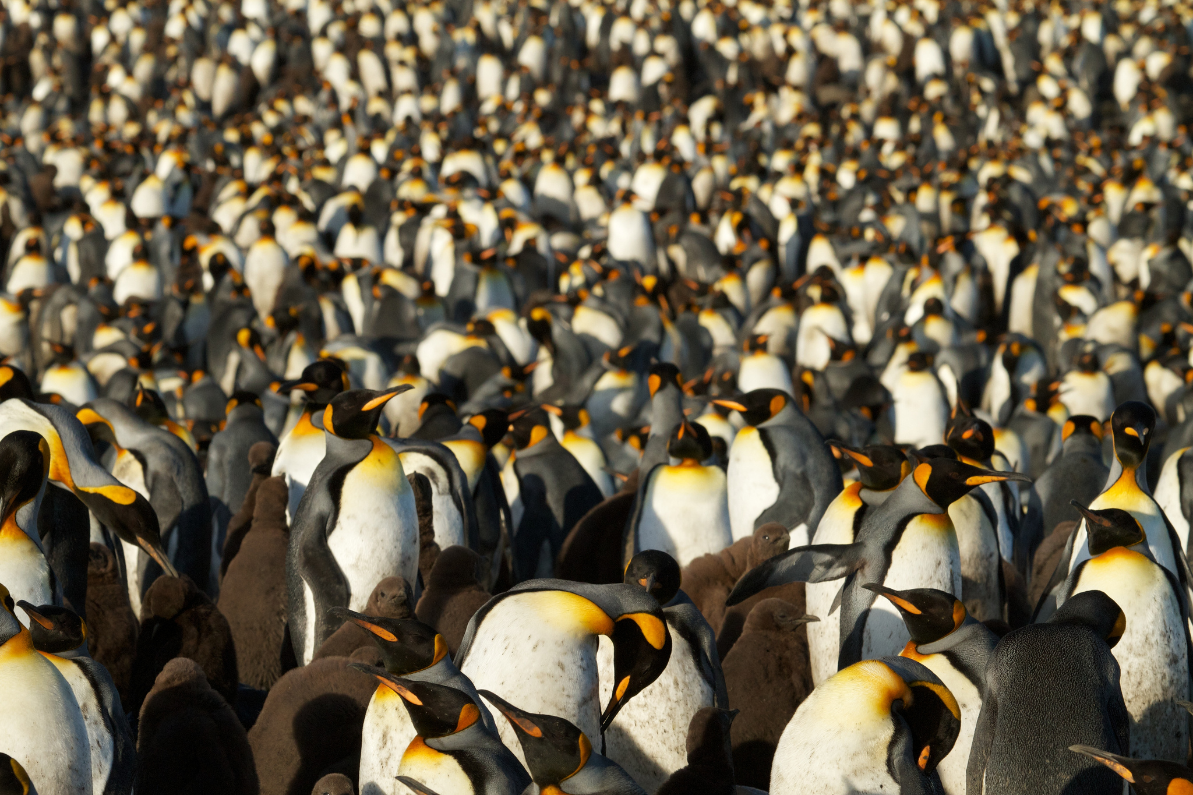
Penguin rookeries can be huge with up to a million nesting pairs and can be smelt from a long way away!
Photo: Brian Gratwicke

Slide 40
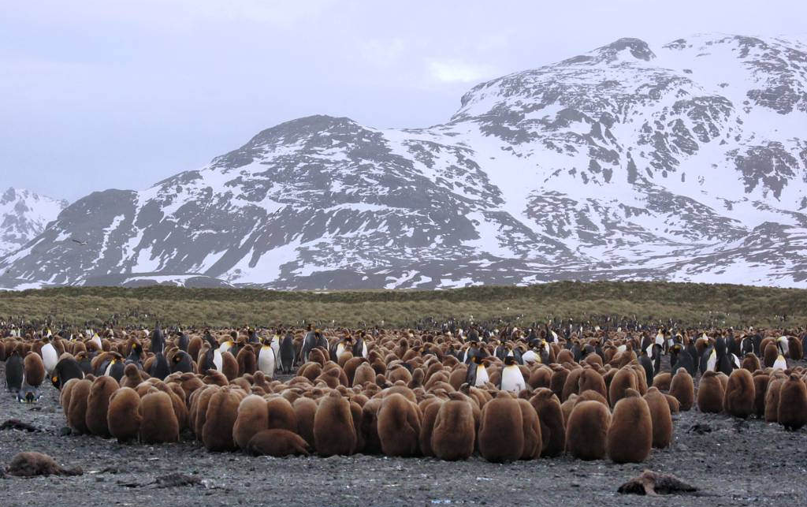
King penguin chicks huddling together for warmth
Photo: David Stanley

Slide 41
Emperor penguins can dive to a depth of 550 metres and hold their breath for up to 22 minutes so can reach food resources other birds cannot
Photo: Christopher Michel

Slide 42
Emperor Penguin: Physical Adaptations
Large size so retain heat and can survive without feeding for long periods
Very small bill (beak) so less blood needed to this area and less heat lost
Photo: Daoud Alahmad
Can store large amounts of fat which insulates their bodies and provides a long-lasting energy source
Several layers of scale-like feathers protect them from icy winds and provide a waterproof coat
Shape makes them very agile underwater. Feet and tail act as a rudder and their stiff, strong flippers as propellers
Small flippers that can be held close to the body reduce surface area on land, so reduce heat loss
Powerful claws on feet help gain a grip on snow, ice or rock when emerging from the ocean or tobogganing

Slide 43
Photo: Liam Quinn
Adélie penguins look a bit clumsy on land but they are fantastic swimmers and can dive down to 180 metres!

Slide 44
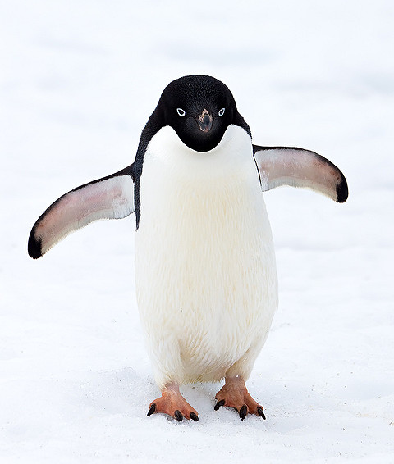
Adélie Penguins: Physical Adaptations
Backward pointing barbs on the tongue to stop slippery prey escaping
Short, densely packed & overlapping feathers for insulation and a waterproof layer
Photo: David Cook
Short stocky bodies & small extremities – reduces body surface area and amount of heat lost
Underneath the feathers there is also a layer of warm down close to the skin
Short wings shaped like paddles which allow them to swim very fast
Thick layer of fat under the skin provides additional insulation
Strong toenails help them grip the ice when thy are walking or sliding

Slide 45
Killer whales travel in family groups known as ‘pods’, using echolocation to talk to each other and hunt
Photo; David Trowbridge

Slide 46
Orca Whale: Physical Adaptations
Thick layer of blubber (fat) for warmth
Sharp teeth to rip apart and chew prey
Can dive deep into water for 1 to 4 minutes
Easily glide through water with use of dorsal and pectoral flippers
Use a method known as echolocation to help them navigate the ocean, find food and avoid danger
Can swim very fast (up to 30mph) to catch prey

Slide 47
Humpback whales are easily identified by their large flippers and tendency to breach up out of the water
Photo: Antarctica Bound

Slide 48
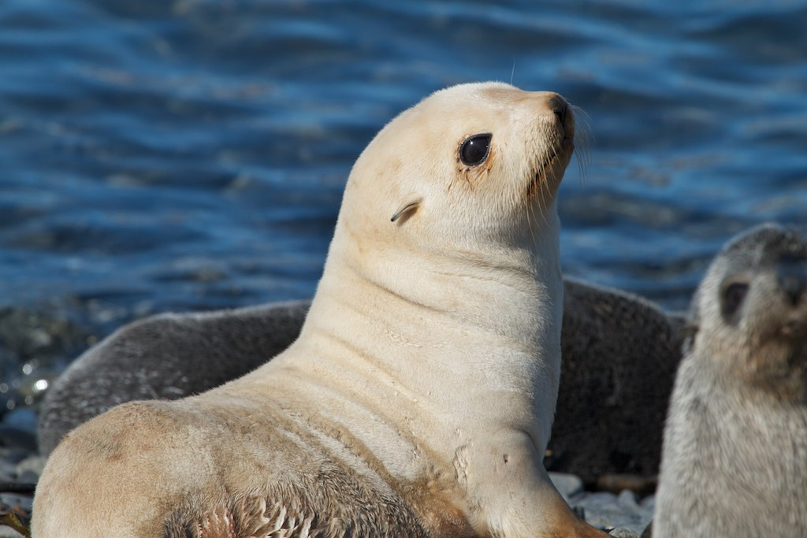
Antarctic seals, like this blonde Antarctic fur seal, have a layer of fur which gives extra insulation
Photo: Brian Gratwicke

Slide 49
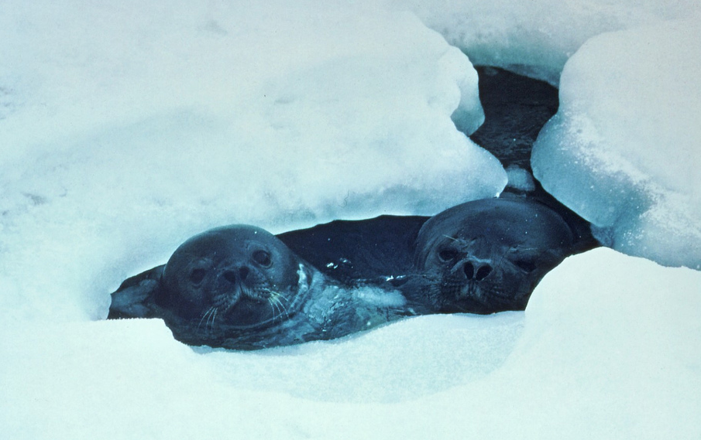
These Weddell seals keep breathing holes in the ice open by rasping back and forth with their teeth
Antarctic and Southern Ocean Coalition

Slide 50
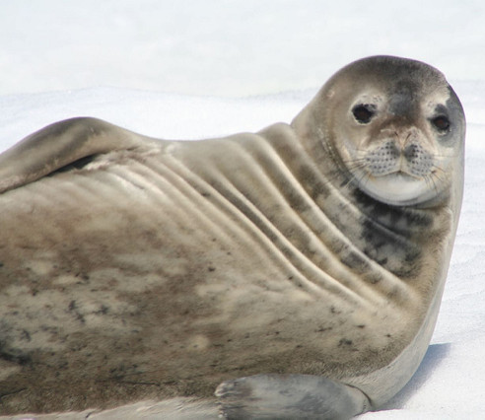
Weddell Seal: Physical Adaptations
Large eyes help when hunting for prey under water and ice where light levels are low
Whiskers that help them feel their way in the dark when catching prey
Photo: Chad Rosenthal
Strong forward-pointing canine teeth to chew breathing holes through cracks in the ice
Substantial layer of blubber under skin for insulation when swimming in freezing waters
Fore and hind limbs developed into flippers for swimming
Smooth, streamlined shape that passes easily through the water
Accurate powers of navigation as they need to find breathing holes in the darkness of winter

Slide 51
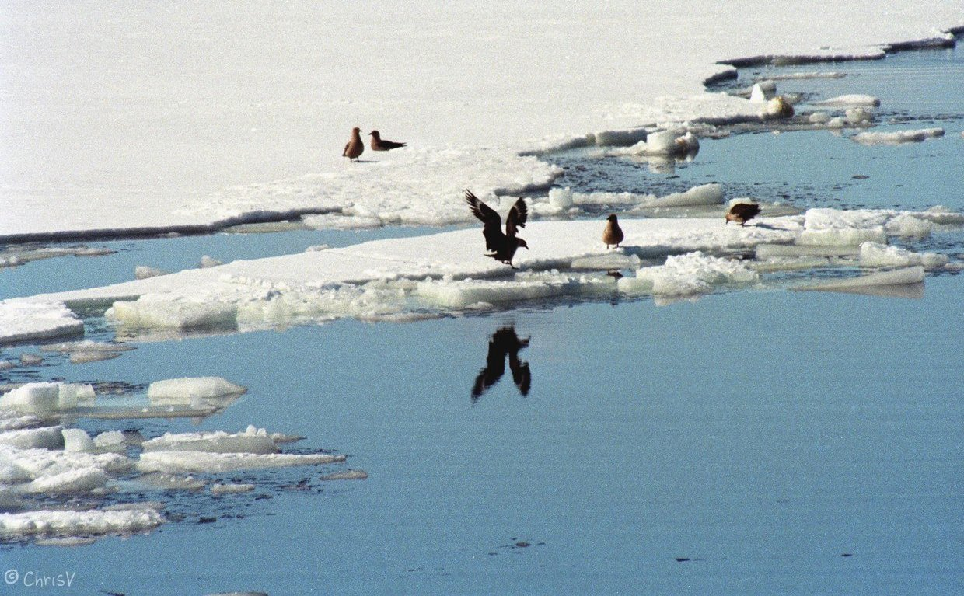
The South Polar Skua is an excellent flier and can fly at speeds of up to 50km per hour
Photo: Christine Veeschkens

Slide 52
Antarctic toothfish have an antifreeze in their blood which prevents it from freezing
Photo; Alan Light

Slide 53
Krill are able to survive for up to 200 days without food and can shrink in length as they starve
Photo: Norkrill

Slide 54
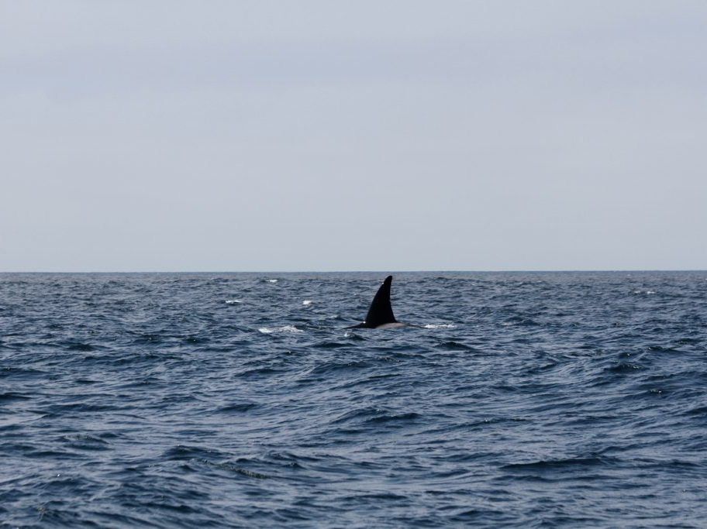
4. HOW DO ANTARCTIC ANIMALS DEPEND ON EACH OTHER?
Photo: devra

Slide 55
Simple Antarctic Food Chain
The orca or ‘killer whale’ is at the top of the Antarctic food chain
Orca
Squid
Phytoplankton e.g. algae
Seal
Antarctic krill

Slide 56
Antarctic seas are extremely productive because phytoplankton grows abundantly during the extended daylight of summer
Photo: NOAA Great Lakes Environmental Research Laboratory

Slide 57
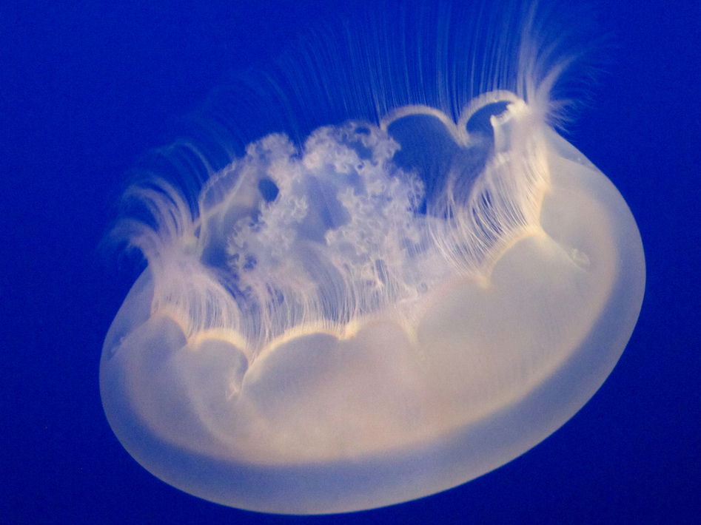
Zooplankton are tiny free-floating animals that live in the ocean
Photo: James Gaither

Slide 58
Krill forms the basis of the food chain in Antarctica and all animals depend on it for their survival
Photo: Laurens

Slide 59
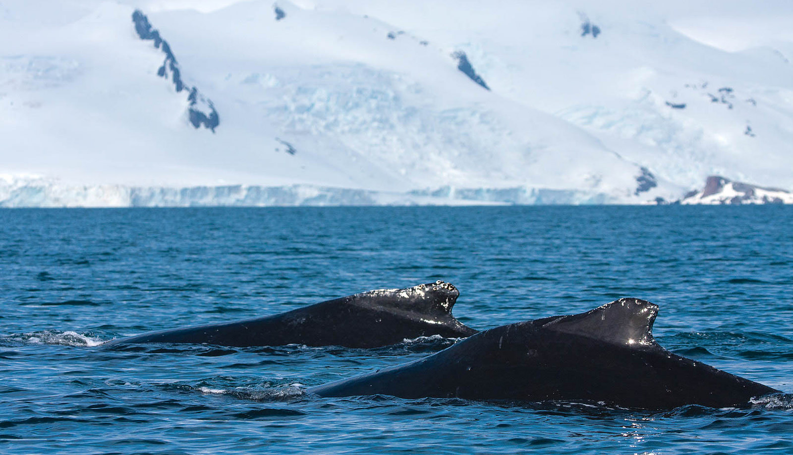
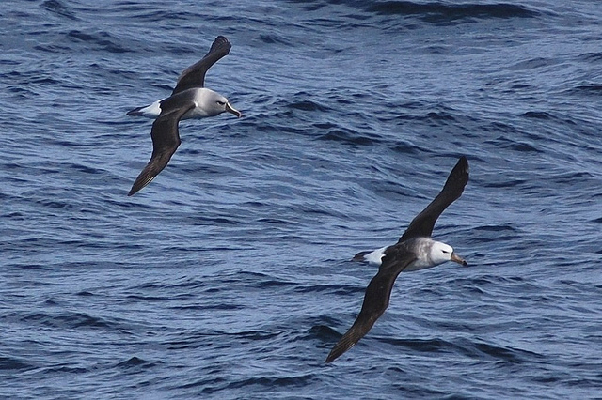
Animals such as the sperm whale and the grey-headed albatross feed on squid
Photo: Outward-bound
Photo: NOAA Photo Library

Slide 60
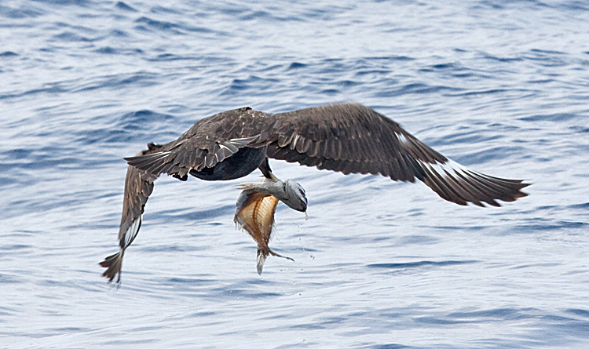
Fish are eaten by seabirds - this South Polar skua has swooped down and caught a fish from near the water’s surface
Photo: Tony Morris

Slide 61
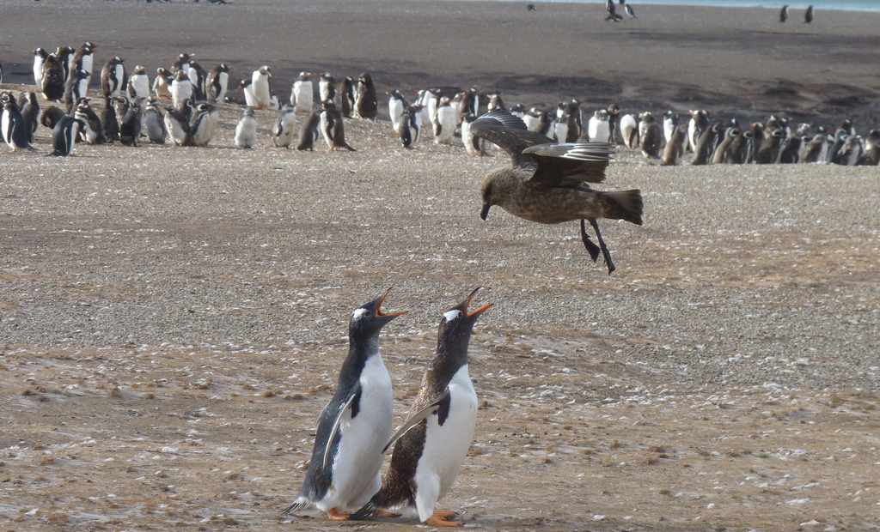
South Polar skua also eat penguin eggs and chicks. These penguins are telling the skua to stay away from their chicks.
Photo: The Humane Society of the US

Slide 62
An adult gentoo penguin feeds its chick regurgitated krill
Photo: NOAA Photo Library

Slide 63
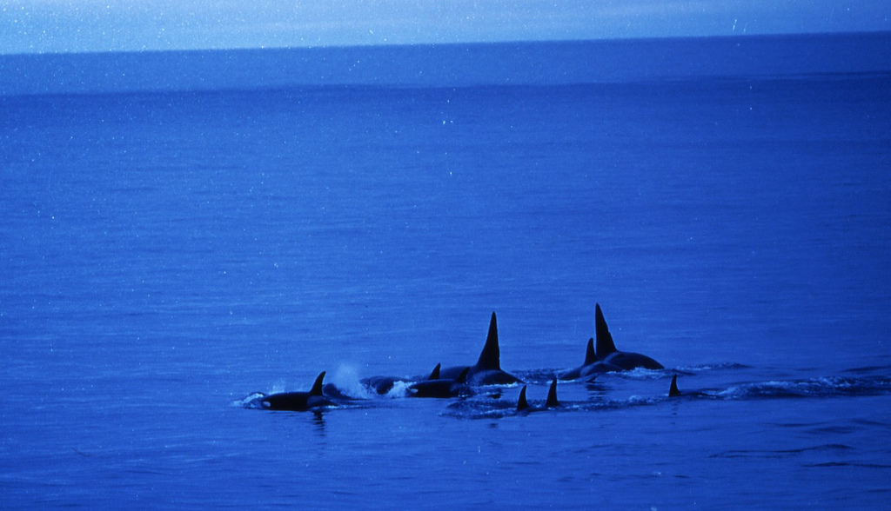
Orcas, or killer whales, are one of the world’s most powerful predators. They hunt in deadly pods of up to 40 individuals
Photo: Gregory “Slobirdr” Smith
Photo: Antarctic and Southern Ocean Coalition

Slide 64
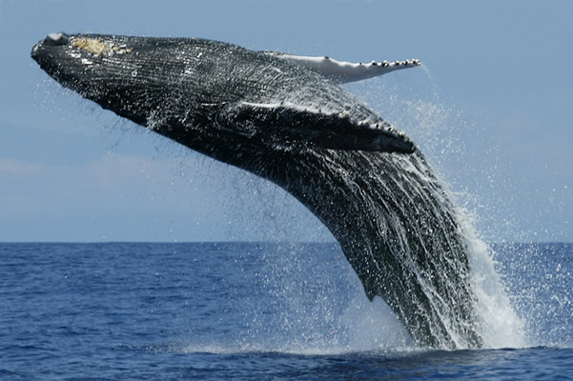
At certain times of the year, an adult blue whale eats about 4 tonnes of krill a day!
Photo: Amila Tennakoon

Slide 65
A leopard seal is attacking these adelie penguins, hoping for his next meal
Photo: GrahamC57

Slide 66
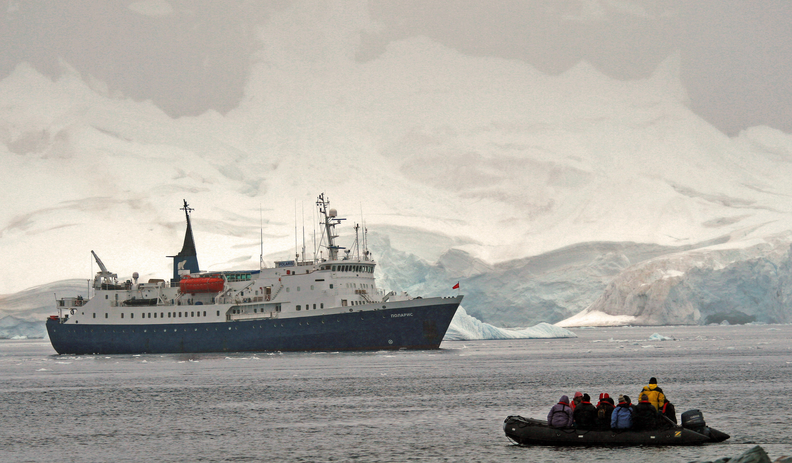
HOW ARE HUMANS AFFECTING ANTARCTICA?
Photo: Gilad Rom

Slide 67
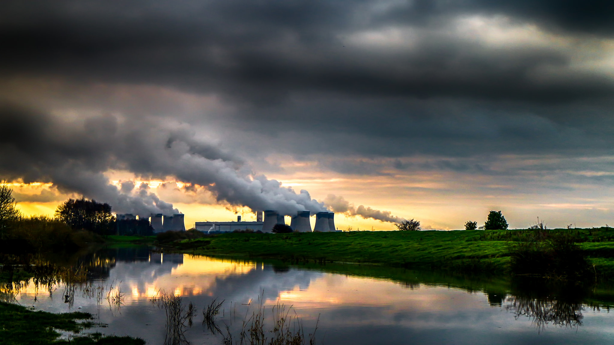
By burning fossil fuels, humans are increasing the amount of carbon dioxide in the atmosphere and increasing the speed of climate change
Photo: Darren Flinders:

Slide 68
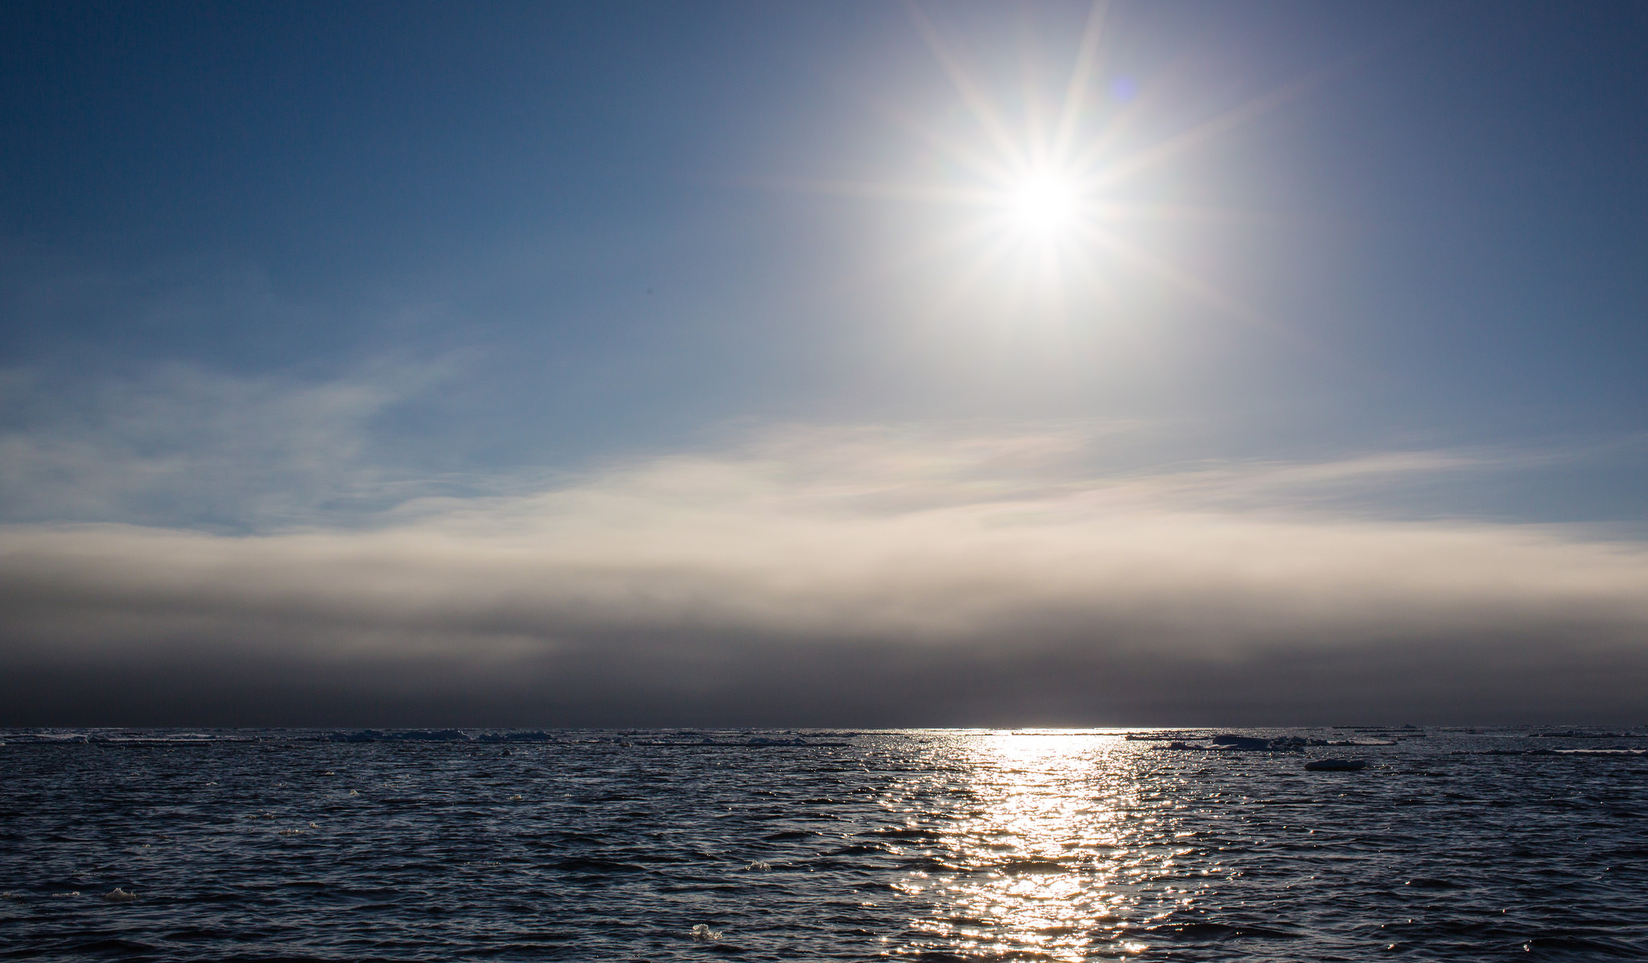
The Antarctic Peninsula has seen temperature increases of nearly 3ºc in the last 50 years. This is a much faster rate of warming than the global average
Photo: jomilo75

Slide 69
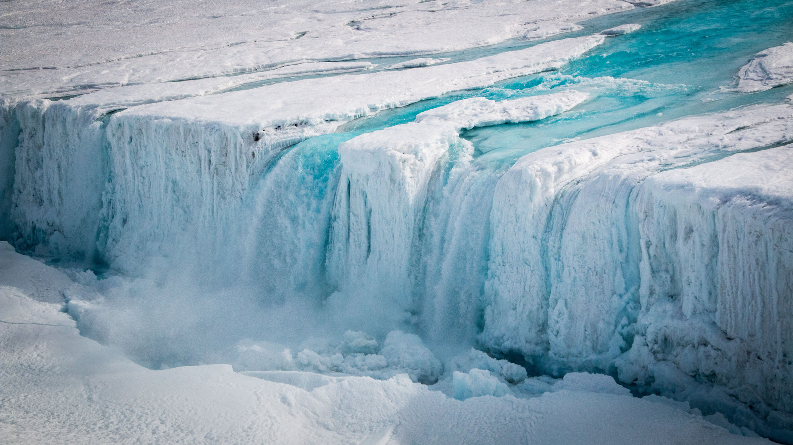
In parts of the Antarctic peninsula, sea ice cover has reduced significantly in 30 years.
Photo: Stuart Rankin

Slide 70
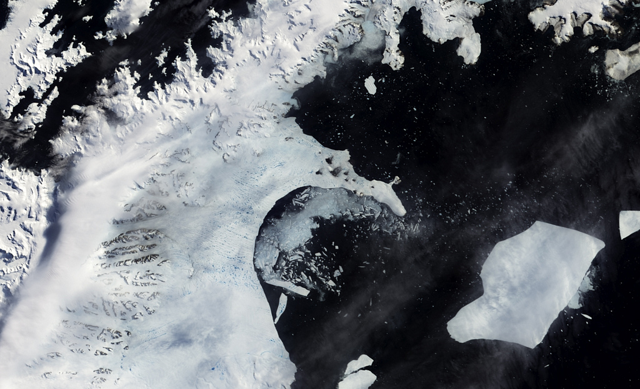
In 2002, the Larsen B ice shelf collapsed dramatically into the Weddell Sea
Photo: NASA Goddard Space Flight Centre

Slide 71
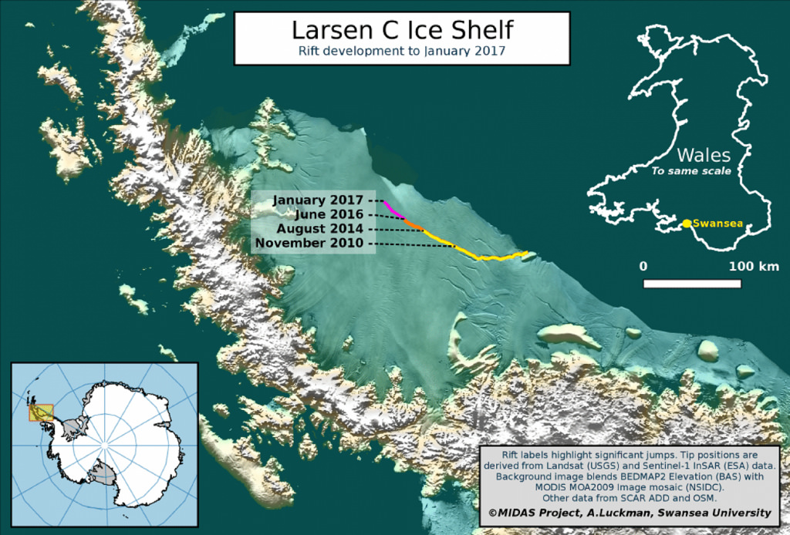
In 2010 a section of the Larsen C ice shelf started to break off. It finally broke off in July 2017, making the world’s largest iceberg

Slide 72
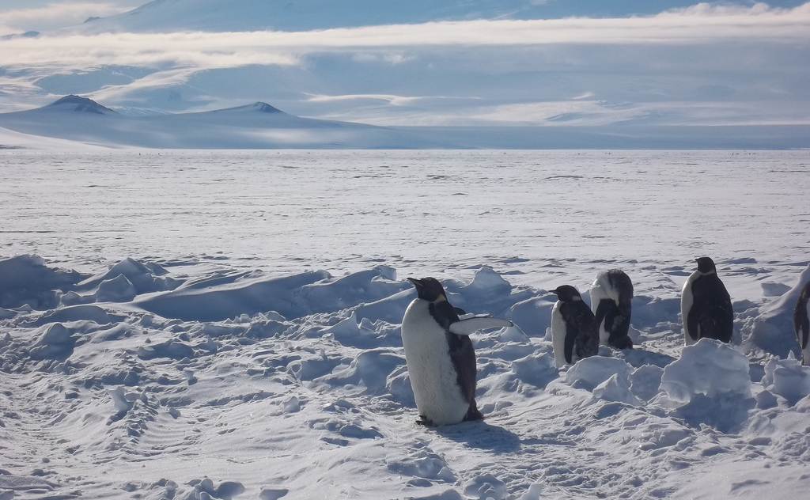
There’s been no significant ice loss from continental Antarctica - it’s so cold here that even if temperatures rise a few degrees there still wouldn’t be any melting
Photo: Cedar

Slide 73
Krill is vital to the Antarctic food web. Whales, penguins, seals and fish all feed on it, so a decline could seriously threaten them
Photo: Christopher Michel
Photo: Michael Sale
Photo: Christopher Michel

Slide 74
On the Antarctic Peninsula, loss of sea ice has led to a decline in the number of adélie penguins
Photo: Murray Foubister

Slide 75
Scientists estimate that if all the ice in Antarctica melted, sea levels around the world would rise by over 60 metres
Photo: Tim Ellis

Slide 76
The melt rate of West Antarctica’s Thwaites Glacier is an important concern as it is currently responsible for about 1% of global sea level rise
Photo: NASA’s Marshall Space Flight Centre

Slide 77
In the 2018-19 season, over 56,000 tourists visited Antarctica. Visitors can cause erosion and can disturb breeding birds
Photo: Scott Ableman

Slide 78
Oil spills are an increasing form of pollution in Antarctica and are potentially disastrous for animal life
Photo: Gilad Rom

Slide 79
Krill populations are in danger from the growing demand for health supplements and food for fish farms
Photo: NOAA Photo Library

Slide 80
The Polar Code aims to minimise the impact of shipping operations on the pristine polar regions

Slide 81
HMS Protector is a Royal Navy ice patrol ship that has an important role in ensuring that the terms of the Antarctic Treaty are being met
Photo: Royal Navy Media Archive

Slide 82
To find out more, please visit
https://www.betterplaneteducation.org.uk
Registered charity number 1153740
Creating a better future by inspiring young people to look after our world

Slide 83
Credits
Better Planet Education would like to thank all the amazing photographers on Flickr who allow the use of their photos for non-commercial purposes.
Your photos are helping young people to learn more about environmental issues. We couldn’t have created this presentation without you!

