Slide 1
Note to teachers
Thank you for downloading this presentation from the Young People’s Trust for the Environment. You are welcome to modify it by adding your own slides or deleting ones you don’t need.
Please do not remove the photo credits from any of the photos you use and we would be very grateful if you could leave YPTE’s logo and web address on the relevant pages.
We want to encourage more and more young people to learn about taking care of our world and our website is a great starting point for this. You can find lots more supporting information by visiting the ‘Explore’ section of ypte.org.uk

Slide 2
COLD AREAS:
THE ARCTIC
Registered charity number 1153740

Slide 3
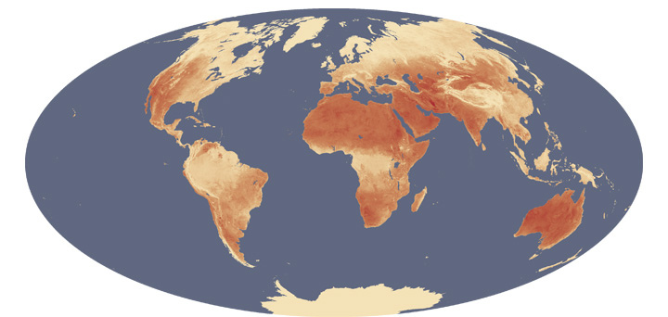
1. WHERE ARE THE HOT AND COLD AREAS?
Image: NASA’s Earth Observatory

Slide 4
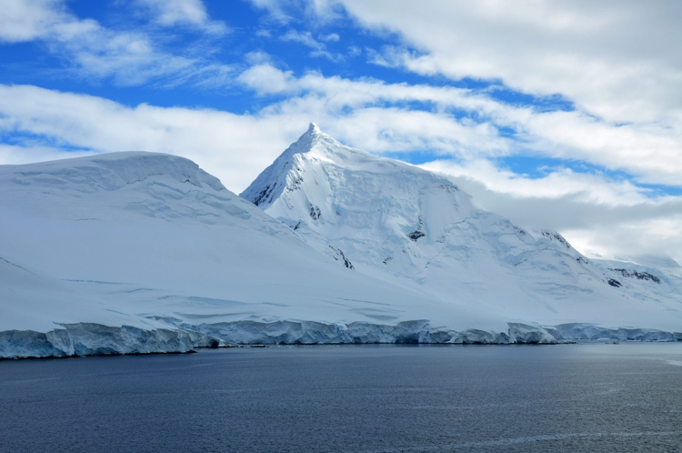
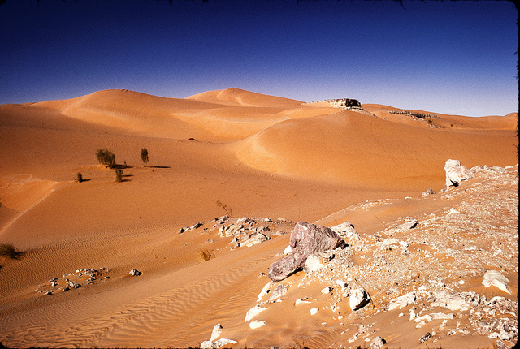
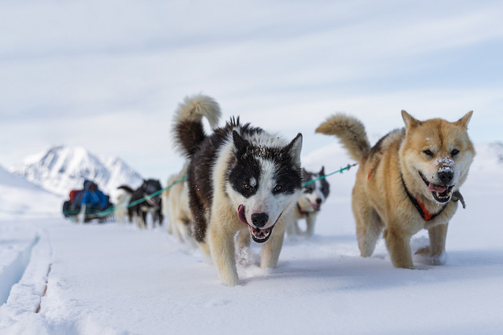
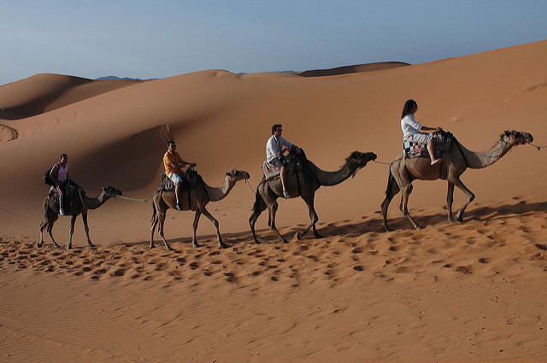
Comparing Hot and Cold Areas
Photo: Victor
Photo: Dave Price
Photo: Markus Trienke
Photo: Robbie

Slide 5
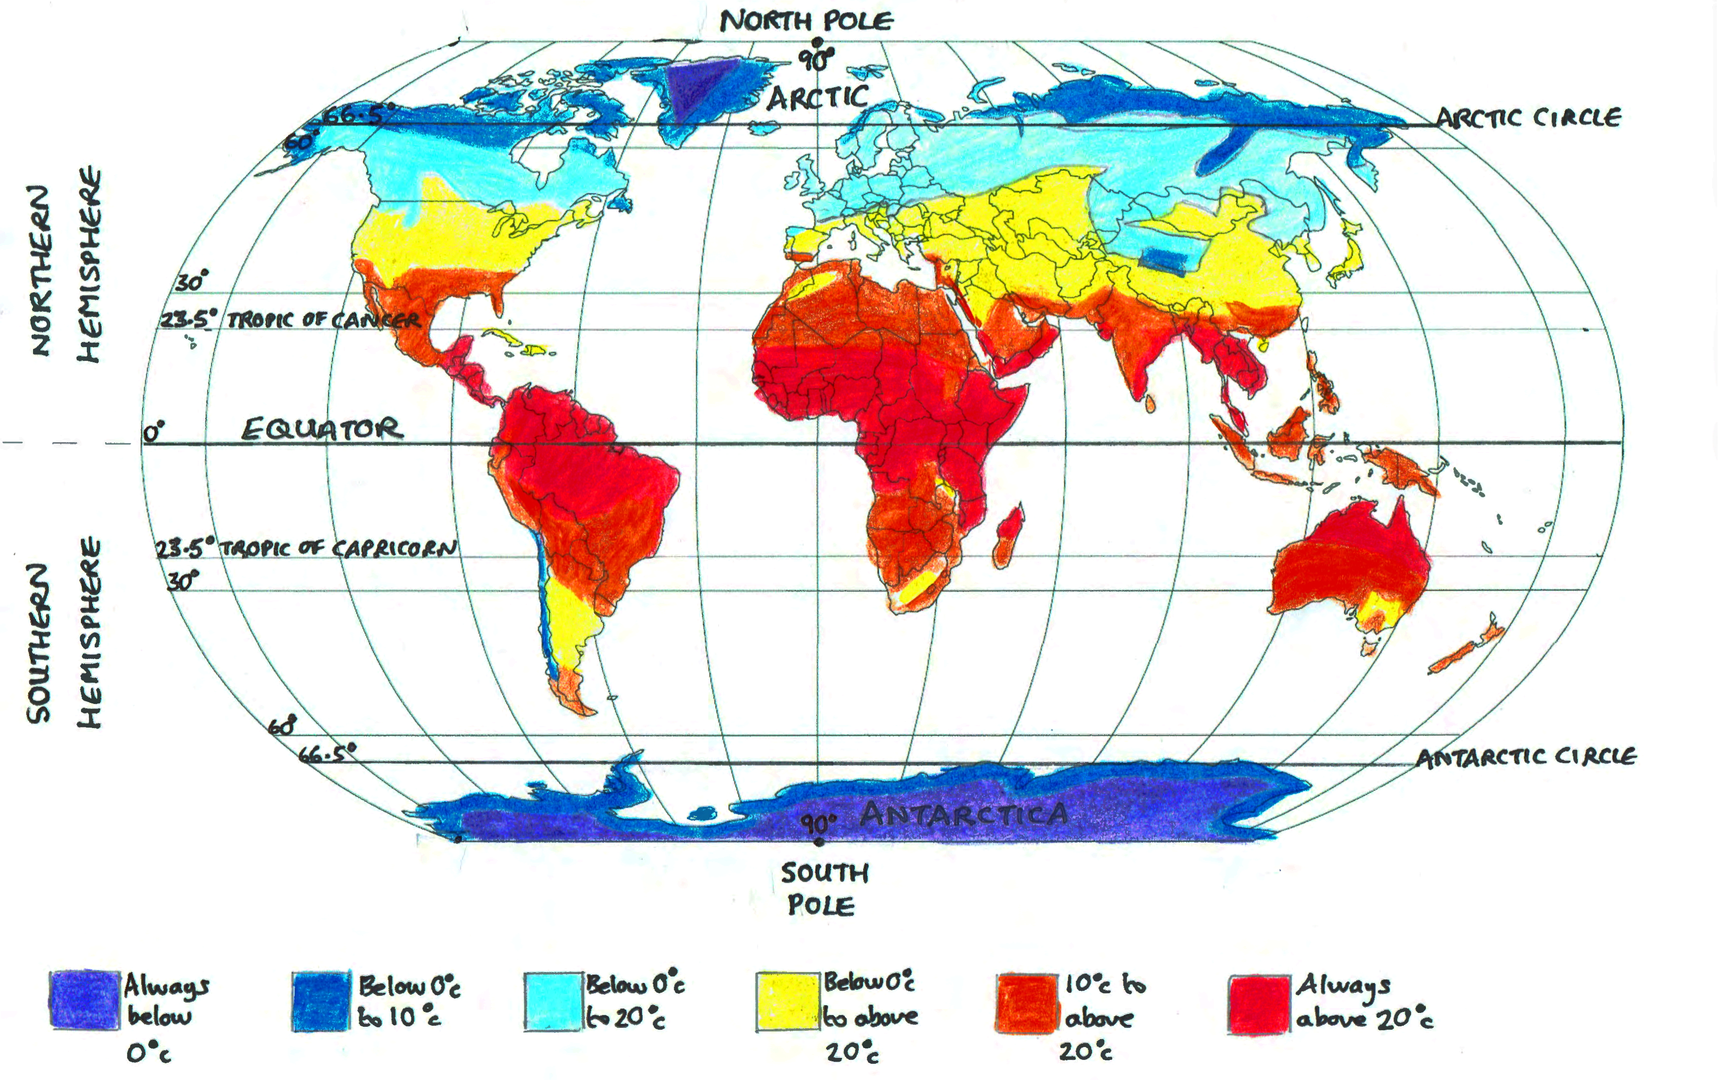
MAP SHOWING TYPICAL GLOBAL TEMPERATURES
Note: shading and lines are approximate

Slide 6
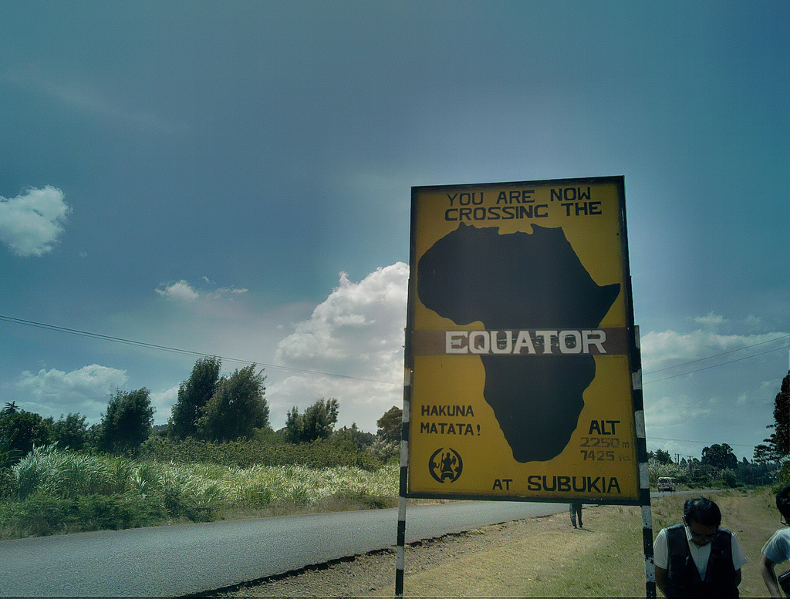
The Equator is an imaginary line around the Earth. Everywhere on the Equator is equally distant from the North Pole and the South Pole
Photo: Henri Bergius

Slide 7
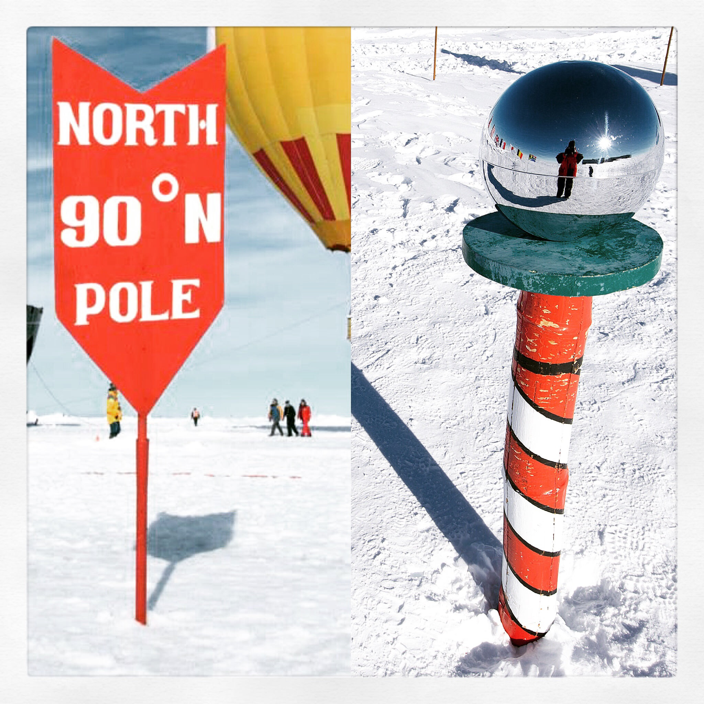
Both Poles are very cold
But the South Pole is a lot colder than the North Pole
Photo: Christopher Michel

Slide 8
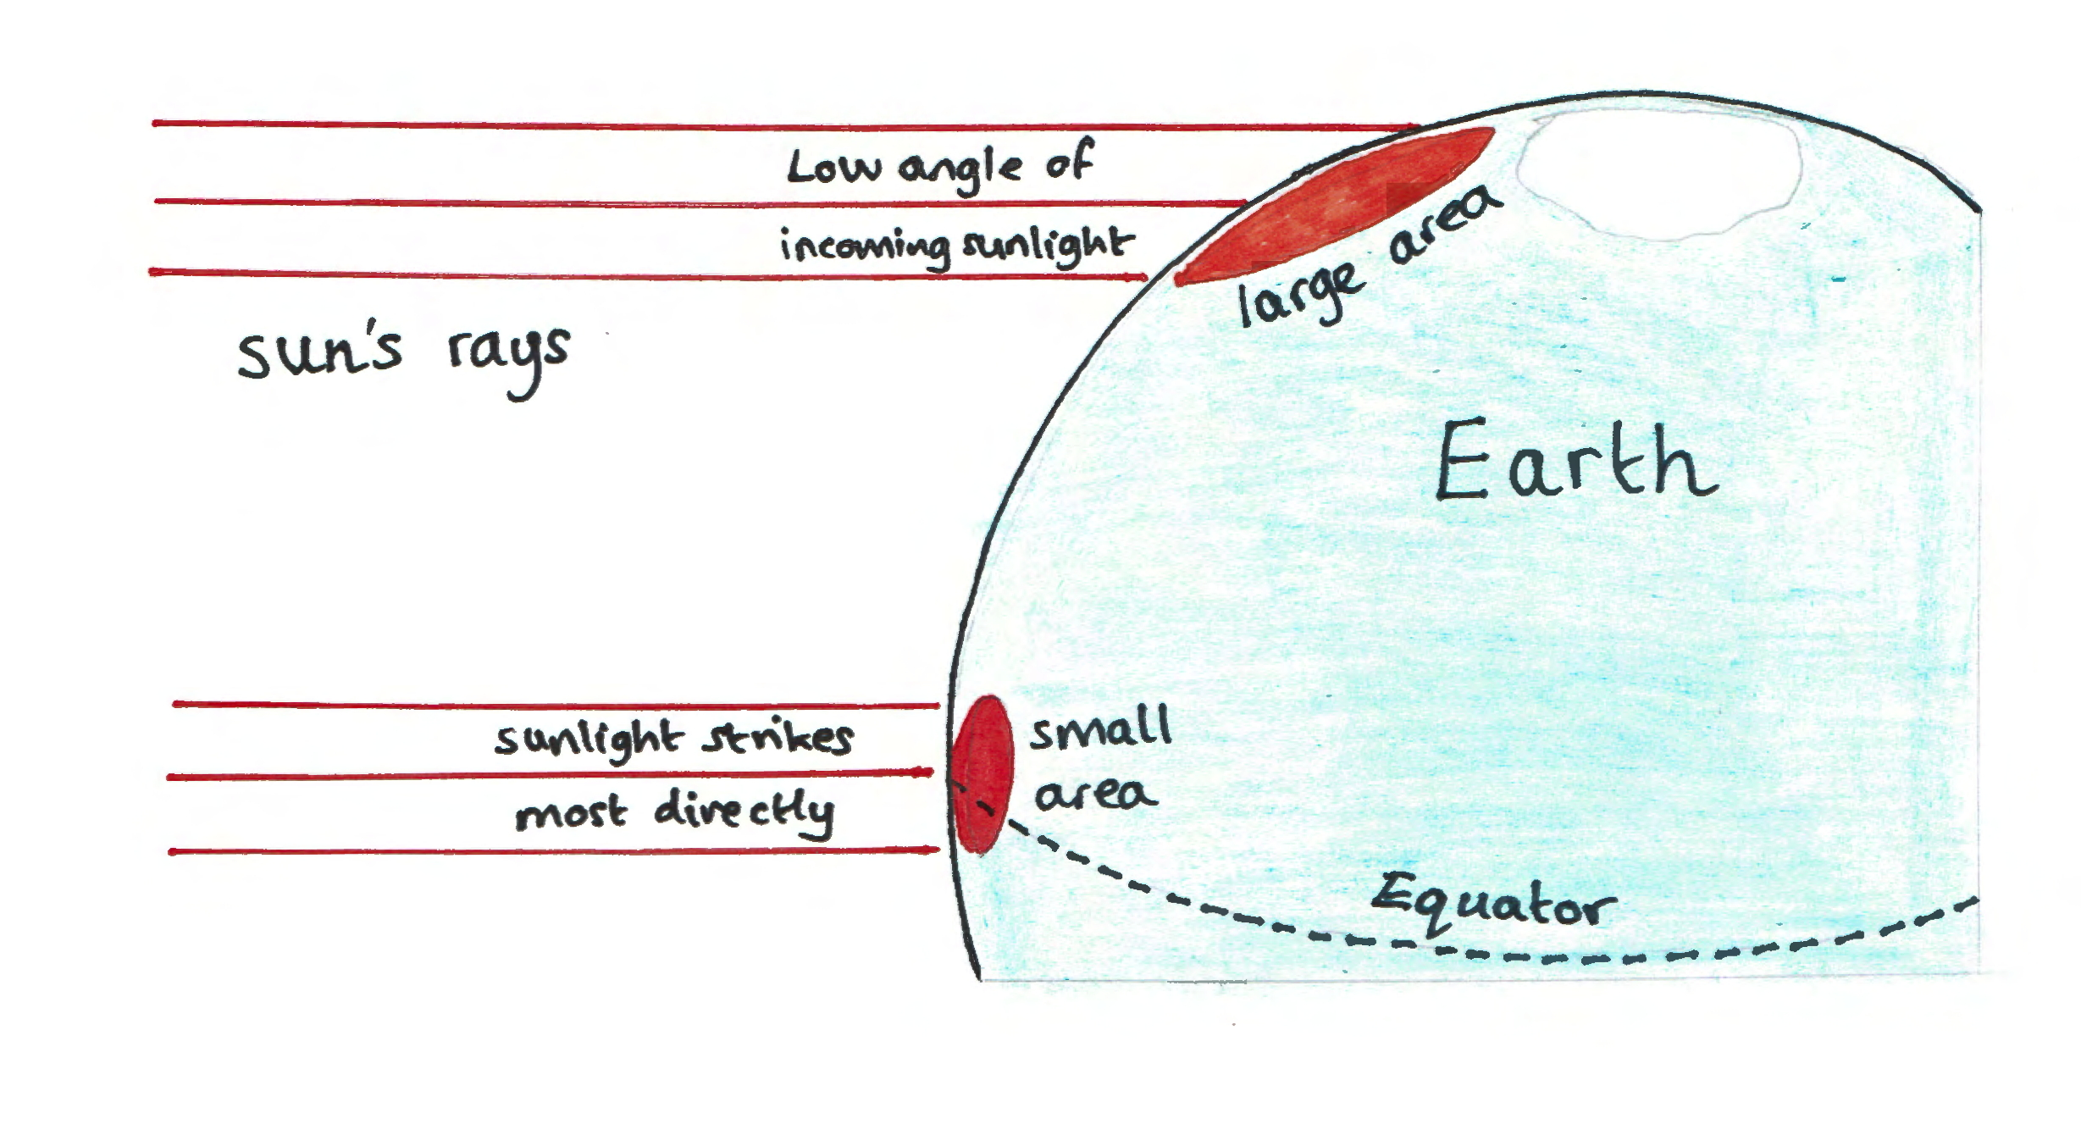
At the Poles, the sun’s rays strike the Earth at a very low angle so they are spread out over a greater area and temperatures are very low

Slide 9
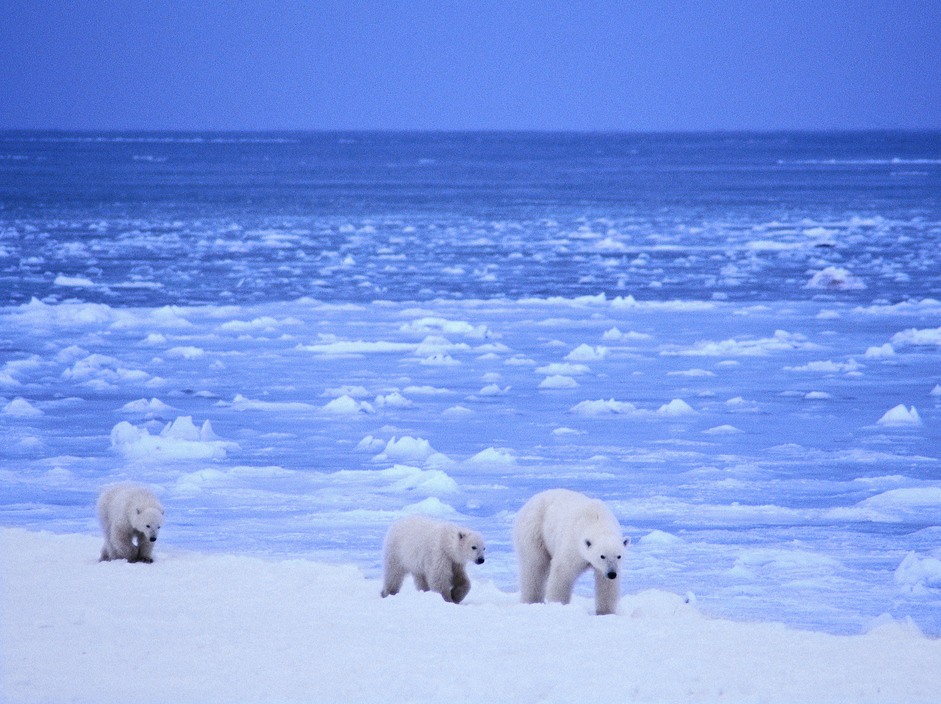
2. WHAT IS IT LIKE IN THE ARCTIC?
Photo: Lwp Kommunikacio

Slide 10
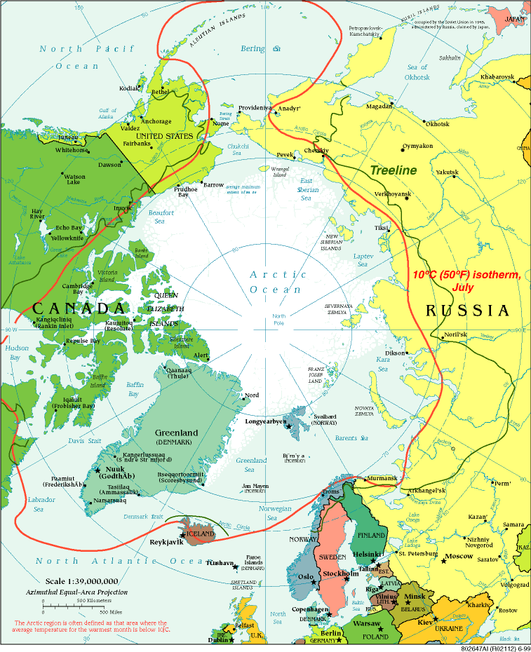
The Arctic consists of the Arctic Ocean and parts of Canada, Russia, the USA, Greenland, Norway, Finland, Sweden & Iceland
Map: vaXzine

Slide 11
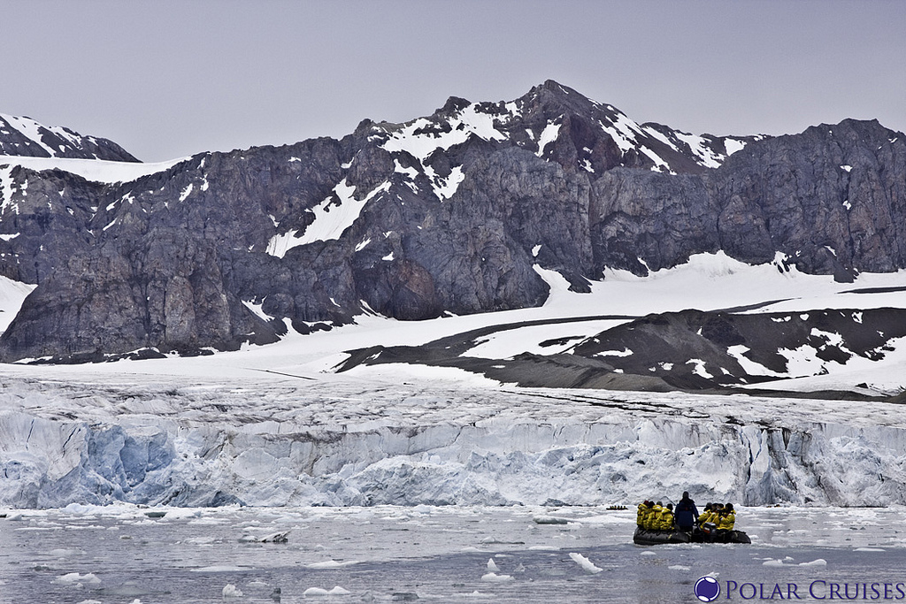
The Arctic is a sea of ice, surrounded by cold, treeless lands
Photo: Polar Cruises

Slide 12
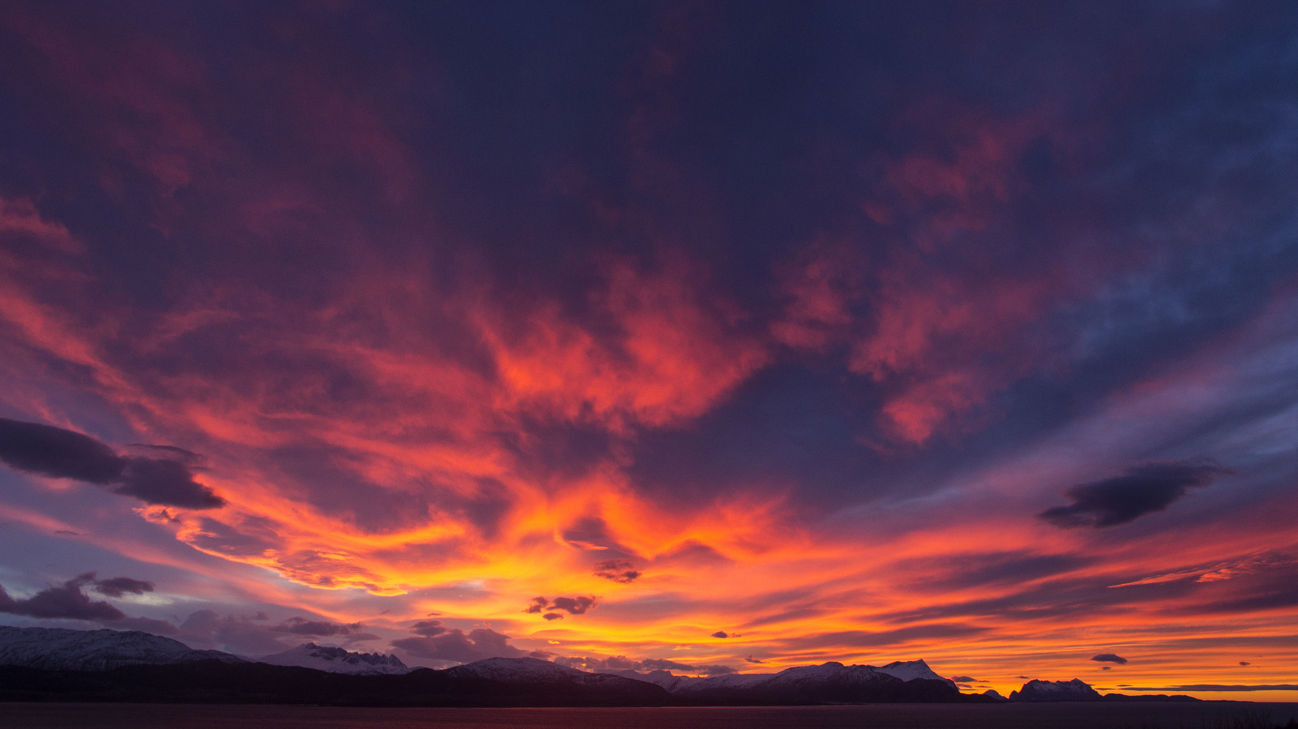
The Arctic is the ‘Land of the Midnight Sun’ – in the summer, months can go by without the sun setting. In the winter there are ‘Polar Nights’ when the sun never rises
Photo: Trond Kristiansen

Slide 13
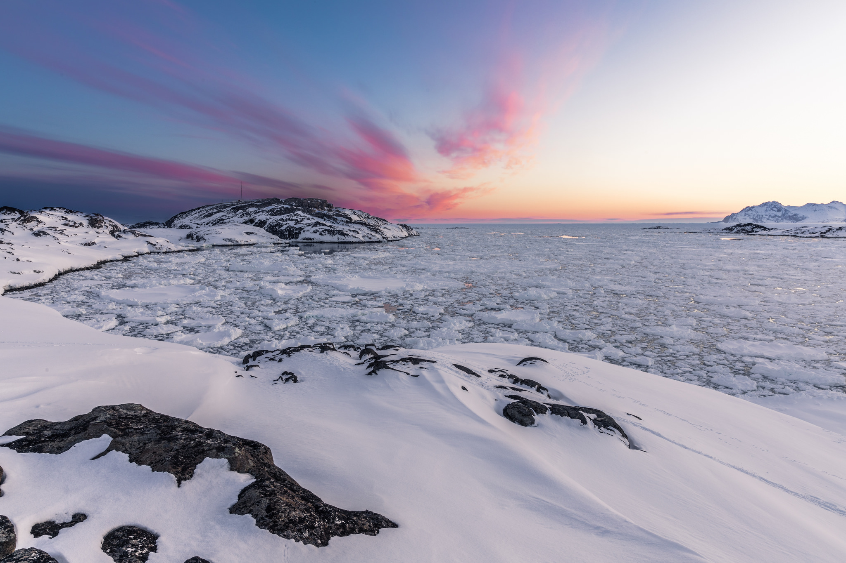
Winter temperatures can drop below −50°c over large parts of the Arctic

Slide 14
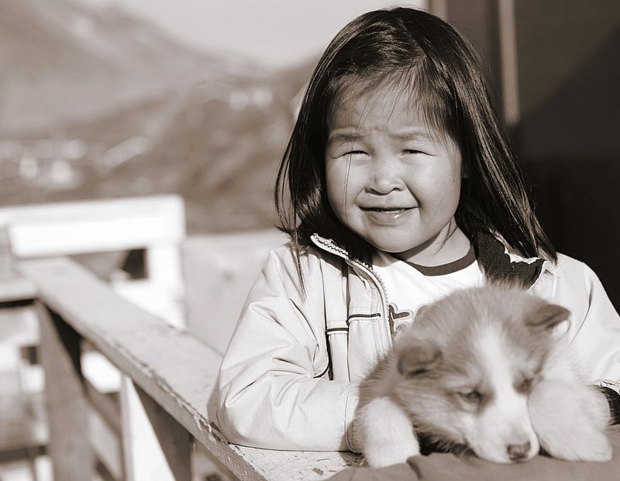
There are many indigenous peoples living in the Arctic, including the Inuit
Photo: Nick Russill

Slide 15
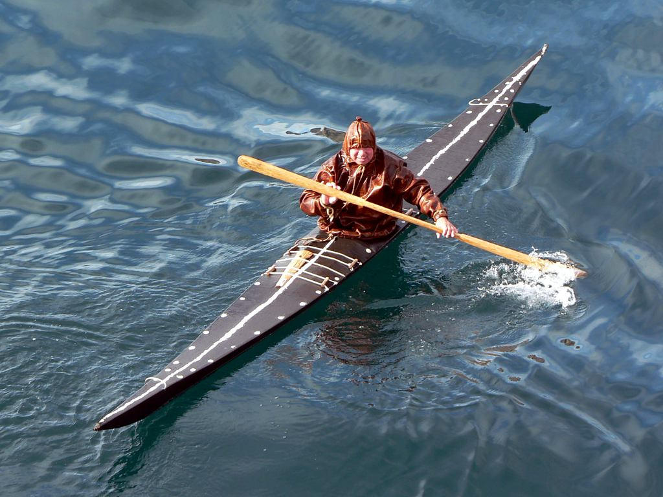
The Inuit are experts in managing the harsh weather conditions they live in
Photo: David Stanley

Slide 16
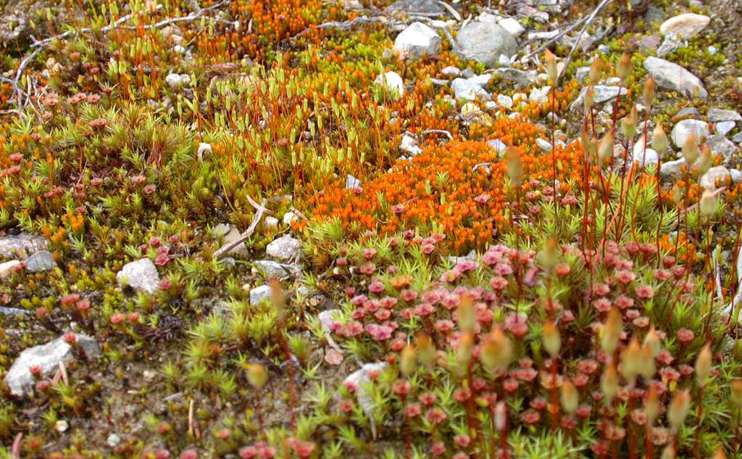
Many species of small plants grow in the Arctic and are adapted to growing in the hostile conditions
Photo: Alastair Rae

Slide 17
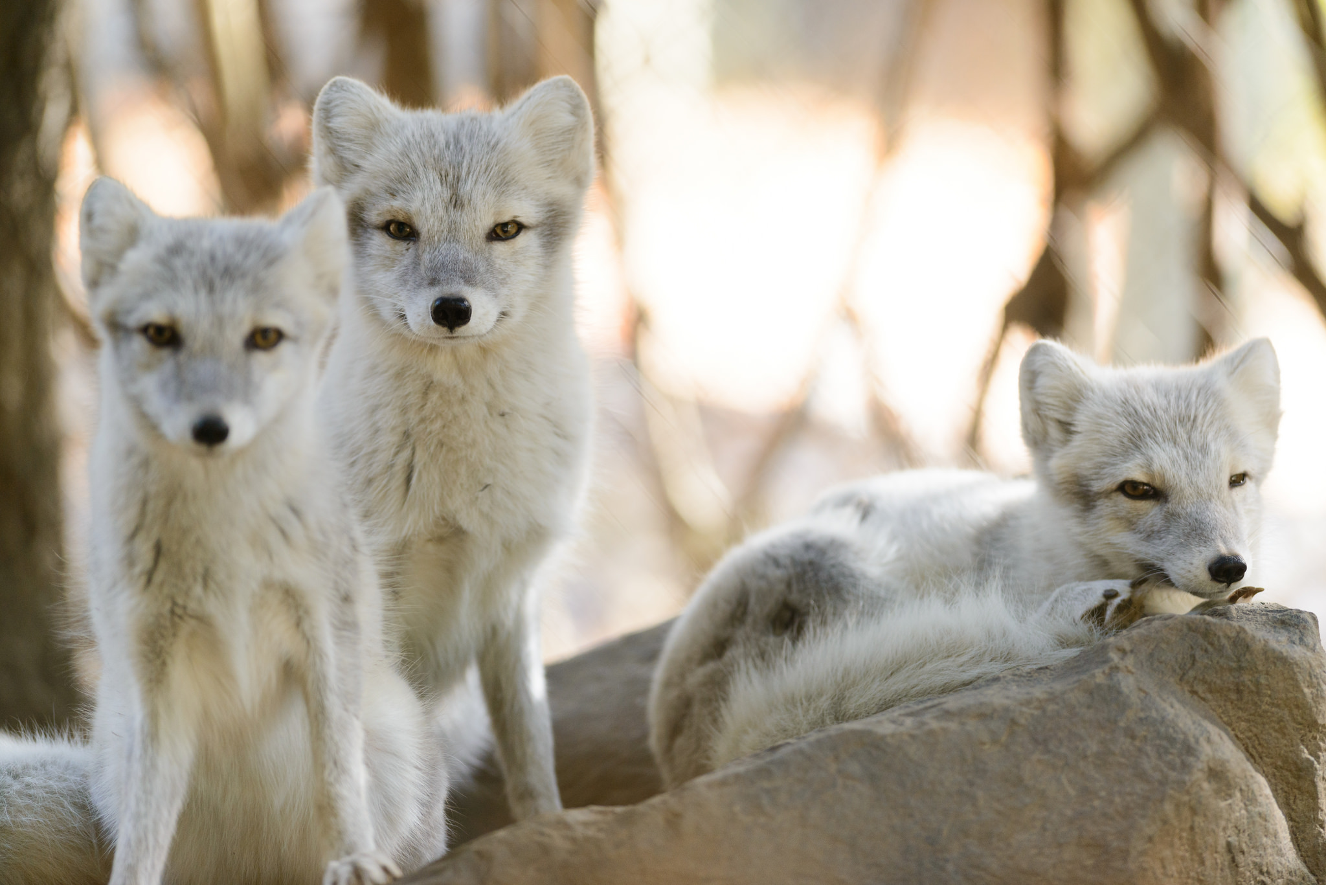
The Arctic is home for some or all of the year to around 450 types of fish, 280 kinds of bird and 130 different mammals
Photo: Eric Kilby

Slide 18
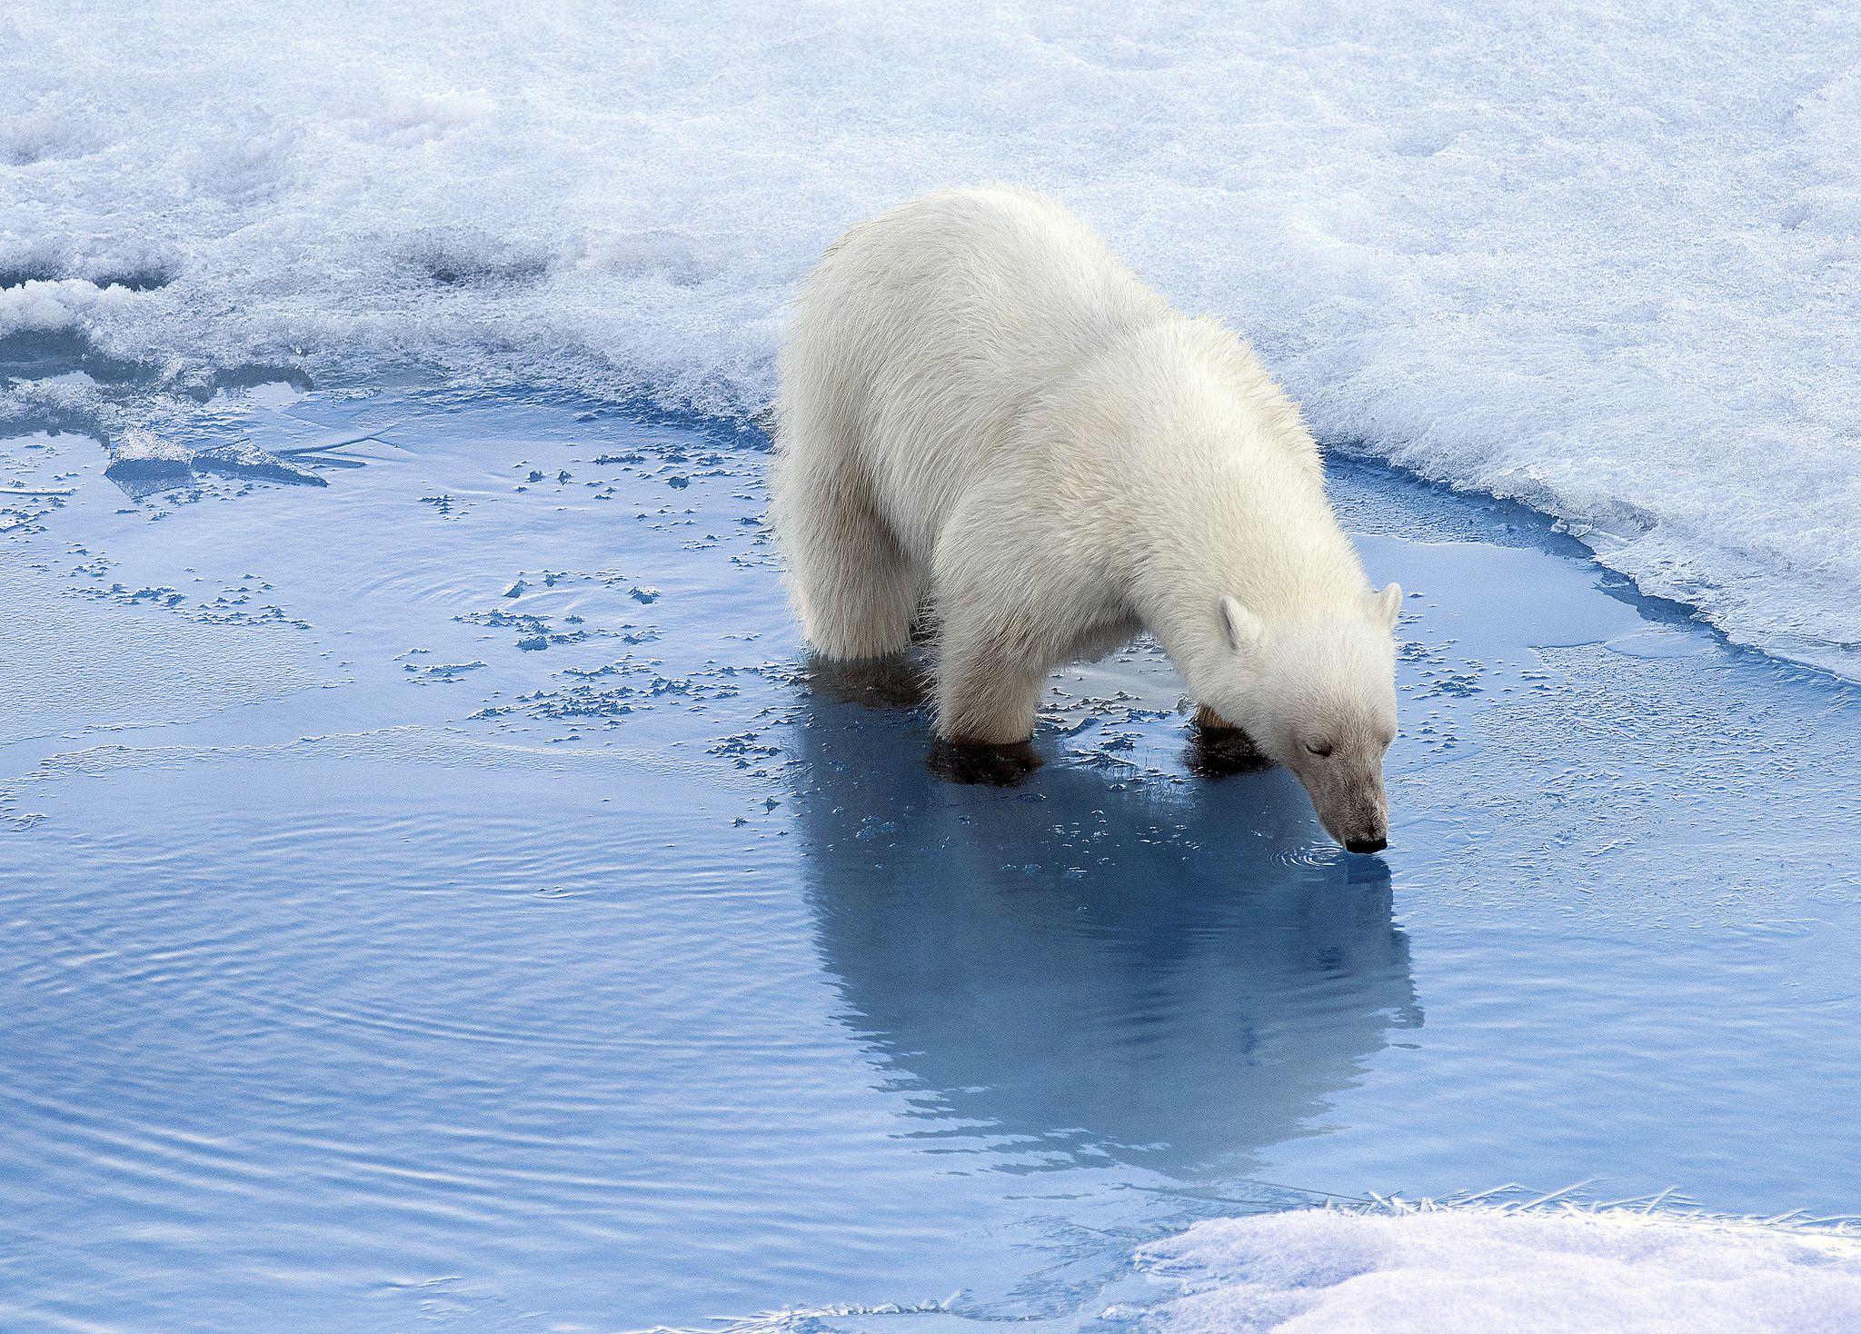
3. HOW ARE ARCTIC ANIMALS ADAPTED TO THEIR ENVIRONMENT?
Photo: Christopher Michel

Slide 19
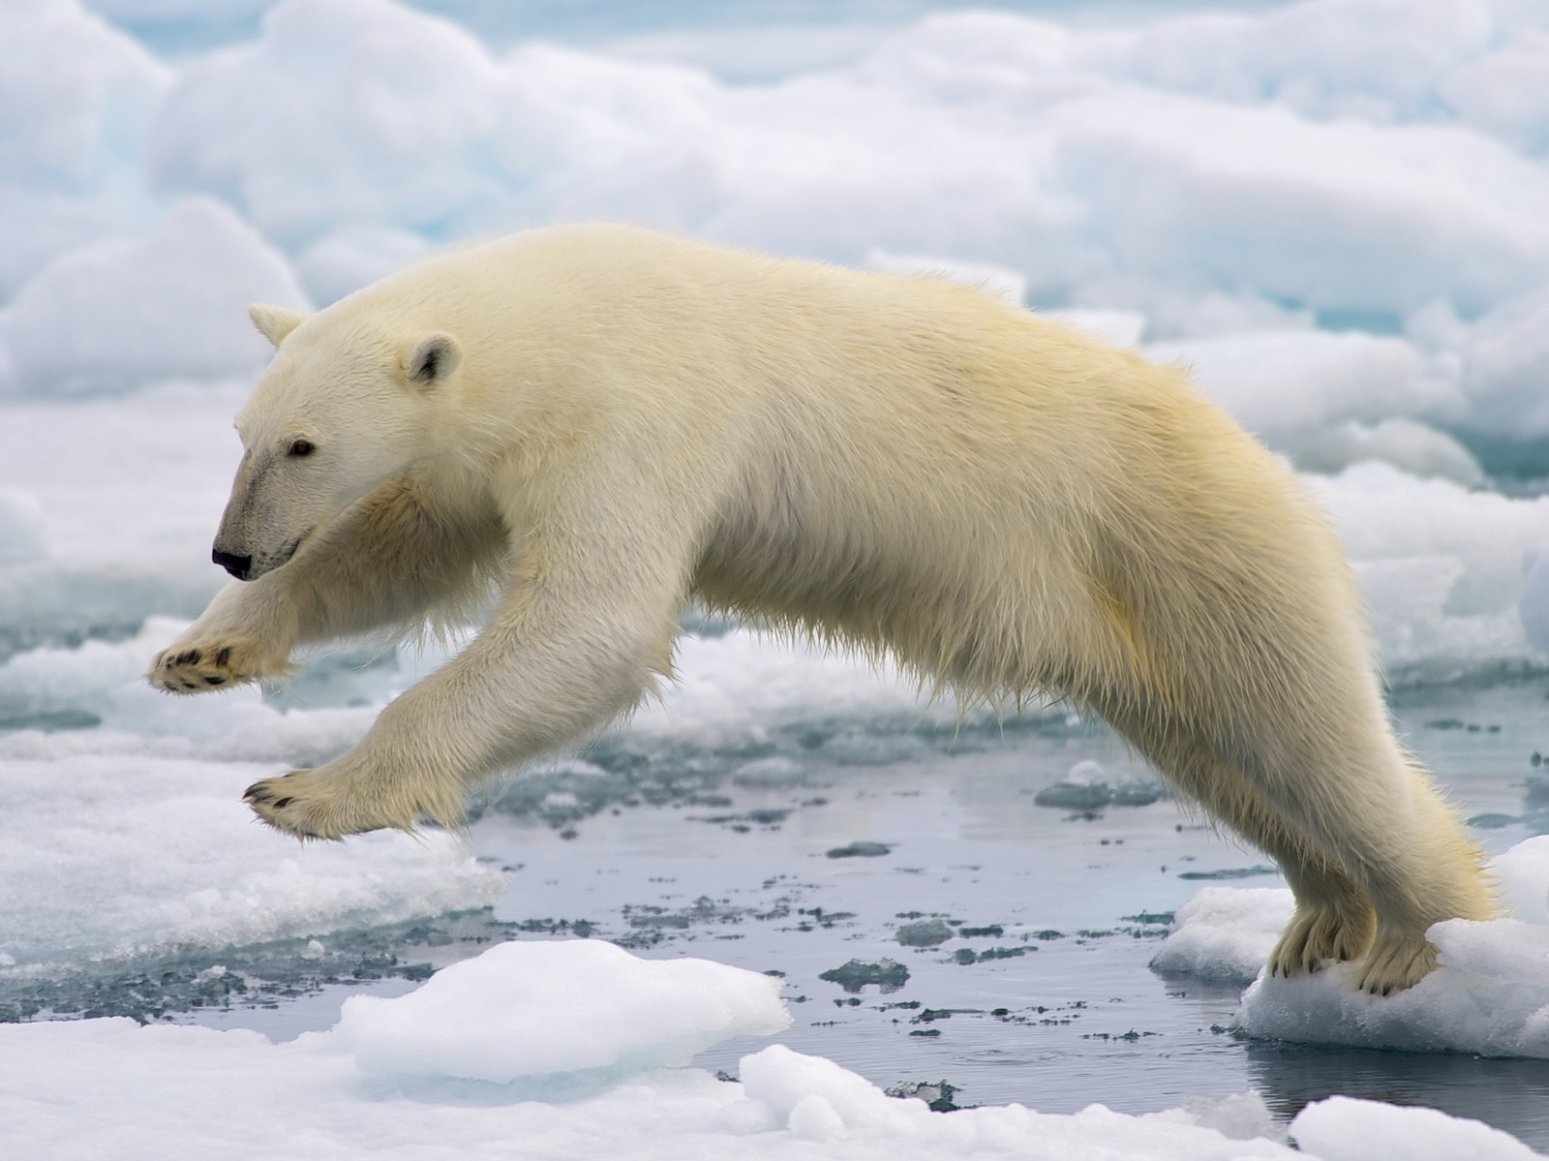
Male polar bears can weigh as much as 10 men (up to 800kg)!
Photo: Bering Land Bridge National Preserve staff

Slide 20
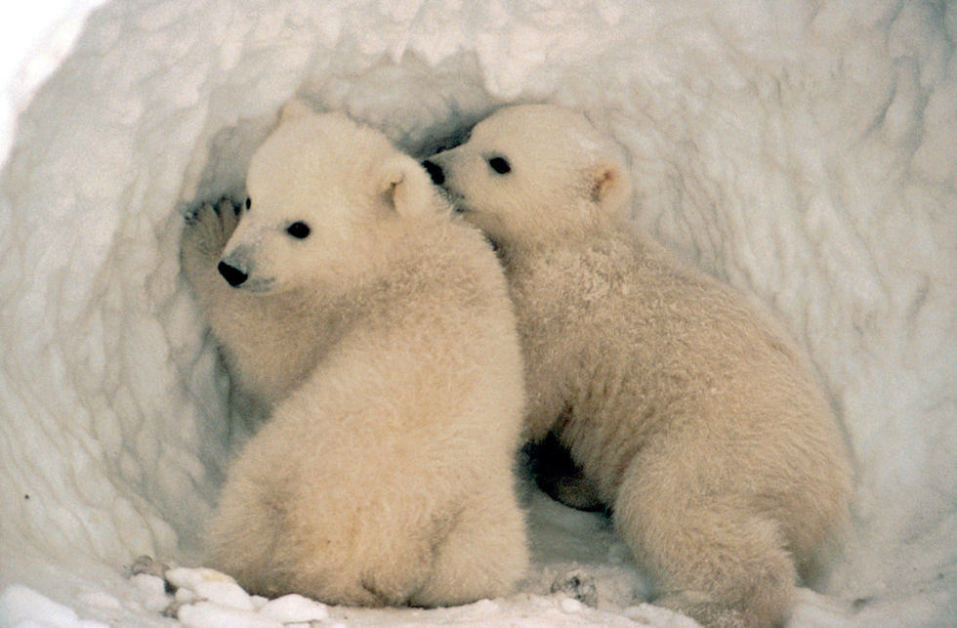
A polar bear’s home is called a den and is where the mother has her babies
Photo: Alaska Region U.S. Fish and Wildlife

Slide 21
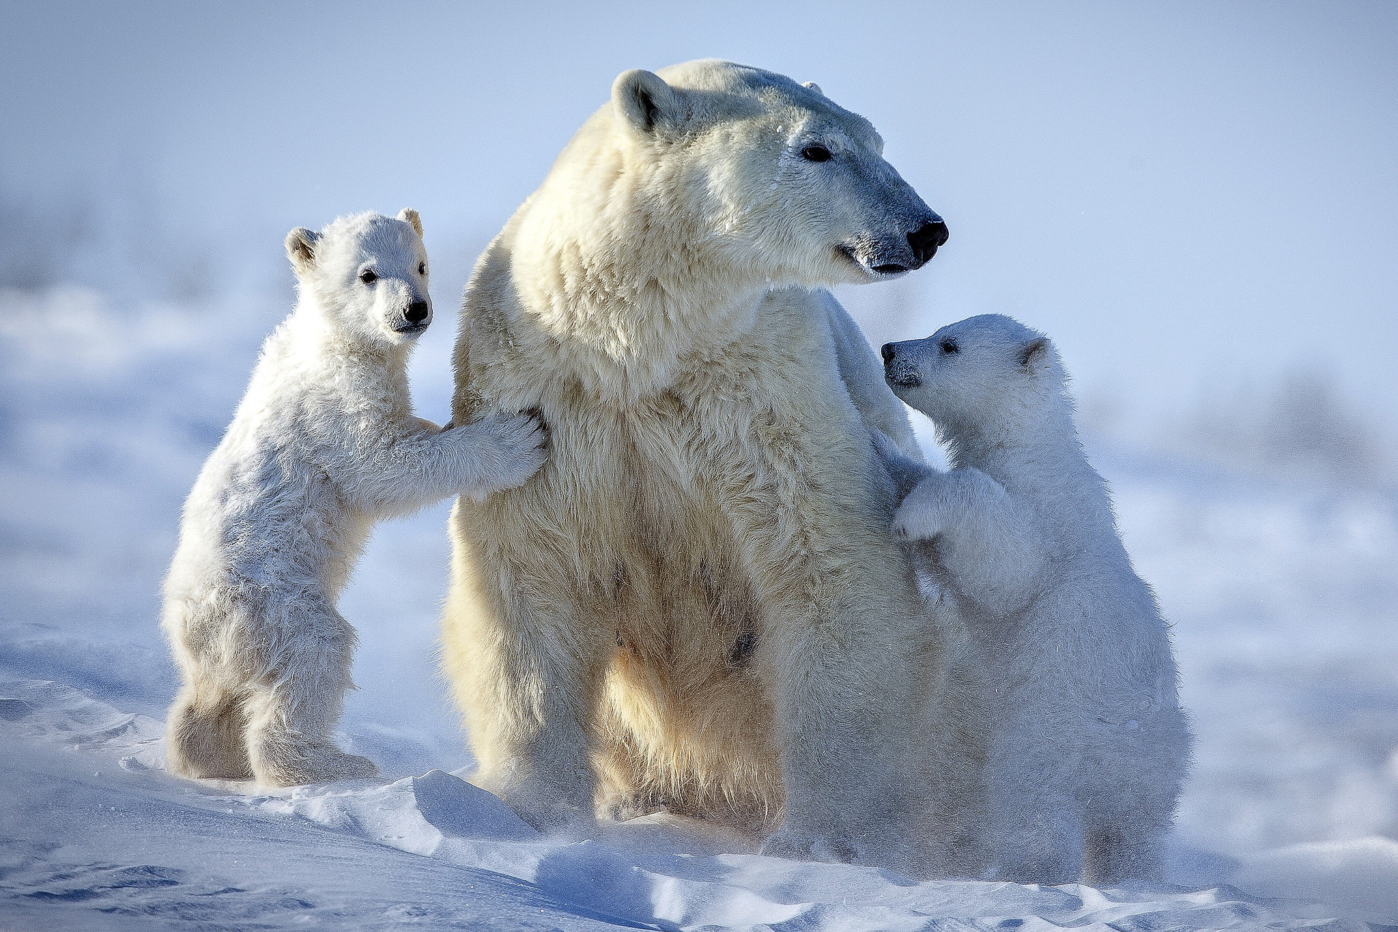
Polar bears have a thick layer of body fat and a water-repellent coat to keep them warm
Photo: U.S. Fish and Wildlife Service
Photo: David Jenkins

Slide 22
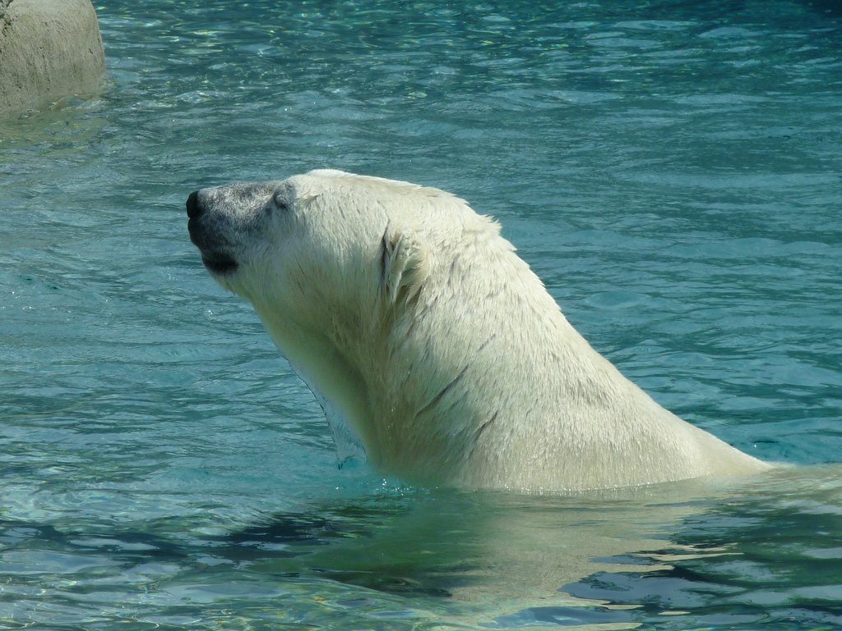
Polar bears are very good swimmers – they can keep up speeds of 6 miles per hour by paddling with their front paws and holding their hind legs flat like a rudder
Photo: Roger Ahlbrand

Slide 23
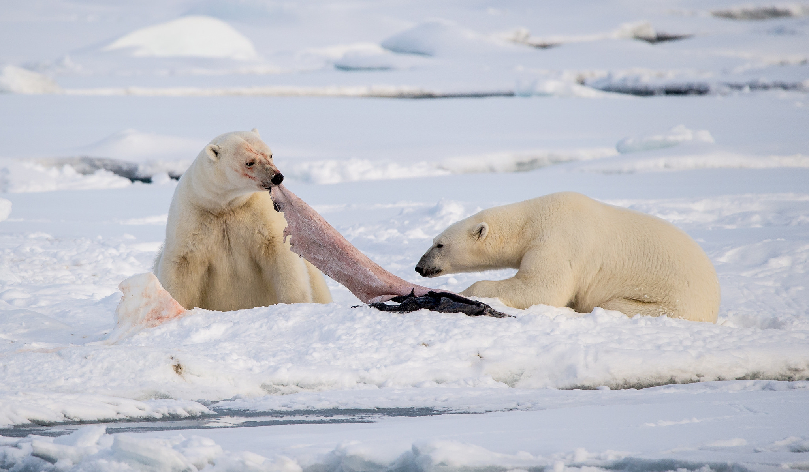
Polar bears have an amazing sense of smell - they can detect a seal in water beneath a metre of compacted snow and from almost a kilometre away
Photo: Mario Nonaka

Slide 24
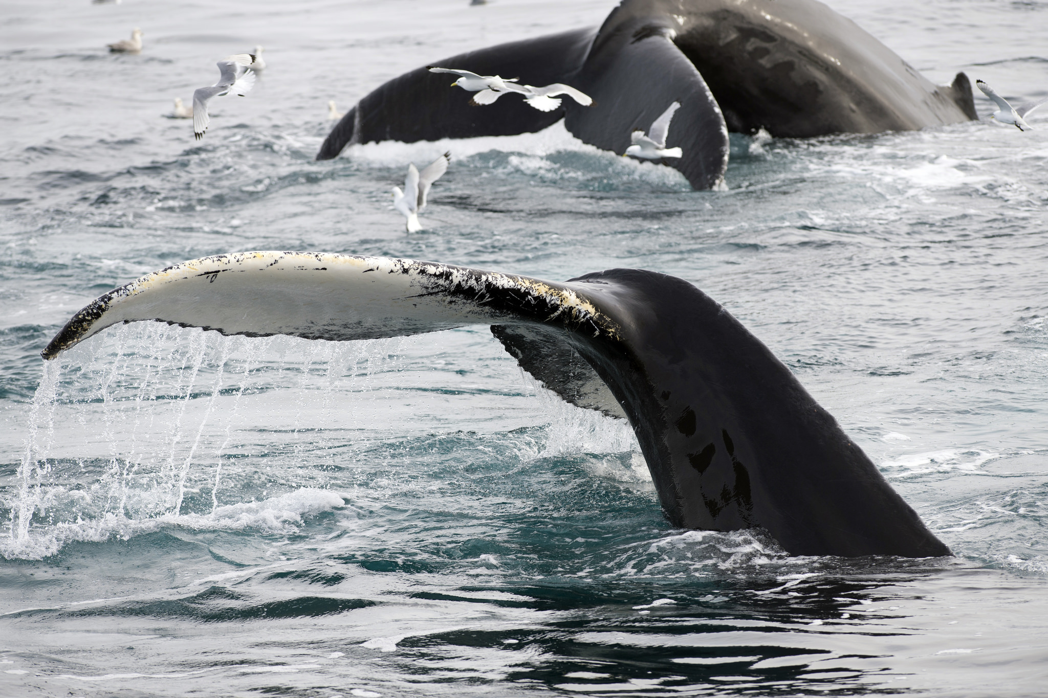
Many whales, such as the humpback, do not live all year round in the Arctic. They migrate to warmer waters to give birth
Photo: Ray Morris

Slide 25
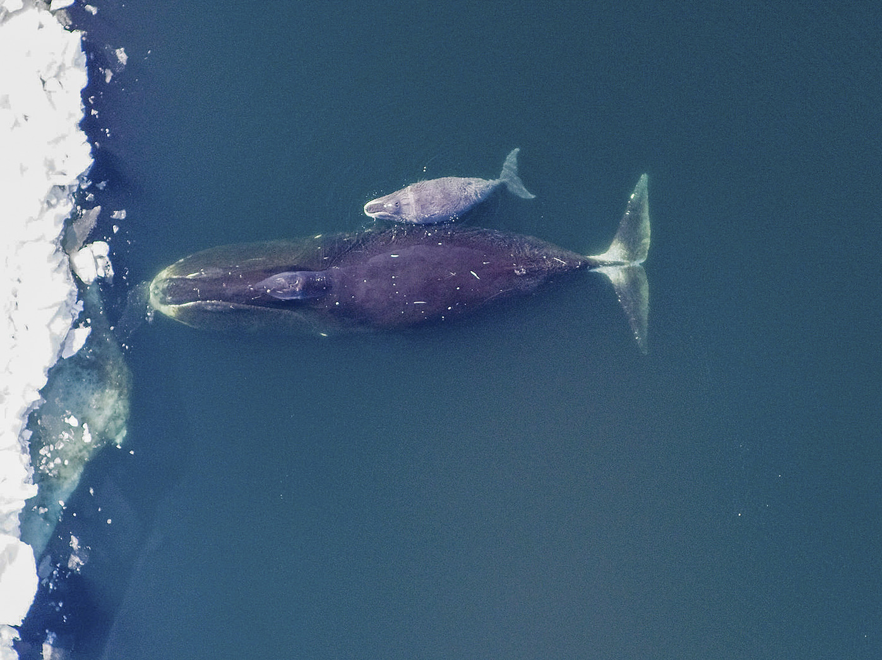
Bowhead whales have huge bow-shaped jaws which enable them to eat large quantities of prey in a single gulp
Photo: IIP Photo Archive

Slide 26
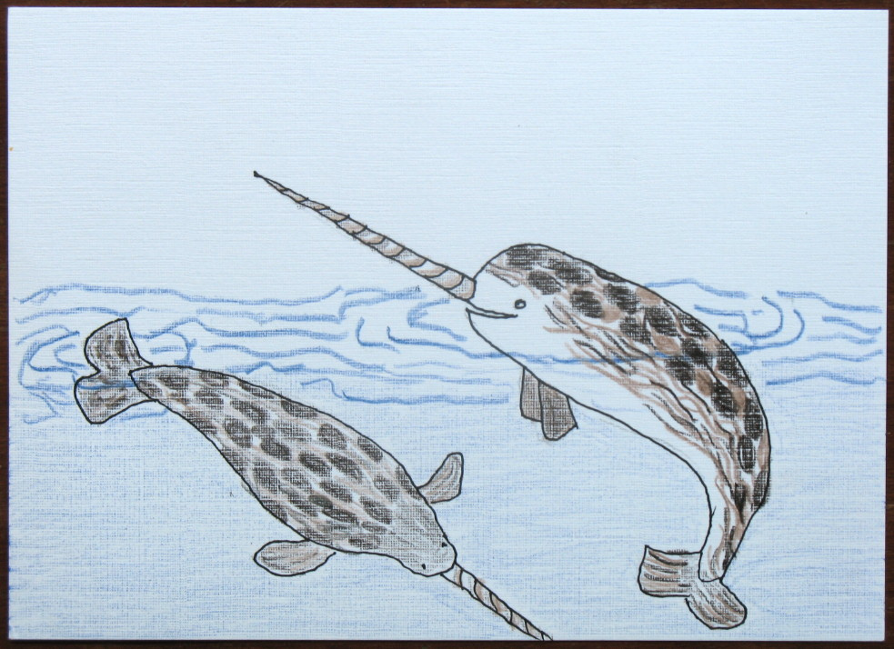
The narwhal whale is famous for its long ivory tusk which spirals several feet forward from its upper lip
Drawing: Tricia J

Slide 27
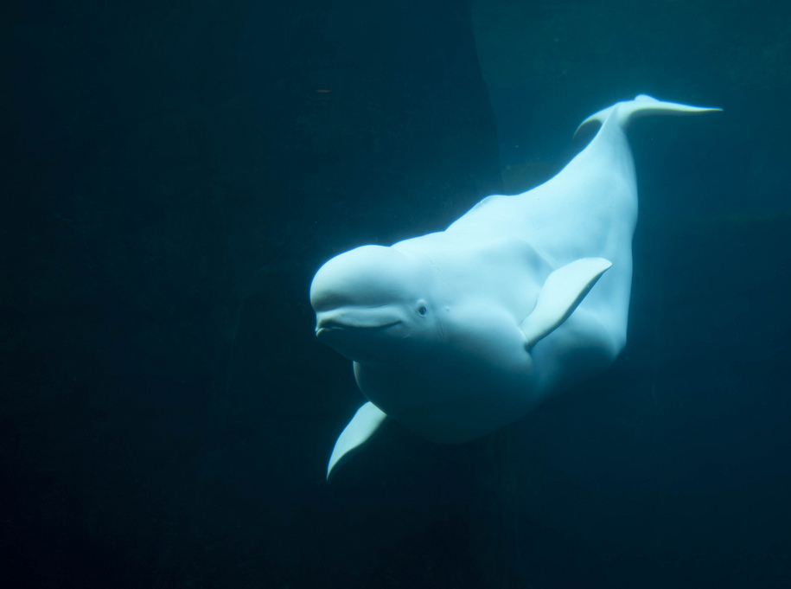
The beluga whale is easy to identify with its distinctive white colour and prominent forehead
Photo: Jason Pier in DC

Slide 28
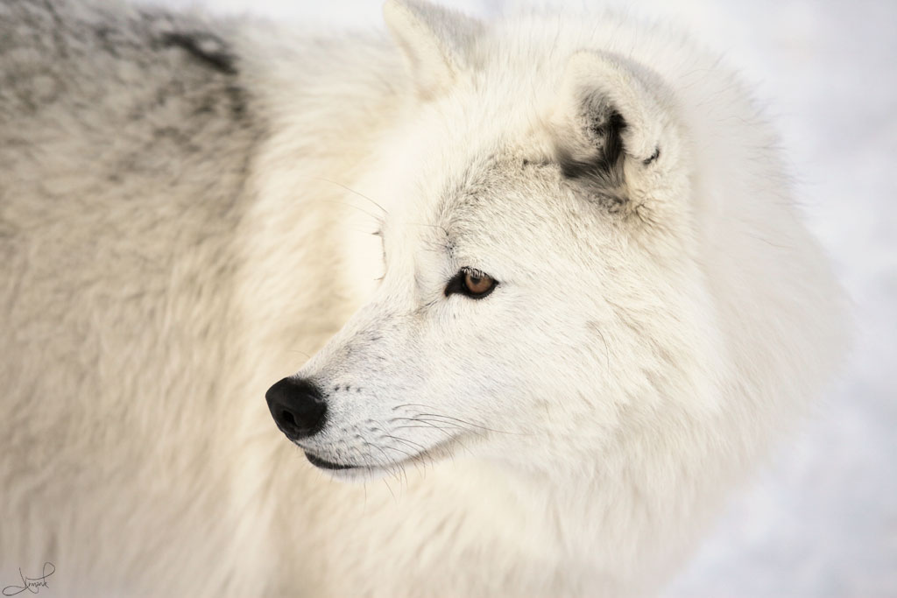
The Arctic wolf has small hairs between the pads of its feet and long, thick fur to keep it warm
Photo: tsaiproject

Slide 29
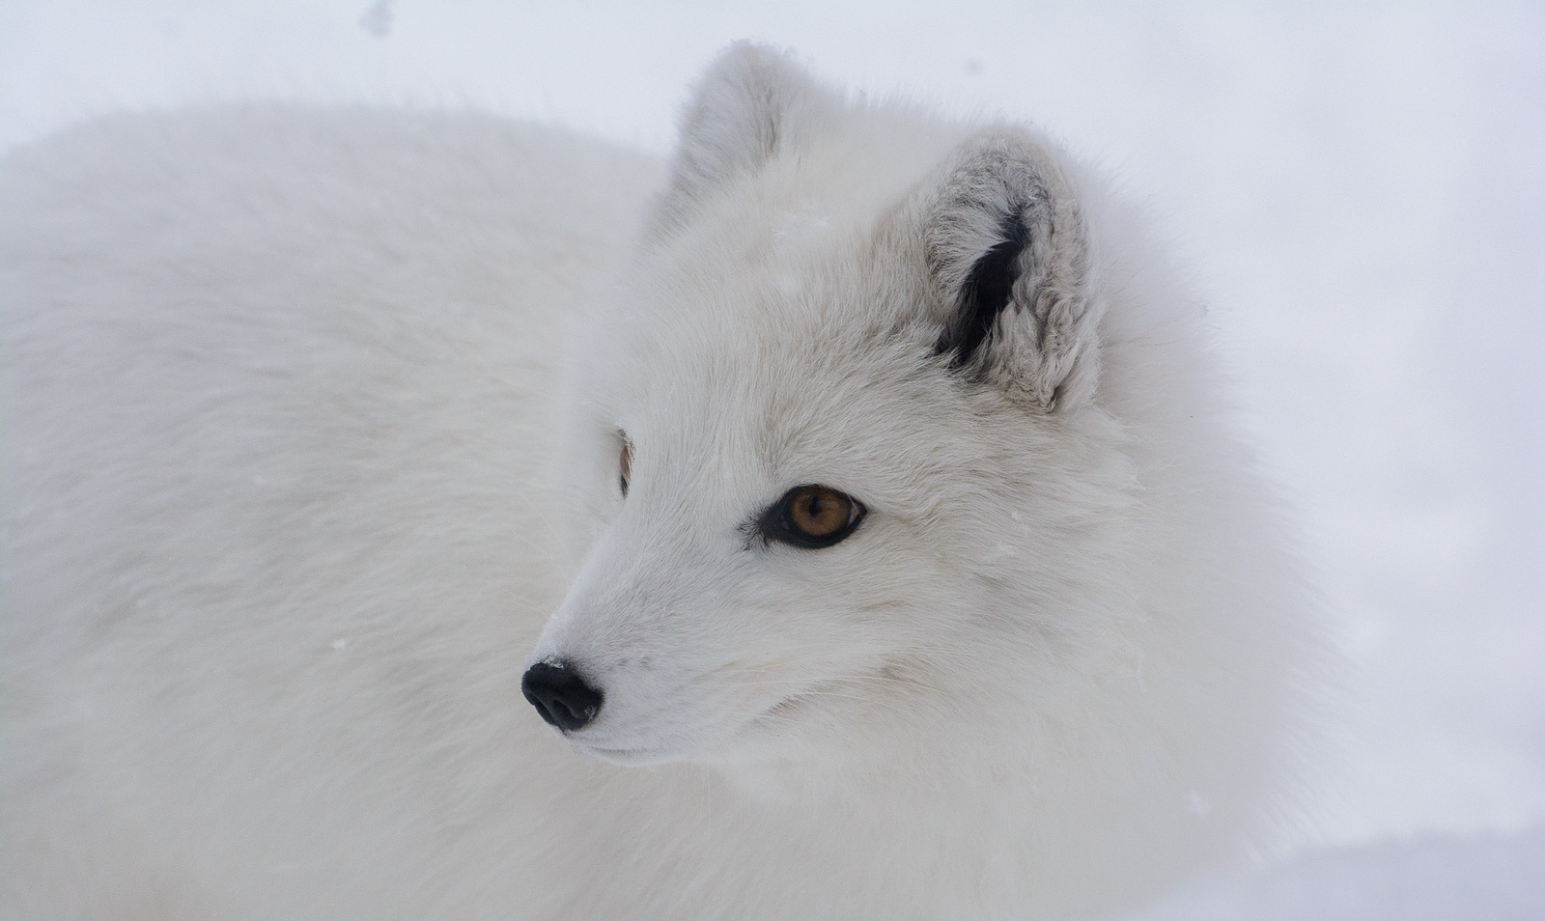
An Arctic Fox has white fur in winter and brown in summer, so it blends into its surroundings
Photo: Claudine Lamothe
Photo: Eric Kily

Slide 30
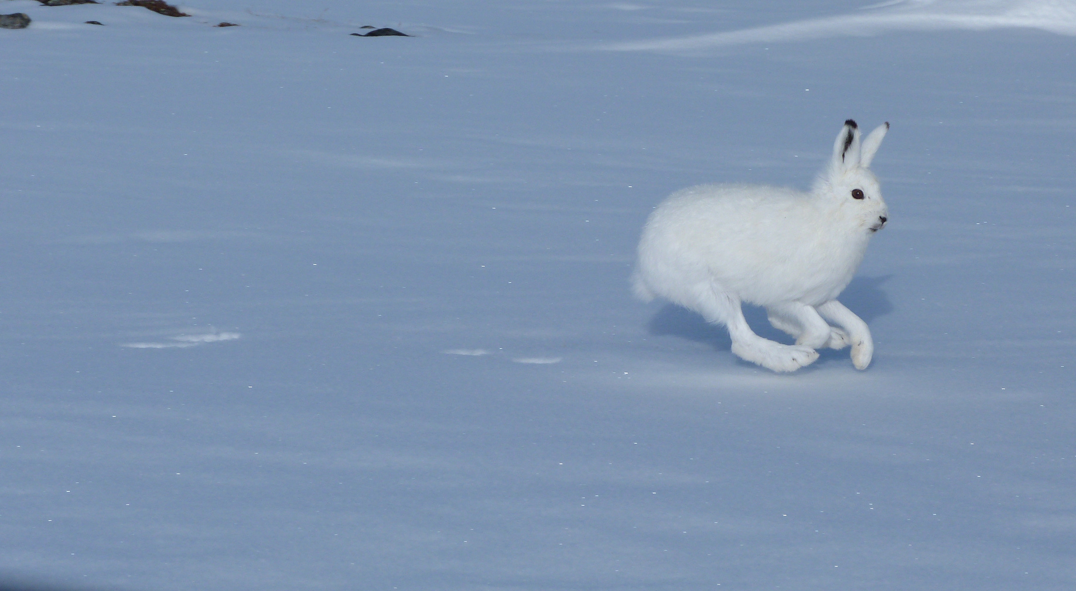
The Arctic hare can reach speeds of up to 40 miles per hour, helping it escape from predators
Photo: Fiona Hunt

Slide 31
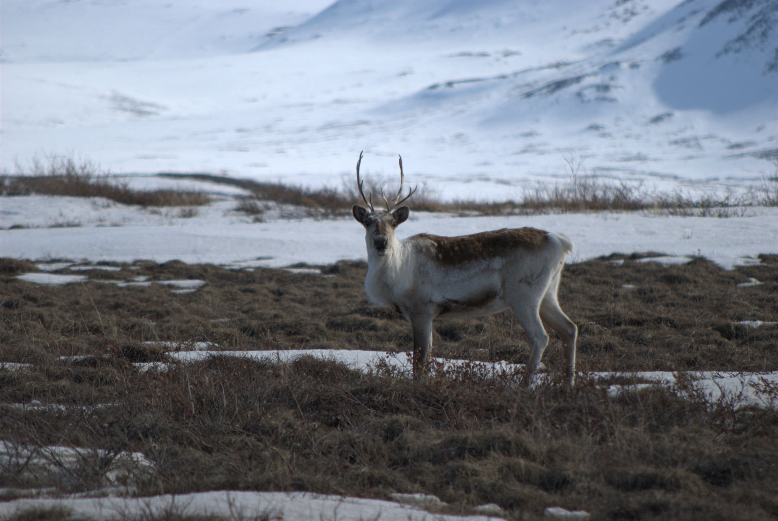
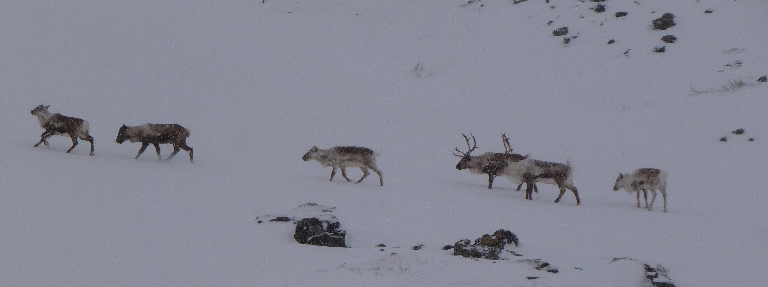
Reindeer can walk miles in search of food - in long lines following each other across the snow
Reindeer and caribou are the same species. But caribou have never been domesticated, unlike reindeer.
Photo: U.S. Geological Survey
Photo: Lukas Polacek

Slide 32
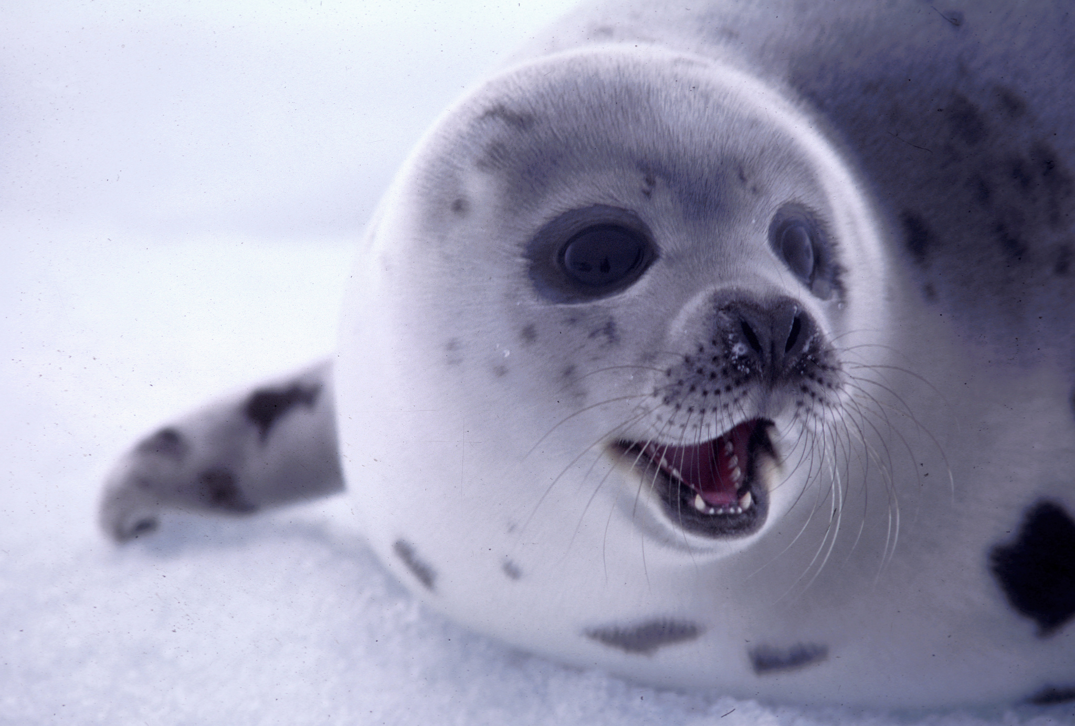
Seals have a thick layer of fat called blubber – this provides insulation and helps them survive in cold water
Photo: International Fund for Animal Welfare

Slide 33
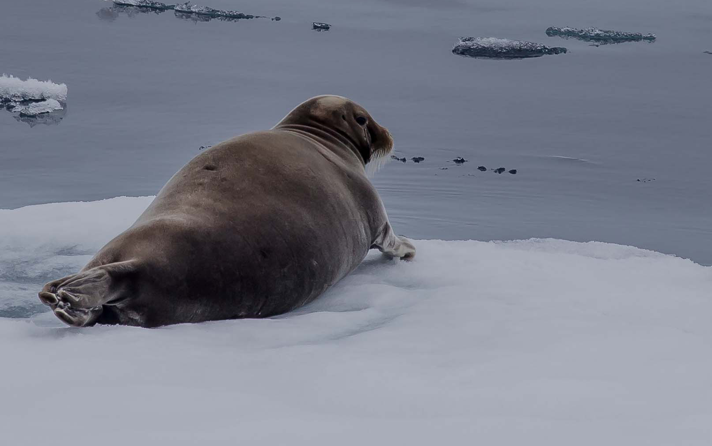
Bearded seals lie on the edge of the ice looking downward into the water, so they can get away if a predator approaches!
Photo: Smudge 9000

Slide 34
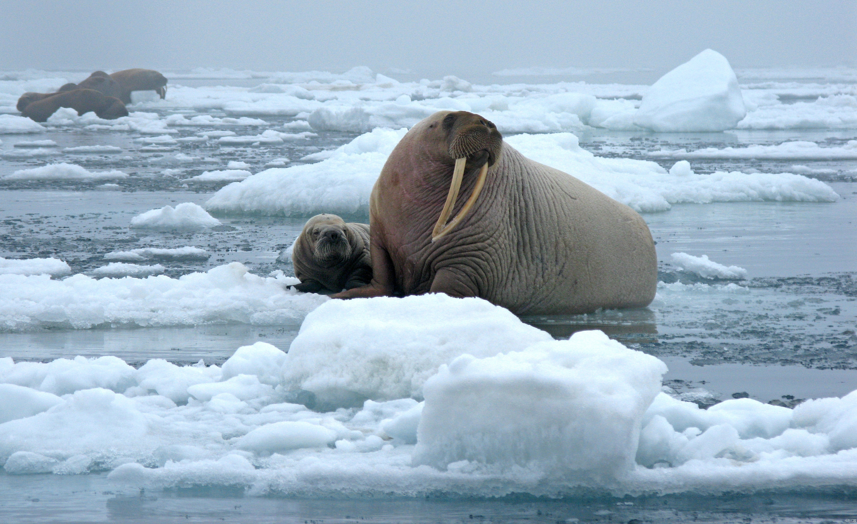
As well as having blubber to keep them warm, walruses can slow their heartbeats to withstand the freezing temperatures
Photo: U.S. Geological Survey

Slide 35
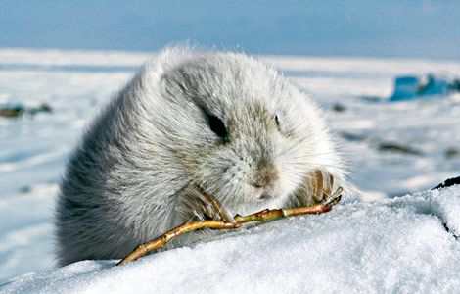
Lemmings stock up on grasses before winter and burrow under the snow to find food
Photo: Karen Kohn

Slide 36
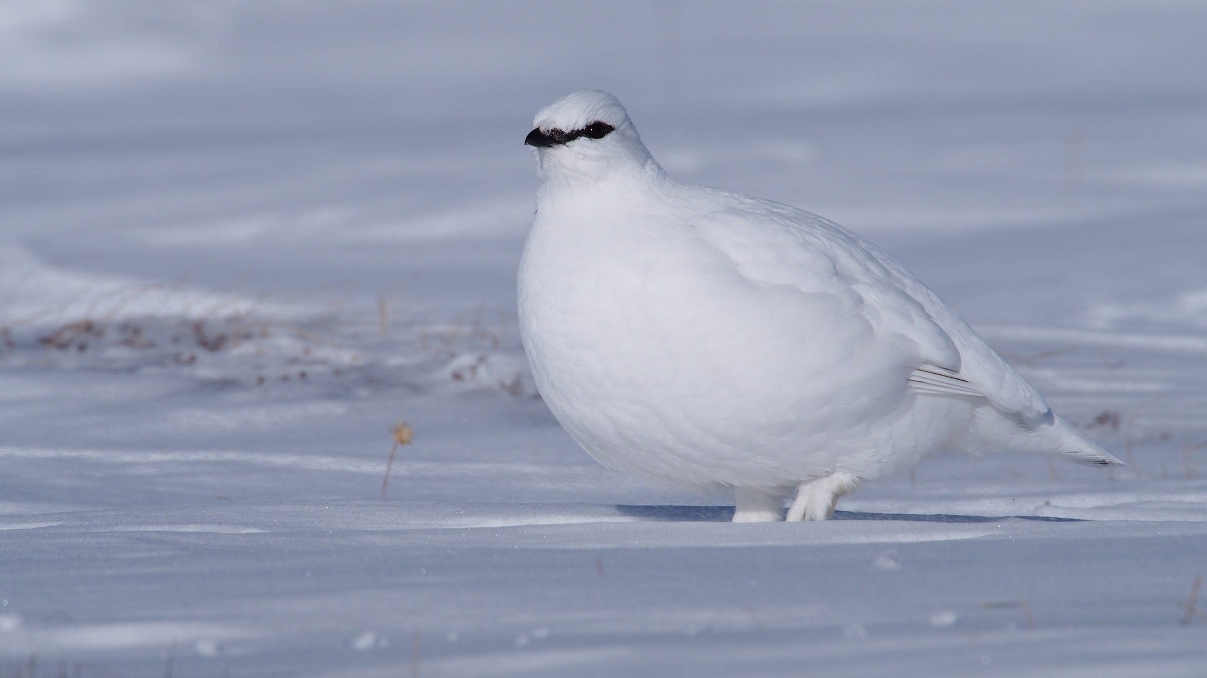
The Rock Ptarmigan is pure white in winter and changes to greyish brown in summer to help it hide from predators
Photo: Fiona Hunt

Slide 37
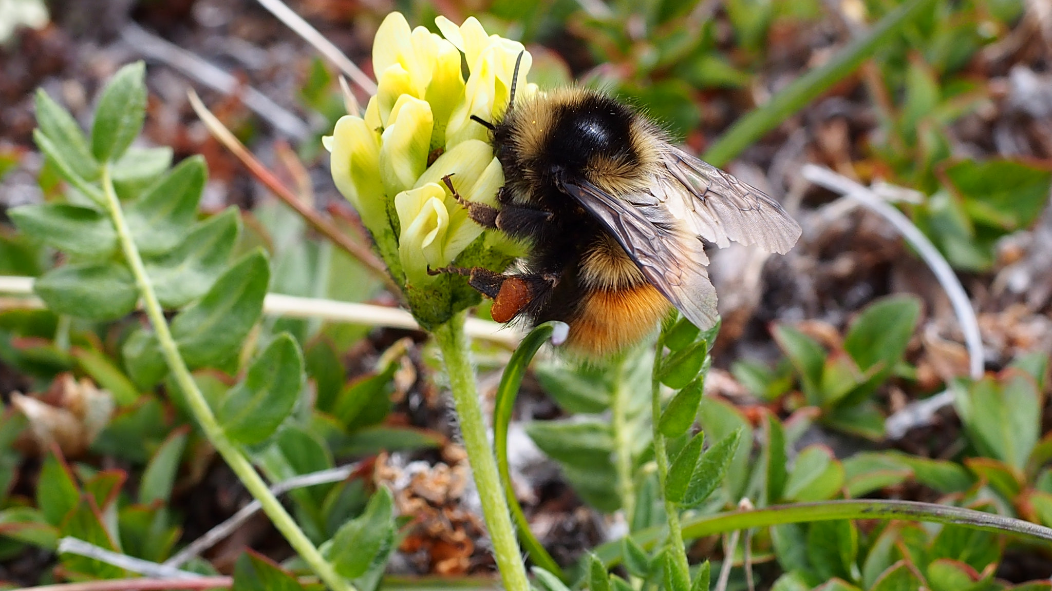
Arctic bees have adapted to cold weather by growing thick fur on their bodies and beating their wings to increase their body heat
.
Photo: Fiona Hunt

Slide 38
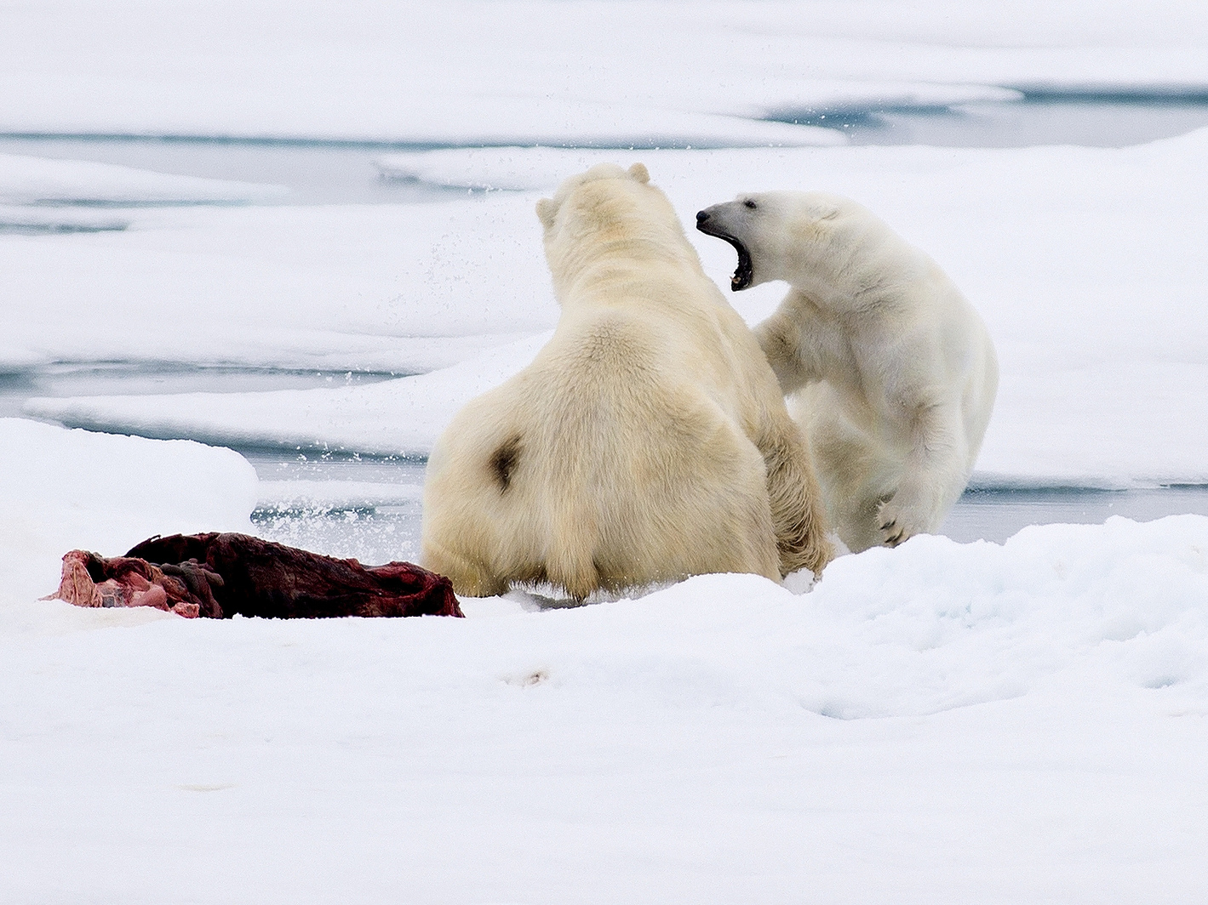
4. HOW DO ARCTIC ANIMALS DEPEND ON EACH OTHER?
Photo: Ray Morris

Slide 39
Simple Arctic Food Chain
Polar bear
Ringed seal
Arctic cod
Krill
Phytoplankton e.g. algae
The polar bear is at the top of the Arctic’s land-based food chain

Slide 40
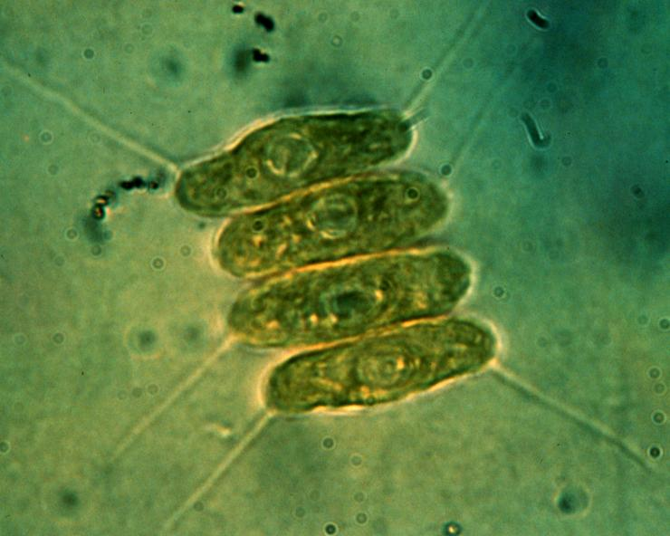
Microscopic phytoplankton, such as green algae, form the basis of the Arctic marine food chain.
Photo: NOAA Great Lakes Environmental Research Laboratory

Slide 41
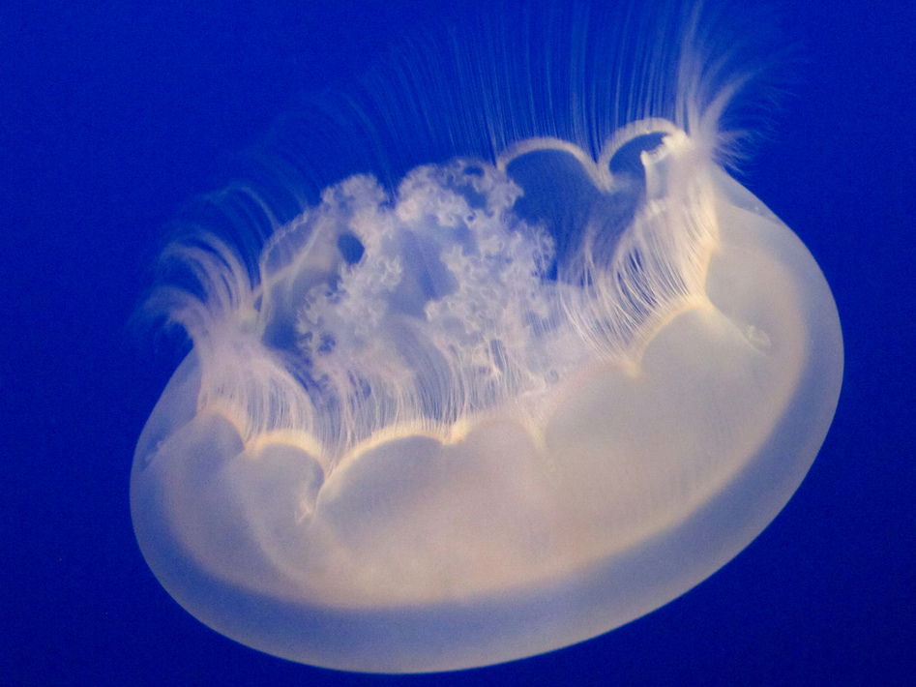
Zooplankton are tiny free-floating animals that live in the ocean
Photo: James Gaither

Slide 42
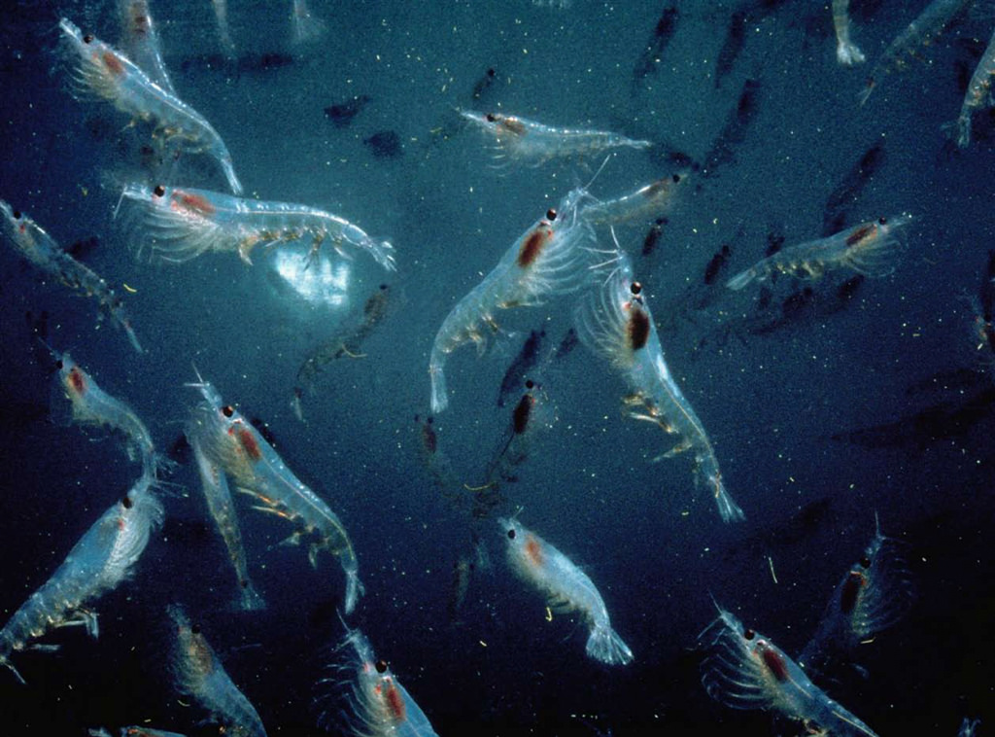
Krill are a vital part of the Arctic food chain as they are eaten by fish, birds, seals and the baleen whale
Photo: Norkrill

Slide 43
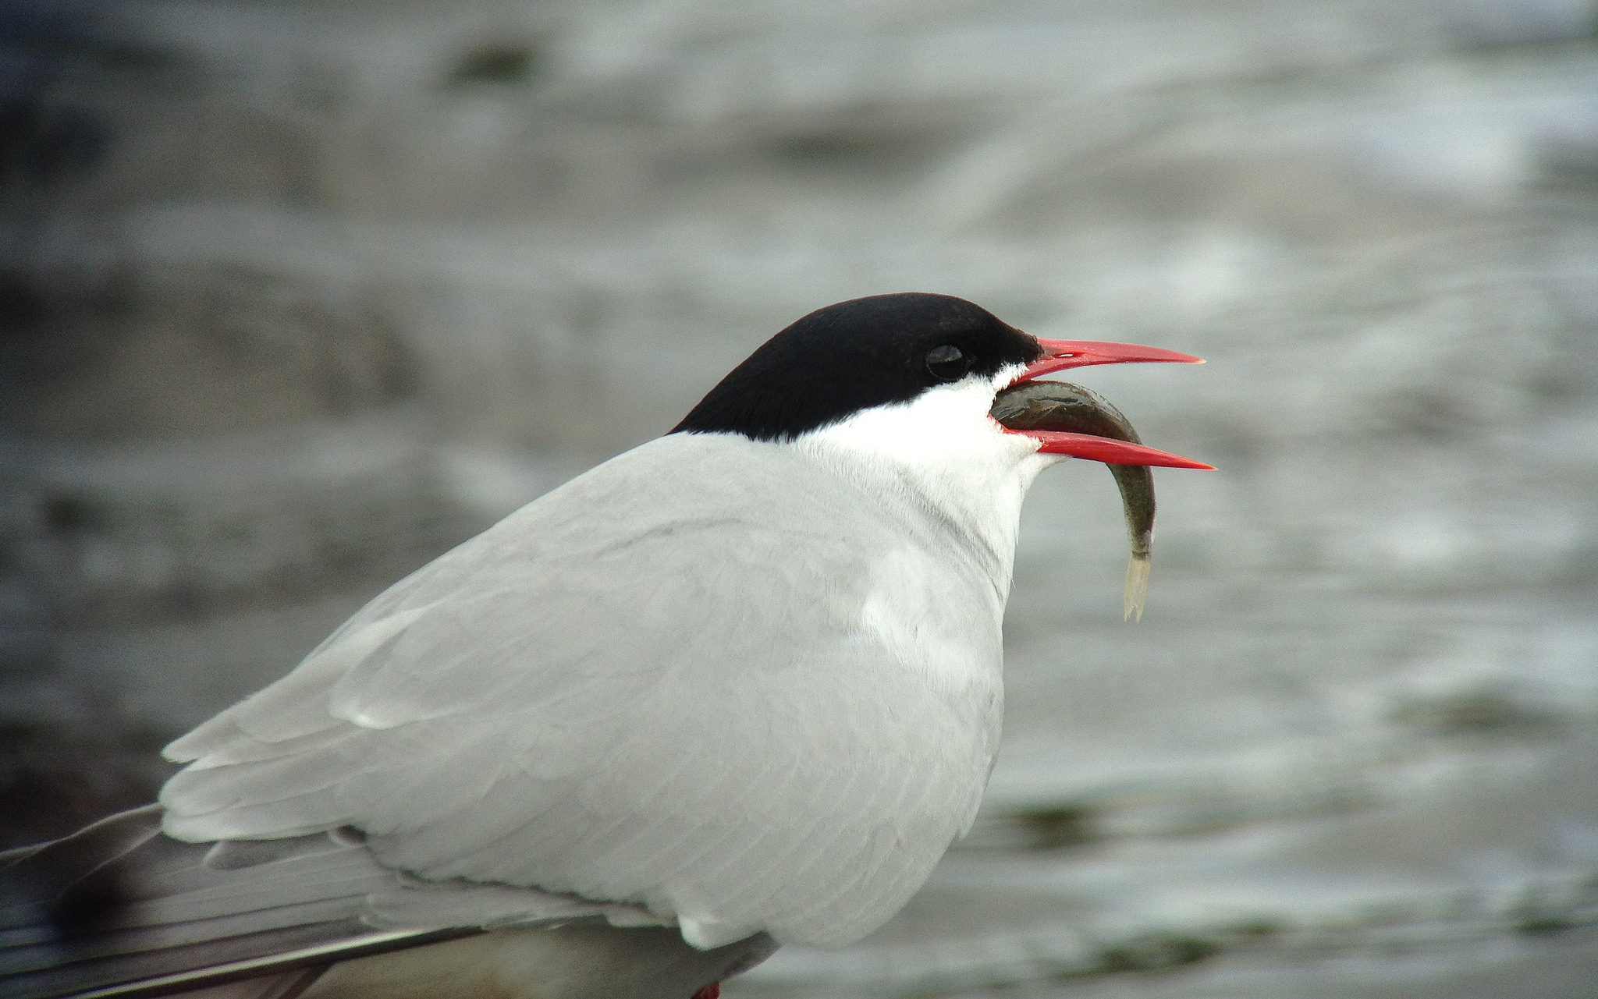
The Arctic Ocean is teeming with fish which are eaten by seals, polar bears, other mammals and birds such as this Arctic Tern
Photo: Tim Lenz

Slide 44
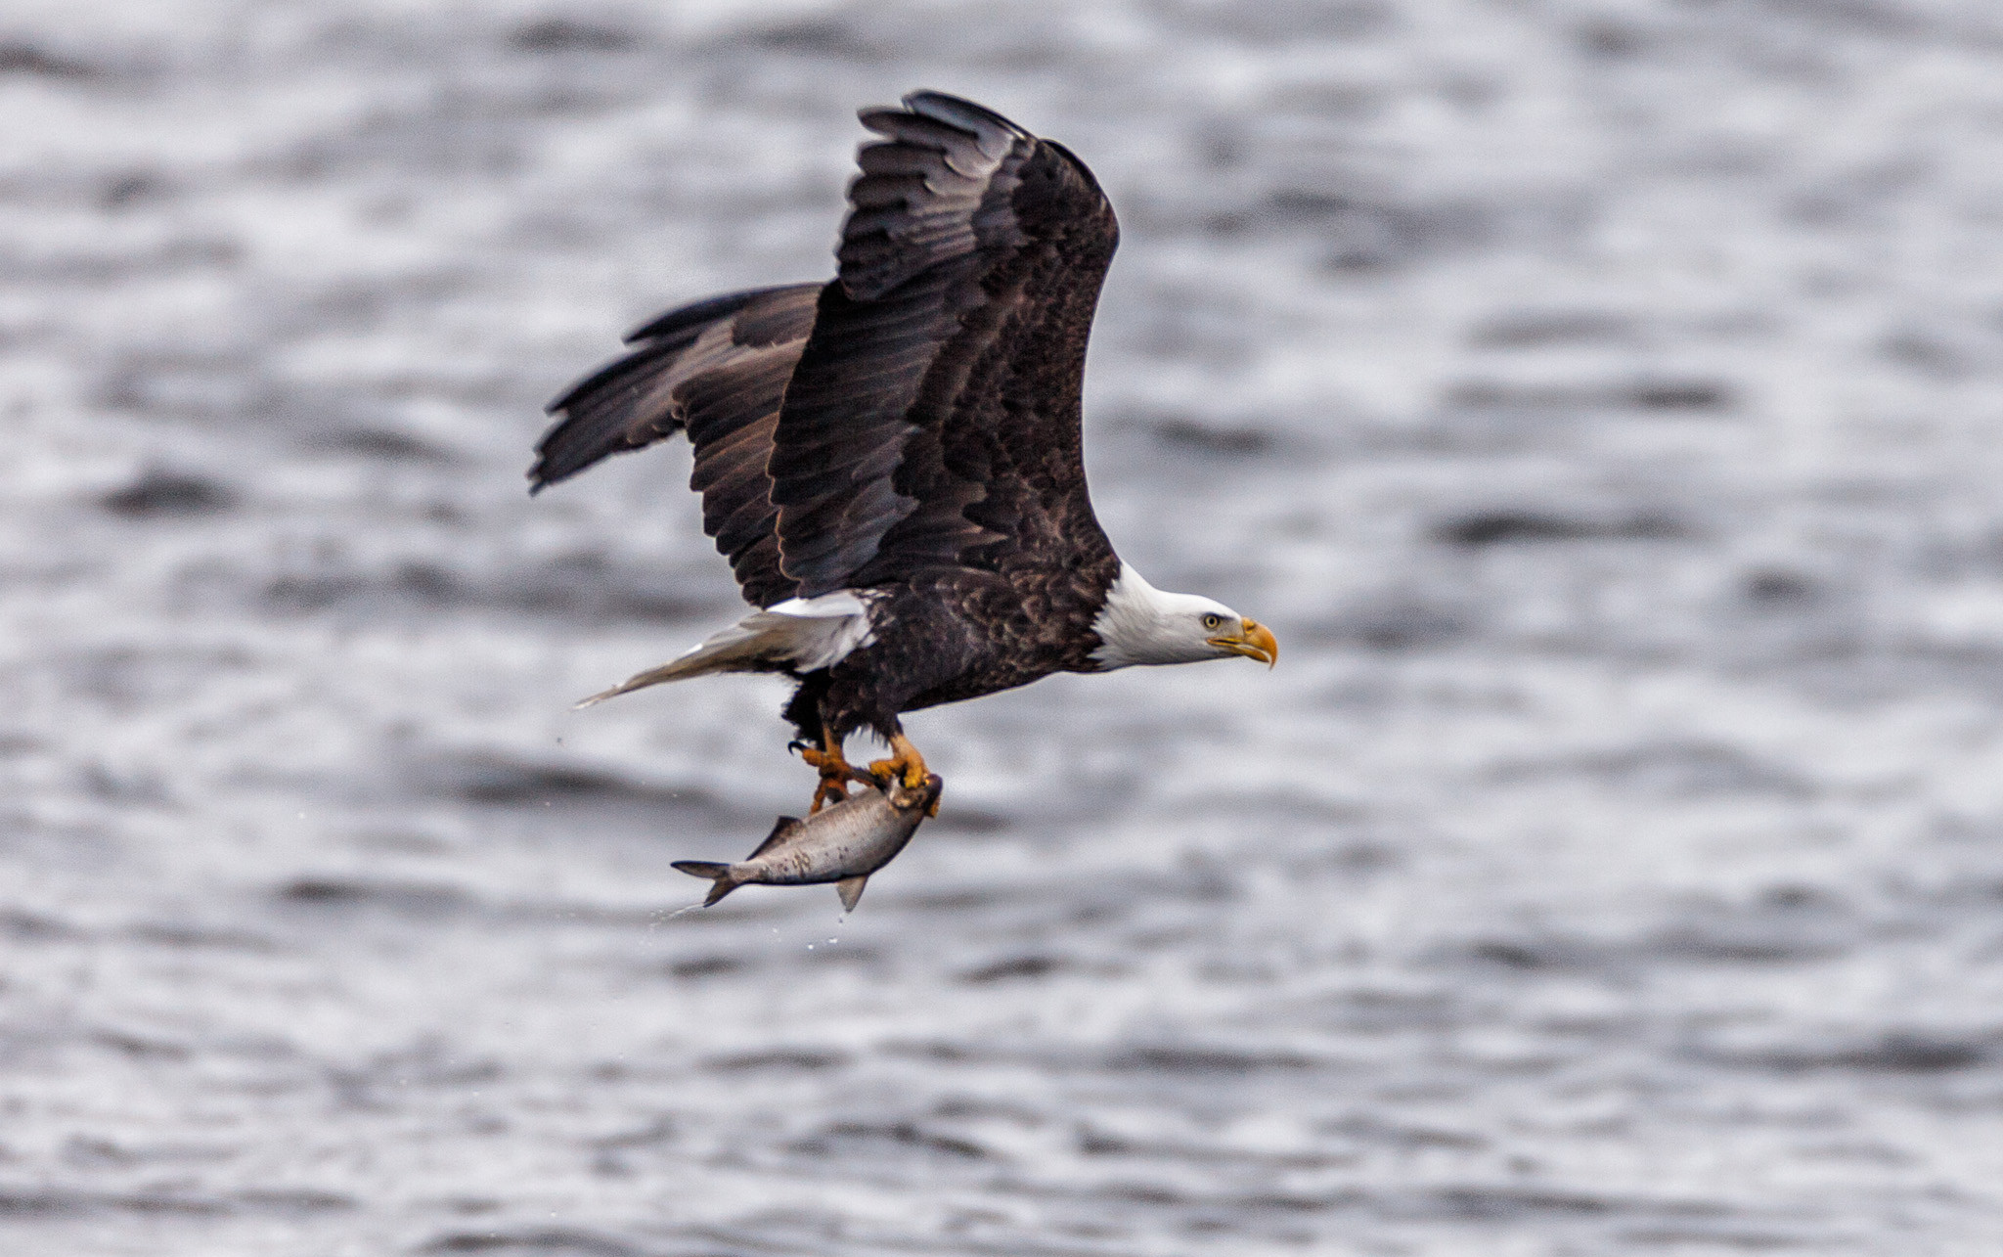
Many birds live in the Arctic Circle. The bald eagle is often seen swooping down to snatch fish out of the water
Photo: Tim Lumley

Slide 45
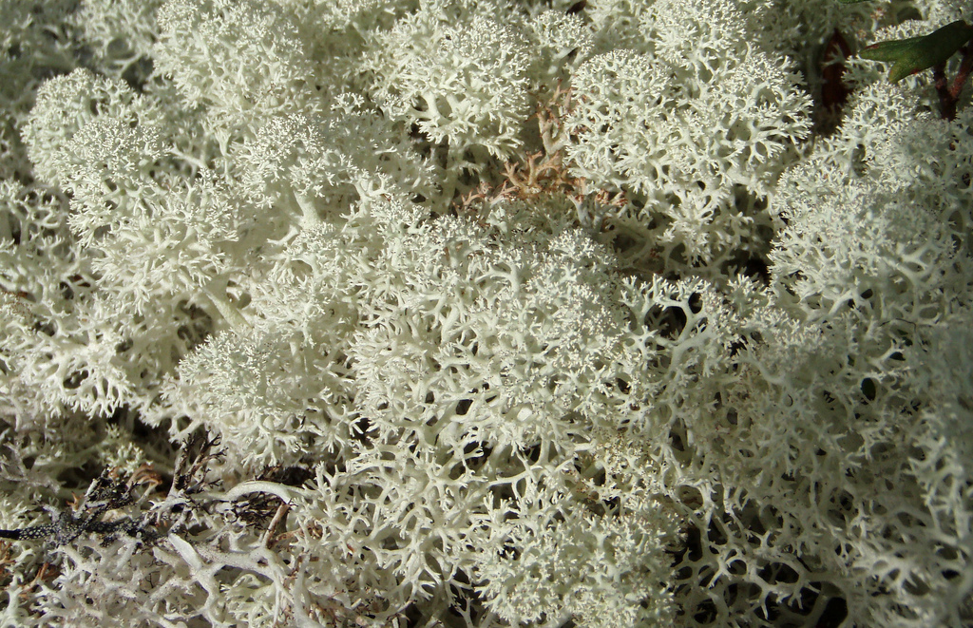
White moss, also known as ‘reindeer moss’ is an important food for reindeer
Photo: Leslie Main Johnson

Slide 46
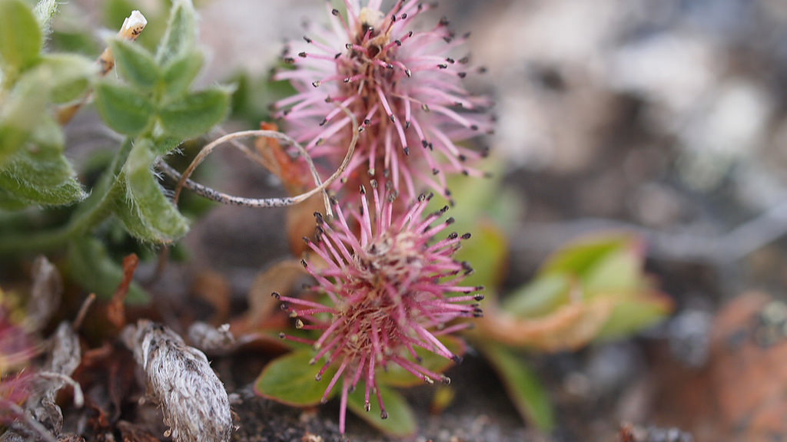
Arctic willow is food for caribou and Arctic hares
Photo: Fiona Hunt

Slide 47
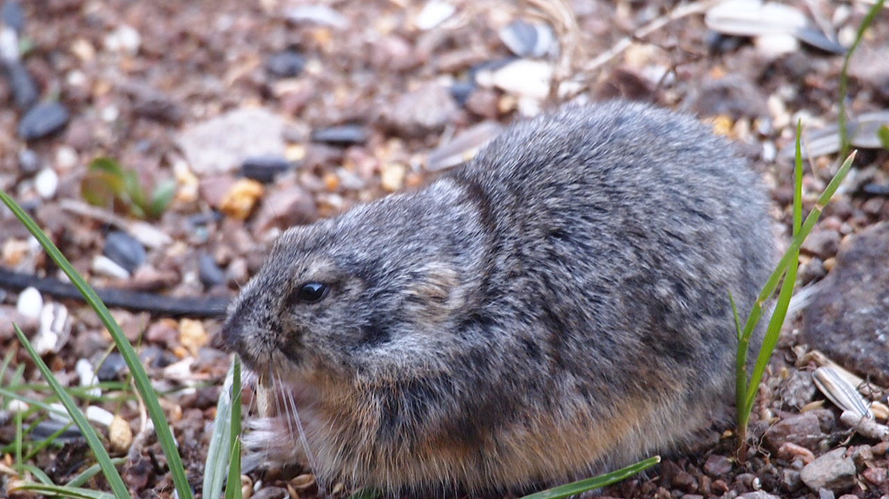
The lemming is a small Arctic mammal. It’s a herbivore with a main diet of moss and grass
Photo: Fiona Paton

Slide 48
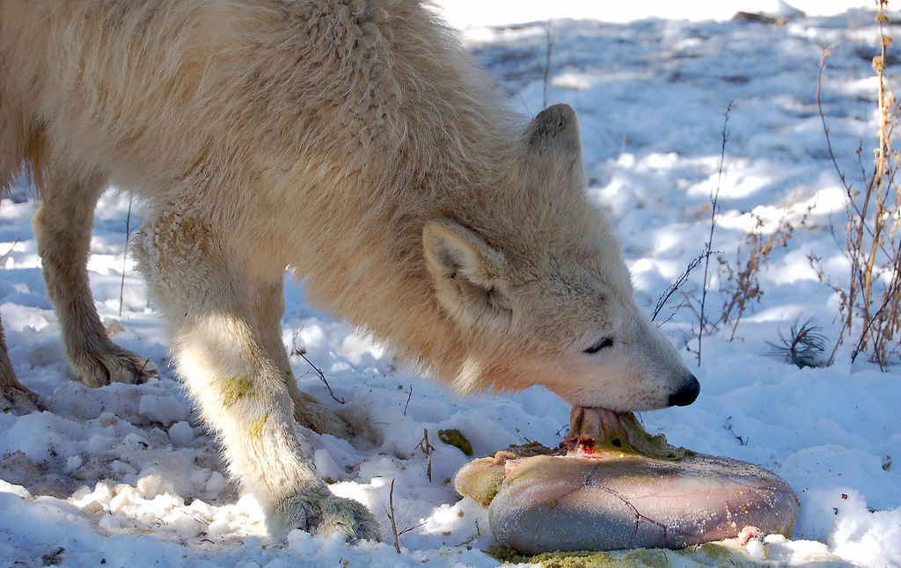
Large mammals, such as the Arctic wolf, feed on smaller animals, fish and birds
Photo: Kamia Wolf
Photo: Gregory “Slobirdr” Smith

Slide 49
The whale is at the top of the Arctic’s marine based food chain
Baleen whale
Krill
Phytoplankton e.g. algae
The secret to the success of the baleen whale is that the food chain is short so energy is transferred efficiently

Slide 50
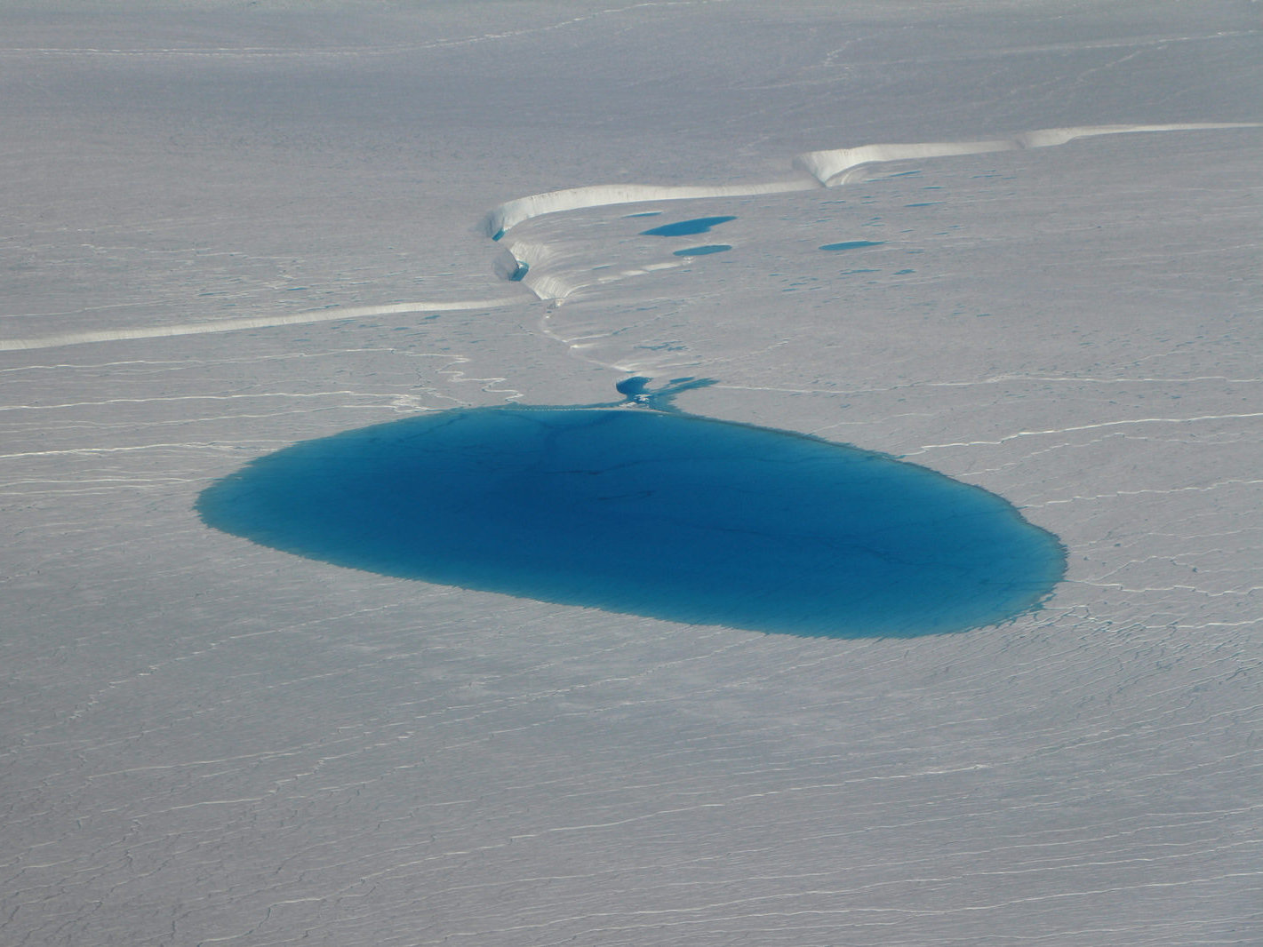
5. HOW IS CLIMATE CHANGE AFFECTING THE ARCTIC?
Photo: NASA’s Marshall Space Flight Centre

Slide 51

By burning fossil fuels, humans are increasing the amount of carbon dioxide in the atmosphere and increasing the speed of climate change
Photo: Darren Flinders:

Slide 52

As climate change has warmed the Earth, global sea temperatures have risen
Photo: jomilo75

Slide 53

Rising sea temperatures means summer sea ice is disappearing in the Arctic
Photo: NASA Goddard Space Flight Centre

Slide 54
The Arctic is warming at a rate of almost twice the global average because of the albedo effect
Ocean
warms
Arctic sea ice melts and shrinks
Less heat reflected and more absorbed

Slide 55

Polar bears are directly affected by climate change and predicted to decline 30% by 2050
Photo: Alaska Region U.S. Fish & Wildlife Service

Slide 56

Rapid sea ice loss causes seal pups to be separated from their mothers during the milking period
Photo: nutmeg66

Slide 57

Melting glaciers are contributing to global sea level rises
Photo: Amanda Graham

Slide 58
To find out more, please visit
ypte.org.uk
Registered charity number 1153740
Creating a better future by inspiring young people to look after our world

Slide 59
Credits
YPTE would like to thank all the amazing photographers on Flickr who allow the use of their photos for non-commercial purposes.
Your photos are helping young people to learn more about environmental issues. We couldn’t have created this presentation without you!

