Slide 1
Have you ever spotted….?

Slide 2
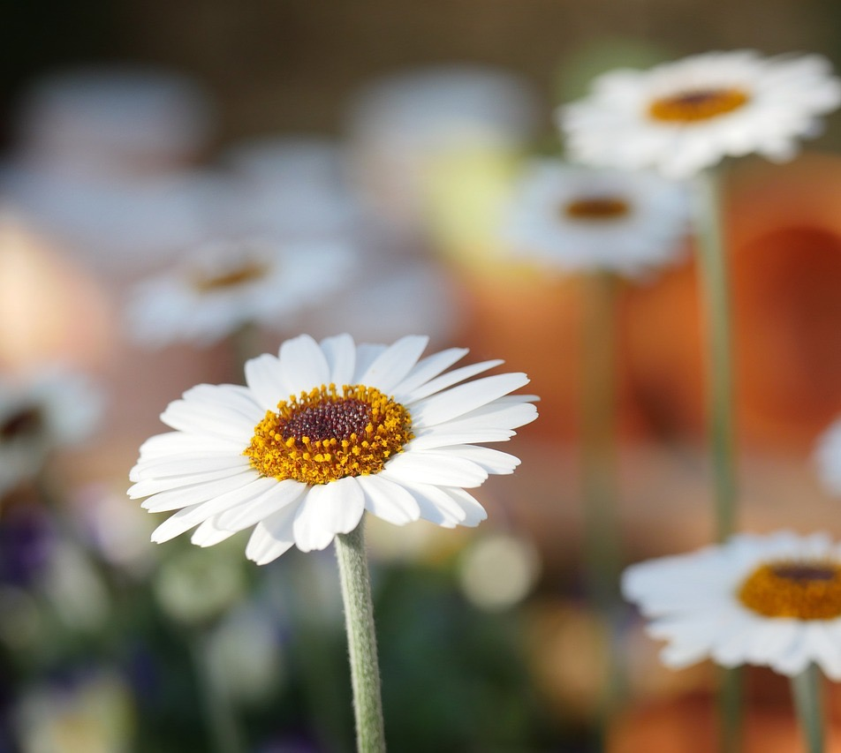
Notes:
Daisies
https://pixabay.com/photos/nature-daisies-daisy-flower-plant-3184889/

Slide 3
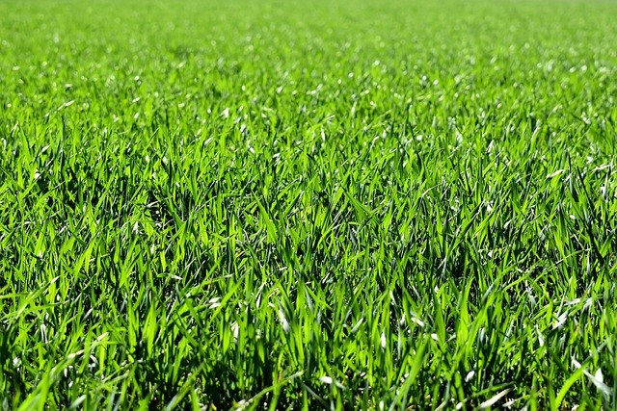
Notes:
Grass
https://pixabay.com/photos/grass-lawn-garden-park-ground-1659054/

Slide 4
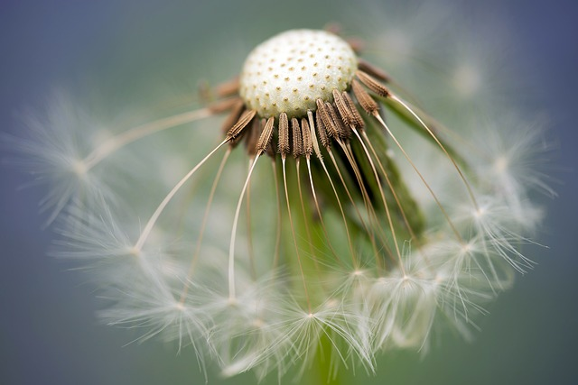
Notes:
Dandelion
https://pixabay.com/photos/flower-dandelion-wildflower-nature-7700011/

Slide 5
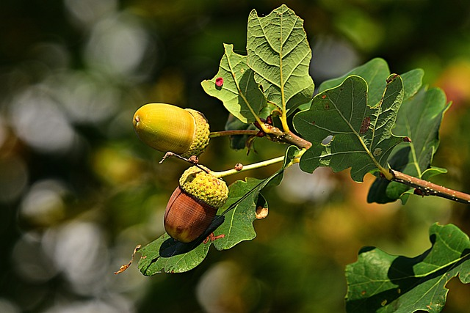
Notes:
Acorns on an oak tree branch
https://pixabay.com/photos/acorn-nut-branch-oak-tree-food-3694485/

Slide 6
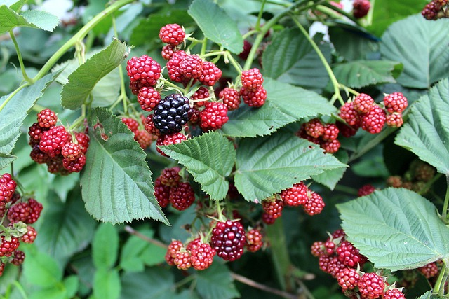
Notes:
Blackberry bush
https://pixabay.com/photos/blackberries-fruit-savage-field-2666088/

Slide 7
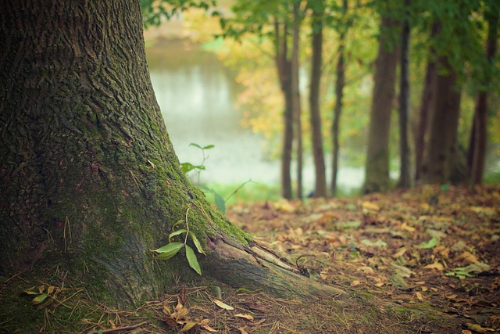
Notes:
Tree
https://pixabay.com/photos/trees-wilderness-nature-woods-3822149/

Slide 8
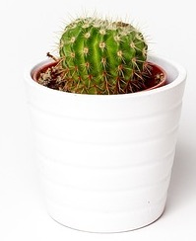
Notes:
Cactus
https://pixabay.com/photos/cactus-minimalism-plant-pot-white-1842095/

Slide 9
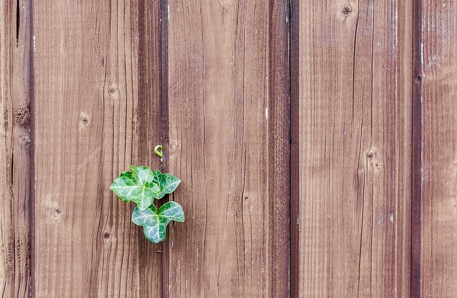
Notes:
Ivy growing out of a wall

Slide 10
What other plants have you spotted?

