Slide 1
What is community science?
The National Education Nature Park

Slide 2

Discuss the following questions…
What is science?
What is a scientist?
What do scientists do?
How do scientists work to help biodiversity?
What questions do you have about the natural world?
Notes:
Highlight that there are no right or wrong answers to these questions, and people have discussed these questions for hundreds of years.
One way to think about science is that it is a process of learning about the natural world through observation and enquiry, so anybody is a scientist if they are gathering and interpreting information about the world around them to answer questions they have. In other words, we can all be scientists, the importance is being curious and asking lots of questions and thinking about how they might be answered.

Slide 3
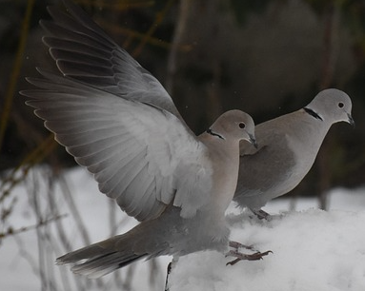
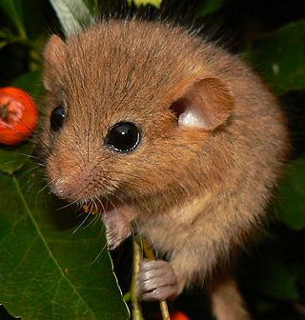
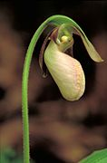
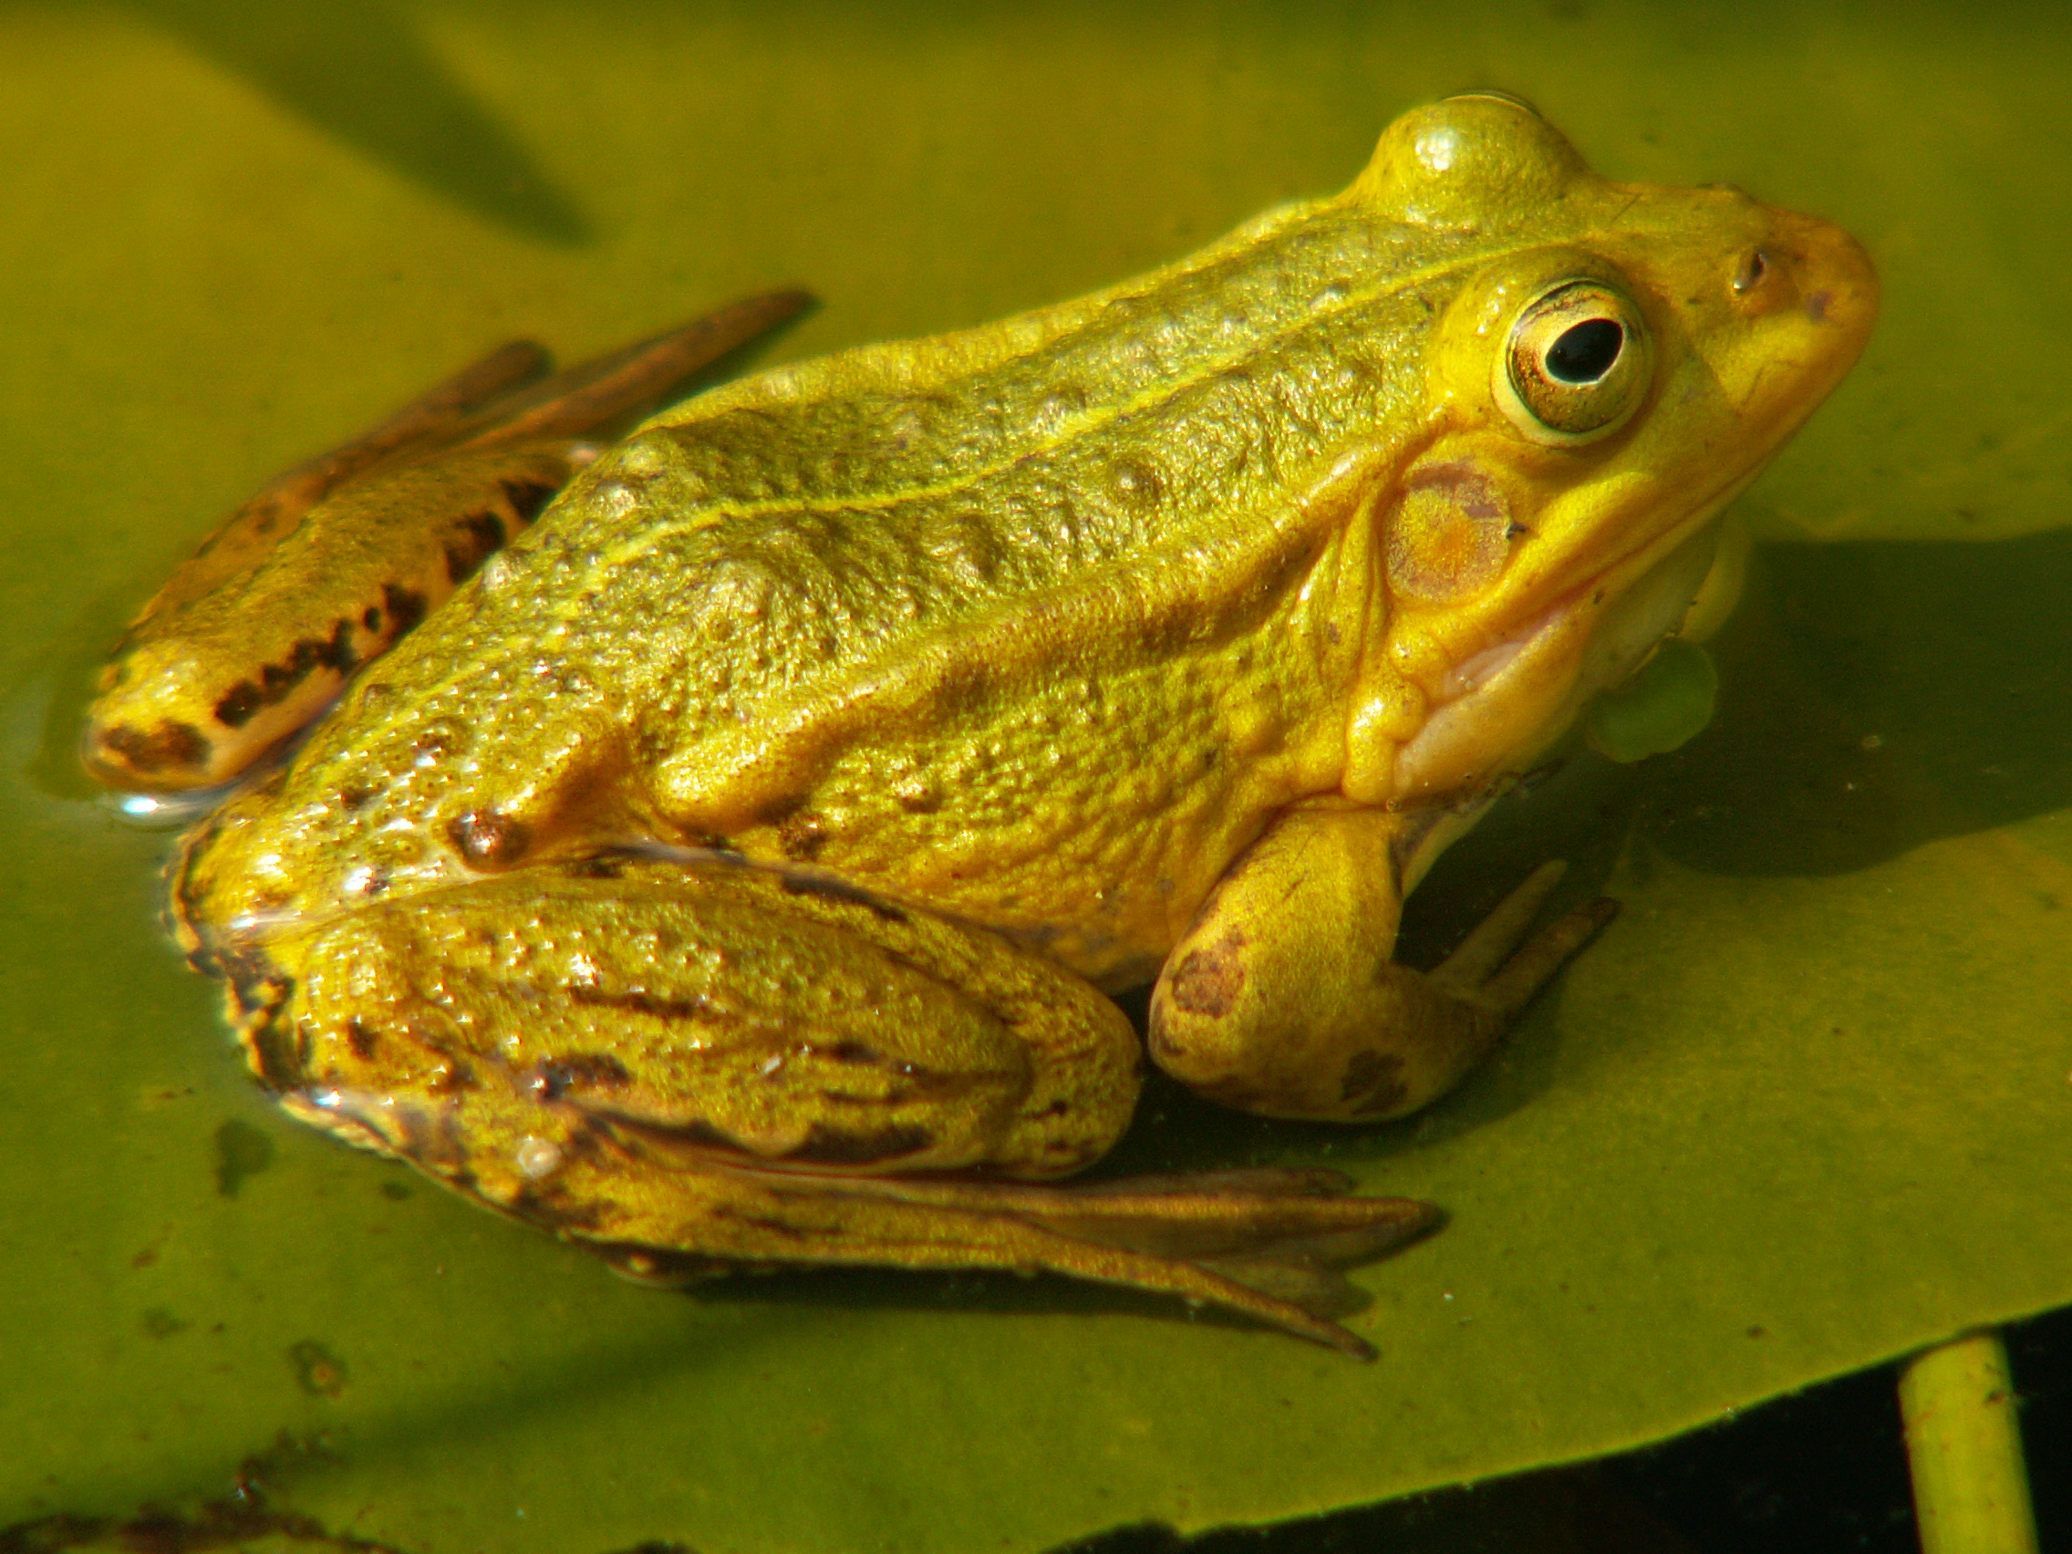
To find out about the state of nature in the UK, scientists (many of these are volunteers) looked at a total of 3897 types of living things including plants, mammals, birds, insects and amphibians.
Mammals, for example hazel dormouse
Plants, for example Lady’s slipper orchid
Amphibians, for example Northern pool frog
Birds, for example turtle doves
They found that...
1 in 6 species is at risk of being lost from Great Britain
The UK is one of the Earth’s most nature depleted countries on Earth
Notes:
The State of Nature report, published in 2023, is the most comprehensive analysis covering the natural world in the UK.
Read the information in this slide aloud. Explain the images show just some of the living things in the UK that are at risk.
Read the two facts from the State of Nature report. Ask learners to think about the two facts. How does it make them feel? You may wish to discuss the meaning of 'being lost' and 'nature depleted'.
Pool Frog: CC BY-SA 2.5
Note: Read this news article, from the Natural History Museum, if you would like to find out more about the State of Nature report.

Slide 4
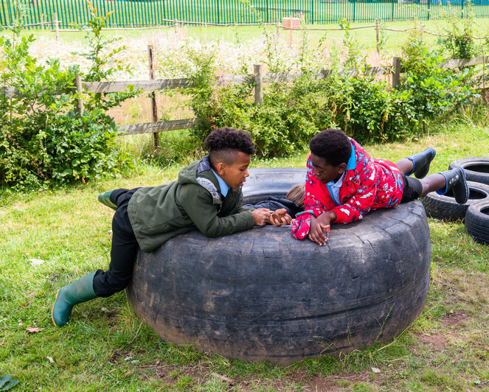
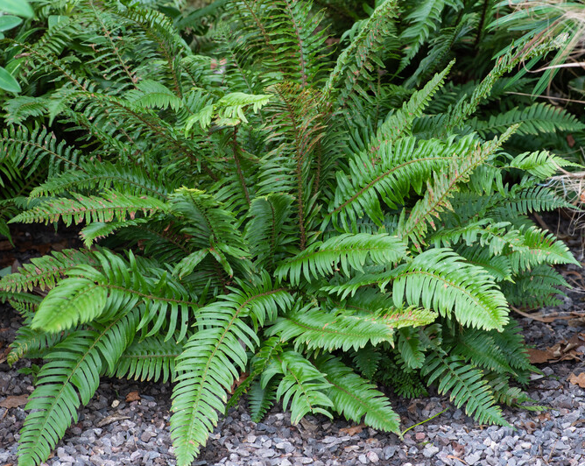
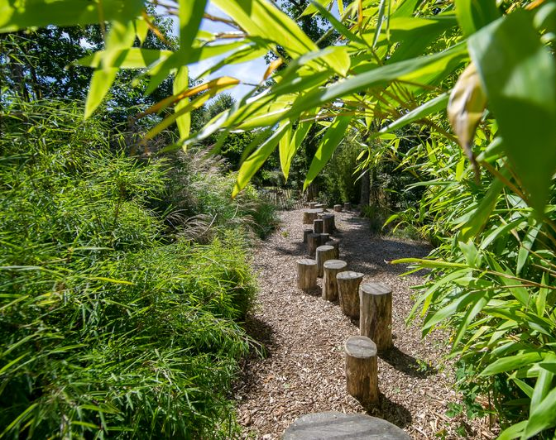
What can we do as a community to help protect nature in the UK?
- understand what community science is and why it is important ​
​
- ask questions to understand nature better
collect information about nature ​
​
communicate our findings to help everybody have a better understanding​
take action, using our findings, to help protect nature
Notes:
Discuss the ideas about what we can do as a community to help protect nature.

Slide 5
Community science is when everyday people, like you, work with scientists to make a big science project happen.
We call these everyday people community scientists.
Anyone can be a community scientist.
Community scientists ask science questions, they collect data and they find out what science can tell them about their local places.
Community scientists are important, without them we would have a lot less information about the natural world.
Helping nature works better as a team
Notes:
Explain that to help nature we need to understand what is happening. We need to ask questions, collect and record data.
Often Scientists ask questions which need lots of data to be collected. They can't do this alone so everyday people, like you, get involved. They observe the natural world, collect data about it and send their findings to scientists. We call these people Community Scientists.
Community science is really important – without community scientists many research projects wouldn't happen. Tell the learners that the National Education Nature Park is a Community Science project.

Slide 6
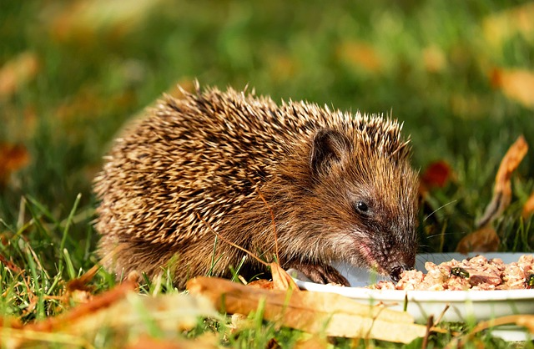
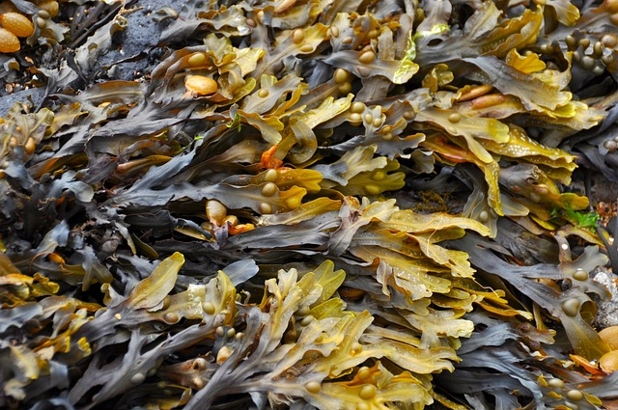
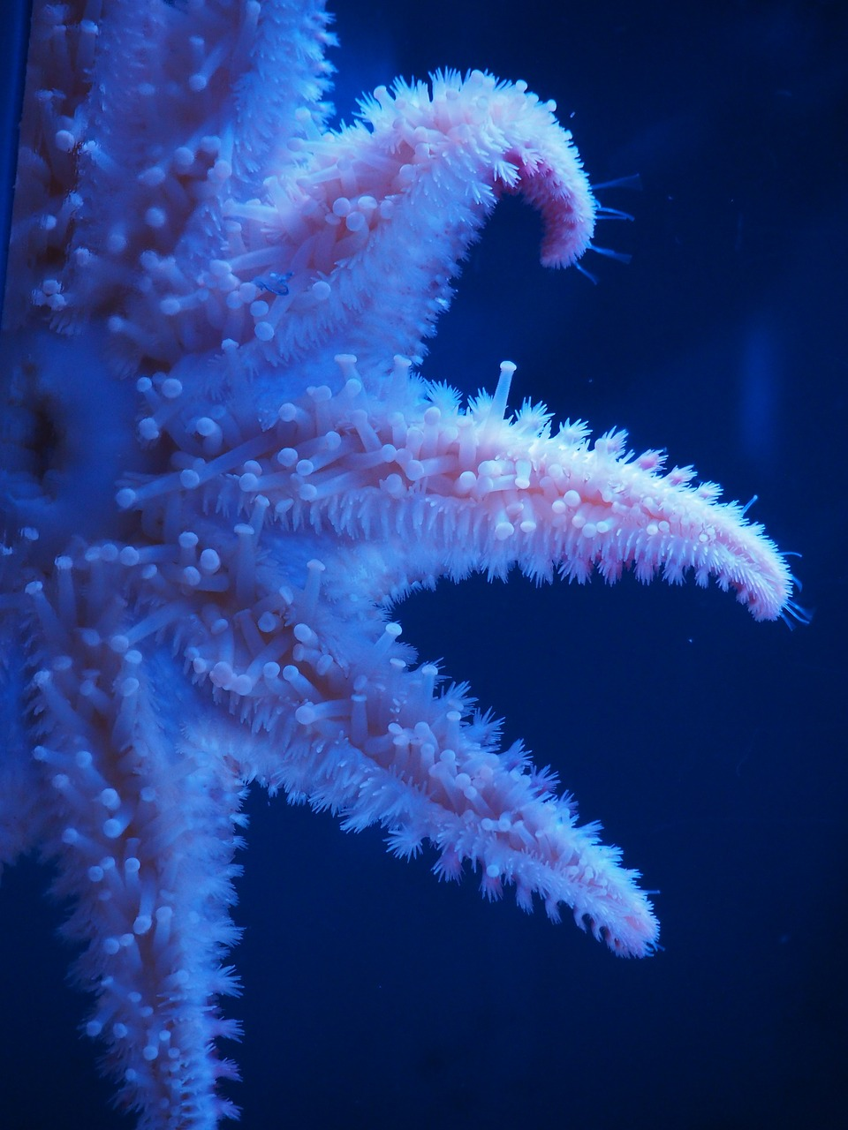
Examples of community science projects
Notes:
Tell learners about the different community science projects. You may wish to discuss the questions below before explaining the three images:
What do you think these community science projects might be?
Have you heard about/taken part in any community science projects?
The community science projects are:
Hedgehog spotting: people help to track and protect hedgehogs before they disappear from our towns and countryside
Big Seaweed Search: recording seaweed people find to monitor the effects of environmental change on British sea life
Searching for colourful starfish: divers and snorkelers help to look for colourful Linkckin laevigata (blue sea star)
Note: If you would like more information on the Big Seaweed Search you can find it here.

Slide 7
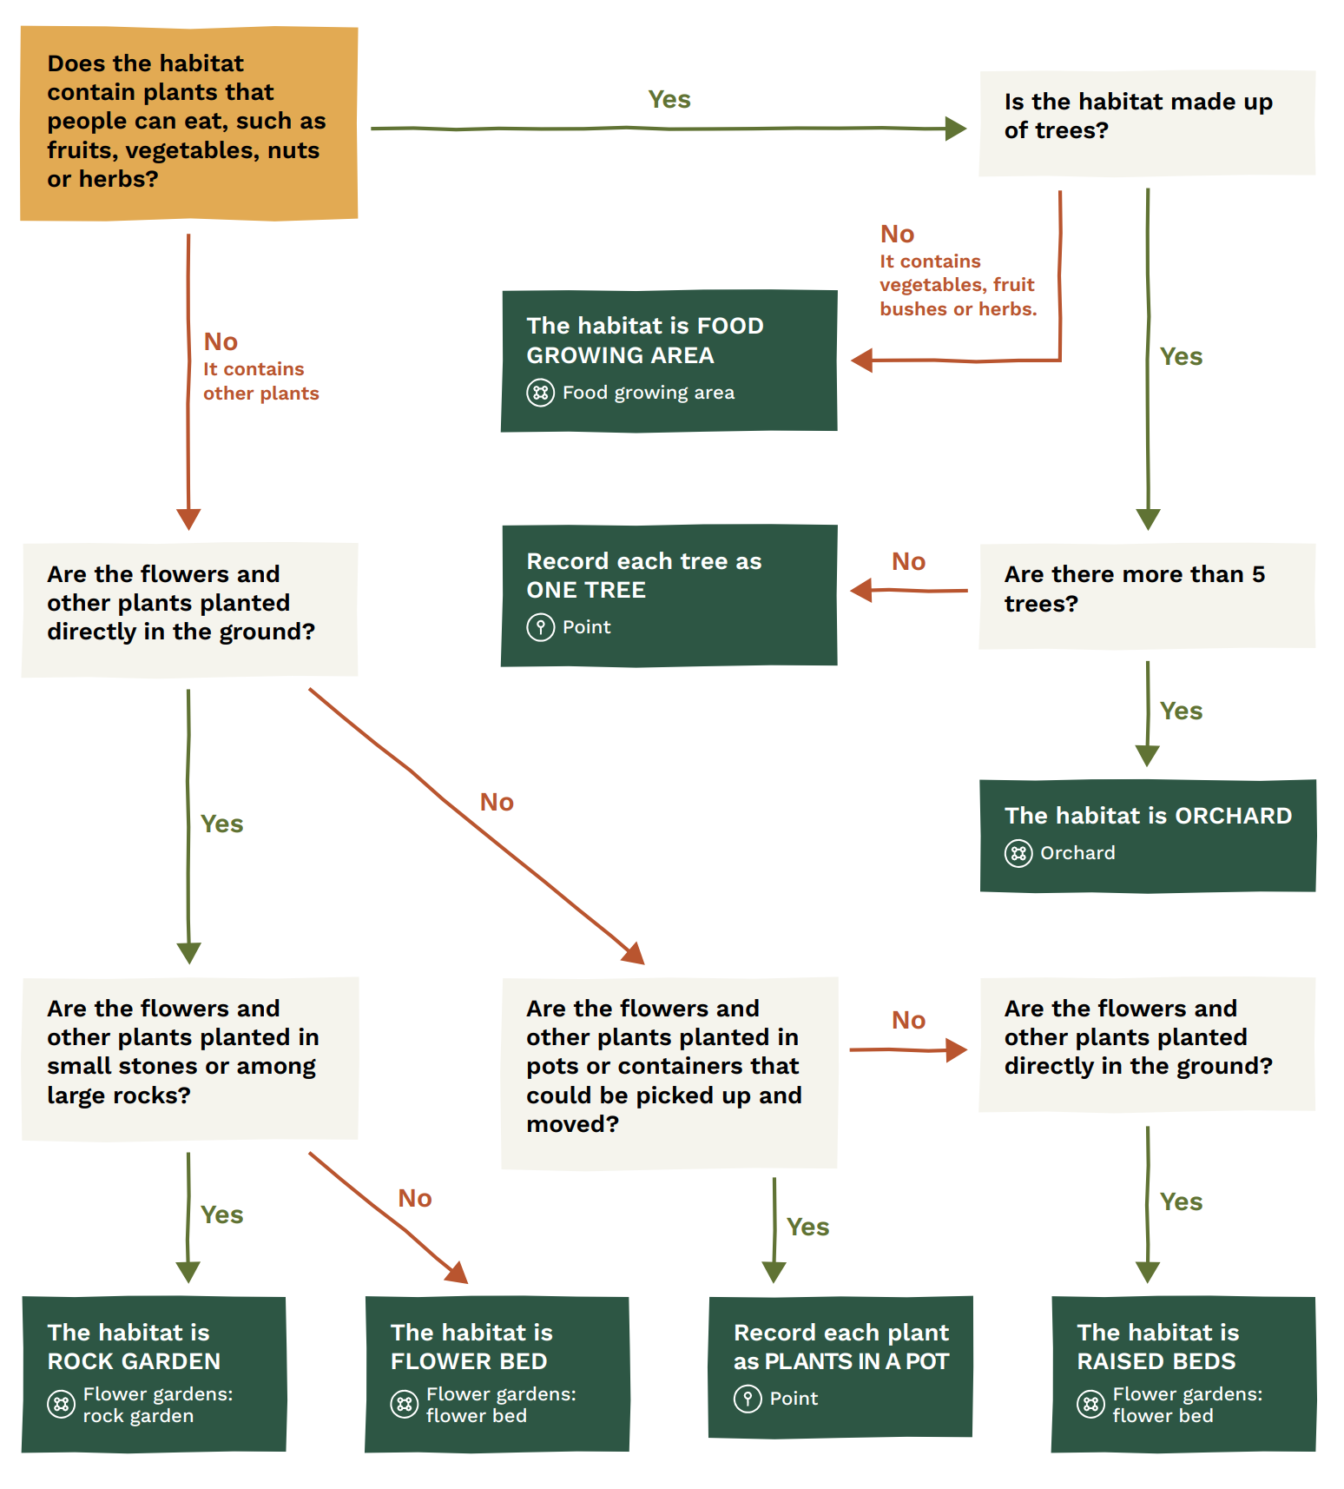
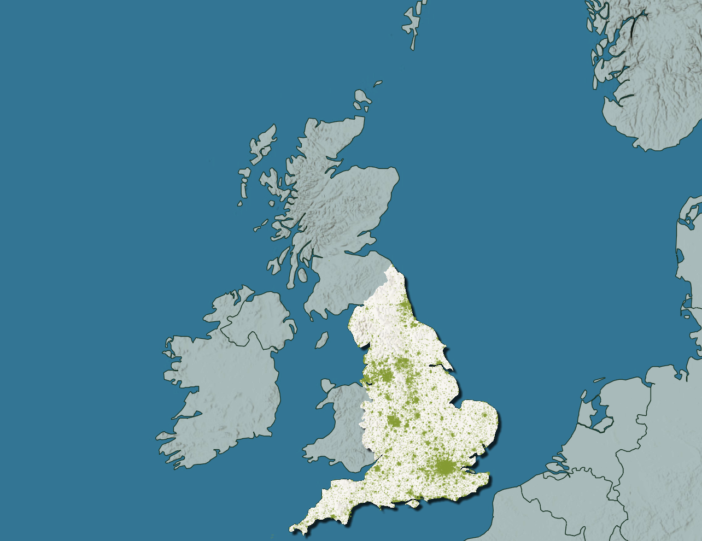
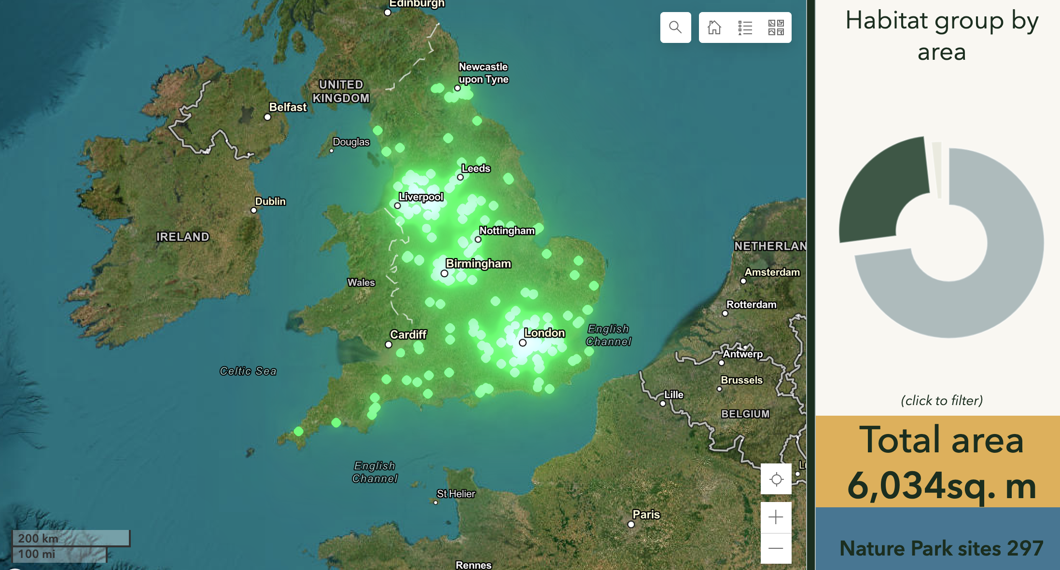
We can work together to develop a better understanding of nature in our schools through community science.
Collect and share information about habitats in your school grounds.
Many schools across England are adding information about their habitats too.
Scientists (including you) can have a better understanding about the habitats in England and how we can better protect them.
Notes:
Explain that the data learners collect about their school grounds is put into a database. This is a national database because schools all over England are inputting their data too. This data helps scientists, including you, to understand habitats in schools across the country and how we better protect the biodiversity there.

Slide 8




Why do you think it is important to map the habitats in our school grounds?
What habitats might we find?
Do you think the habitats we find may have been different in the past?
Do you think most schools will have the same types of habitats?
Notes:
Tell learners that they will be mapping the habitats on their school grounds. Ask learners the question: why do you think it is important to map the habitats in our school grounds? Encourage learners to think about what a habitat is and what we can learn from them. Answers may include:
Knowing what habitats are there will help us understand what wildlife is currently present
Mapping habitats will help us identify opportunities for helping nature in our playground
Mapping habitats is an important first step in helping us identify what species may be present
Use the three remaining questions to discuss predictions learners may have for habitats in school grounds.

Slide 9
Meet one of our community scientists….
Name:
Hobbies / interests:
What scientific questions I have:
Victoria Burton
walking my dog, breeding hognose snakes and exotic insects
Which types of shrubs have the most insects?
Is short or long grass better for earthworms?
Notes:
Introduce one of the community scientists working on the National Education Nature Park.

Slide 10
What type of community scientist are you?
Name:
Hobbies:
What scientific questions you have:
Notes:
Encourage learners to make their own community science introduction. Asking scientific questions is an important skill. You could encourage learners to think about questions specific to the Nature Park Process.

Slide 11
Let's get mapping…..

