Slide 1
Insects in decline

Slide 2
Learning outcomes
By the end of this lesson, you will be able to:
Explain how a change in the environment can affect an animal.
Use information to connect two events.

Slide 3
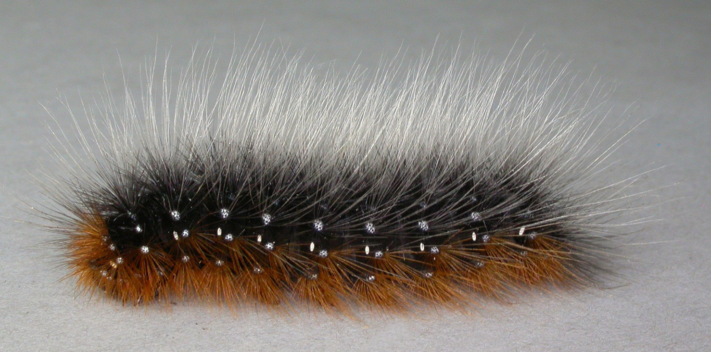
Starter
What is this?

Slide 4
Starter

Slide 5
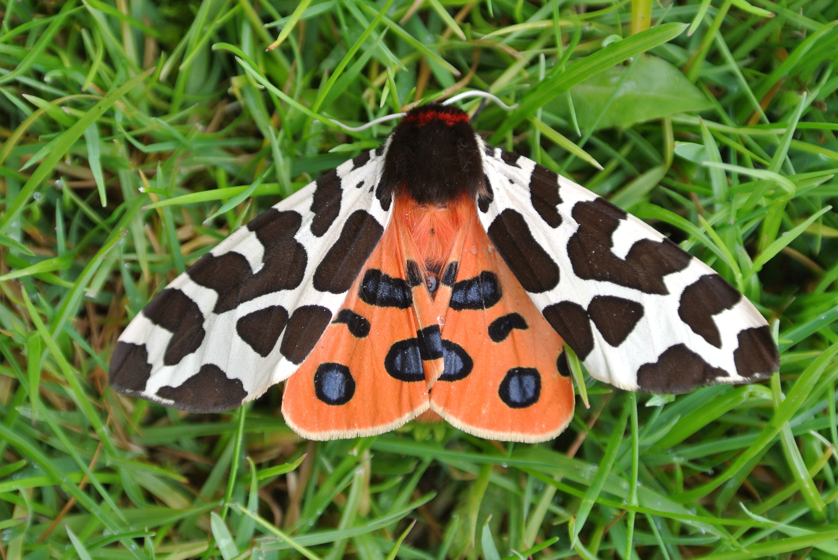
Starter
It is a woolly bear, or garden tiger moth caterpillar.
They live in the UK and grow into adult moths.
Notes:
See them in action here: https://youtu.be/prehUoHUDHk?si=lmNDoVPrfHh6PbI1

Slide 6
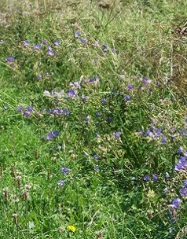
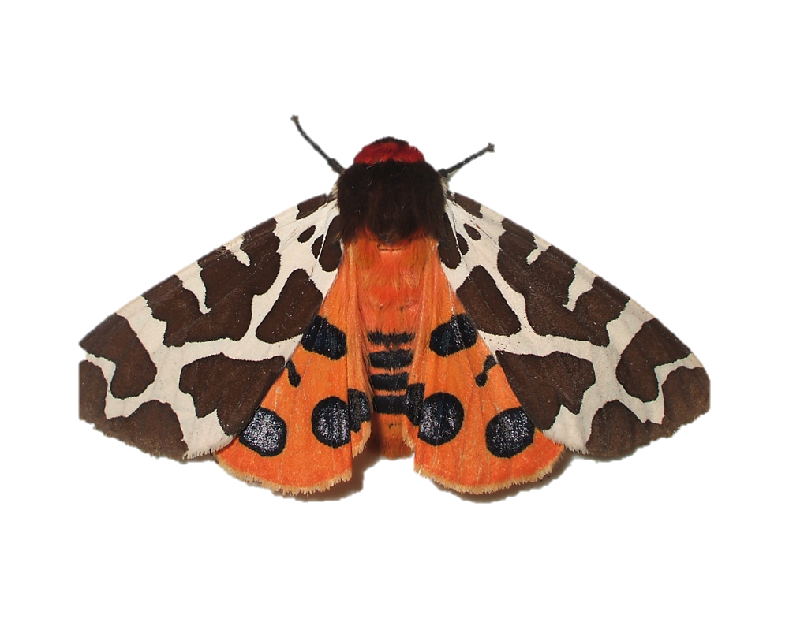
Starter
There is a problem.
The number of garden tiger moths in the UK is decreasing.
1970
2024
Can you help stop the decrease in garden tiger moths?

Slide 7

Main
There are many species (types) of moth that live in the UK.
What does this chart show you?
Number of moth species in the UK
Key
Many species
Few species
1970
2019

Slide 8
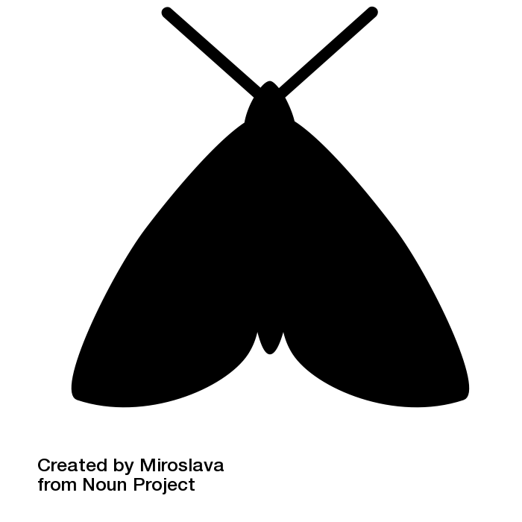
Main
The chart shows that the number of different species of UK moths has decreased from 1970 to 2019.
If few species now exist, many species must have gone extinct.
The tiger moth could be next.

Slide 9
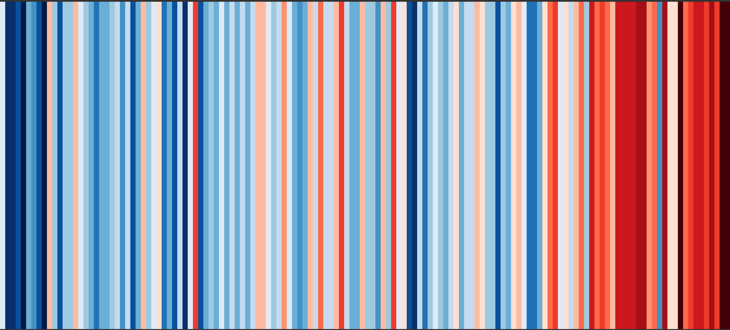
Main
What does this chart show?
UK temperature
High
Low
1890
2023

Slide 10

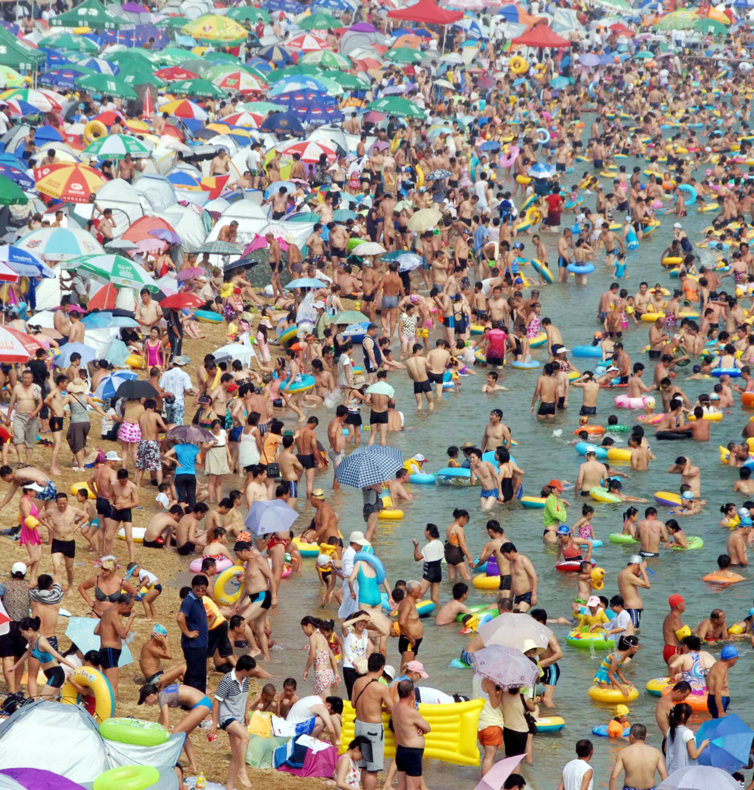
Main
The chart shows that temperatures in the UK have increased since 1890.
2022 was the hottest summer since we started recording temperature
2023 was second hottest.
Notes:
Source: https://www.bbc.co.uk/news/science-environment-67845671#:~:text=The%20summer%20in%20the%20UK,temperature%20records%20in%20the%20world.

Slide 11
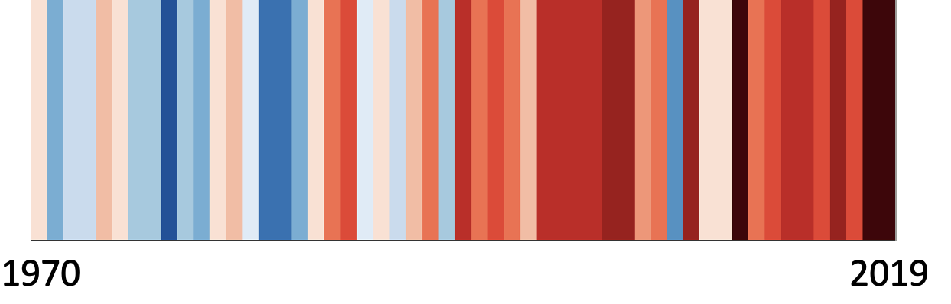
Main
As the temperature has gone up,
the number of moth species has gone down.
Temperature
Number of moth species in the UK
1970
2019
Can you think why?

Slide 12
Main
It looks like higher temperatures have caused the decrease in moths.
But to be sure we need to find facts that connect them.
Temperature rises
Decrease in moths
Task: Look at the information on the cards.
Work out what can go in the boxes to connect the two events.

Slide 13
Main
Did your boxes look like this?
More droughts happen.
There is less rain.
Plants have less water.
They die.
Caterpillars and moths have less food.
Temperature rises
Decrease in moths
Notes:
Students self-assess

Slide 14
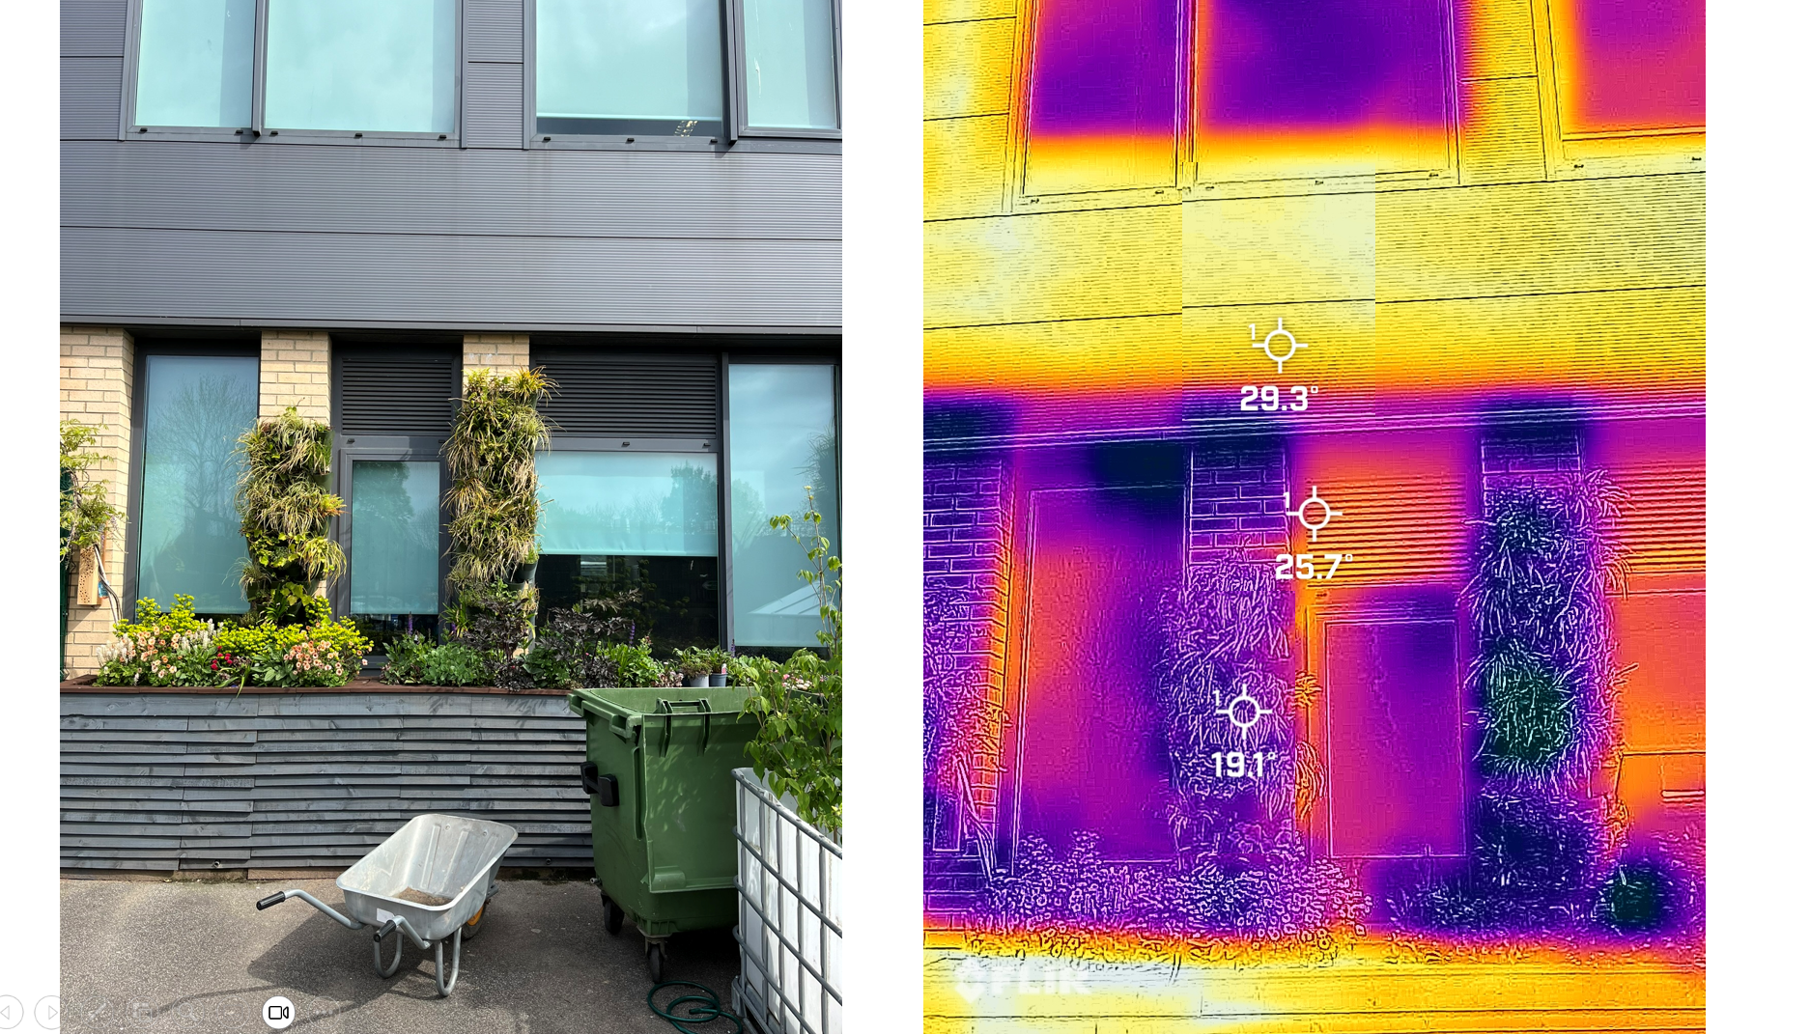
Action
Main 2
There might be a way that YOU can help moths!
Green walls have plants growing on them.

Slide 15
Action
Green walls help keep people inside buildings cool in the summer.
They can reduce the inside temperature by up to 4.8°C.
Infra-red image of the green wall

Slide 16
Action
Task: Design a green wall for your school that will:
help keep you cool in the summer.
help the garden tiger moth survive by giving them more food.
Choose a location for your green wall. Decide how big you want it to be.
Choose what types of plants to grow. Think about what plants the moths need.
Draw your design and explain why you want to create a green wall.

Slide 17
Image credits
Slide(s) | Image | Credit
3-5 | Garden tiger moth caterpillar | Janet Graham, CC BY 2.0 <https://creativecommons.org/licenses/by/2.0>, via Wikimedia Commons
5 | Garden tiger moth | Temple of Mara, CC BY-SA 3.0 <https://creativecommons.org/licenses/by-sa/3.0>, via Wikimedia Commons
6 | Garden tiger moth | Ben Sale from UK, CC BY 2.0 <https://creativecommons.org/licenses/by/2.0>, via Wikimedia Commons
7,11 | Biodiversity stripes | Contains public sector information from Defra, licenced under the Open Government Licence v3.0
8 | Moth icon | Moth by Miroslava from <a href="https://thenounproject.com/browse/icons/term/moth/" target="_blank" title="Moth Icons">Noun Project</a> (CC BY 3.0)
9,10,11 | Climate stripes | Professor Ed Hawkins (University of Reading) https://showyourstripes.info/
14-15 | Green wall | Melissa Lord

