Slide 1
The Kelp Forest Initiative

Slide 2
Learning outcomes
By the end of this lesson, you will be able to:
Explain how a method to reduce global warming works.
Use evidence and reasoning to support a claim.
Notes:
From KS4 NC:
explaining everyday and technological applications of science; evaluating associated personal, social, economic and environmental implications; and making decisions based on the evaluation of evidence and arguments

Slide 3

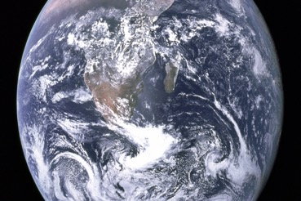
Starter
Look at this – we could win
£1 million to help save the Earth!
THE
EARTHSHOT
PRIZE
Click to find out more
My school is entering and we’re looking for a partner school.
Can we submit an Earthshot idea to reduce global warming?
Notes:
Image: under license from Deposit photos

Slide 4

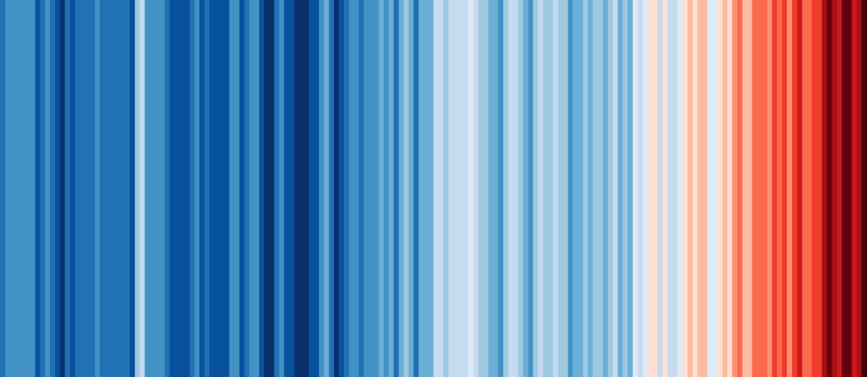
Starter
Here’s the problem. What do these stripes tell us?
Average world temperature
1850
2023

Slide 5
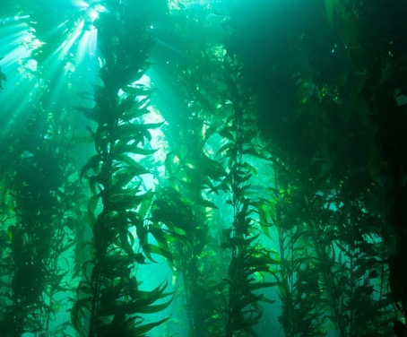
Starter
Right, average world temperatures have been increasing since 1850.
Our Earthshot idea is to plant kelp
(a type of algae) along the UK coast.
Find out more.
Explore a kelp forest

Slide 6
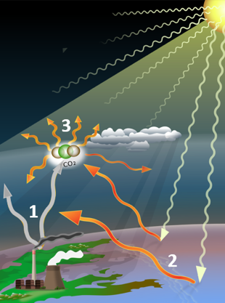
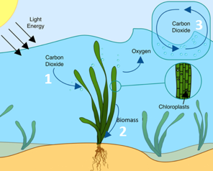

Main
To submit our idea, we’re going to fill in the application form together.
We’ve found these diagrams but they’re hard to make sense of.
Work out what the diagrams on the next slides mean
Answer Q1 about what causes global warming
Answer Q2 about how kelp will reduce global warming

Slide 7
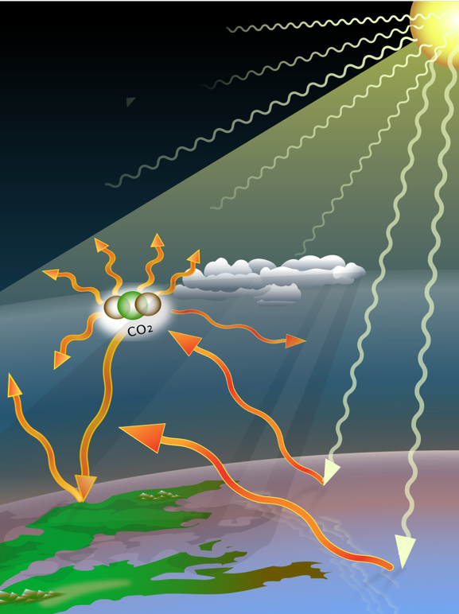


The Greenhouse Effect
Main
2
Greenhouse gases like CO₂ in the atmosphere absorb and emit heat. This keeps the Earth warm.
Energy from the Sun (light and heat) is absorbed by the Earth’s surface, warming it up. The Earth’s surface releases heat back into the atmosphere.
1
2
CO₂
3
Human activities release more greenhouse gases, so more energy is absorbed. This is global warming.
3
1
3

Slide 8

The Carbon Cycle
Main
1
Kelp takes in CO₂ to use it for photosynthesis.
CO₂ from the atmosphere dissolves into the water to replace the used CO₂.
3
3
2
The CO₂ is converted into the kelp’s tissues (biomass) and stored.
1
2

Slide 9

Main
We are making a claim - that planting kelp (algae) will decrease CO_{2.}
For Q3 we need to collect evidence and show our reasoning that the idea will work.
So, let’s do an experiment!
Try the experiment using algal balls
Answer Q3 with evidence and reasoning from the experiment
Notes:
Image: Deposit Photos

Slide 10

Main
Now comes question Q4 – we need to say if our idea can help solve any more of Earth’s problems.
There is another major one…
Notes:
Deposit photos

Slide 11

Main
Here’s the problem. What do these stripes tell us?
Number species on Earth
Key
Many species
Few species
1970
2019

Slide 12

Main
The number of different species on Earth – its biodiversity - is decreasing.
Our next claim is:
Growing kelp can help increase biodiversity.
Use the information I found online to support this claim.
Read the information.
Answer Q4 about other benefits.
Structure your answer as claim, evidence and reasoning.
Notes:
Image: deposit photos

Slide 13
Image credits
Slide(s) | Image | Credit
4 | Climate stripes | Professor Ed Hawkins (University of Reading) https://showyourstripes.info/
5 | Kelp forest | NOAA's National Ocean Service, CC BY 2.0 <https://creativecommons.org/licenses/by/2.0>, via Wikimedia Commons
6,7 | Global warming | A loose necktie, CC BY-SA 4.0 <https://creativecommons.org/licenses/by-sa/4.0>, via Wikimedia Commons
6,8 | Carbon uptake and photosynthesis in a seagrass meadow | Cullen-Unsworth L, Jones B, Lilley R and Unsworth R, CC BY 4.0 <https://creativecommons.org/licenses/by/4.0>, via Wikimedia Commons
11 | Biodiversity stripes | Contains public sector information from Defra, licensed under the Open Government License v3.0

