Slide 1

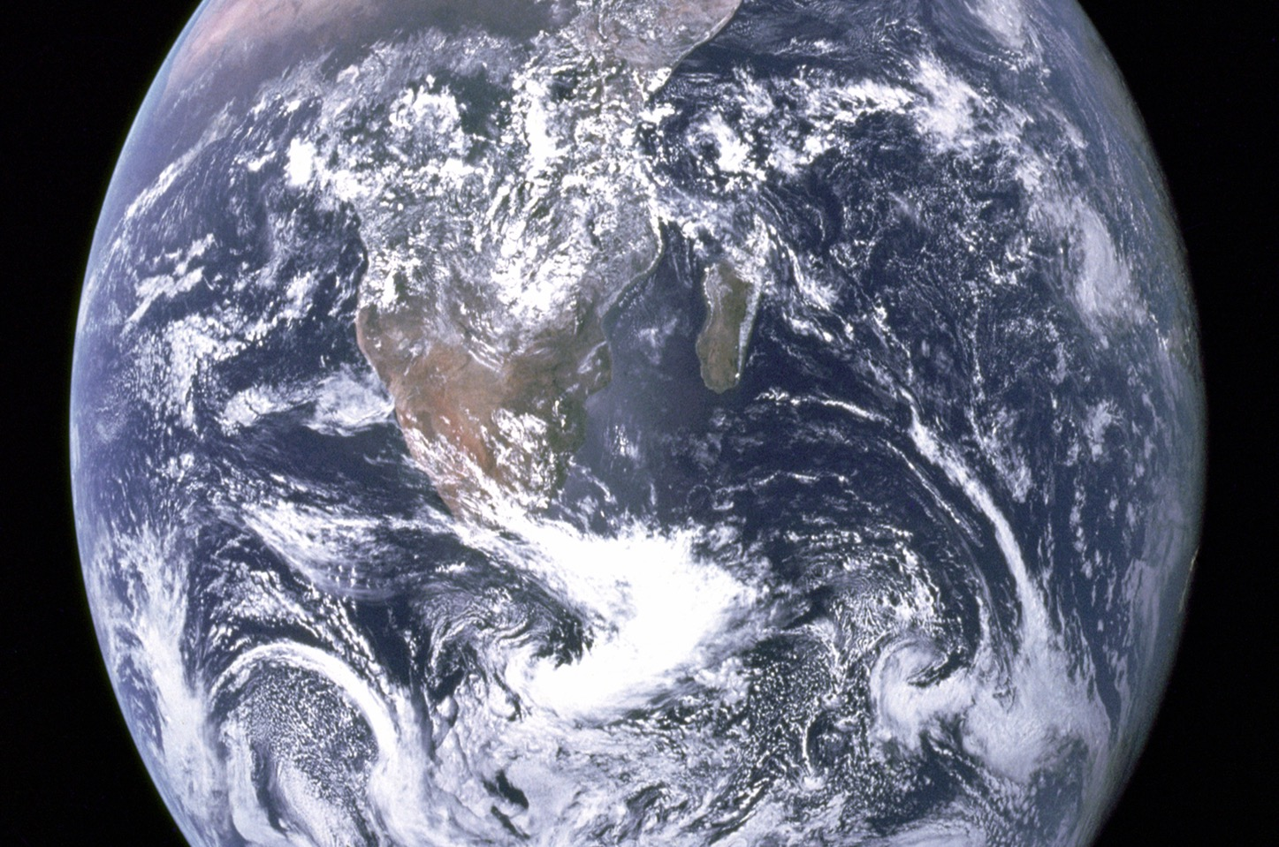
The kelp forest initiative
Student sheet 1
Application form
Planting kelp forests along the UK coast.
Title of idea
Q1. What is the problem you are trying to solve? What causes the problem?
Q3. How can you support your claim (that your idea will work)?
Give evidence (this could be an experiment and the results)
And reasoning (why the results supports your claim)
Q2. How will your idea help solve the problem?
Q4. Are there any other problems your idea can help solve?

Slide 2
The kelp forest initiative
Student sheet 2
Student sheet 2
The kelp forest initiative
The algal ball experiment
The algal ball experiment
The water contains dissolved carbon dioxide gas.
The jelly balls contain algae. They are like the popping jelly balls in a boba drink.
The jelly balls contain algae. They are like the popping jelly balls in a boba drink.
The water contains dissolved carbon dioxide gas.
The water is coloured because it contains hydrogencarbonate indicator.
The water is coloured because it contains hydrogencarbonate indicator.
The hydrogencarbonate indicator changes colour depending on how much carbon dioxide is present in the water.
The hydrogencarbonate indicator changes colour depending on how much carbon dioxide is present in the water.
Concentration of carbon dioxide | Colour of hydrogen carbon indicator
Highest | Yellow
Higher | Orange
Atmospheric level (control) | Red
Lower | Pink
Lowest | Purple
Concentration of carbon dioxide | Colour of hydrogen carbon indicator
Highest | Yellow
Higher | Orange
Atmospheric level (control) | Red
Lower | Pink
Lowest | Purple

Slide 3
The kelp forest initiative
Student sheet 3
Student sheet 3
The kelp forest initiative
Kelp forests benefits
Kelp forests benefits
Planting more kelp in the ocean could have big environmental benefits, especially in fighting climate change, improving ocean health, and supporting marine life. Here’s how:
Absorbing carbon dioxide (CO₂) Kelp is great at absorbing CO₂, which is one of the main gases causing global warming. It can grow super fast (up to 2 feet per day), and while it grows, it pulls CO₂ from the air and stores it in its leaves. Some of this carbon can sink to the ocean floor, trapping it for a long time.
Reducing ocean acidification By absorbing CO₂ from the water, kelp can help stop the ocean from becoming too acidic. Acidification harms many sea creatures like corals and shellfish, so kelp helps protect these animals and keeps ocean ecosystems balanced.
Creating habitats: Kelp forests provide shelter and food for many sea creatures like fish, crabs, and sea otters. More kelp means more places for animals to live, making the ocean a healthier and more diverse environment.
Protecting coastlines: Kelp forests can reduce the power of ocean waves, helping to protect coastlines from erosion and damage during storms. With rising sea levels and stronger storms, kelp can act like a natural defense system for coastal areas.
Improving water quality: Kelp can absorb excess nutrients like nitrogen and phosphorus from the water, which helps prevent pollution and harmful algae blooms. This improves the overall health of the ocean and nearby environments.
Planting more kelp in the ocean could have big environmental benefits, especially in fighting climate change, improving ocean health, and supporting marine life. Here’s how:
Absorbing carbon dioxide (CO₂) Kelp is great at absorbing CO₂, which is one of the main gases causing global warming. It can grow super fast (up to 2 feet per day), and while it grows, it pulls CO₂ from the air and stores it in its leaves. Some of this carbon can sink to the ocean floor, trapping it for a long time.
Reducing ocean acidification By absorbing CO₂ from the water, kelp can help stop the ocean from becoming too acidic. Acidification harms many sea creatures like corals and shellfish, so kelp helps protect these animals and keeps ocean ecosystems balanced.
Creating habitats: Kelp forests provide shelter and food for many sea creatures like fish, crabs, and sea otters. More kelp means more places for animals to live, making the ocean a healthier and more diverse environment.
Protecting coastlines: Kelp forests can reduce the power of ocean waves, helping to protect coastlines from erosion and damage during storms. With rising sea levels and stronger storms, kelp can act like a natural defense system for coastal areas.
Improving water quality: Kelp can absorb excess nutrients like nitrogen and phosphorus from the water, which helps prevent pollution and harmful algae blooms. This improves the overall health of the ocean and nearby environments.

