Slide 1
Harlequin ladybird case study

Slide 2
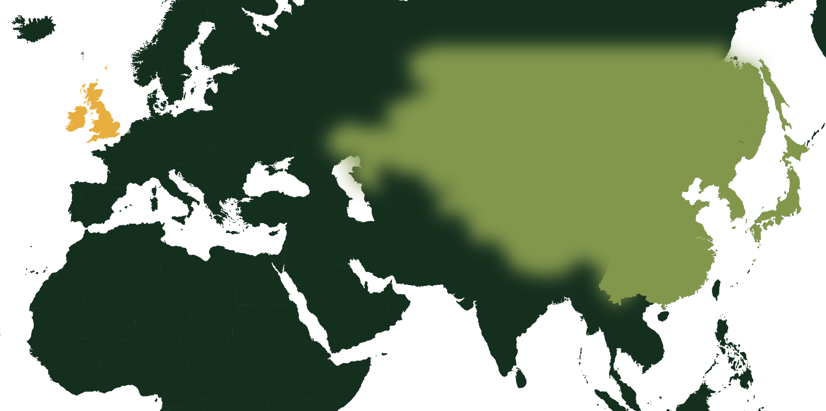
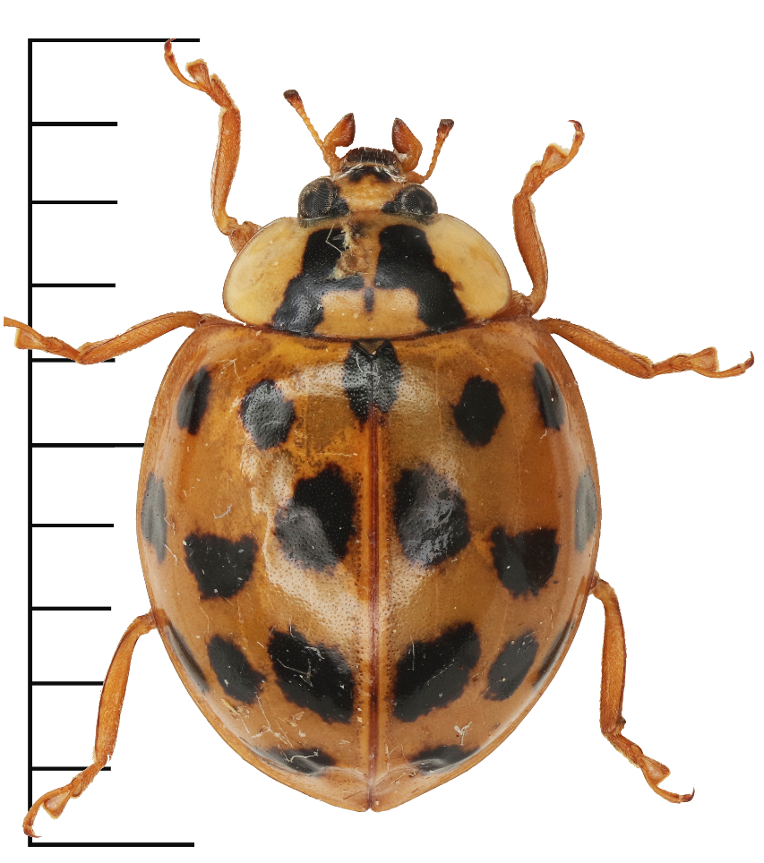
Why study harlequin ladybirds?
Harlequin case study
Harlequin range before 1980
The Harlequin ladybird is one of the UK’s largest ladybird species.
They were first seen in the UK in 2004. Before the 1980s they were mainly found in Asia.
UK

Slide 3
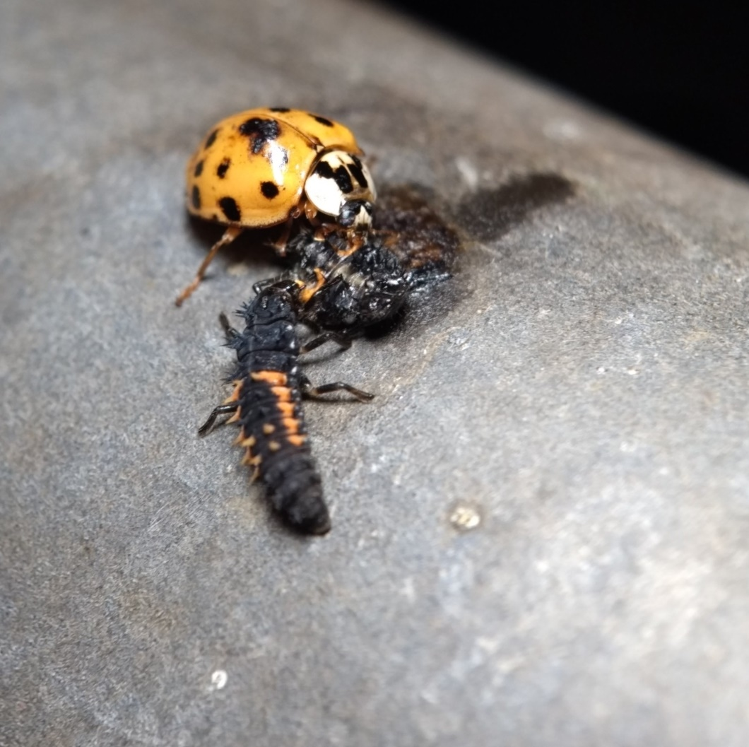
Harlequin case study
Many ladybirds are carnivorous and can even eat the larvae of other ladybirds.
Harlequins are bigger than most other ladybird species. They also lay more eggs!
Scientists have been worried that they might eat other ladybirds until they become endangered or extinct.
Harlequin ladybird adult and larva eating another harlequin ladybird larva!

Slide 4
Harlequin case study
To study how harlequin ladybirds were affecting other species, scientists surveyed ladybirds at different sites over several years.
This is what they found:

Slide 5
Harlequin case study
We can summarize their data on a chart.
What do you notice?
Notes:
Native ladybirds were going up until 2011.
In 2013 there were very few ladybirds in total.
Since 2013 harlequin and other species are going back up, but it looks like harlequin ladybird numbers are going up faster.
What happened in 2013?
2012 was the second wettest year on record. This might have made if harder for ladybirds to find food and lay eggs.
Early 2013 was particularly cold and snowy. This might have killed ladybirds trying to hibernate through winter.
The scientists also noted that lime trees in one area were pollarded in 2013. This is when tree surgeons chop off a tree’s upper branches. This helps the tree live longer. It can also help the trees not blow over in strong wind because they have fewer heavy branches. This is probably part of the reason there were fewer ladybirds. They had fewer places to find food and live because some of the trees in the area had fewer branches.
Were the harlequin ladybirds eating other ladybirds?
Possibly. Data like this can show us when some ladybirds are doing well (we should find more of them) and when some are not (we find fewer of them). But it doesn’t necessarily tell us why.
What happens if we look at each location individually?

Slide 6
Harlequin case study
We see a different picture if we graph each location separately.
Notes:
Harlequin ladybirds in Worlington increased quickly after the pollarding in 2013.
Native ladybirds started to increase in number, but decreased again in 2015/2016. Maybe because the harlequins were eating them.
In Chettisham the native ladybirds went up after 2013 and didn’t go down like at the other site. The harlequin ladybird population stayed low.
Maybe it is because the ladybirds were surveyed from different plants?

Slide 7
We hope you found this resource useful!
Send your feedback to school-bookings@nhm.ac.uk
This resource was produced with support from Evolution Education Trust.

