Slide 1
Bumblebee cards
For printing on A4
Also available with printer’s marks for printing on A6 cards

Slide 2
About the cards
These cards feature photos of specimens from the collections at the Natural History Museum. The deck contains 78 individual specimens from 7 species common in the UK.
Some have been in the collections for nearly 100 years, so you will see that some of the bumblebees are dusty. Over this time, some of their colours may have faded or changed slightly from what you might see in living bumblebees.
The deck is divided into 7 sets. Sets 1 - 6 are intended to be the main working sets for students. Each set consists of 10 cards, 2 from each of 5 common UK species. Set 7 contains 18 cards that can be used to add complexity to the activities.

Slide 3
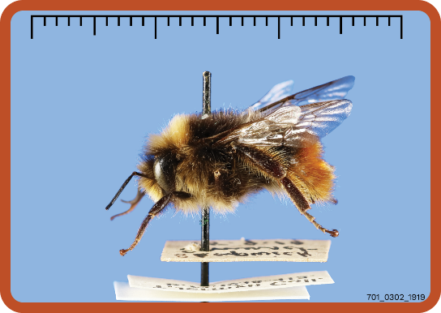
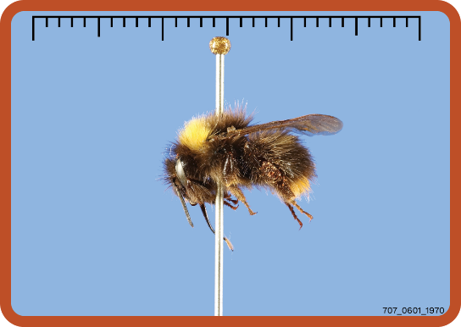
Set 7
Cards 701-706 are drone red-tailed bumblebees.
These are included to illustrate polymorphism. This is where there are different forms within a species. Sexual dimorphism is a type of polymorphism where there are two forms associated with reproduction. In social insects like bees and ants, a single species can have three or more different forms (also called castes) associated with different roles, which can include queens, guards, nurses, or foragers.
Cards 707-712 are early-bumblebees
At first, these look similar to the drone red-tailed bumblebees, but a close inspection reveals they have black heads and red/orange hairs only on the last segment of their abdomen.
Drone red-tailed bumblebee
Worker early bumblebee

Slide 4
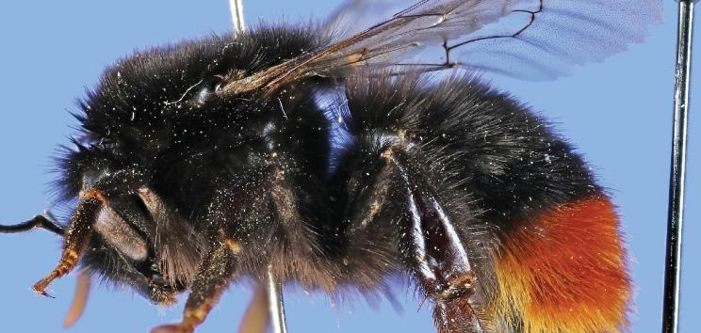
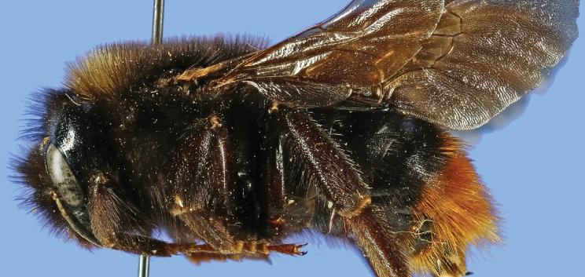
Cards 713-718 are ruderal bumblebees.
This species is a type of cuckoo-bumblebee, meaning they lay their eggs in the nests of other bumblebees, like the cuckoo bird lays its eggs in the nests of other birds. Their colouring mimics the red-tailed bumblebee, whose nests they tend to lay their eggs in. They are still pollinators, but they do not need to actively collect pollen to feed their young, relying on the host colony to do that instead. Ruderal bumblebees and other cuckoo species can be recognized by the lack of a pollen basket on their hind legs. In other bumblebee species, the pollen basket is a smooth area surrounded by long hairs.
Hairs on the flattened area
Smooth pollen basket
Red-tailed bumblebee queen
Ruderal bumblebee female

Slide 5
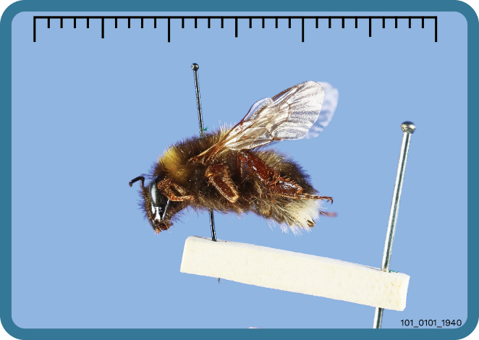
Decoding the card numbers
Species numbers
01 | White-tailed bumblebee
02 | Tree bumblebee
03 | Red-tailed bumblebee
04 | Common carder bumblebee
05 | Buff-tailed bumblebee
06 | Early bumblebee
07 | Ruderal bumblebee
Millimetre scale (3cm total)
Caste numbers
01 | Worker
02 | Drone
03 | Queen
Card number
(Set + card) _ (Species + Caste) _ (Date collected)
101_0101_1940 is decoded as:
Set 1 card 01 _ White-tailed bumblebee (worker) _ Collected in 1940

Slide 6

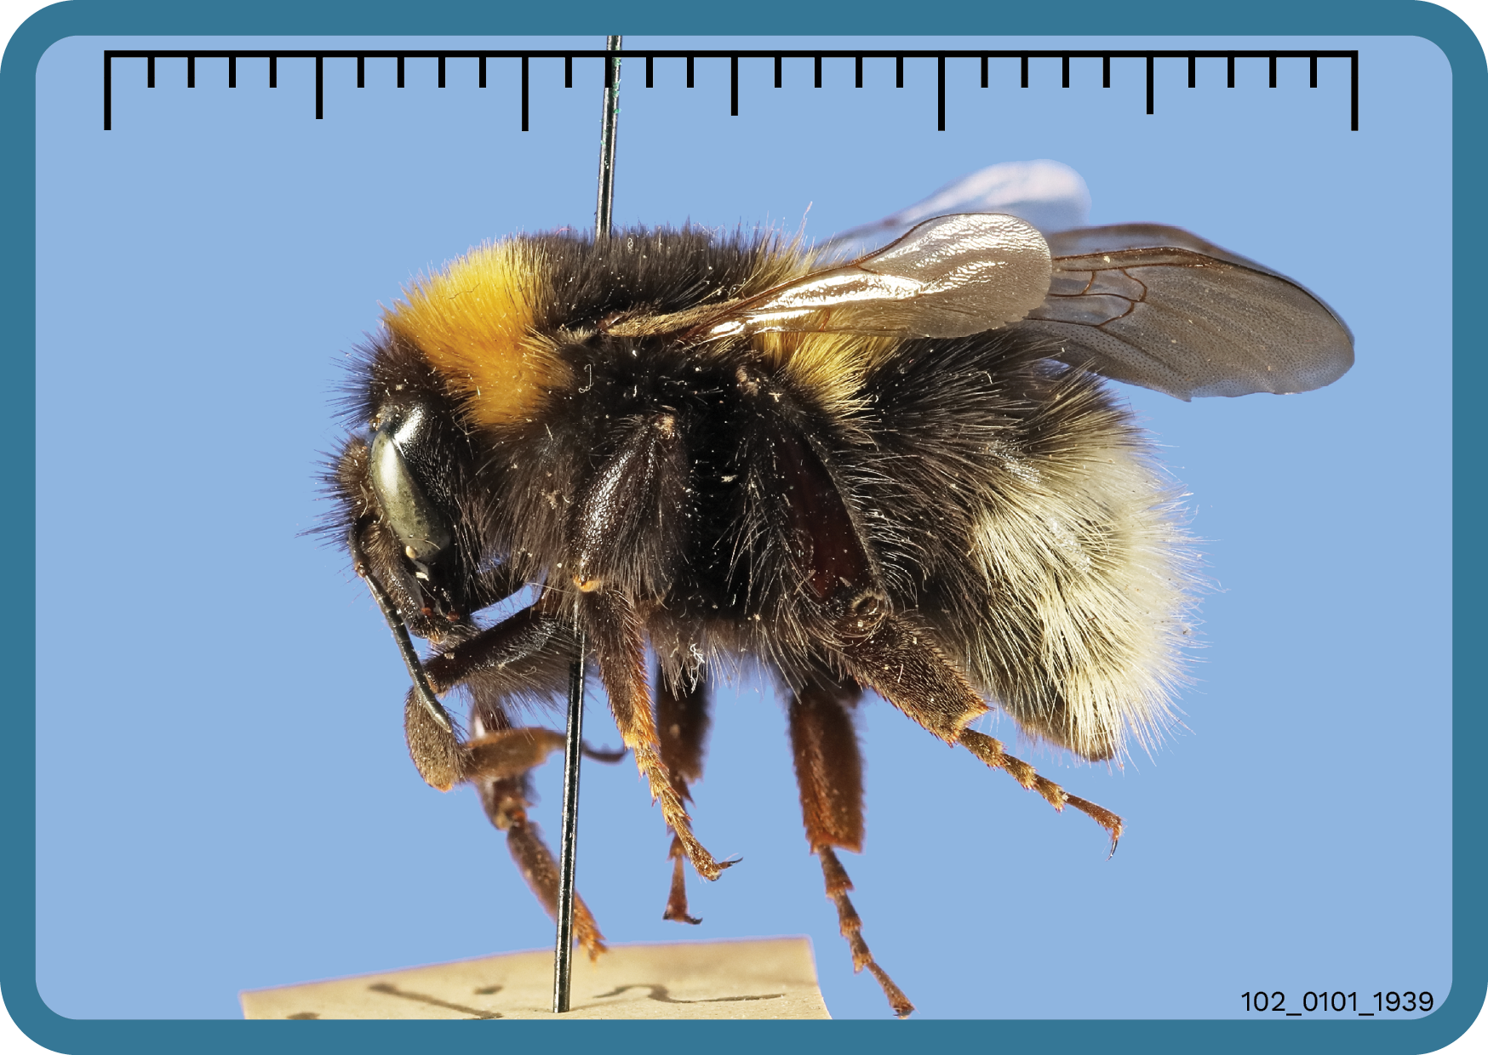
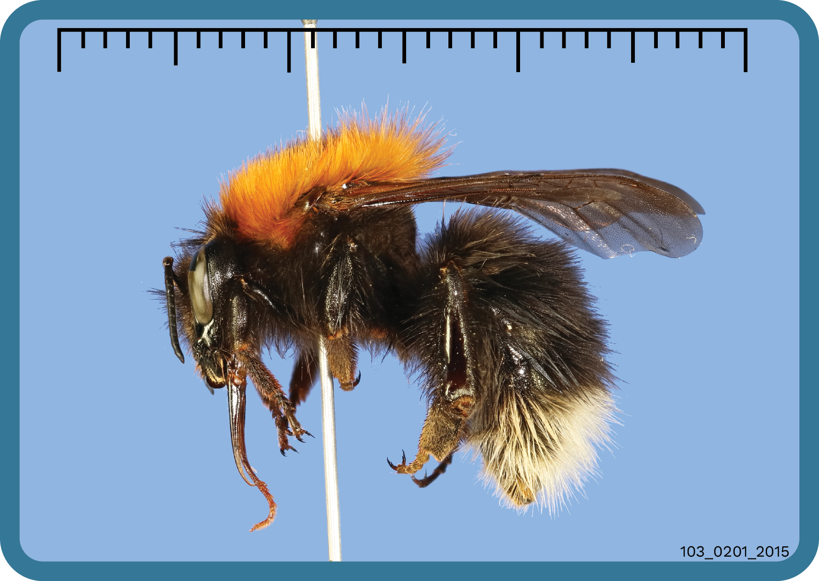
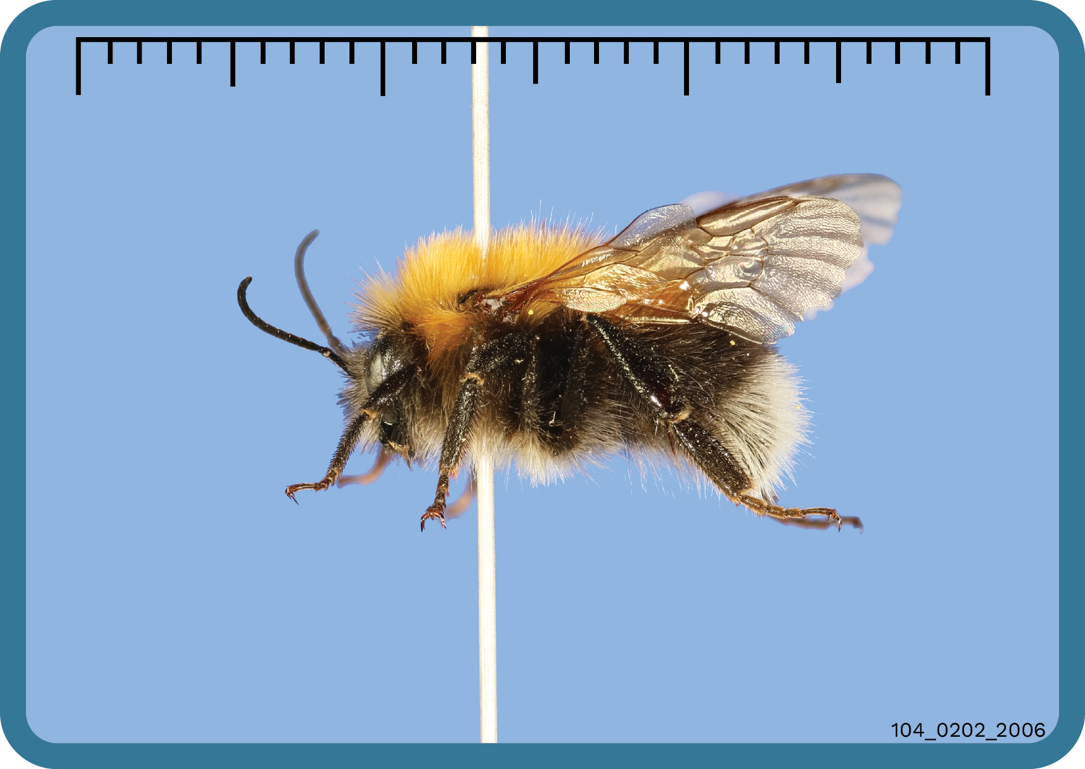

Slide 7
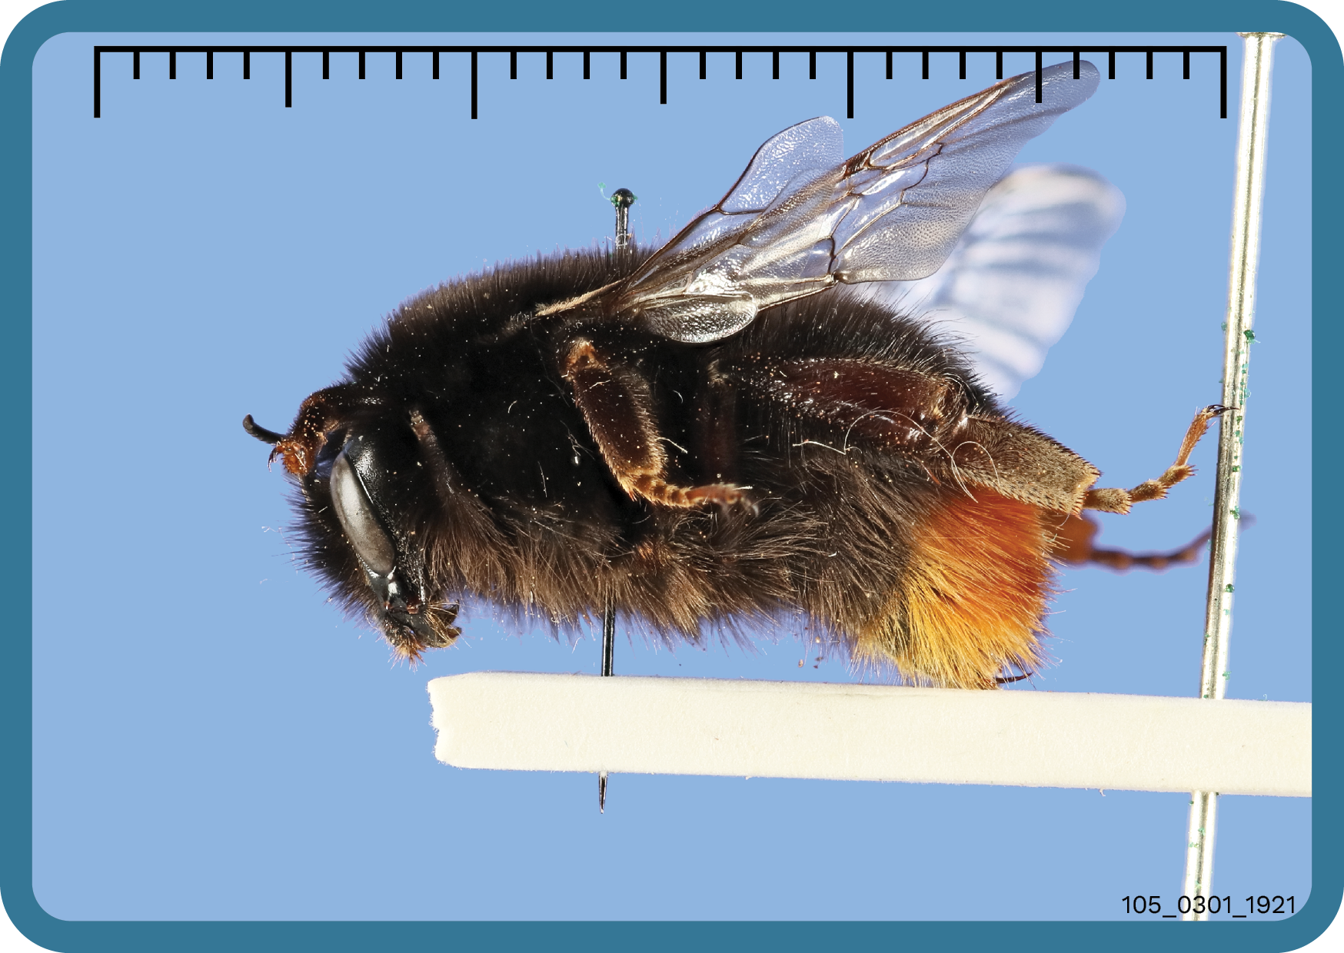
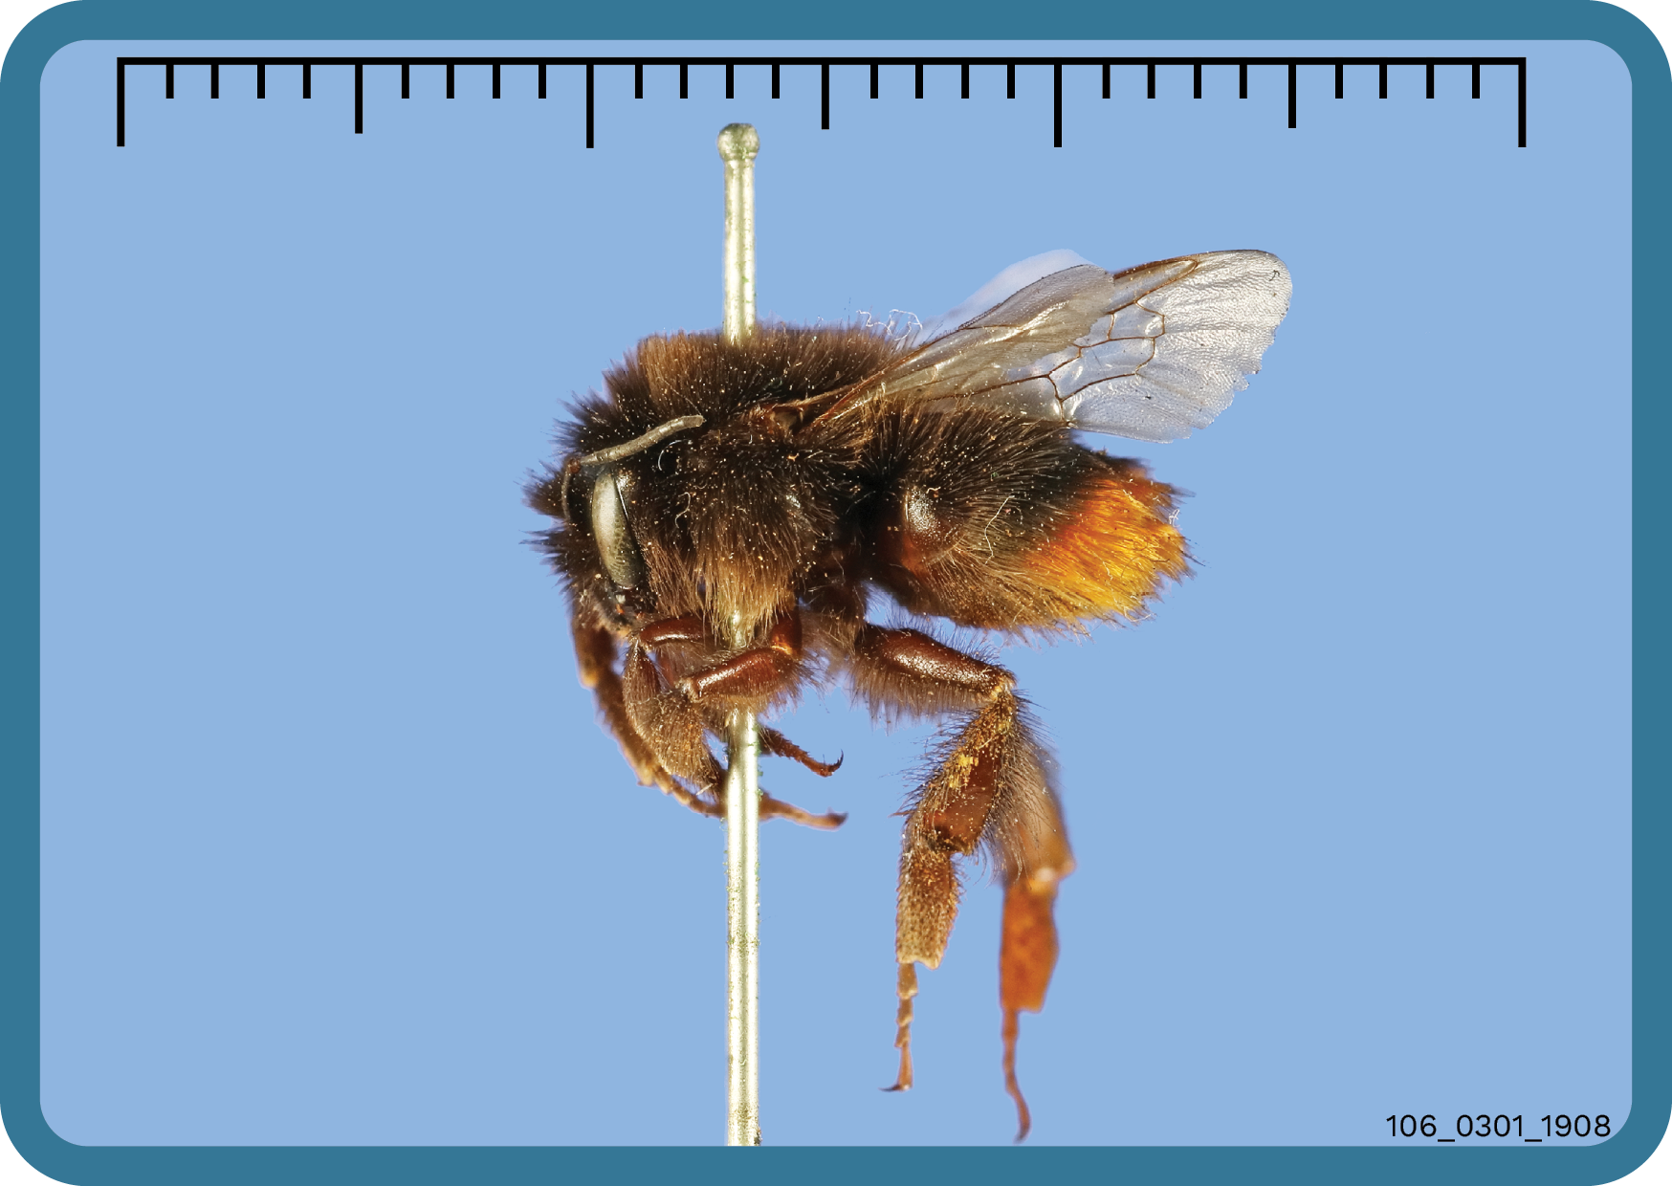
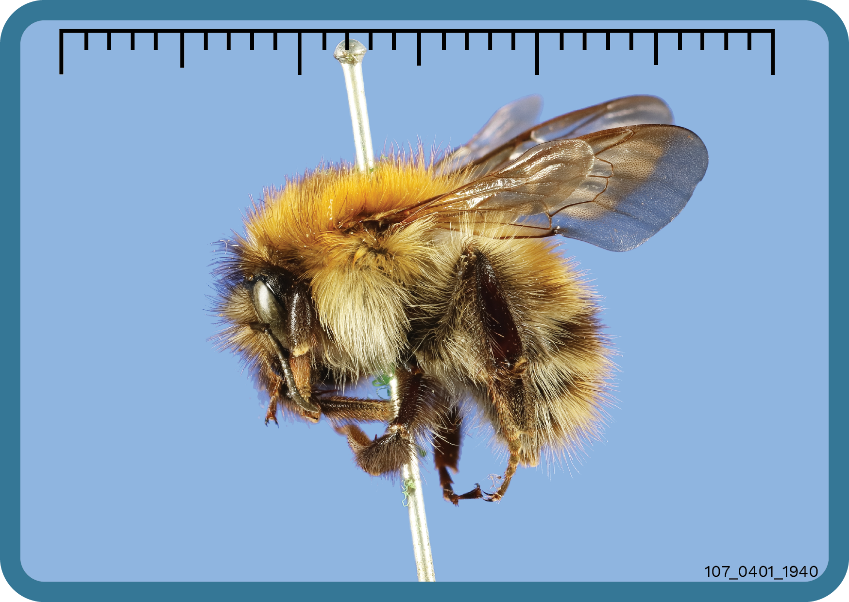
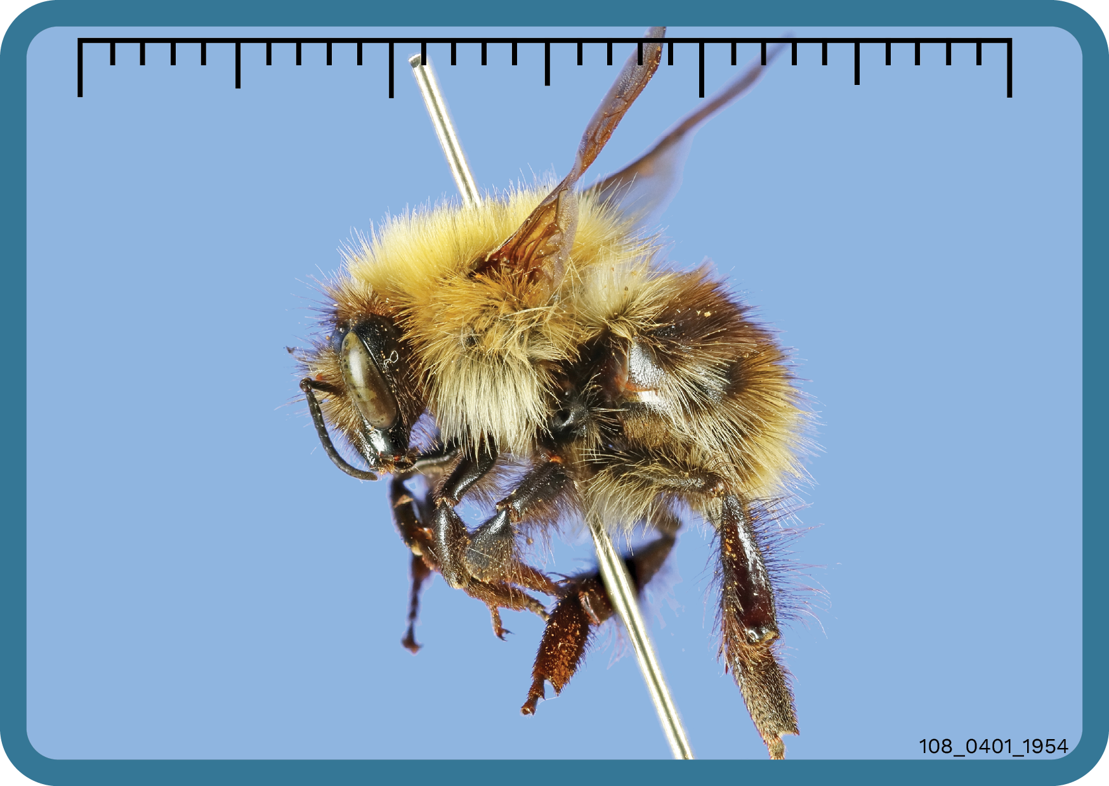

Slide 8
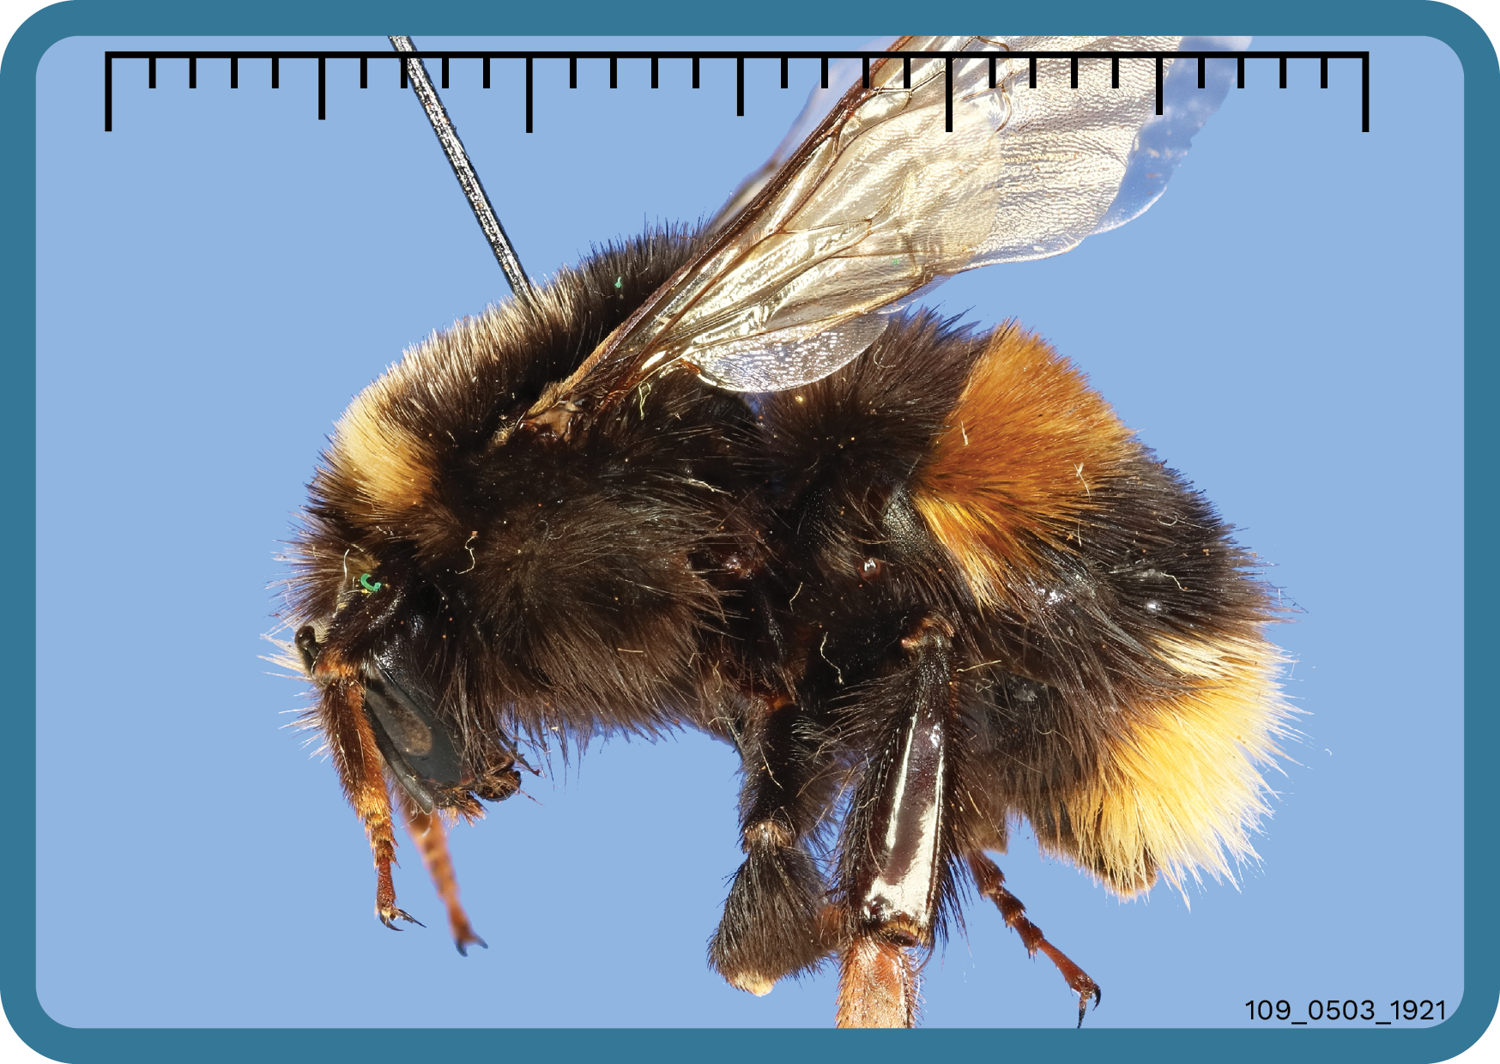
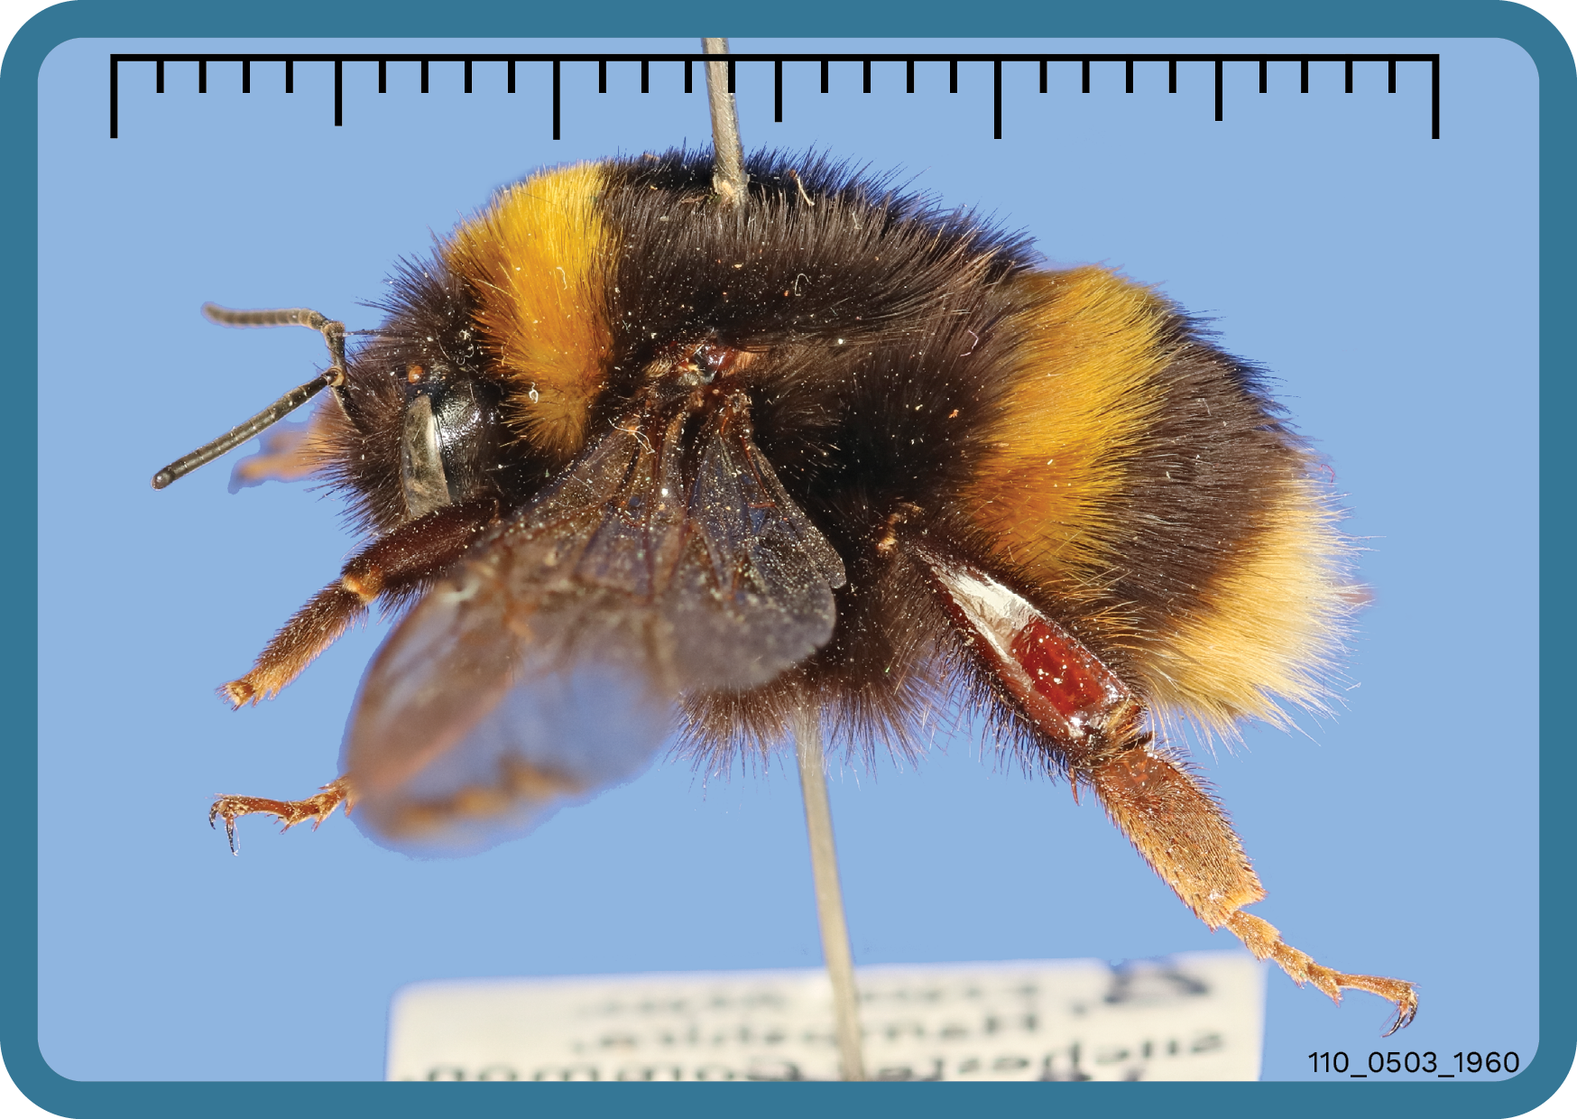

Slide 9
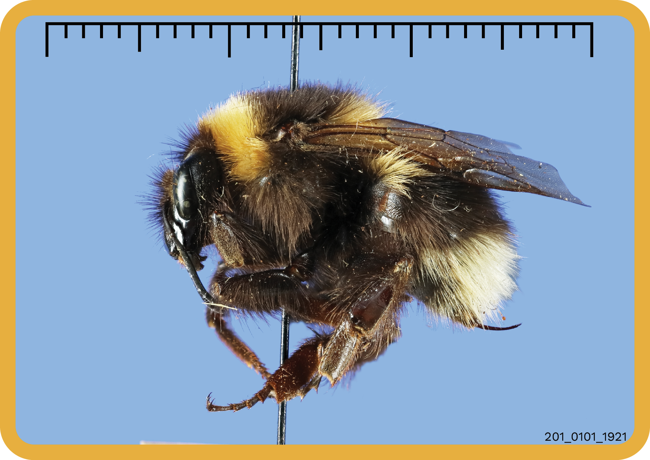
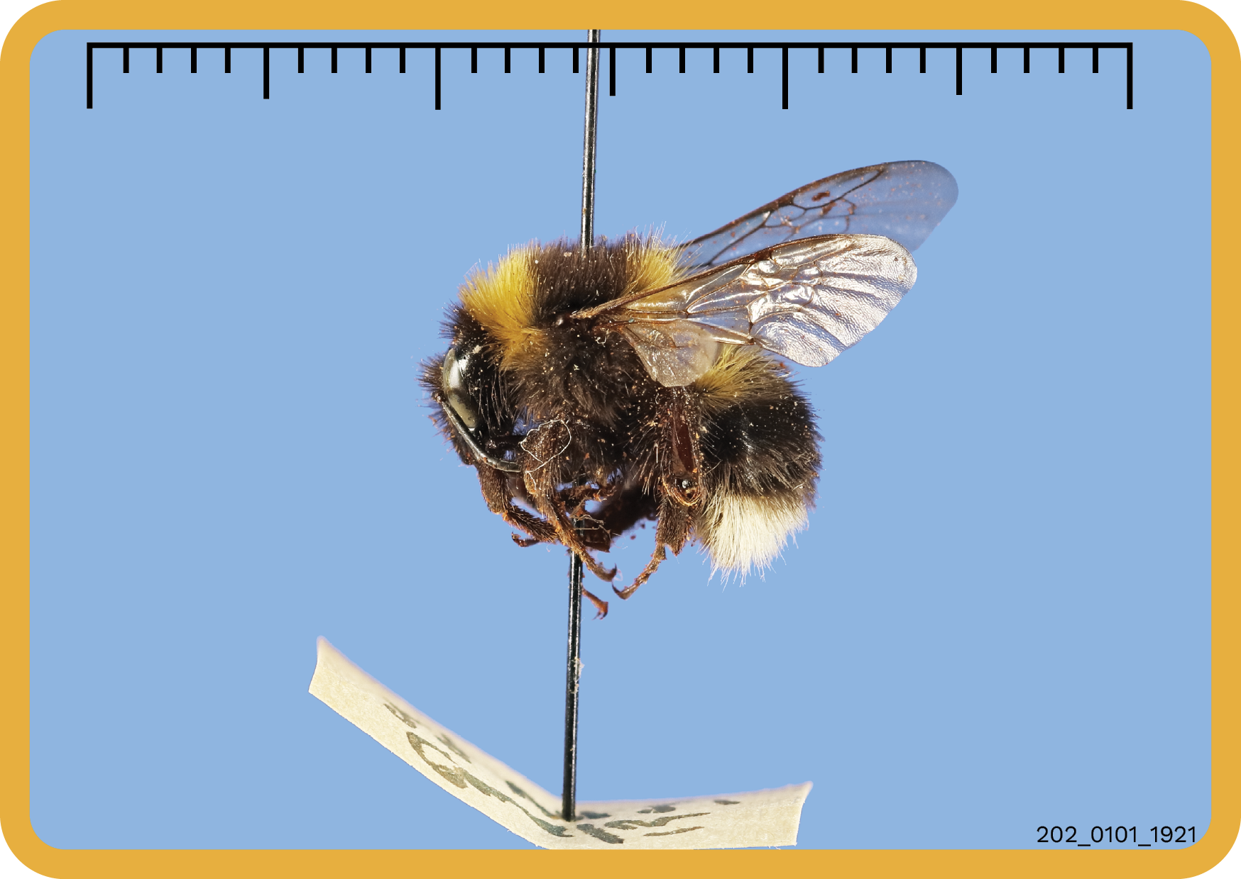
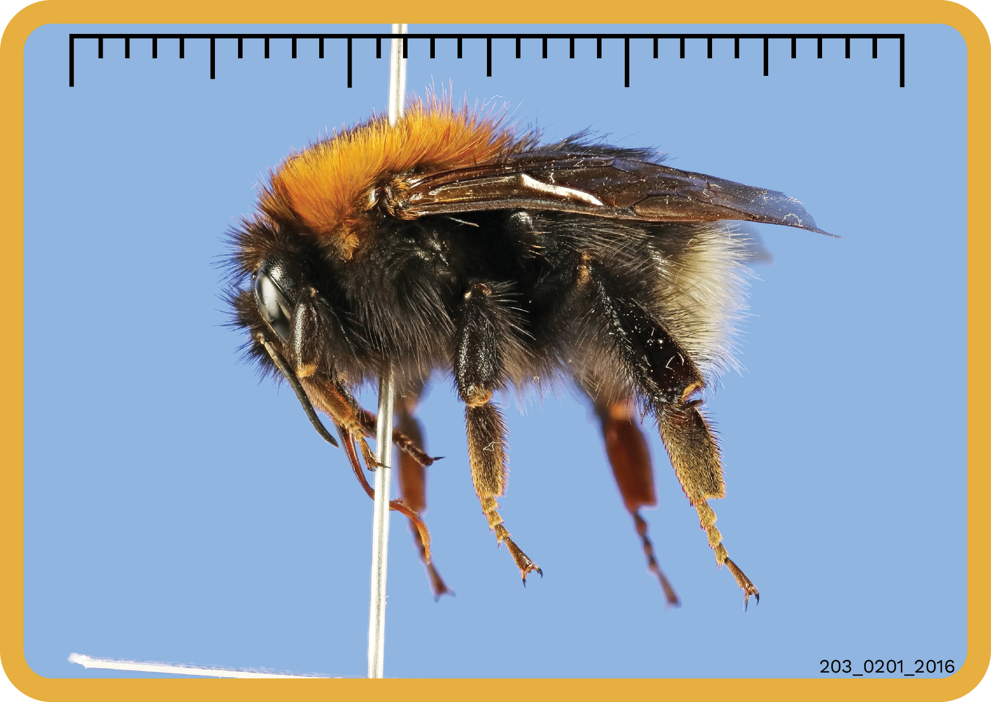
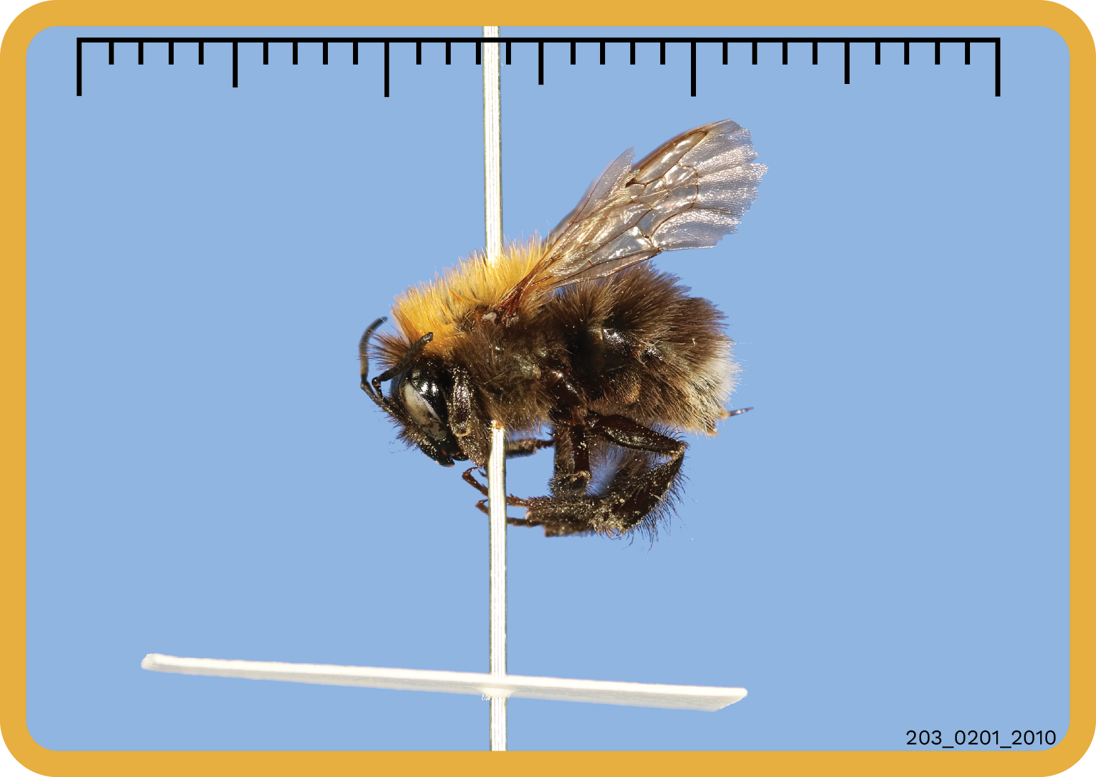

Slide 10
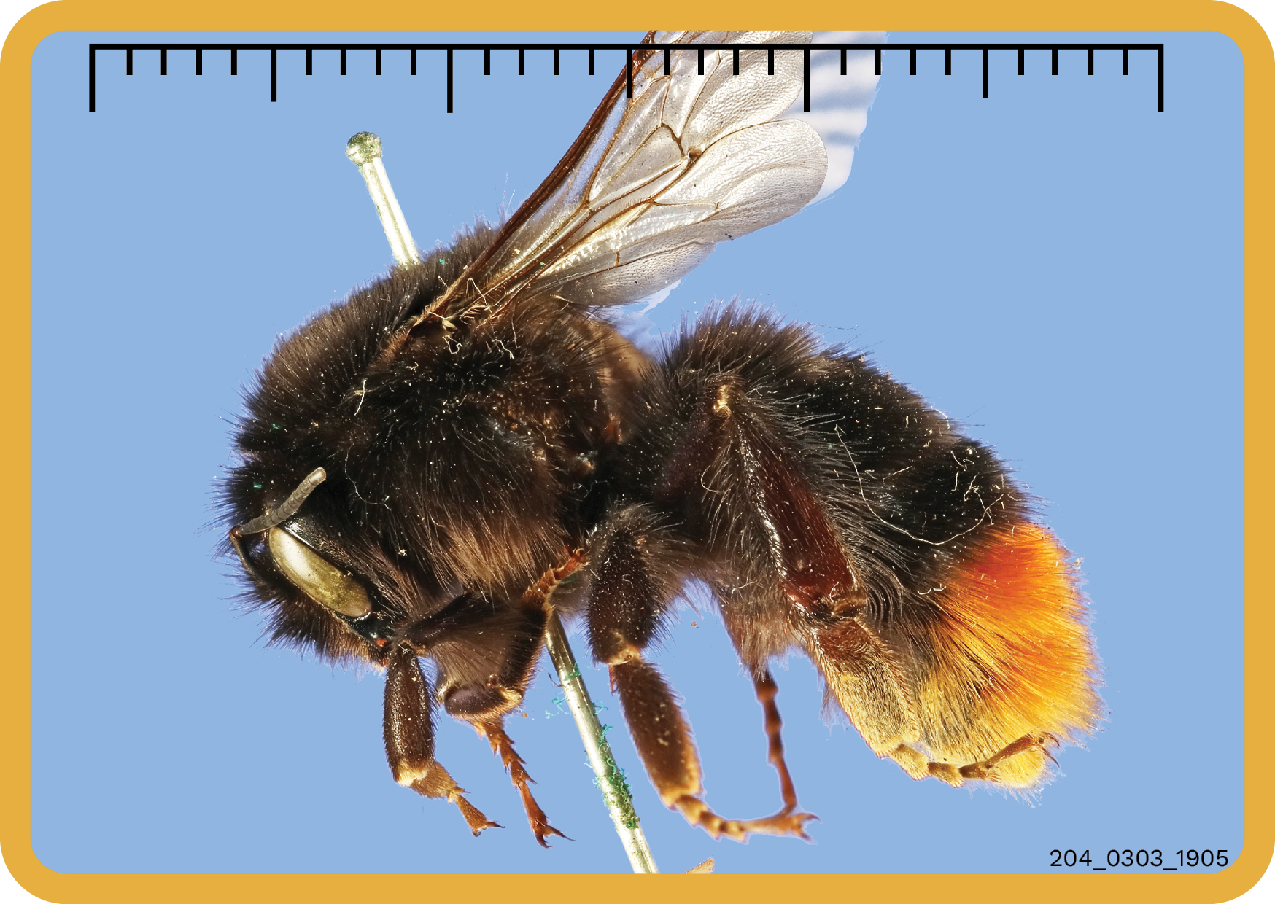
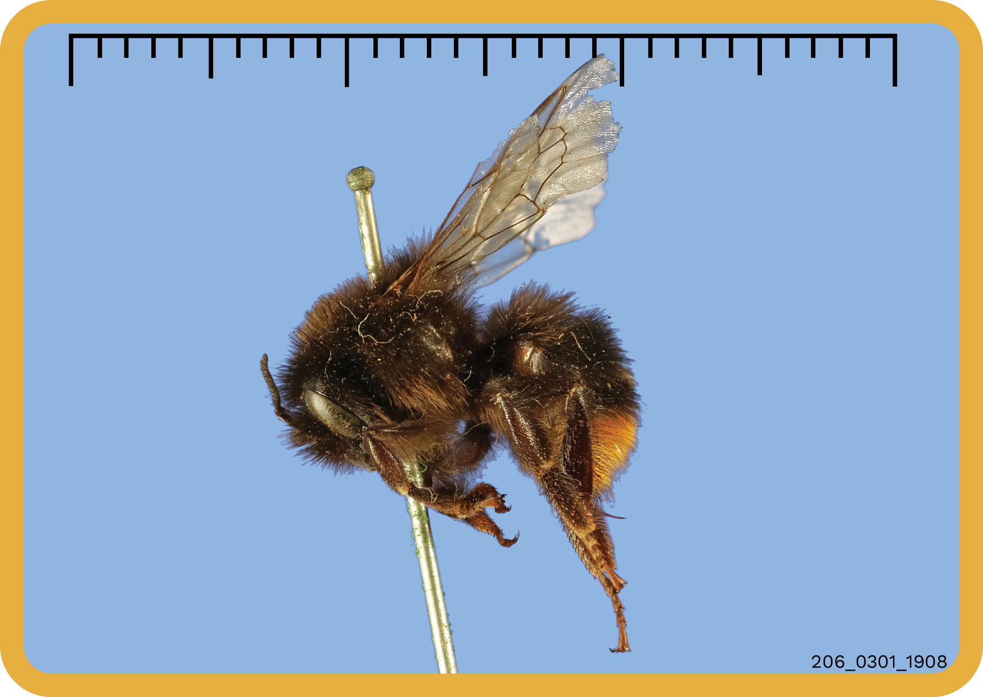
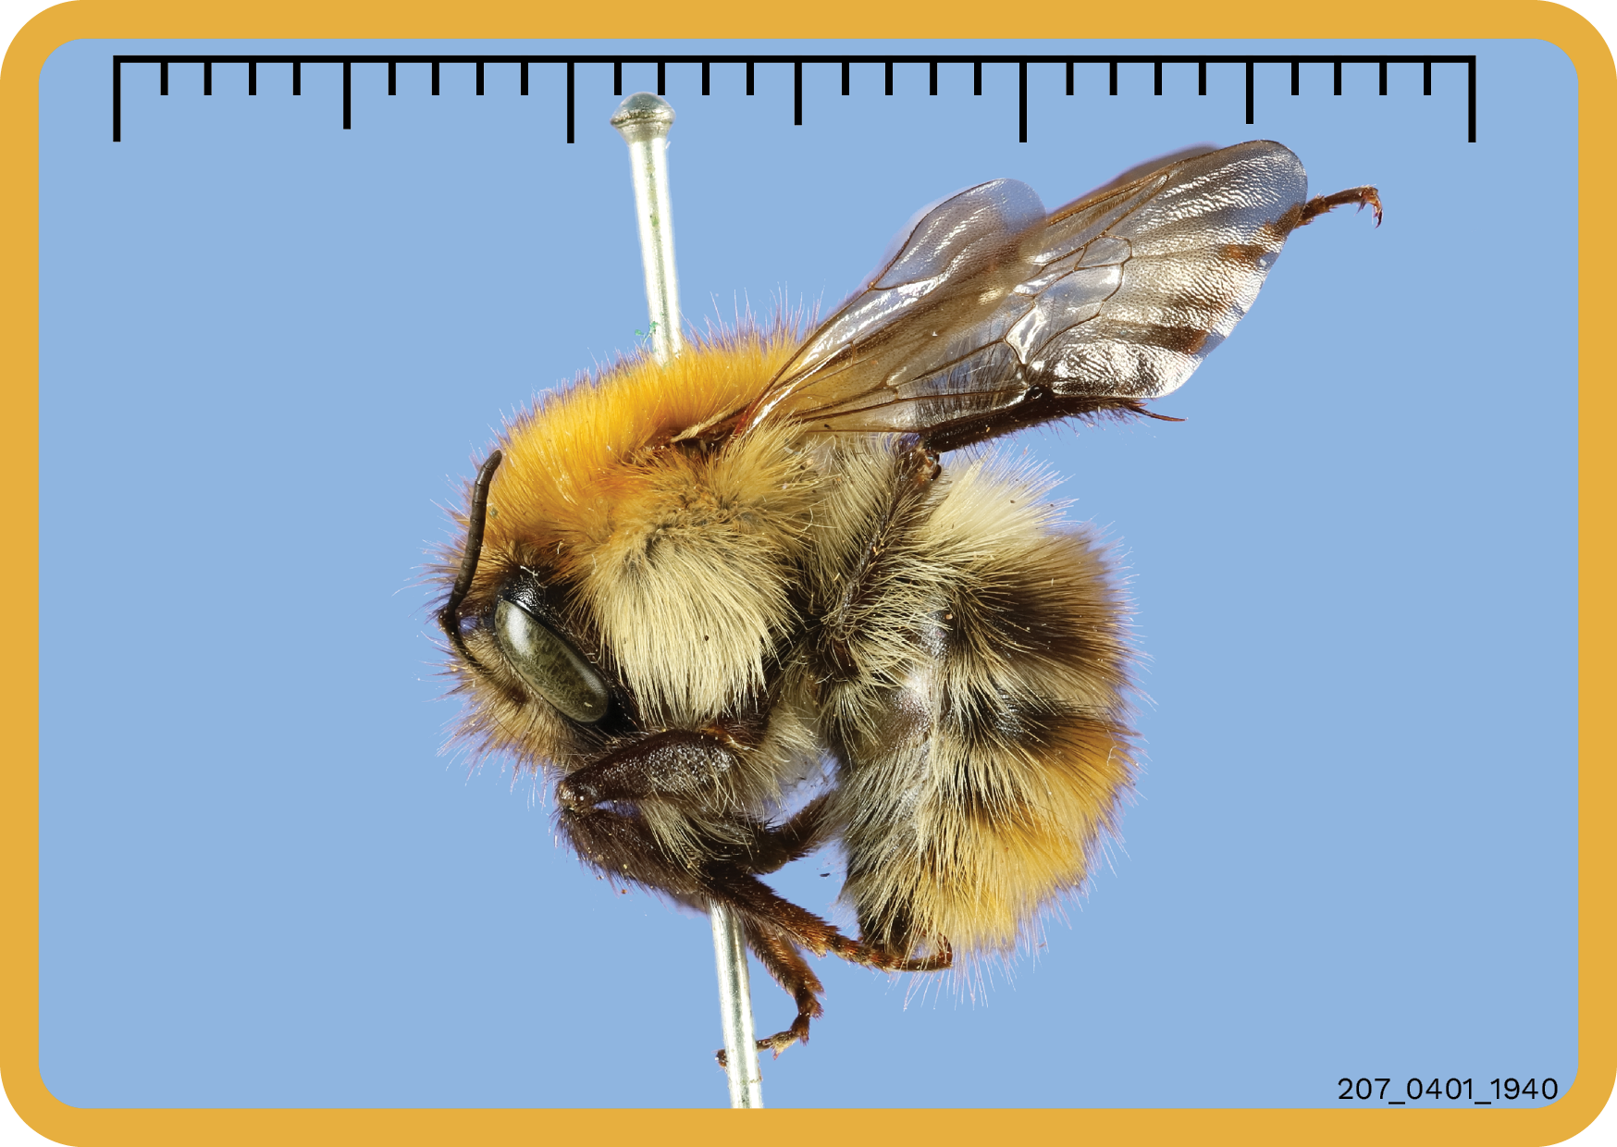
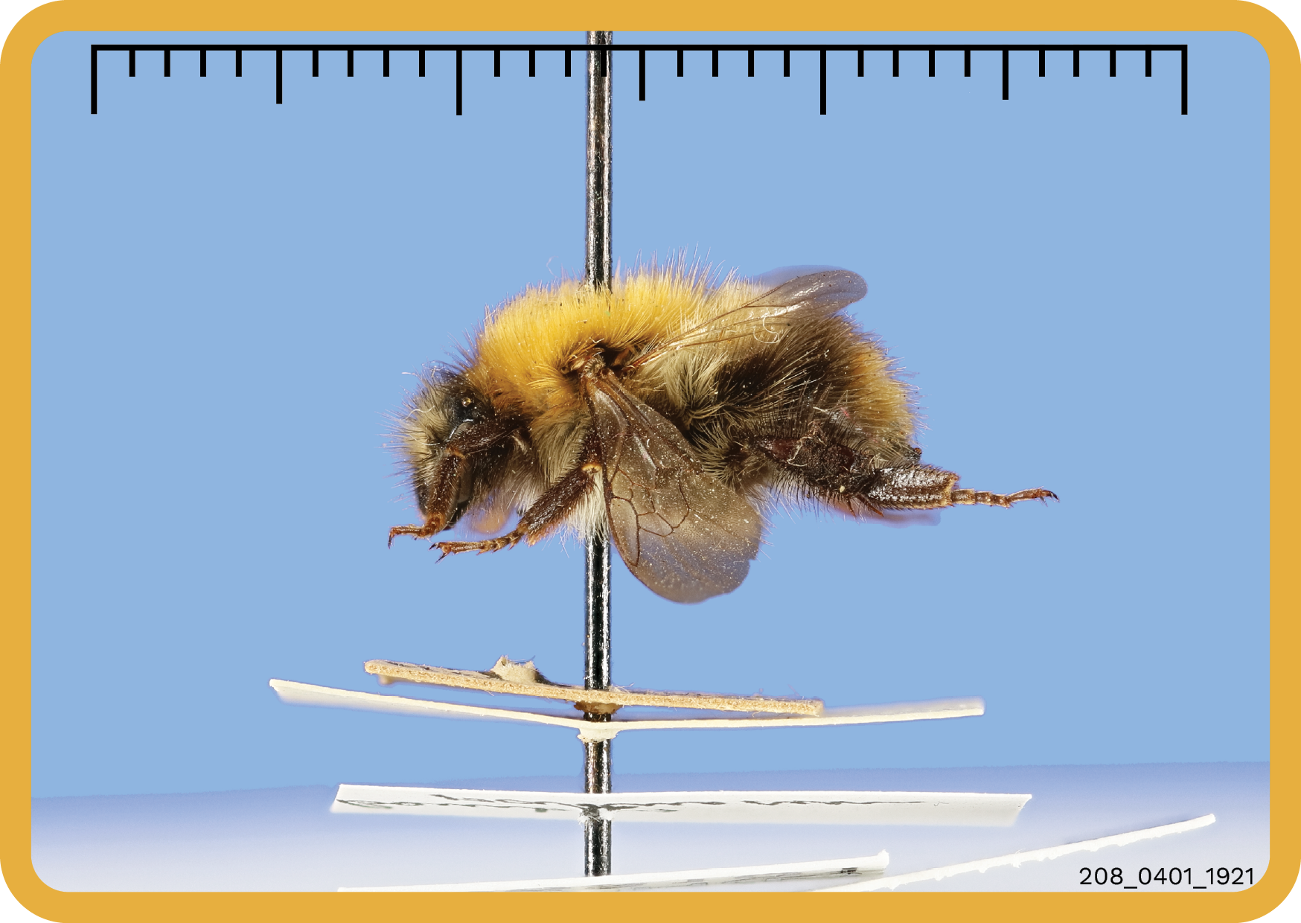

Slide 11
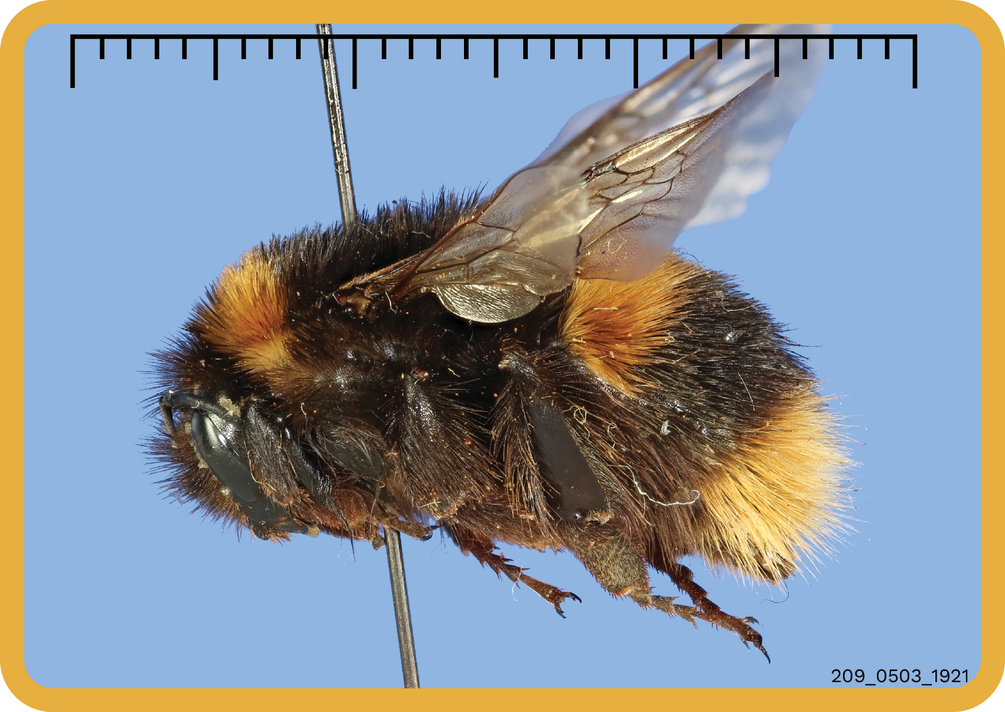
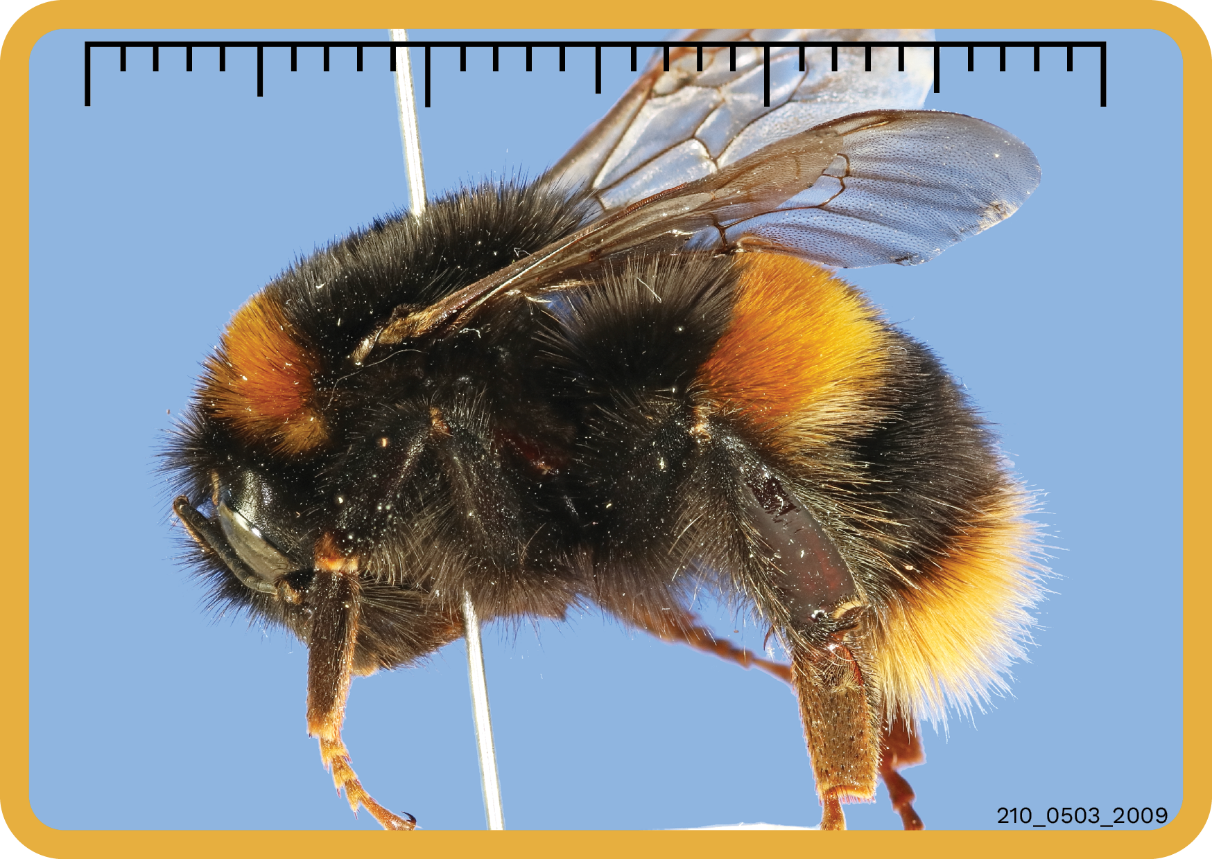

Slide 12
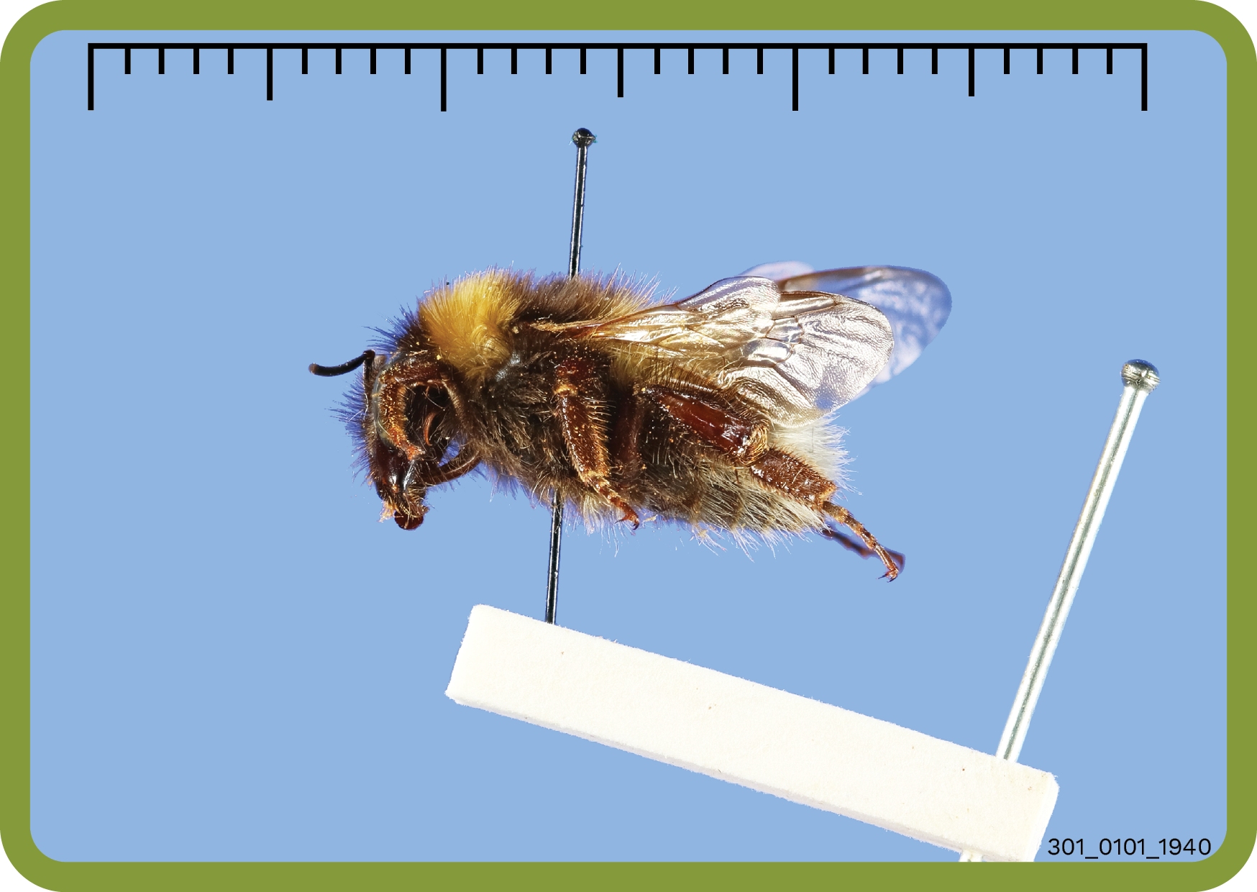
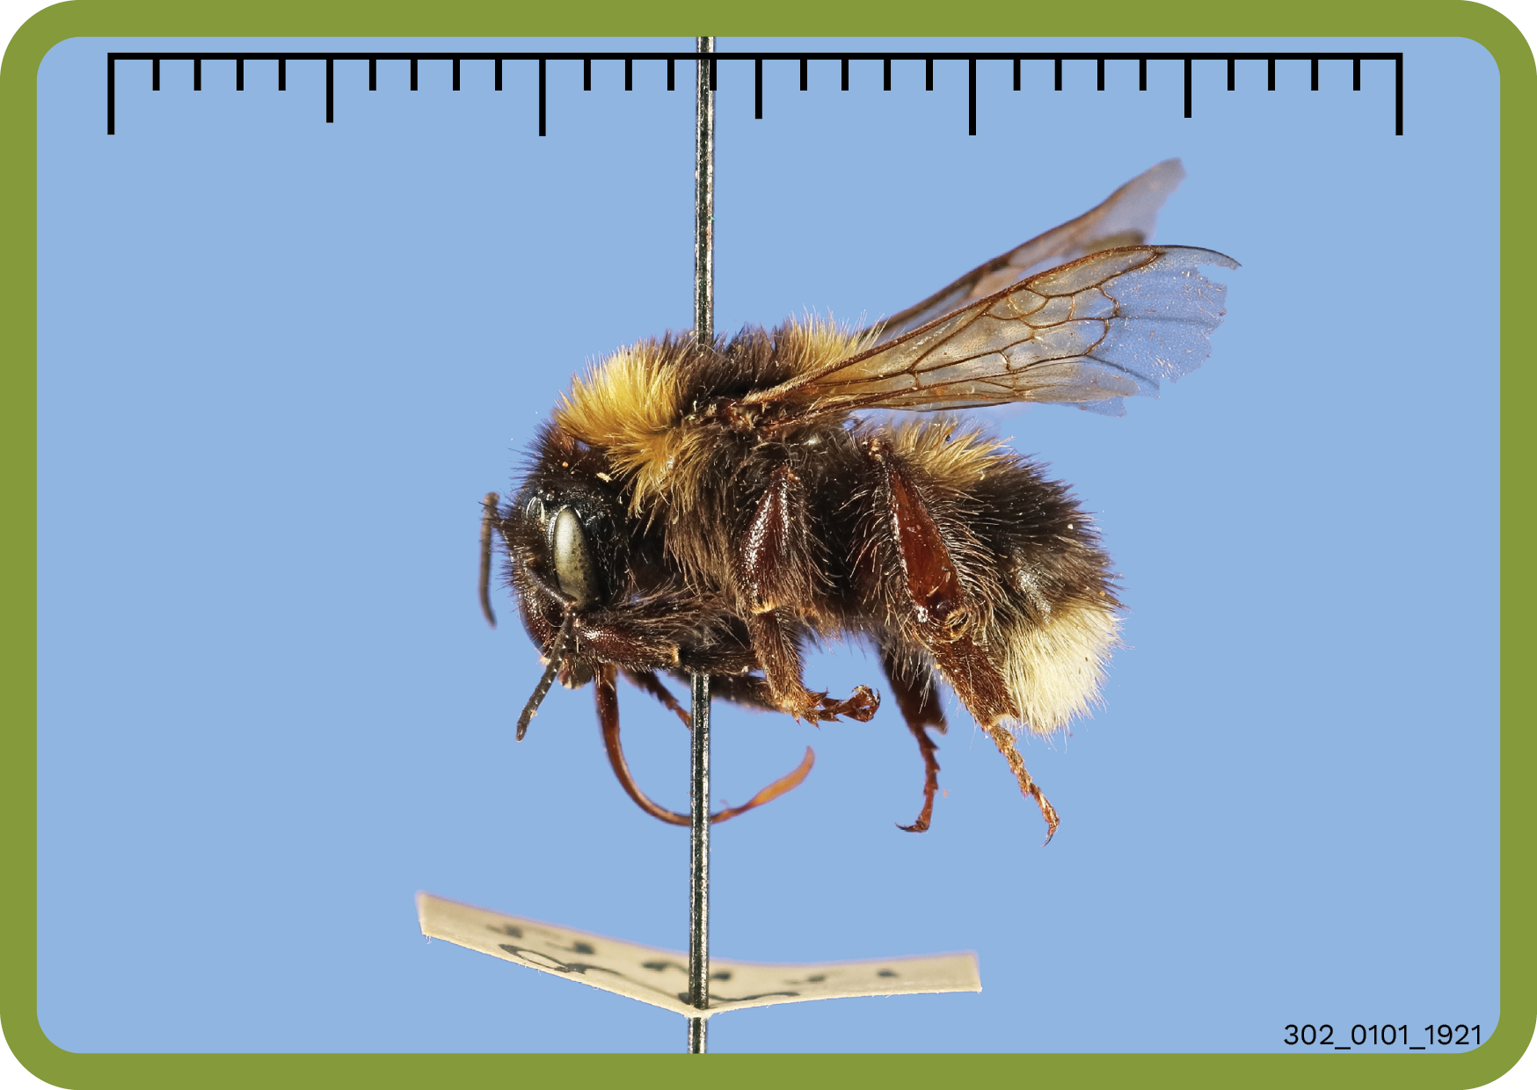
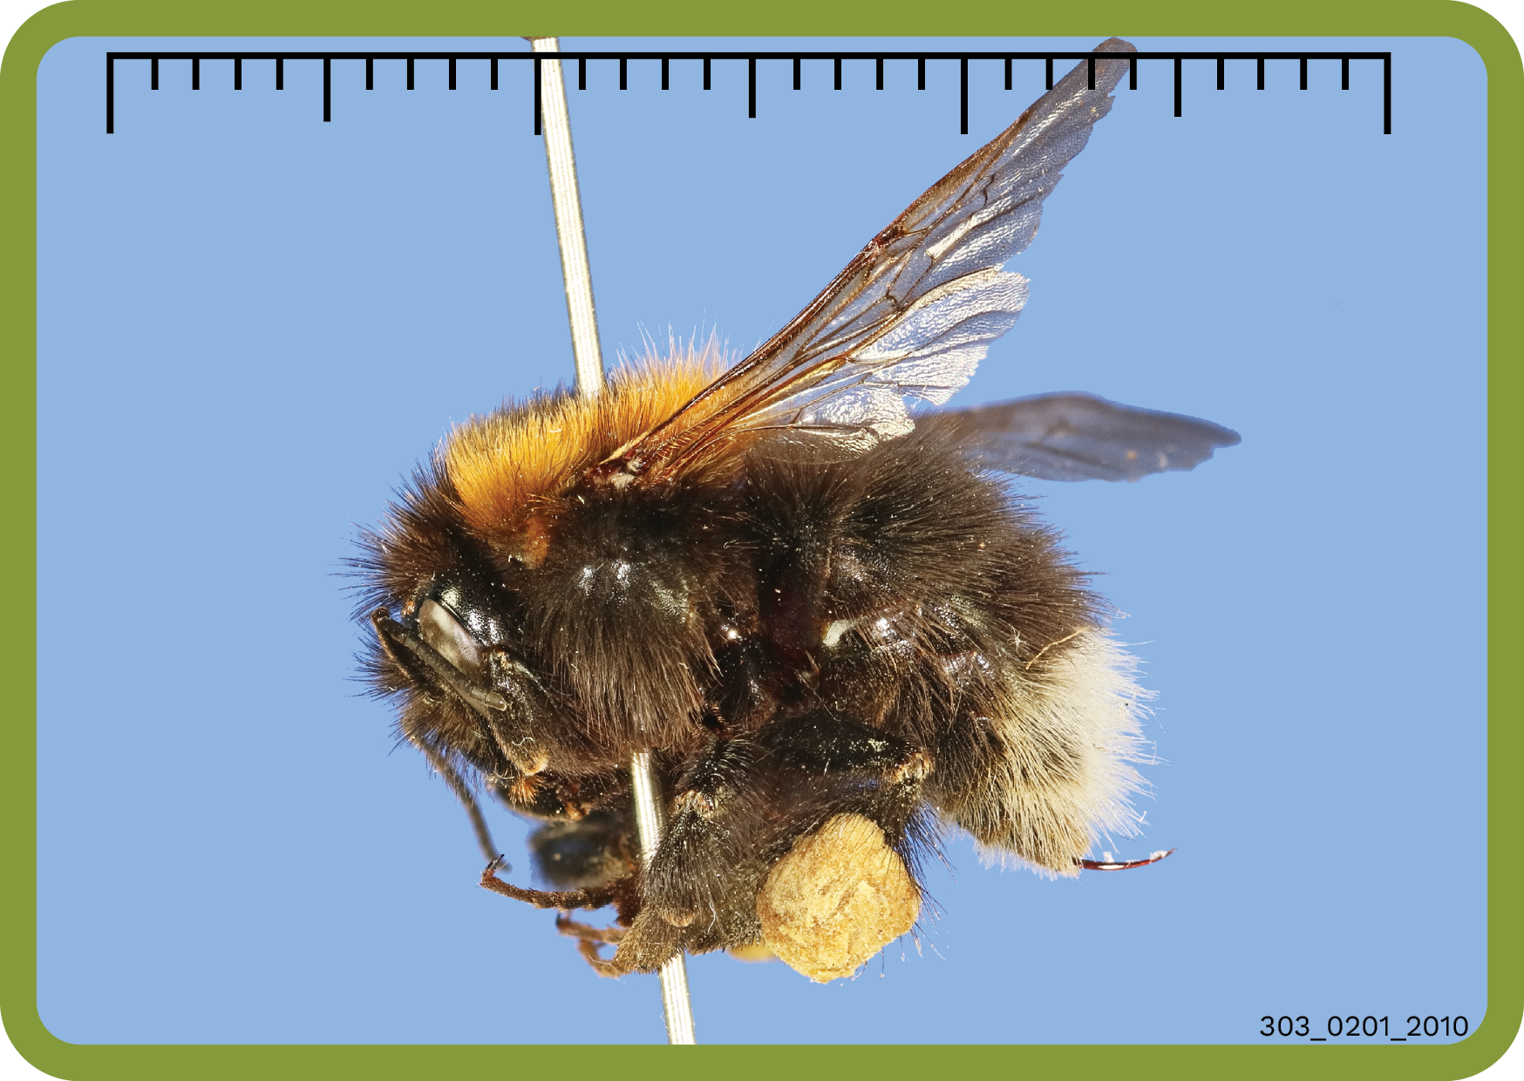
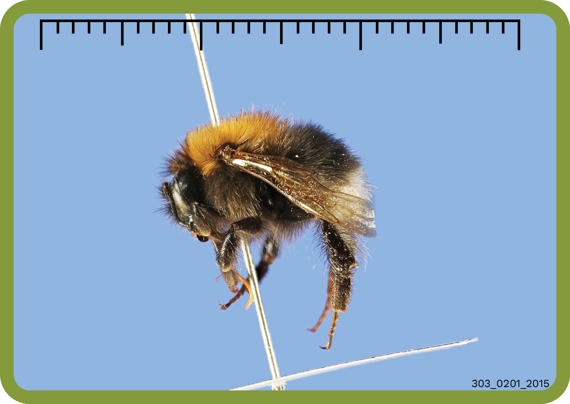

Slide 13
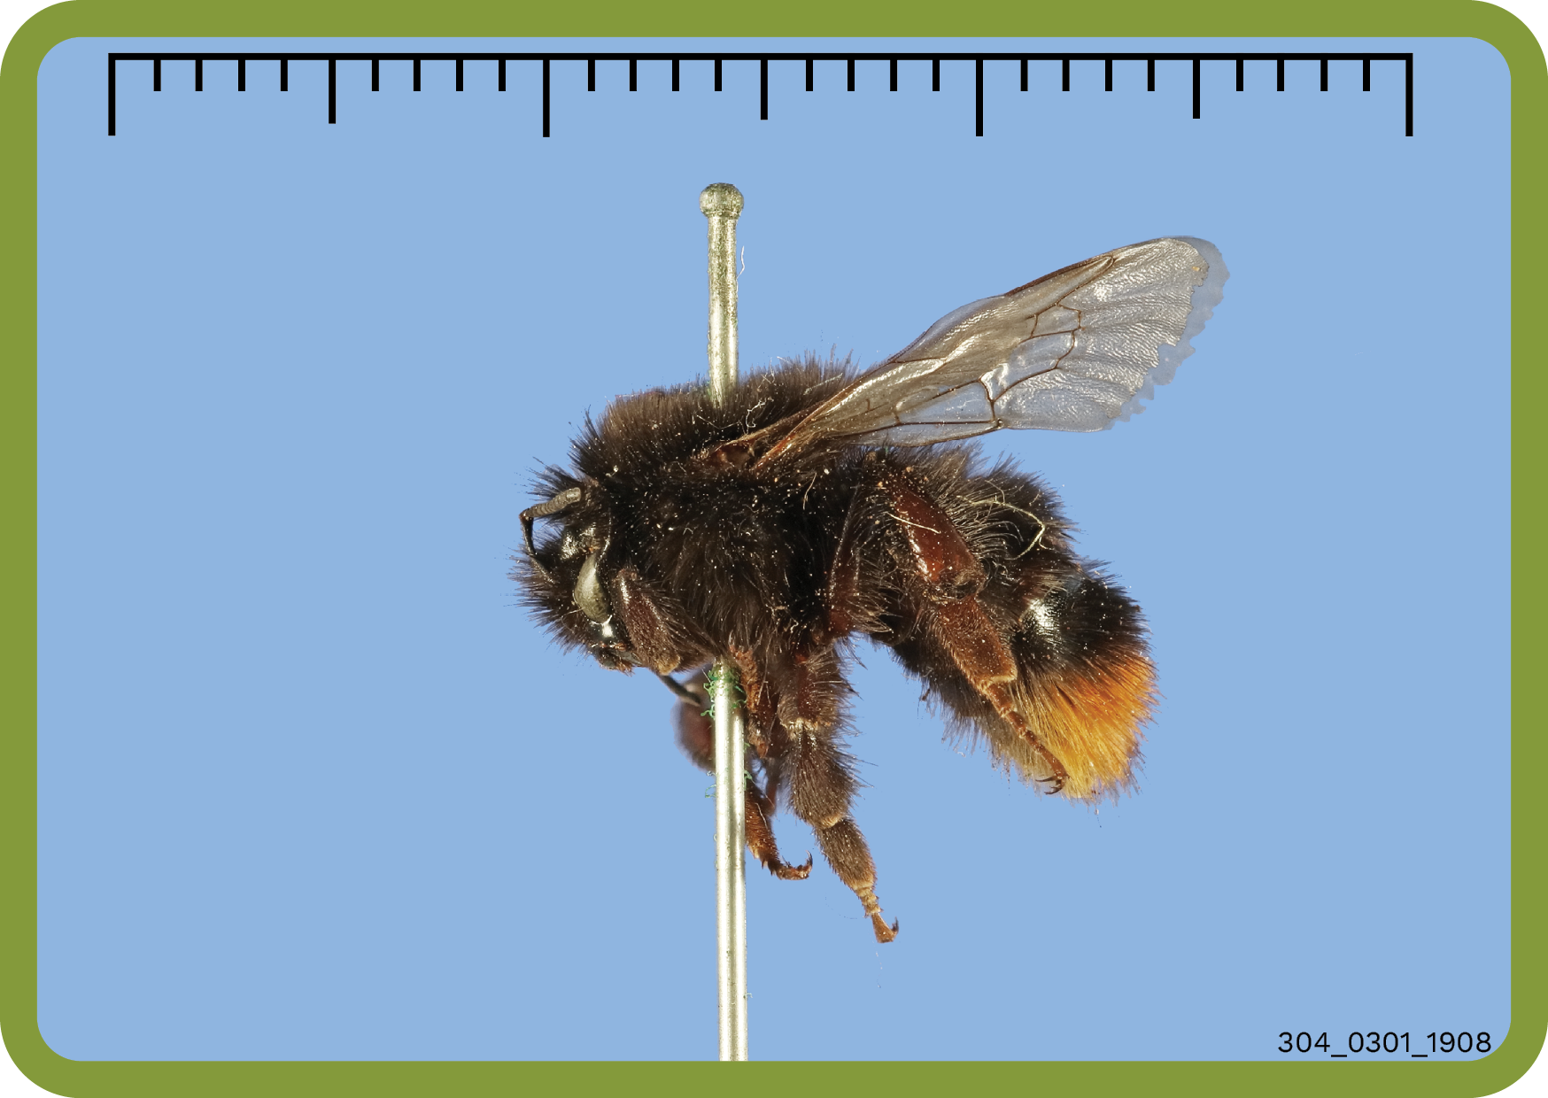
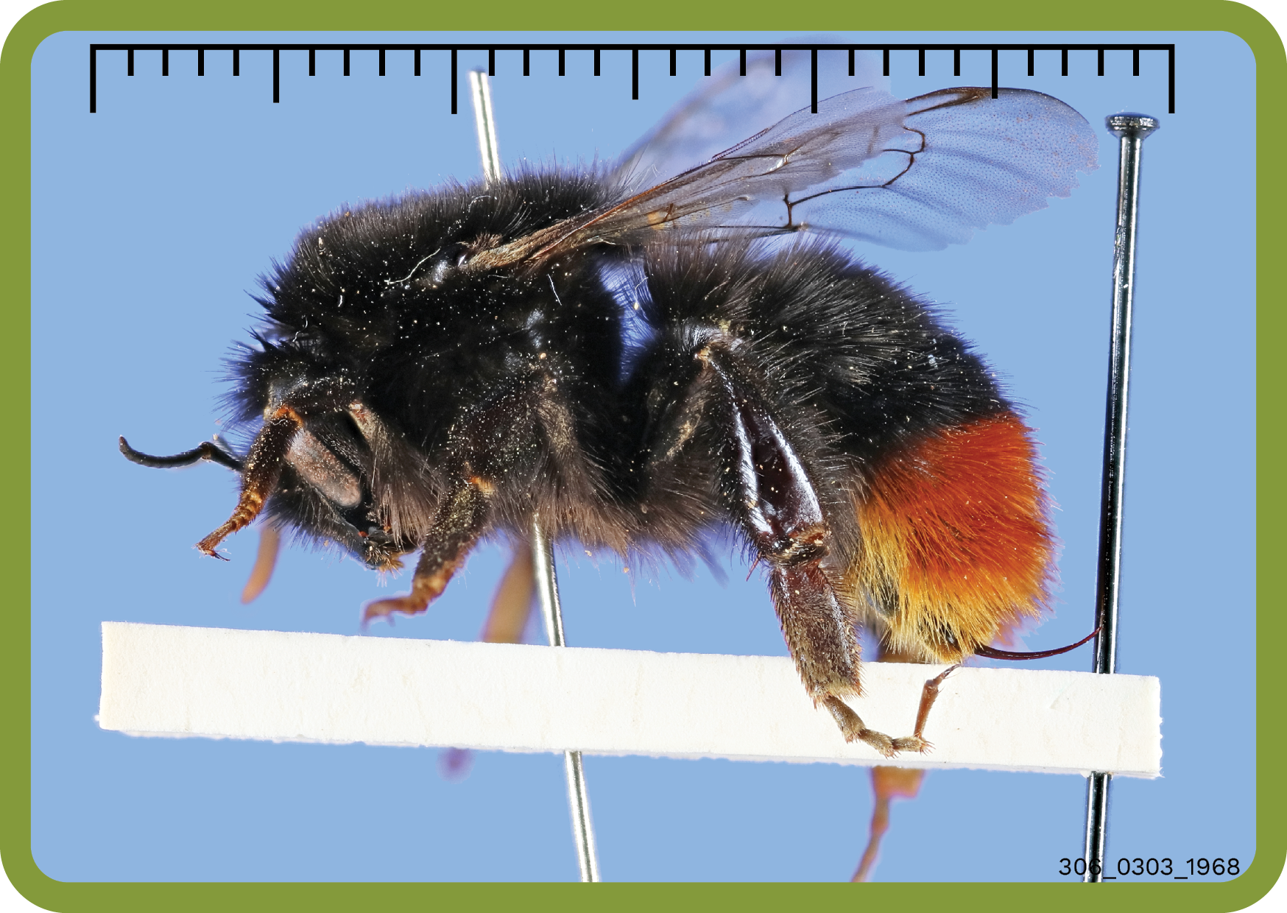
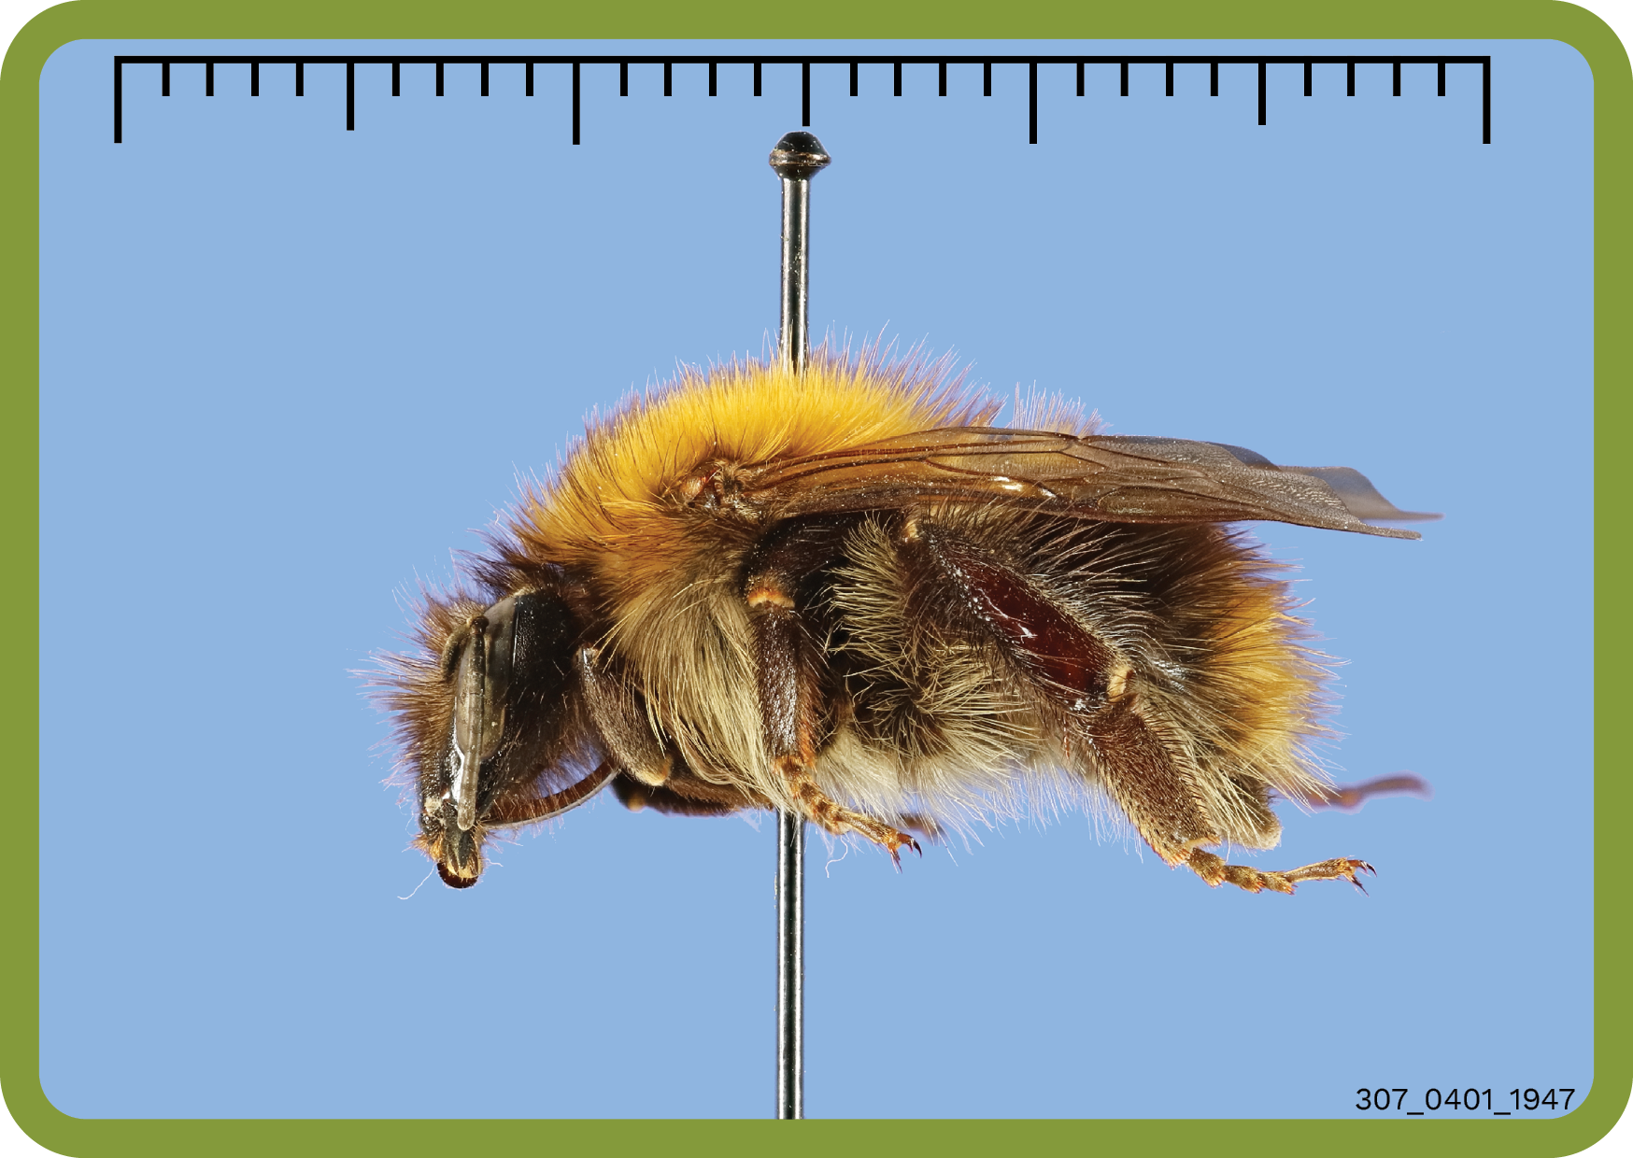
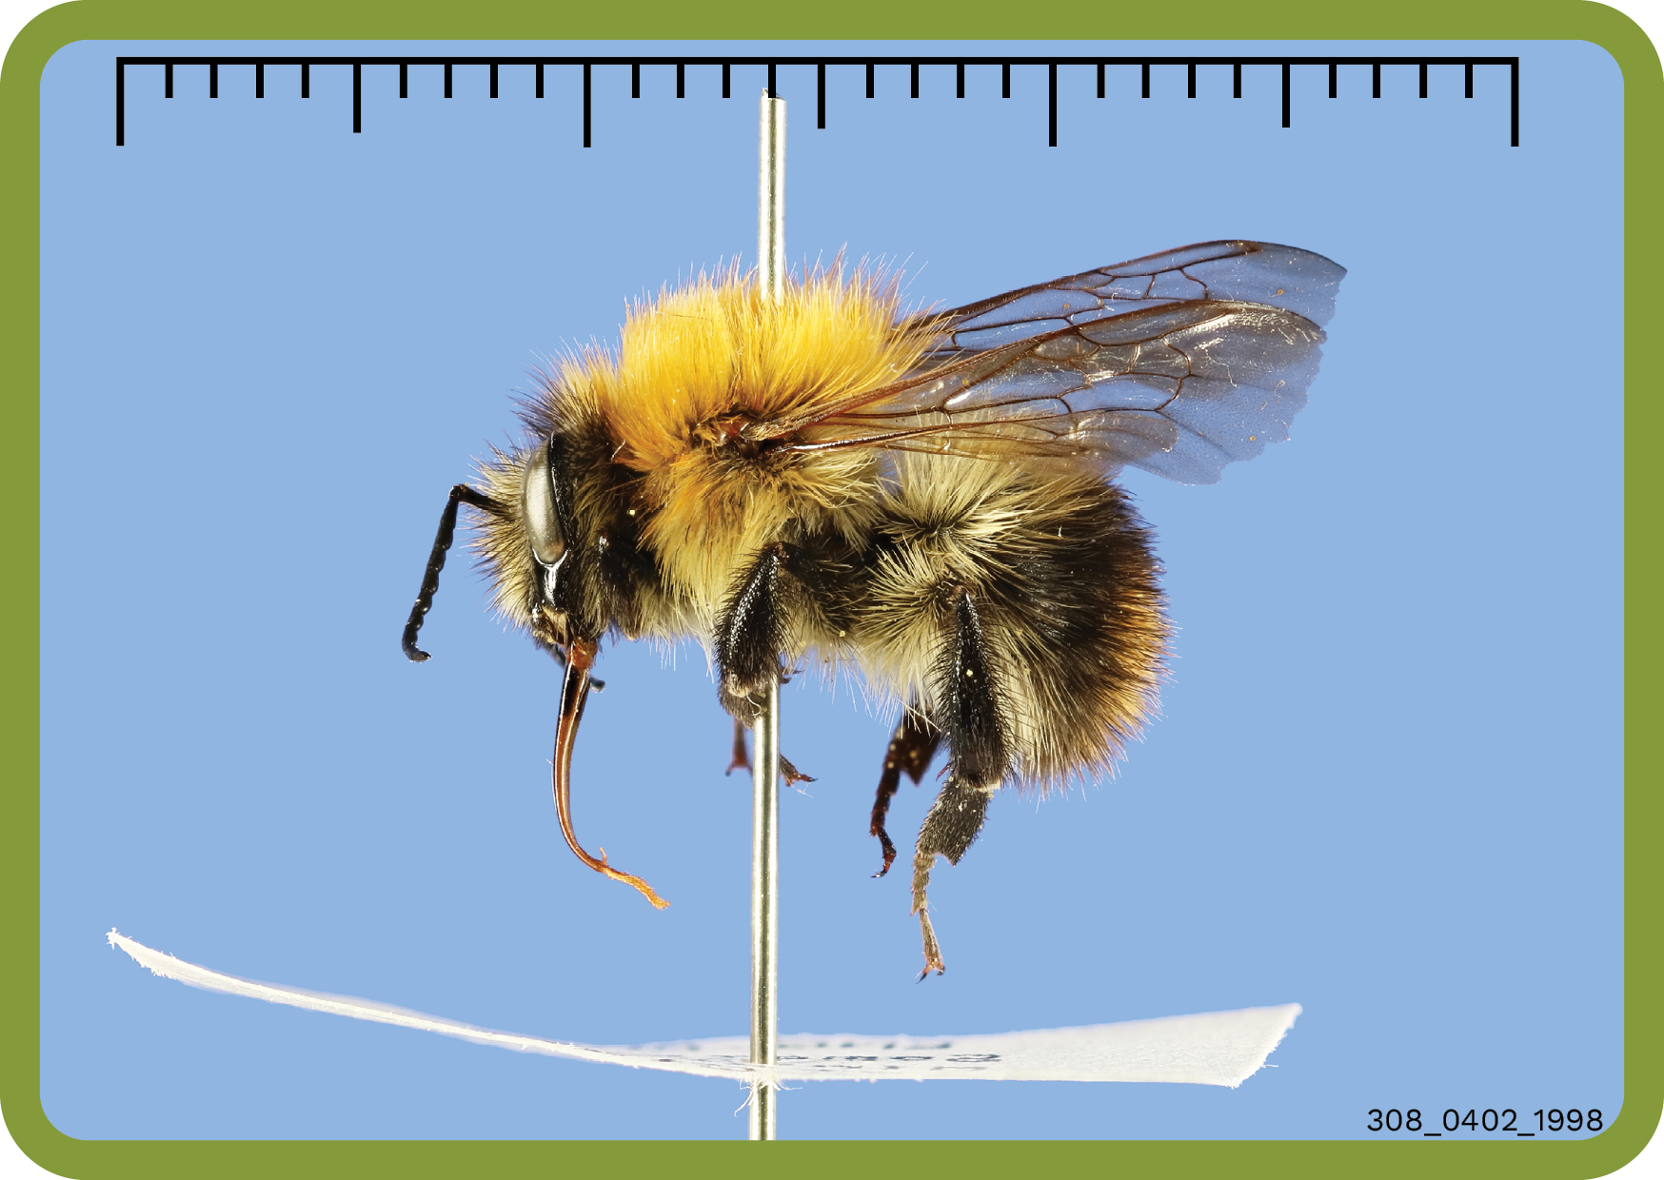

Slide 14
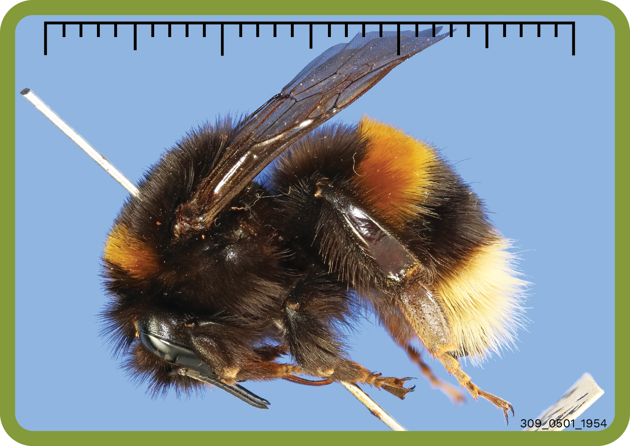
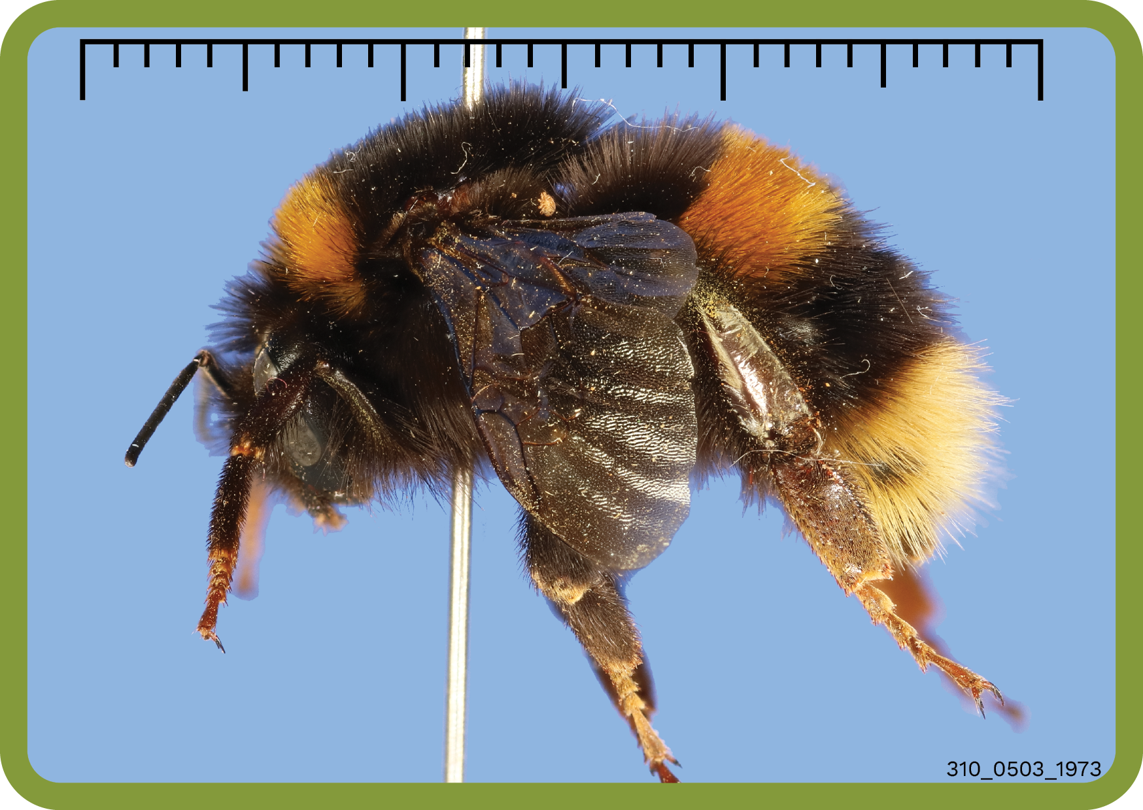

Slide 15
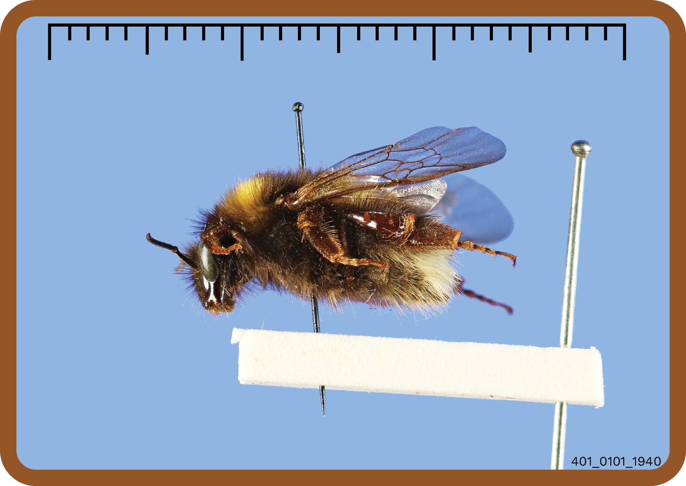
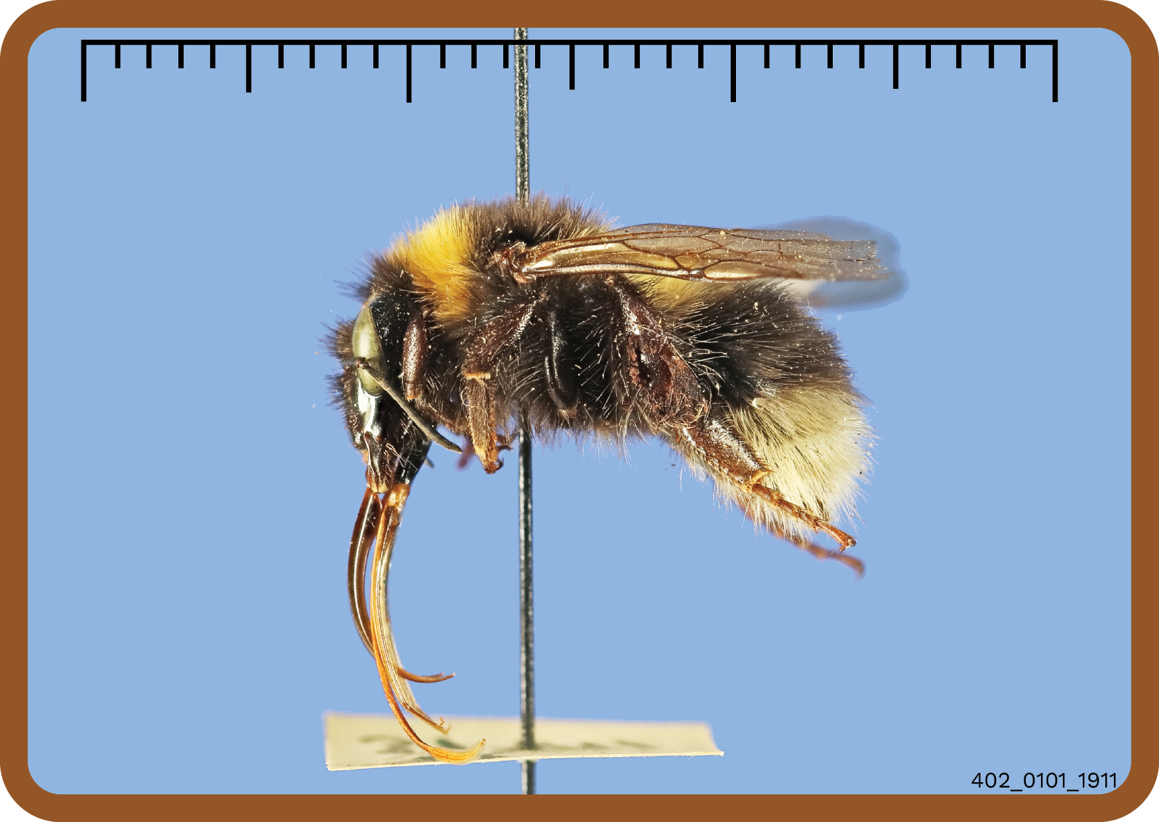
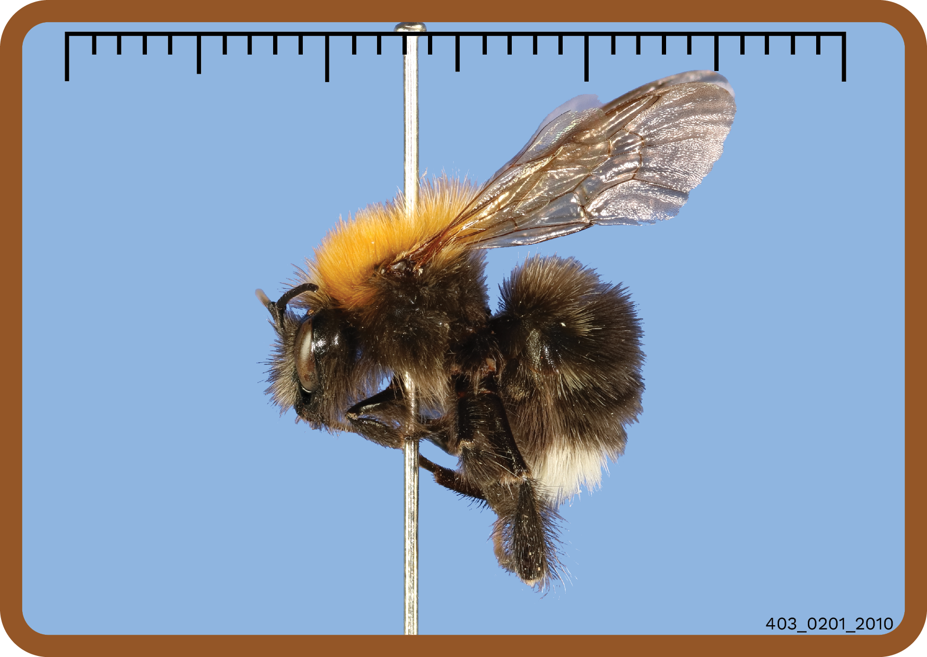
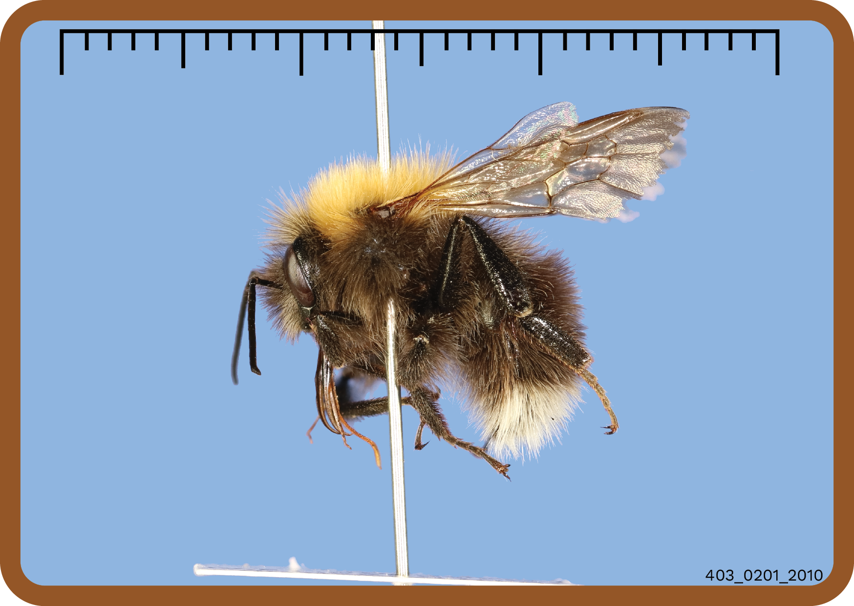

Slide 16
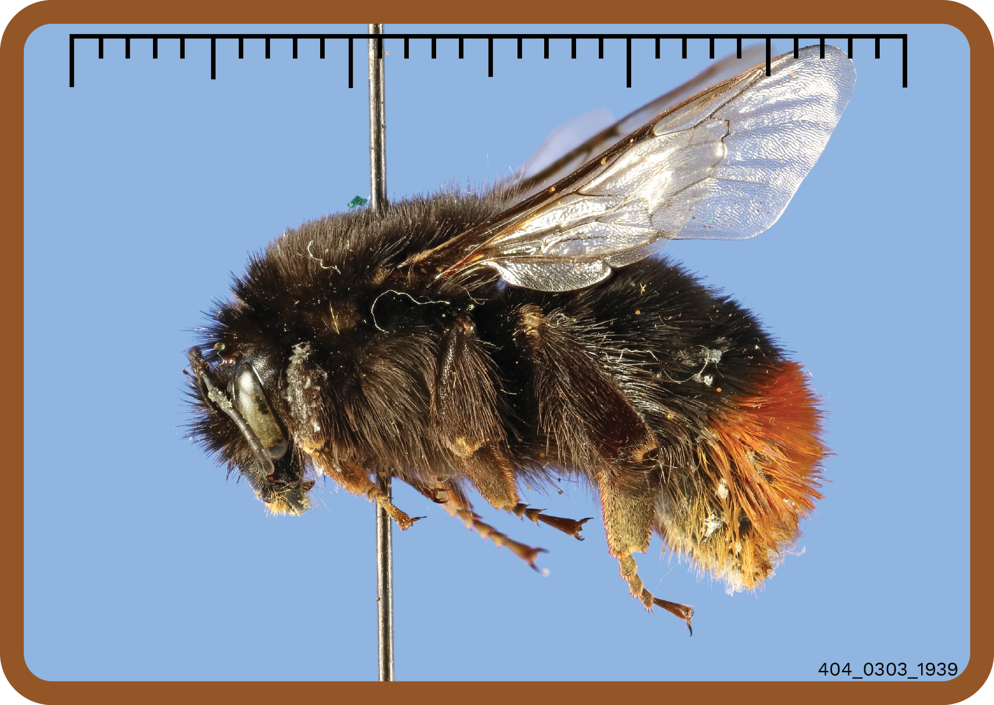
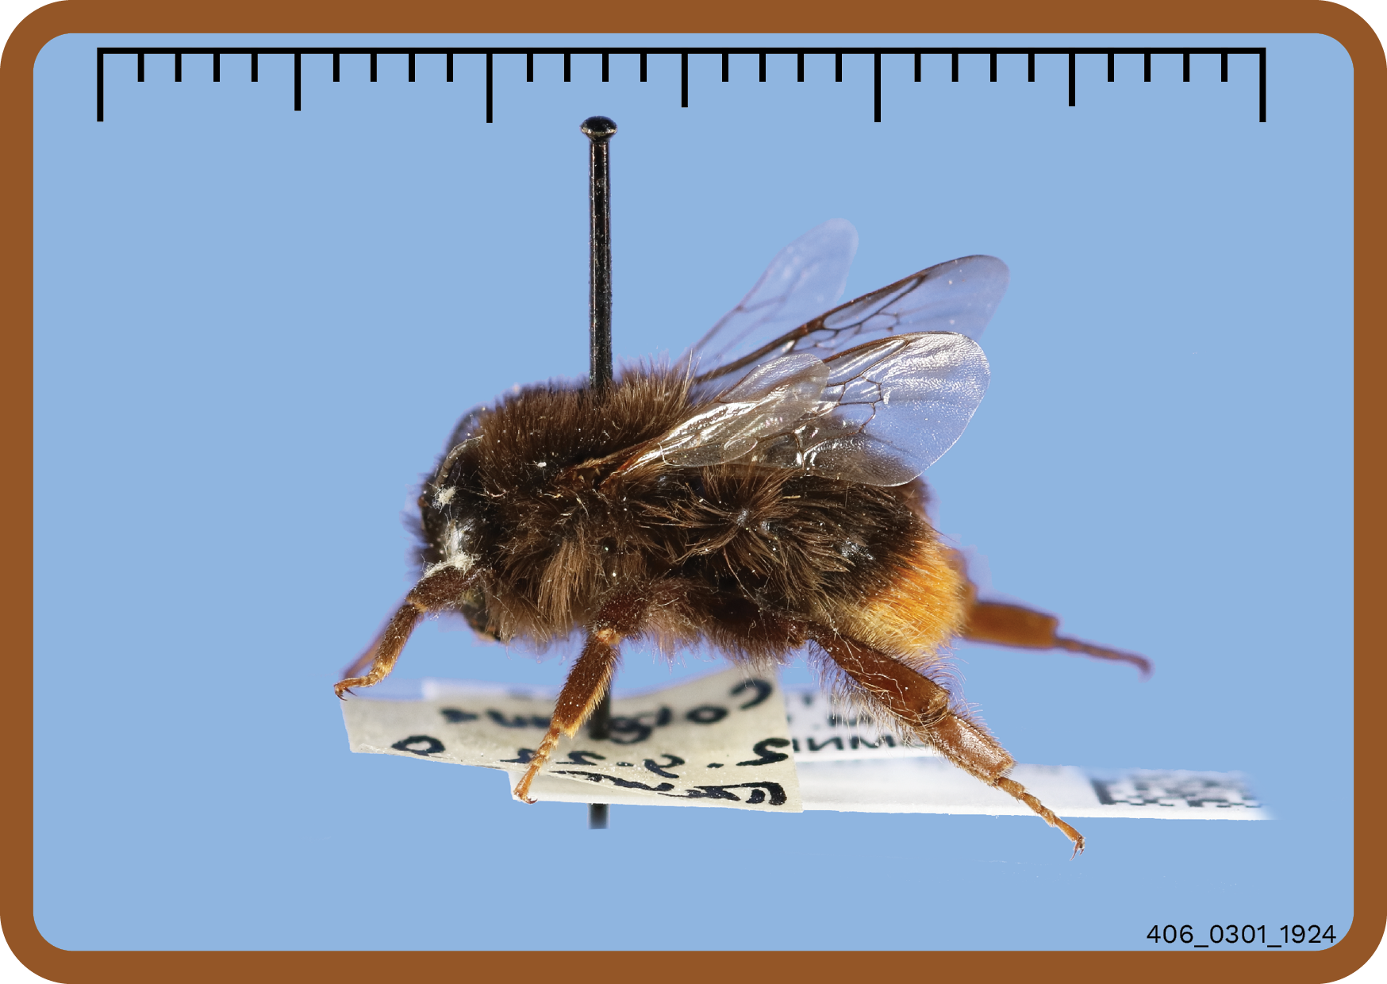
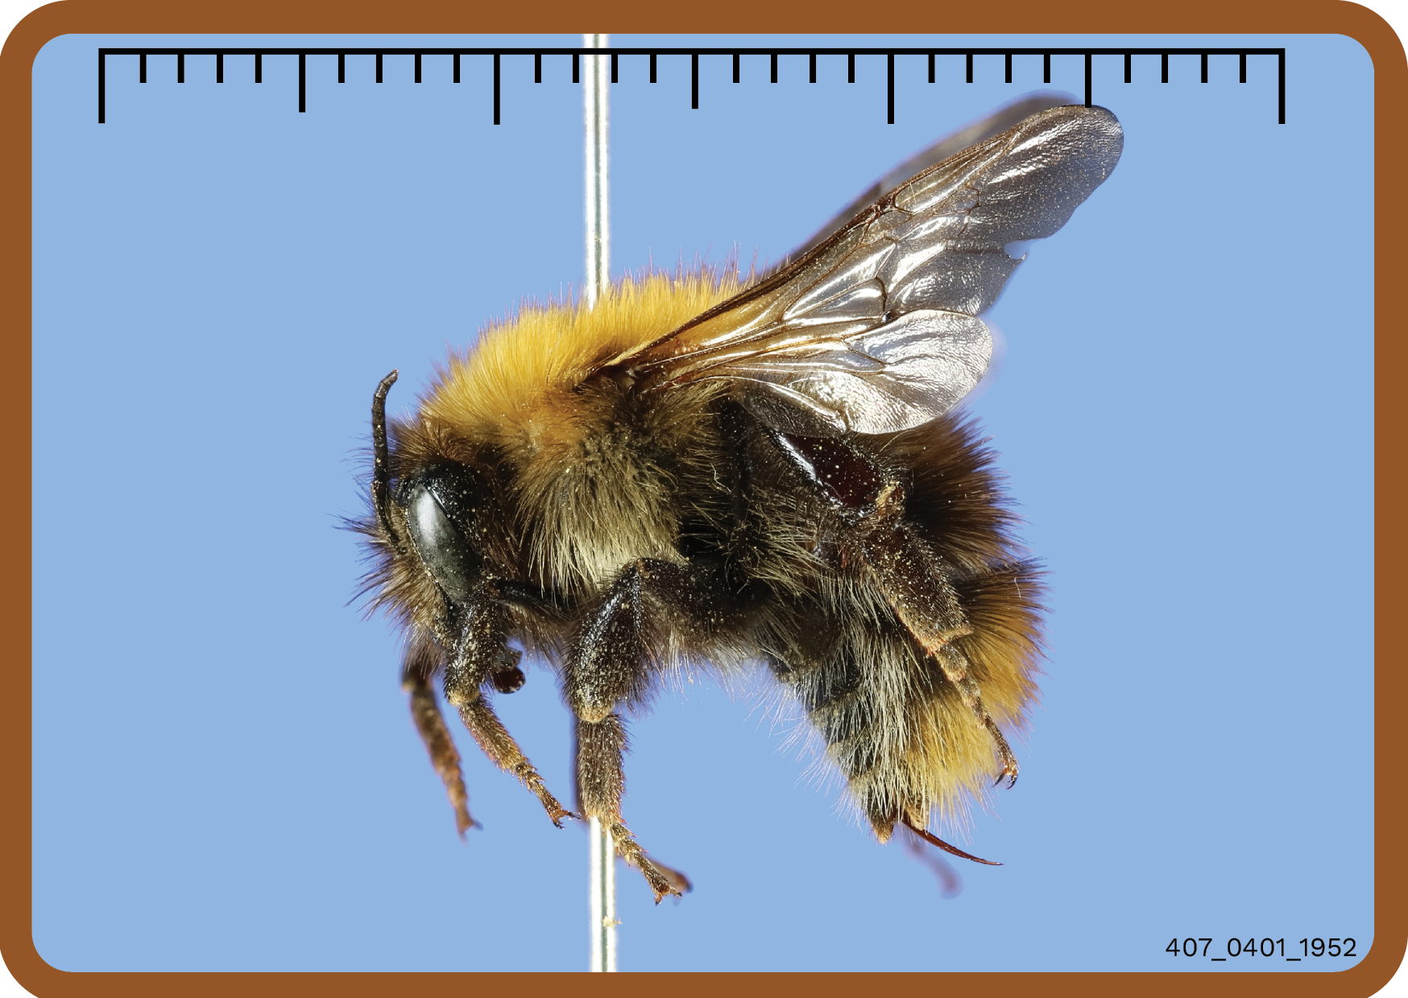
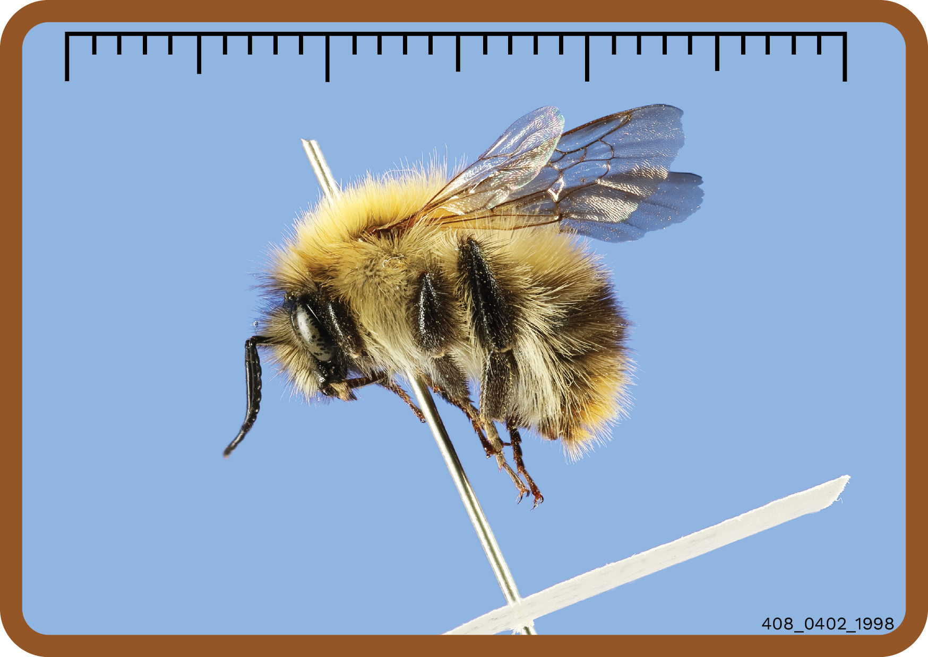

Slide 17
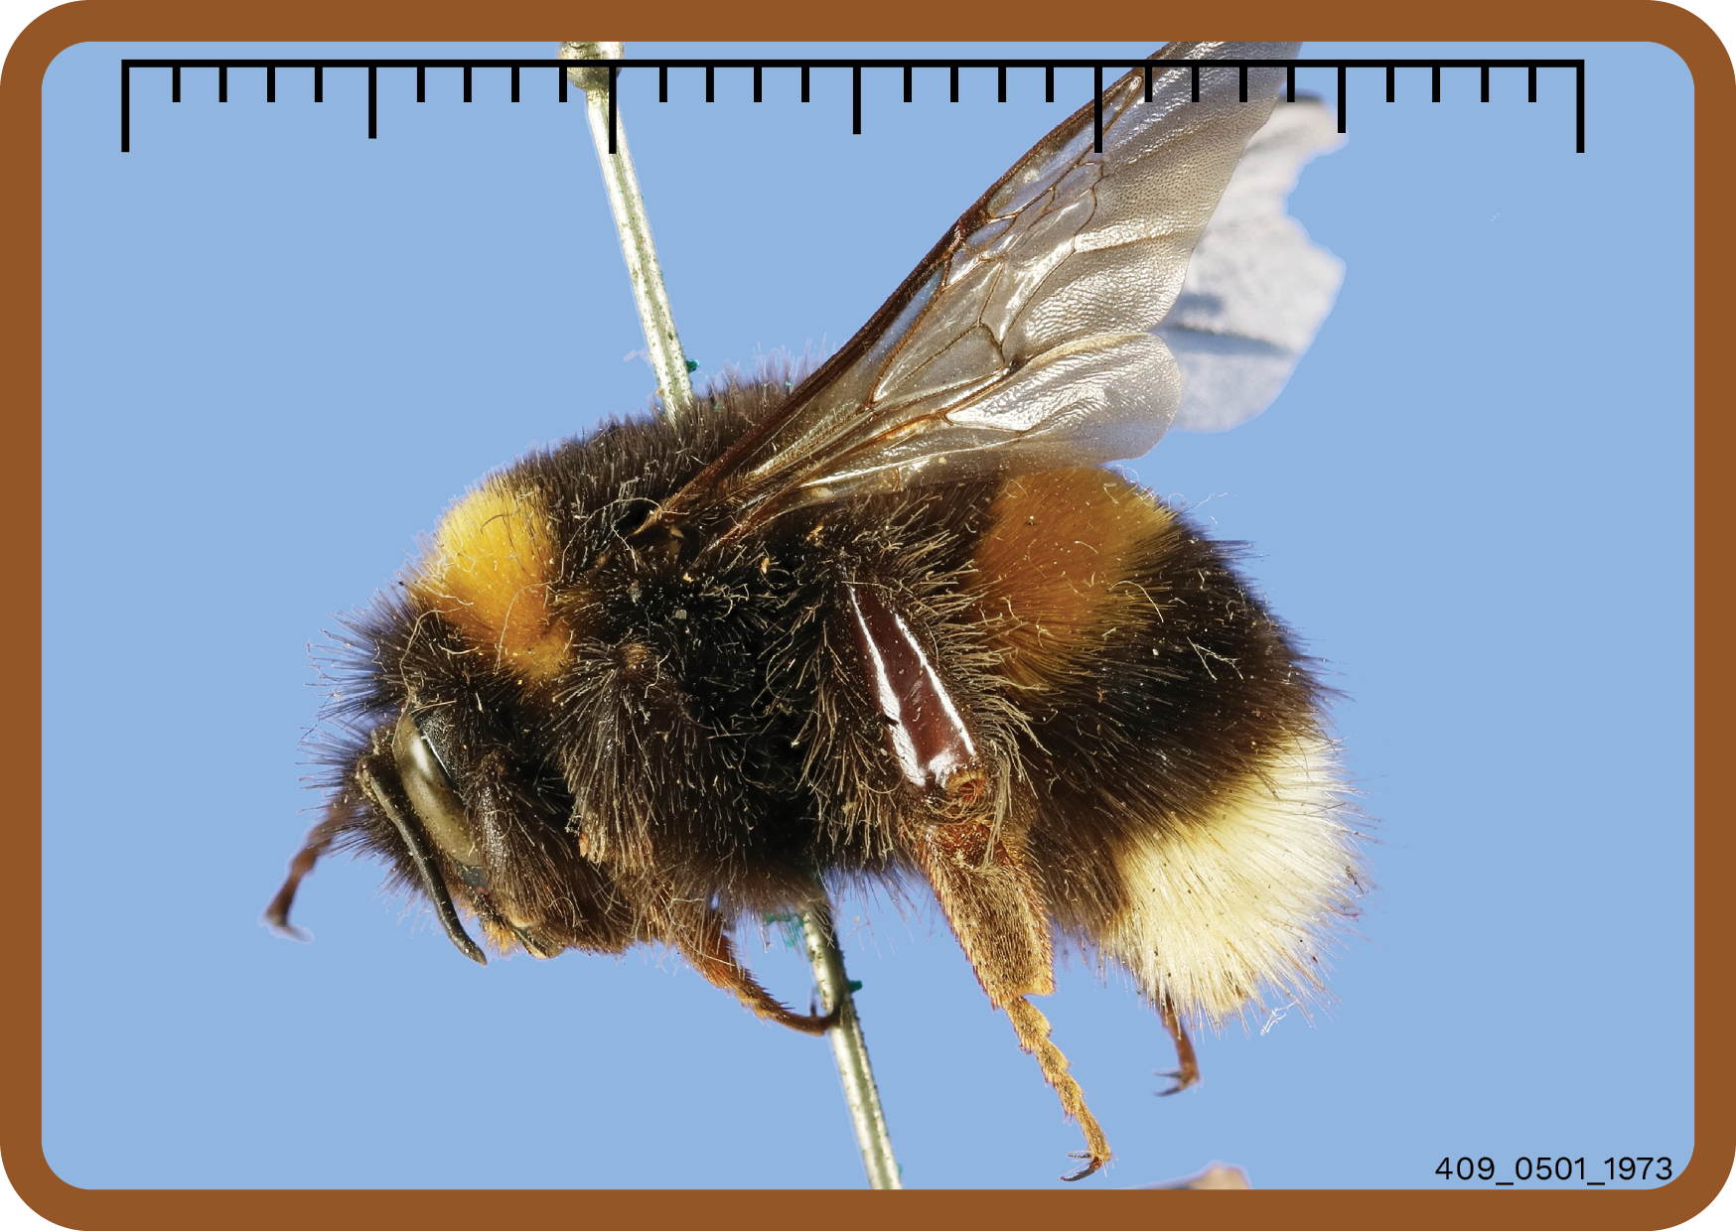
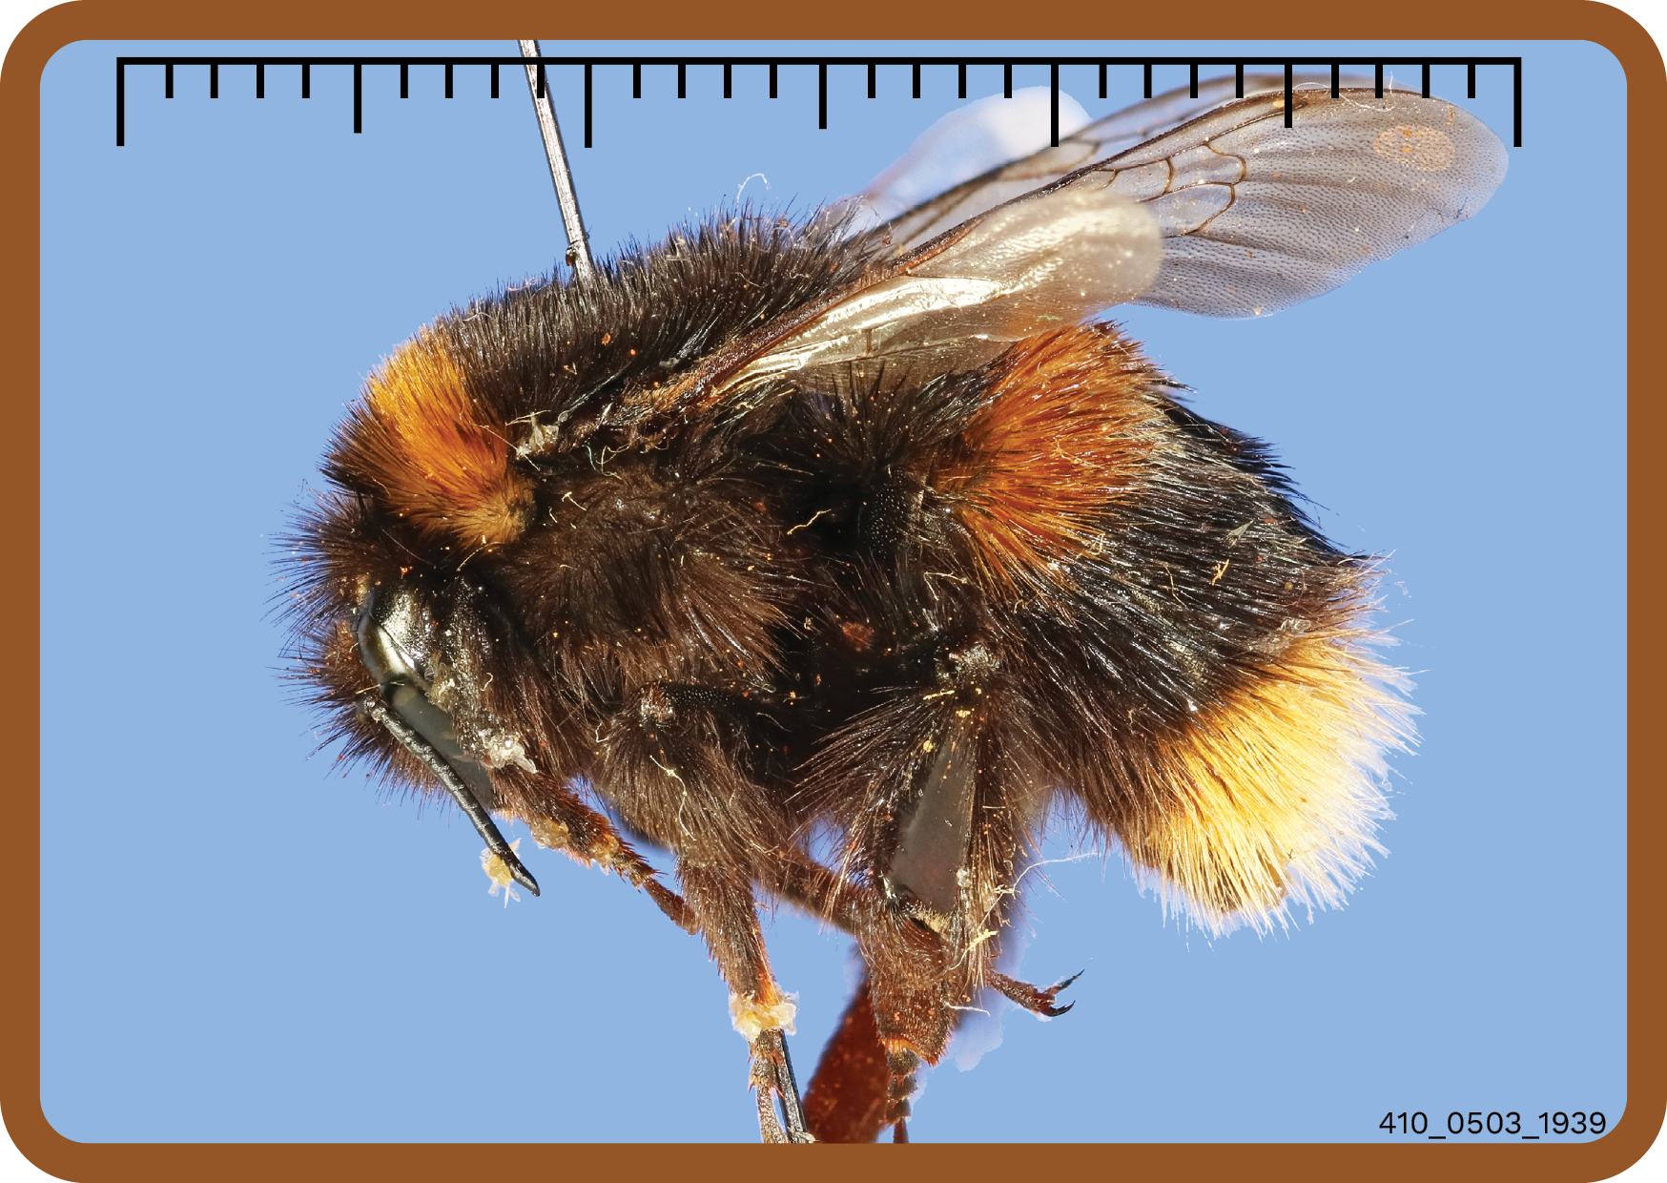

Slide 18
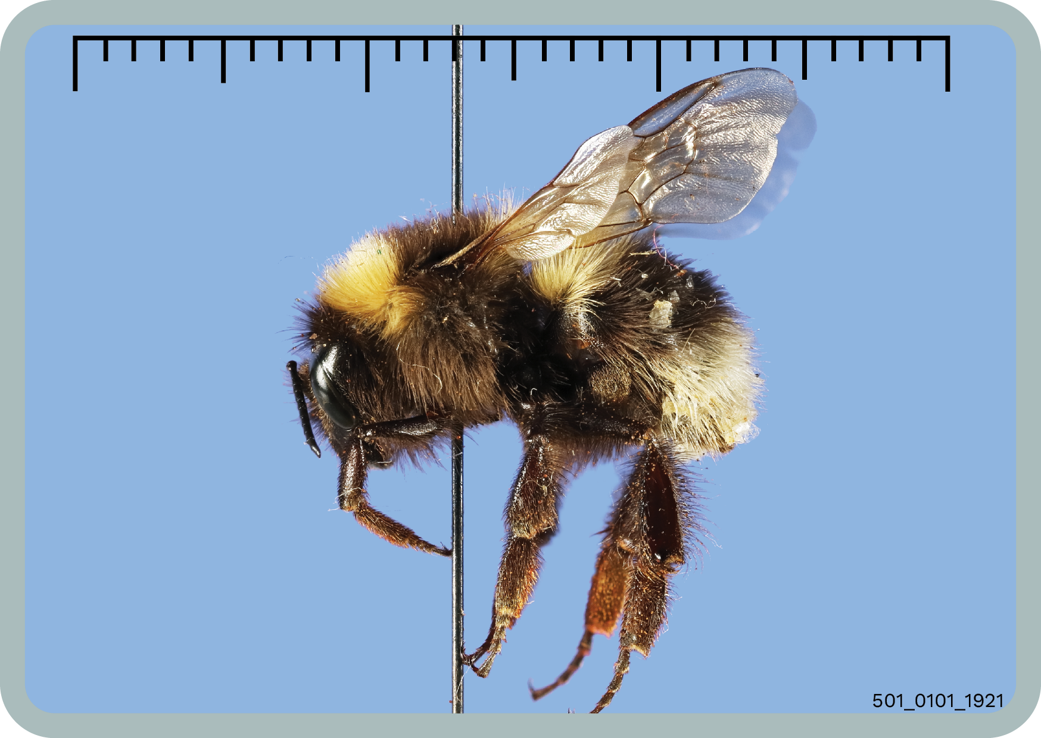
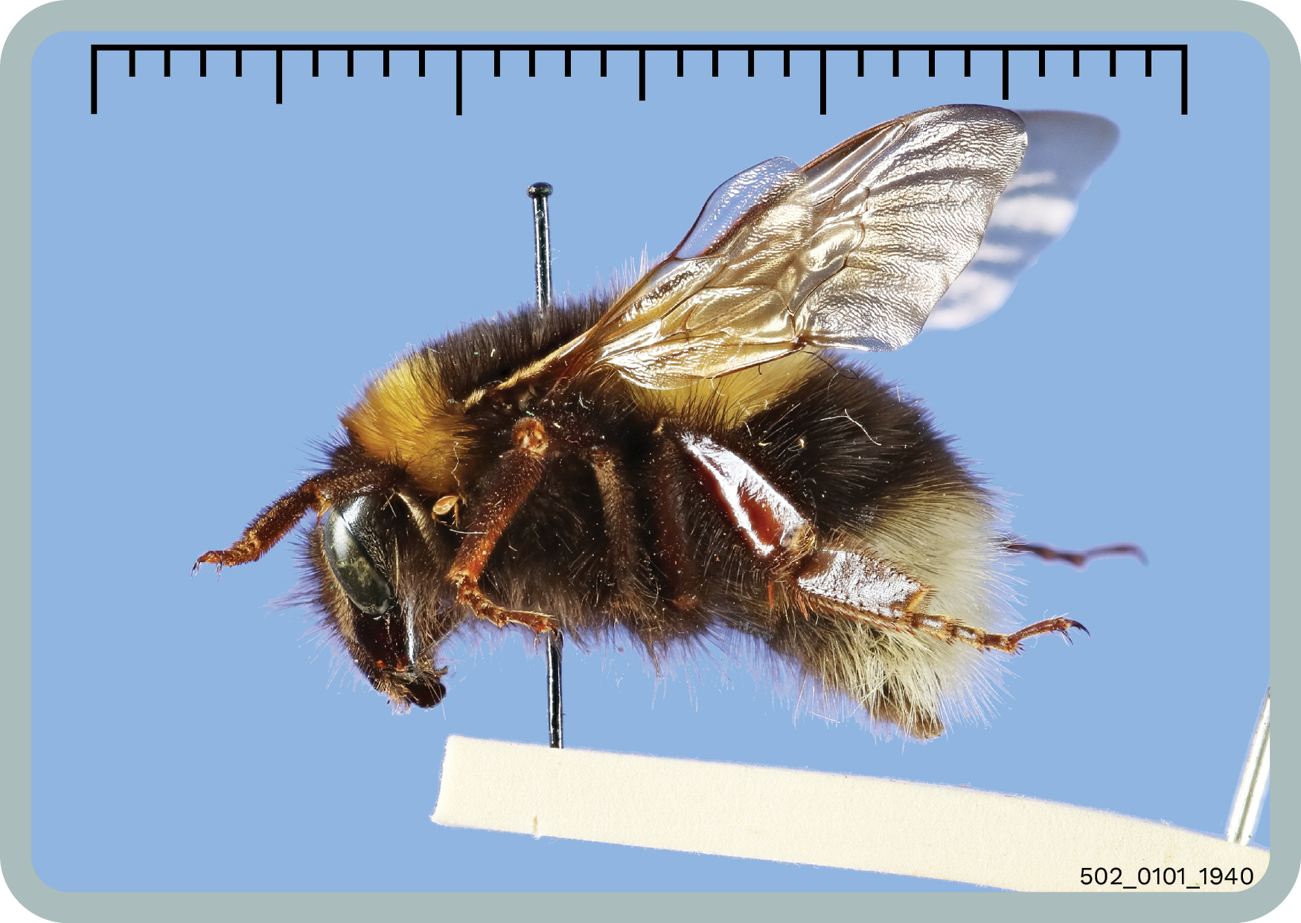
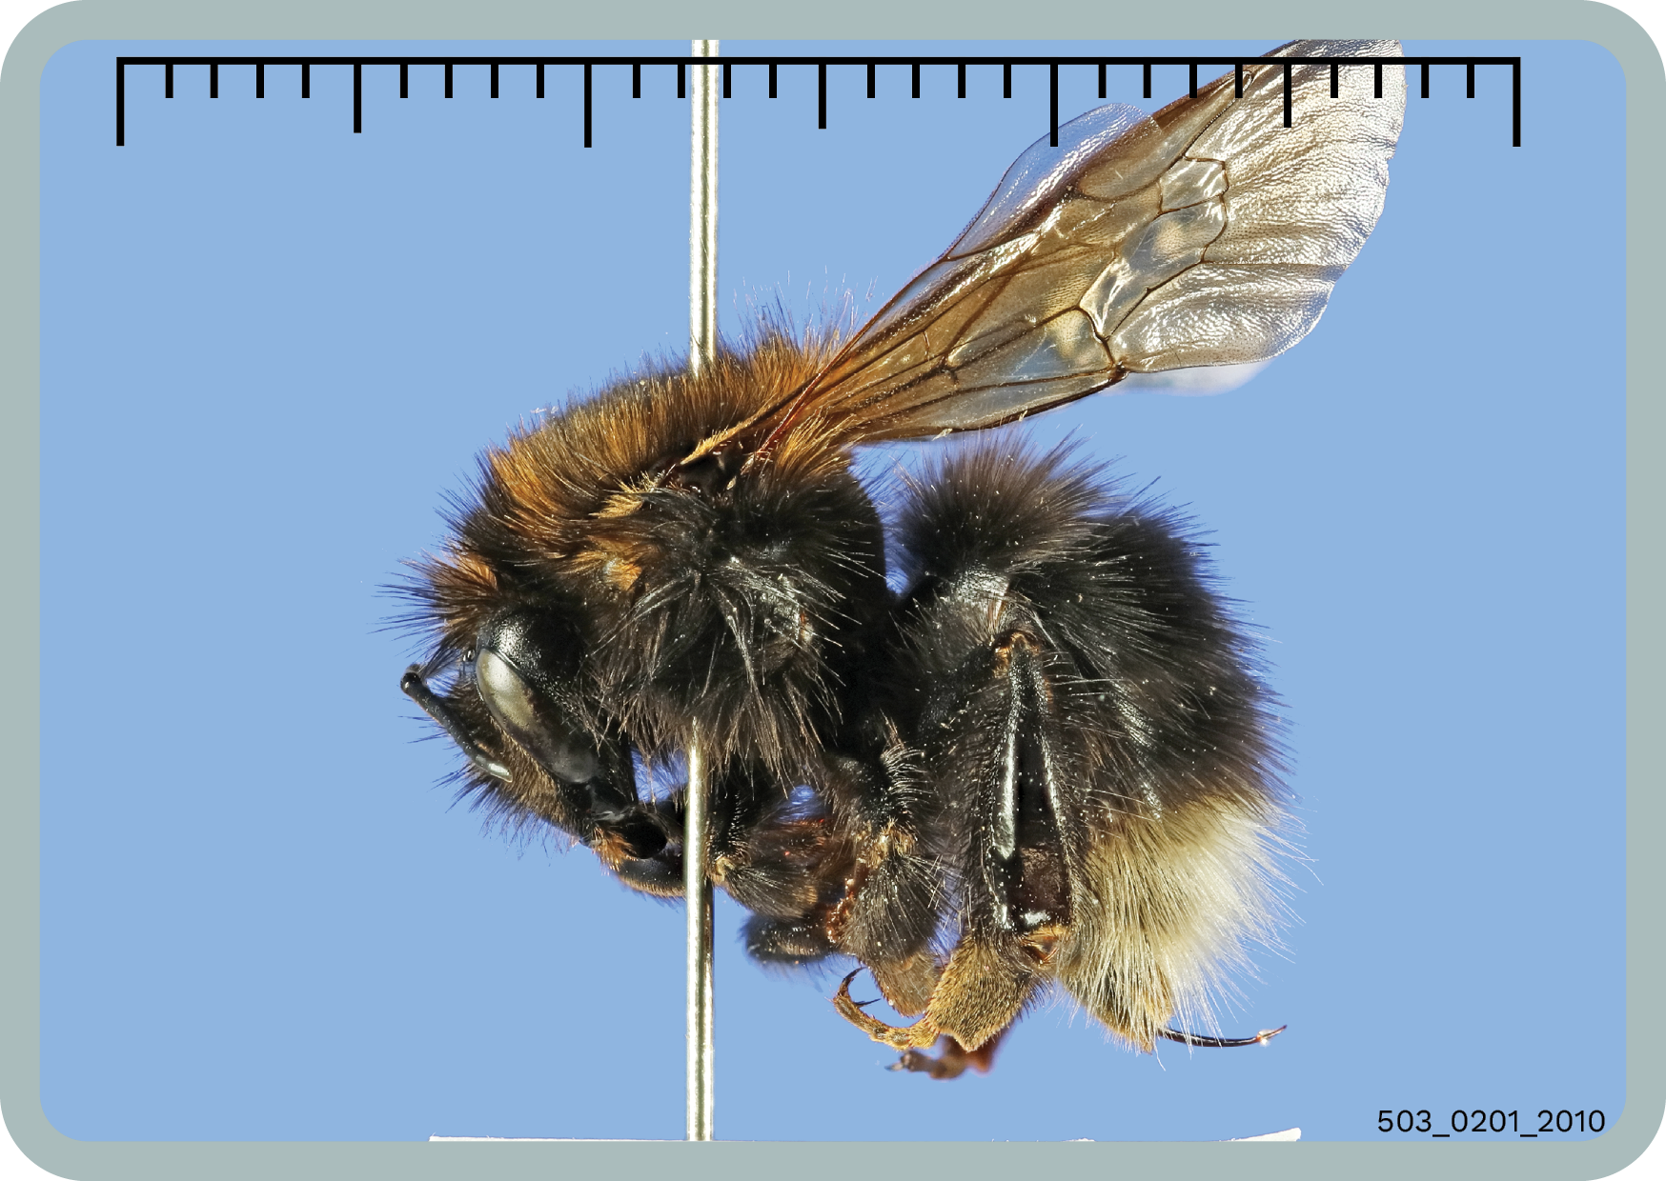
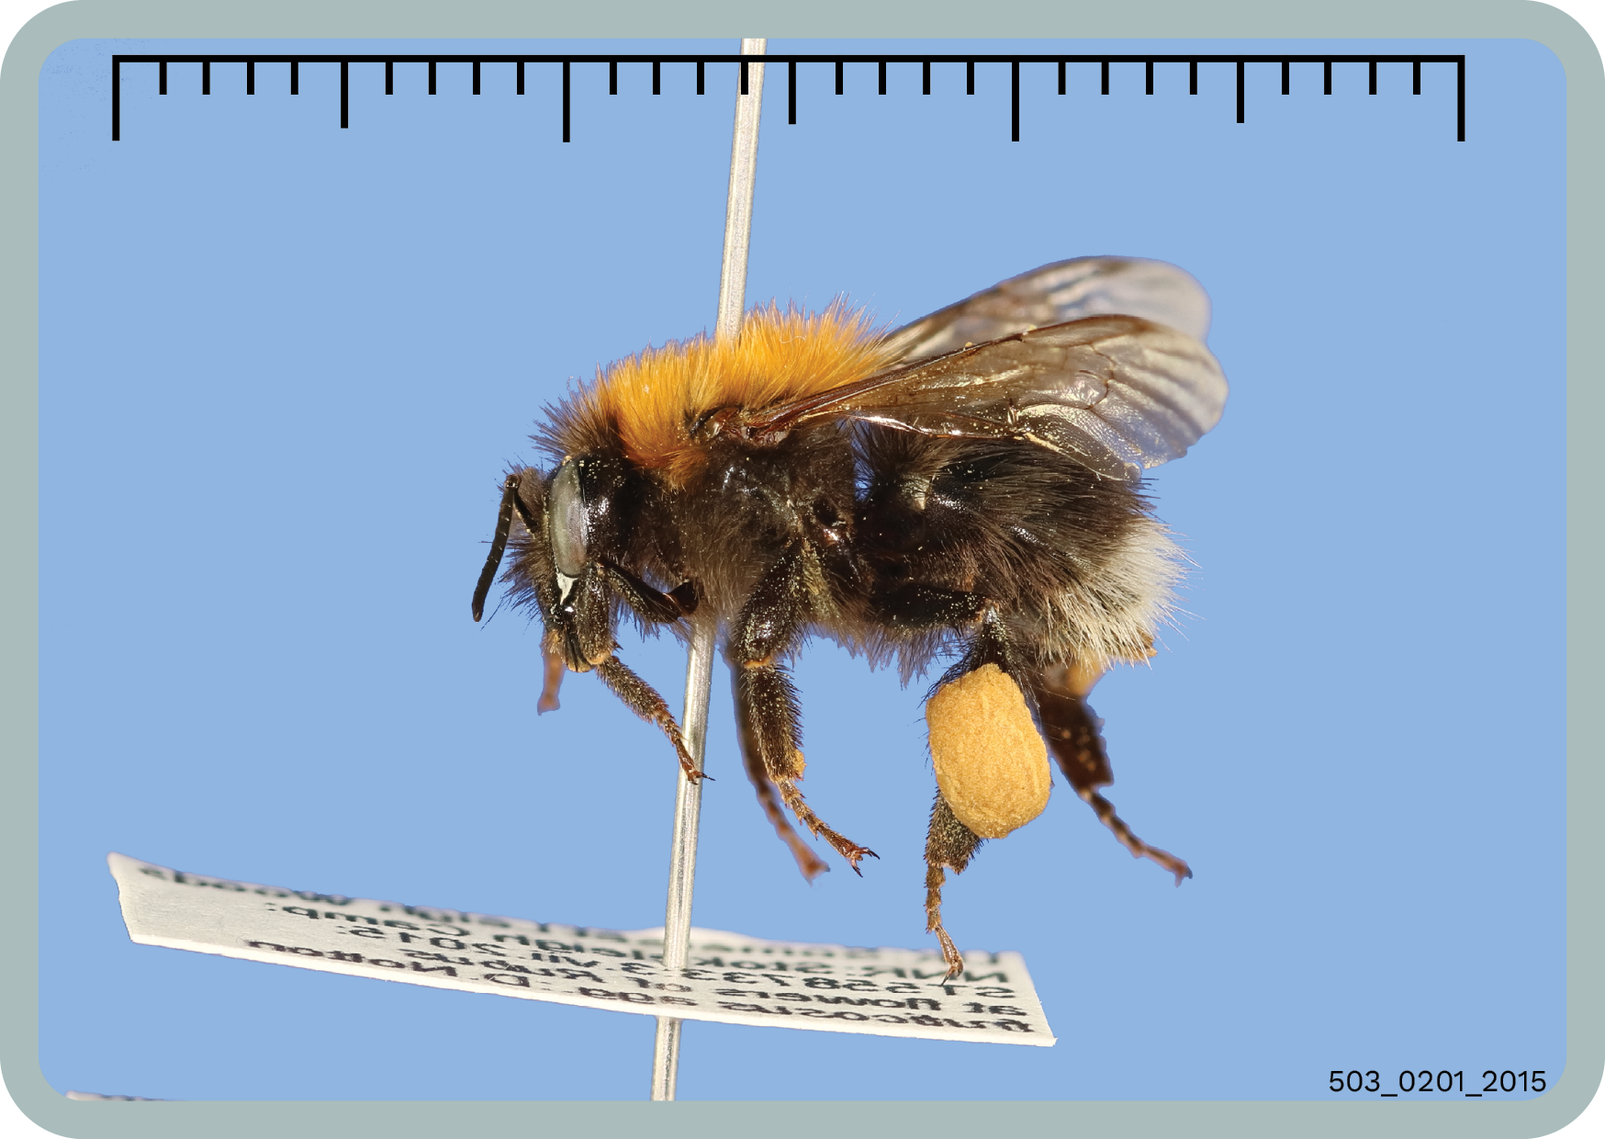

Slide 19
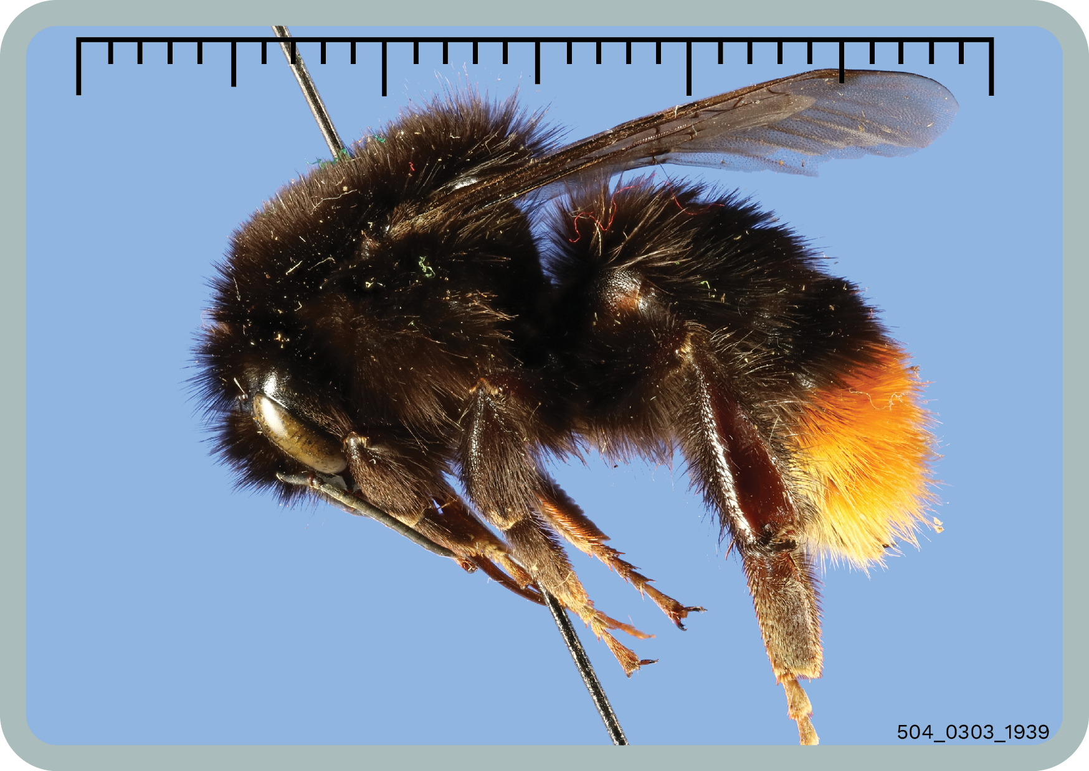
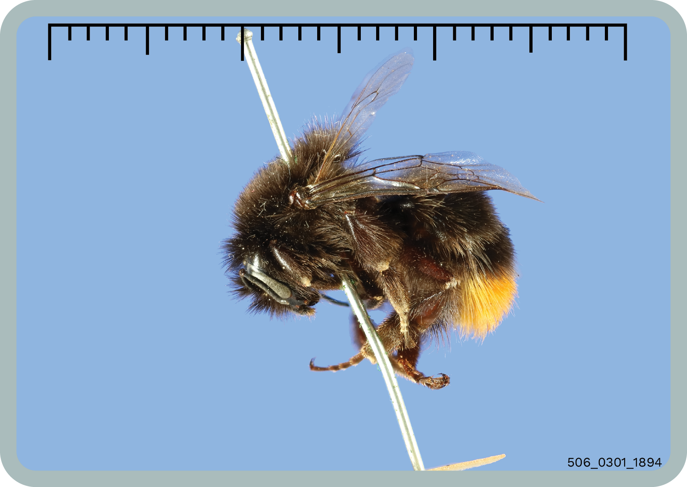



Slide 20



Slide 21





Slide 22





Slide 23



Slide 24





Slide 25



Slide 26





Slide 27



Slide 28





Slide 29



